Slide 1
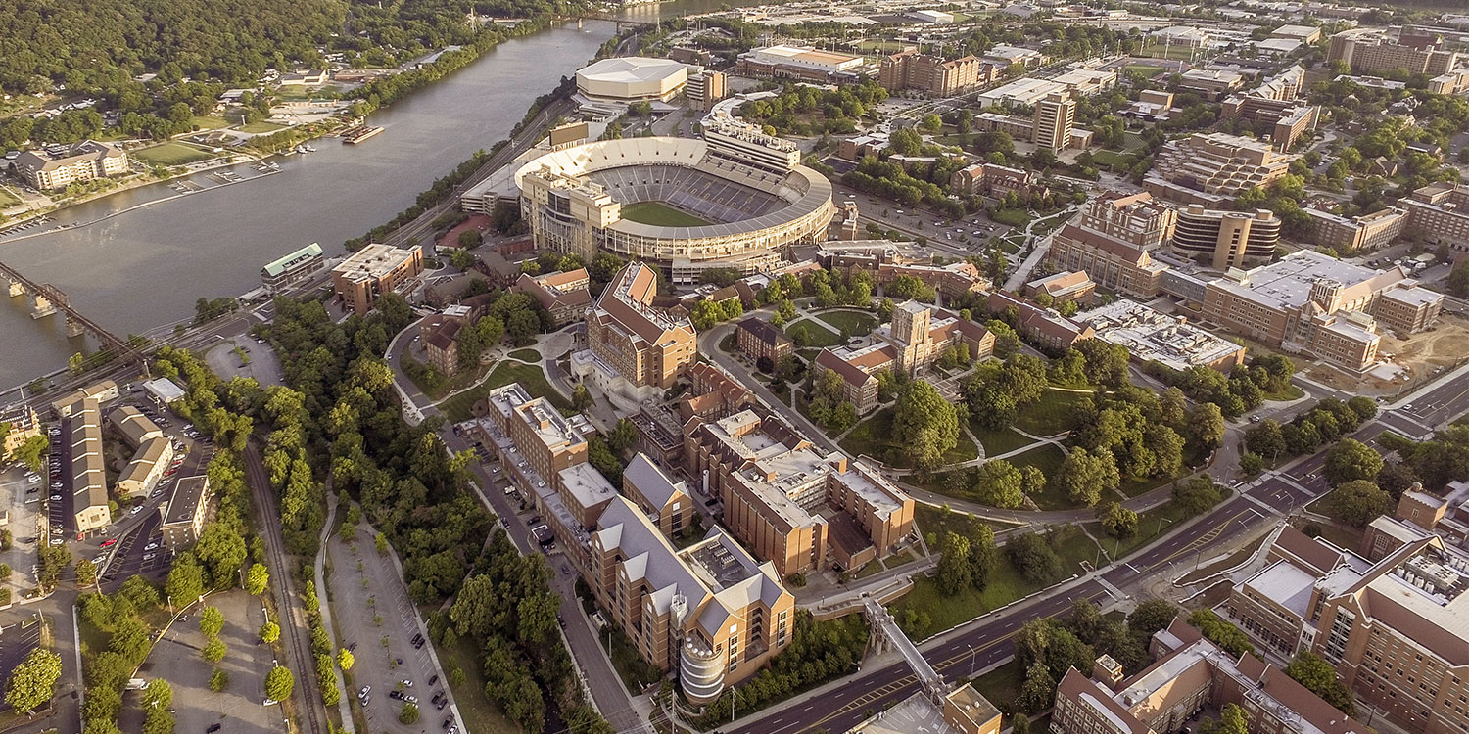

The Future of Aviation: Integrating IoT in the Aerospace Industry

Slide 2
Introduction

Slide 3
Internet of Things (IoT)
Connects physical devices, appliances, and objects to collect and exchange data
Embeds sensors and other detectors to relay information
Notes:
Network that bridges the cyber domain to everything and anything in the physical world

Slide 4

Records and Analyzes complex data more timely and efficiently than humans
Manufacturing
Application

Slide 5
Various Subsets:
Consumer Internet of Things (CIoT)
Short Range Communication
  Smartphones
  Smart Assistants
  Home Appliances
  Wearables
Commercial Internet of Things
Expands CIoT to Larger Venues
  Supermarkets
  Hotels
  Healthcare Facilities

Slide 6
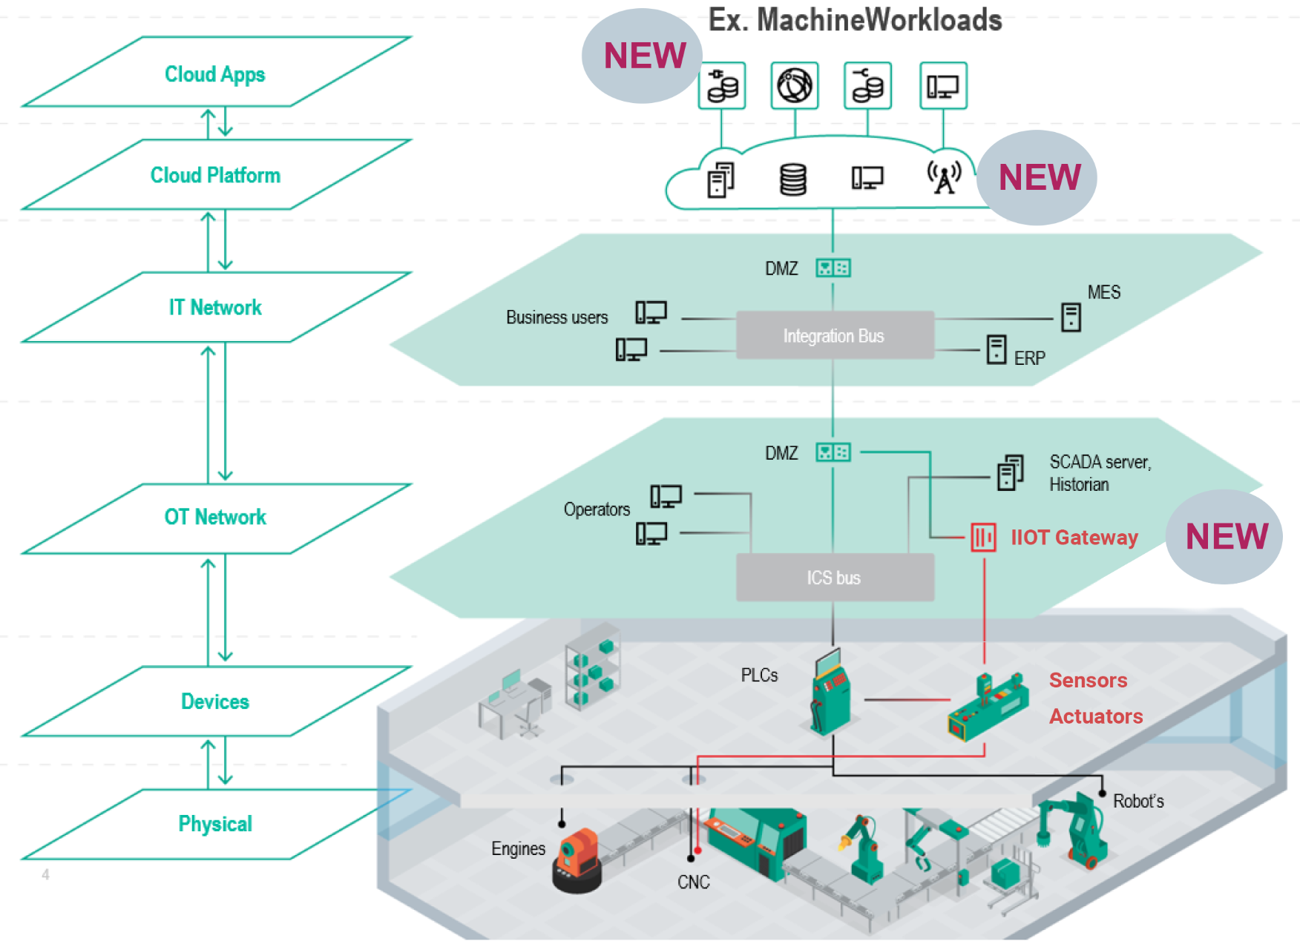
Industrial Internet of Things (IIoT)
→ Industrial Systems and Factories

Slide 7



Infrastructure
Military
Many More

Slide 8
In the Aerospace Sector

Slide 9
Production:
Proactive Maintenance
  Minimize operational downtime
  Improve system dependability
  Streamline maintenance timetables

Slide 10
  Avoids…
  Catastrophic accidents
  Waste of resources
  Waste of funds
  Loss of time in high-pressure circumstances

Slide 11
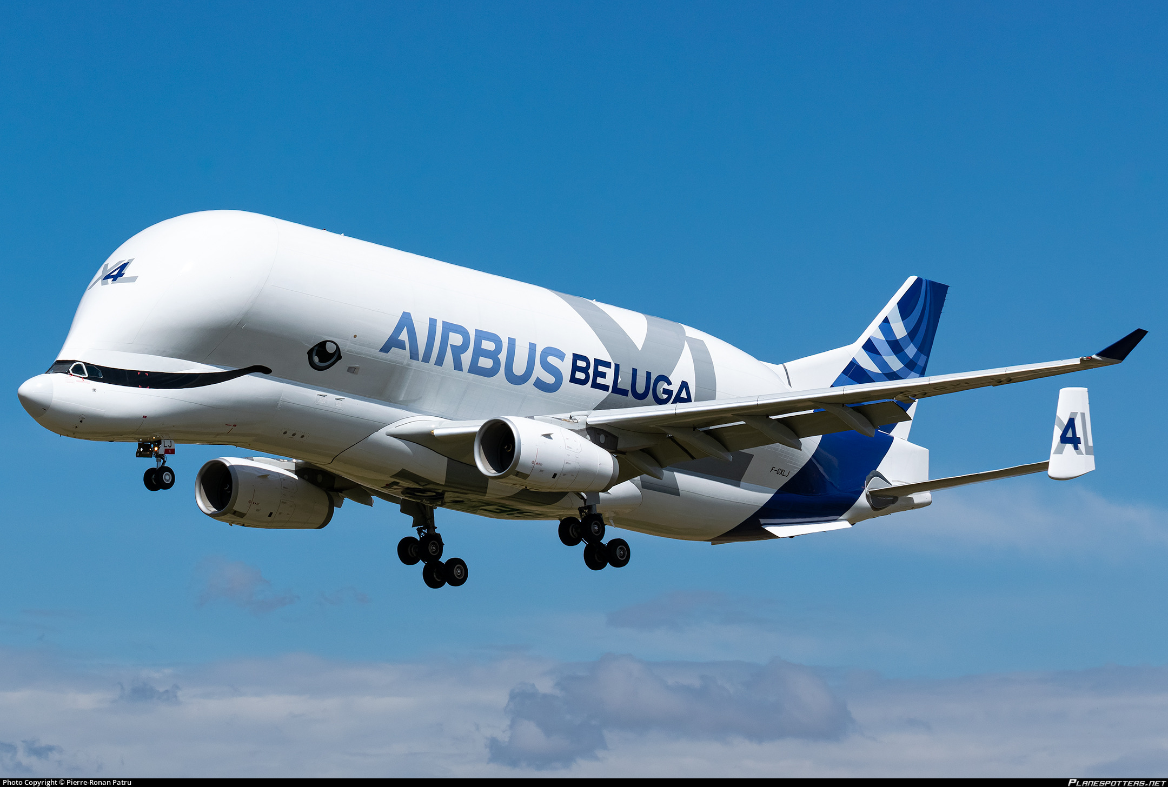
Performance:
“Connected Experience”
  Improves cabin flexibility and service
  More personalized environment
Notes:
Industrial and commercial implementation of IoT

Slide 12
Risks

Slide 13
Security Concerns
Routing Attack
Denial of Service (DoS) Attack

Slide 14
Can resources manage massive amounts of IoT data?
Notes:
Study aimed at analyzing satellite architecture, IoT technologies can stress the resources and network in correlation

Slide 15
Skillset
Need engineering and IT expertise to maintain systems
  Not enforce IoT technologies and progress with competing industries
  Enforce IoT technologies without a complete understanding of the network
    Cannot detect malfunctions
    Cannot properly react in emergency situations
Notes:
Network that bridges the cyber domain to everything and anything in the physical world

Slide 16
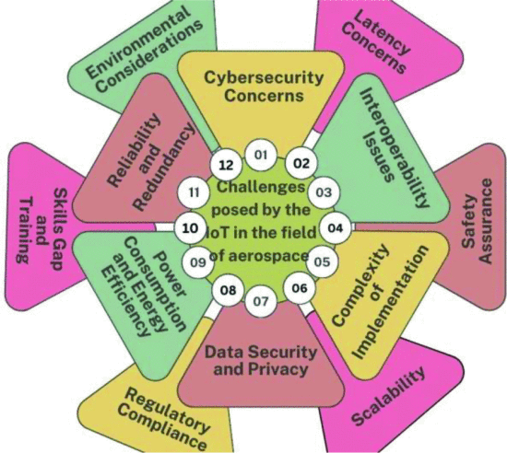
Notes:
Many challenges that must be researched and accounted for…
Speak on the exact tolerances and safety conditions, classified info that must be looked into

Slide 17
Future Directions

Slide 18
Continued Research
Close attention during every stage of IoT system development

Slide 19
Sustainability of IoT
  What systems coexist and collaborate with IoT the best
  Cost-efficiency
    Energy supply & computational capabilities

Slide 20


Education
Few co-curricular education of IT and engineering
  Purdue University: Internet of Things/Interdisciplinary Engineering Program
  Massachusetts Institute of Technology: Professional Education courses teaching concepts and applications of Industrial IoT
Notes:
Development of these programs → more accessible → more narrowing focused programs → better results in specific industries like aerospace

Slide 21
Conclusion

Slide 22
Acknowledgments
Thank you to Dr. Damiano Baccarella for his guidance and support. Thank you to Emma Elise Ferber for her mentorship and support as well.

Slide 23
References
[1] B. K. Tripathy and J. Anuradha, Eds., Internet of things (IoT): technologies, applications, challenges and solutions. Taylor & Francis, CRC Press, 2018.
[2] O. M. Bushnaq, A. Celik, H. Elsawy, M.-S. Alouini, and T. Y. Al-Naffouri, "Aeronautical Data Aggregation and Field Estimation in IoT Networks: Hovering and Traveling Time Dilemma of UAVs," IEEE Transactions on Wireless Communications, vol. 18, no. 10, pp. 4620–4635, 2019. doi: 10.1109/TWC.2019.2921955.
[3] "IIoT: Enabling Your Factory via Digitisation," Irish Manufacturing Research, Jun. 10, 2019. [Online]. Available: https://imr.ie/2019/06/10/project-industrial-internet-things-iiot/.
[4] "Internet of Things: The Five Types of IoT," Syntegra, Aug. 22, 2022. [Online]. Available: https://syntegra.net/internet-of-things-the-five-types-of-iot/.
[5] D. Rodrigues, P. Carvalho, S. Rito Lima, E. Lima, and N. V. Lopes, "An IoT platform for production monitoring in the aerospace manufacturing industry," Journal of Cleaner Production, vol. 368, p. 133264, 2022. doi: 10.1016/j.jclepro.2022.133264.
[6] D. L. Andersen, C. S. A. Ashbrook, and N. B. Karlborg, "Significance of big data analytics and the internet of things (IoT) aspects in industrial development, governance and sustainability," International Journal of Intelligent Networks, vol. 1, pp. 107–111, 2020. doi: 10.1016/j.ijin.2020.12.003.
[7] :IoT: Aerospace’s Great New Connector,” Airbus, Jul. 4, 2019. [Online]. Available: https://www.airbus.com/en/newsroom/stories/2019-07-iot-aerospaces-great-new-connector.
[8] G. K. Panda, B. K. Tripathy, M. K. Padhi, and J. Anuradha, "Evolution of Social IoT World: Security Issues and Research Challenges," in Internet of Things (IoT), 1st ed., CRC Press, 2018, pp. 77–98. doi: 10.1201/9781315269849-5.
[9] M. Luglio, M. Marchese, F. Patrone, C. Roseti, and F. Zampognaro, "Performance Evaluation of a Satellite Communication-Based MEC Architecture for IoT Applications," IEEE Transactions on Aerospace and Electronic Systems, vol. 58, no. 5, pp. 3775–3785, 2022.
[10] R. Rajora, A. Rajora, B. Sharma, G. R. Kumar, P. Aggarwal, and S. Thapliyal, "Advancing Horizons: Exploring the Aerospace IoT Revolution - Analysis, Advancements, and Prospects for the Future," in 2024 3rd International Conference for Innovation in Technology (INOCON), pp. 1–5, 2024. doi: 10.1109/INOCON60754.2024.10512339.
[11] A. Al-Fuqaha, M. Guizani, M. Mohammadi, M. Aledhari, and M. Ayyash, "Internet of Things: A survey on enabling technologies, protocols, and applications," IEEE Commun. Surveys Tuts., vol. 17, no. 4, pp. 2347–2376, 4th Quart., 2015.
[12] "Internet of Things/Interdisciplinary Engineering," Office of the Vice Provost for Graduate Students and Postdoctoral Scholars - Purdue University, 2022. [Online]. Available: https://www.purdue.edu/gradschool/prospective/gradrequirements/westlafayette/inot.html.
[13] "Online Course Industrial Internet of Things," MIT Professional Education, 2023. [Online]. Available: https://professionalprograms.mit.edu/online-program-internet-of-things/.
[14] J. Bernal and B. Sridhar, Industrial IoT for Architects and Engineers. PACKT Publishing Limited, 2023.

Slide 24

THANK YOU

