Slide 1
Implementing Collaboration and Structure: Bolstering USC AIAA in the Aerospace Community
Michael Cargill, Patrick Bailey, Dr. Wout De Backer
University of South Carolina
AIAA Region II, 4/3/2025 - 4/4/2025
Copyright © by Michael Cargill, Patrick Bailey, Dr. Wout De Backer
Published by the American Institute of Aeronautics and Astronautics, Inc., with permission.

Slide 2

Table of Contents
About USC AIAA
Challenges of a Growing Organization
Aerospace Collaboration
Bridging the Experience Gap
Implementing Long Term Projects
Expanding Leadership
Closing Remarks

Slide 3
Table of Contents
About USC AIAA
Challenges of a Growing Organization
Aerospace Collaboration
Bridging the Experience Gap
Implementing Long Term Projects
Expanding Leadership
Closing Remarks

Slide 4
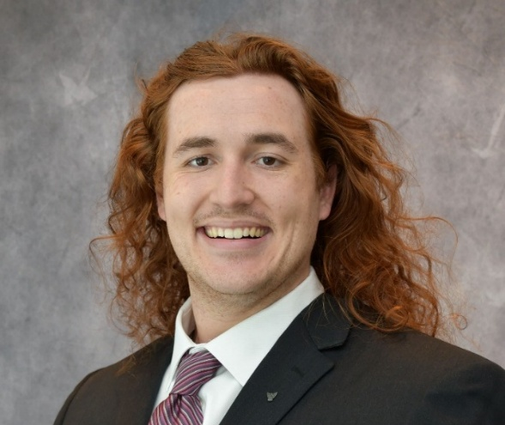
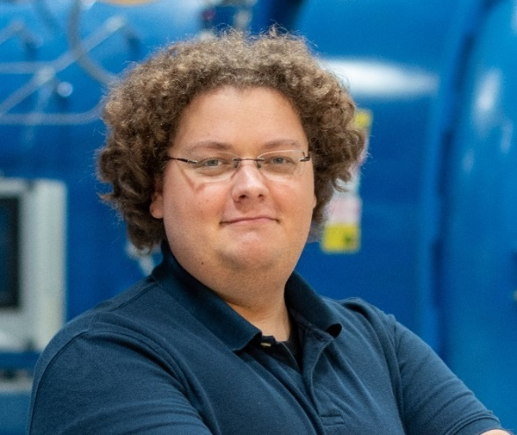
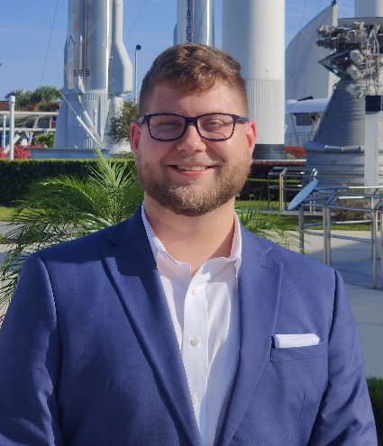
About the Authors
Michael Cargill, A.A.S.
Patrick Bailey, B.S.
Dr. Wout De Backer, Ph.D

Slide 5

About the Speaker
Michael Cargill
Undergraduate Research Assistant
University of South Carolina
  B.S. Aerospace Engineering (Junior)
Midlands Technical College
  A.A.S. Machine Tool Technology
USC AIAA Chair (2024 – 2026)
Michael Cargill, A.A.S.

Slide 6
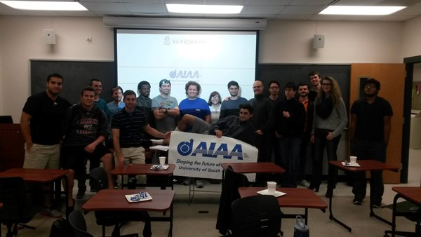
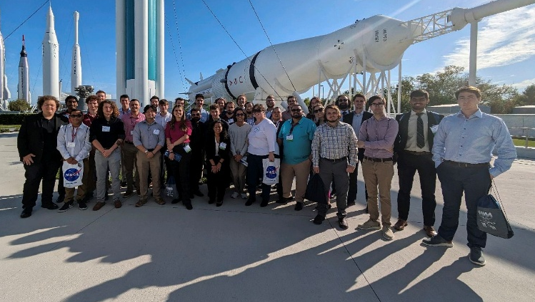
About USC AIAA
University of South Carolina
  First aerospace engineering cohort graduated 2018
  Over 100 incoming freshman this fall
USC AIAA
  Founded in 2015
  Recognized in 2016
  28 initial members
  Over 90 national members as of Fall 2024

Slide 7
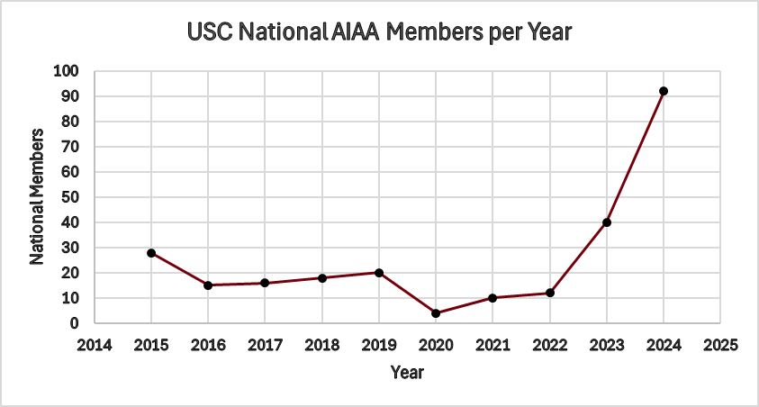
About USC AIAA

Slide 8
Table of Contents
About USC AIAA
Challenges of a Growing Organization
Aerospace Collaboration
Bridging the Experience Gap
Implementing Long Term Projects
Expanding Leadership
Closing Remarks

Slide 9
Challenges of a Growing Organization
Growth presents several challenges/considerations for the club:
Stress on resources
  Event funding
  Club supplies
Member engagement
  Experience disparity
Club Organizational Structures
  Roster maintenance
  Club communications

Slide 10
Stress on Resources
Event Funding
  No club dues are expected from members
  Majority of funding provided by donations and student government
  Time consuming process
  Increase in request frequency and funding per request
Club Supplies
  Technical workshops are both popular and educational to members
  Increase in consumables required
  Increase in time commitment to lead meetings

Slide 11
Member Engagement
Experience disparity
  Recent growth means most new members are underclassmen
  Need to retain experienced veteran members
  Meetings and activities must strike balance between approachable and engaging
  Technical workshops become a stress point
    Either repetitive for veteran members
    Or unapproachable to new members

Slide 12
Club Organizational Structures
Roster Maintenance
  Maintaining an accurate count of members is time consuming
  Requires unification of USC and AIAA rosters
Club Communications
  Ensuring all members are receiving communication from club leadership more difficult

Slide 13
Table of Contents
About USC AIAA
Challenges of a Growing Organization
Aerospace Collaboration
Bridging the Experience Gap
Implementing Long Term Projects
Expanding Leadership
Closing Remarks

Slide 14
Aerospace Collaboration
Collaborating with other organizations helps to alleviate stresses and provide opportunities to members that may be outside the scope of the club:
Student Organizations
Local Partnerships
Industry

Slide 15



Student Organizations
USC AIAA
  Professional organization
  Emphasis on technical skills
Carolina Flight Club
  Aviation focused
  Assists members with flight training
Rocketry Club
  High powered rocketry
  Advanced amateur rocketry projects

Slide 16
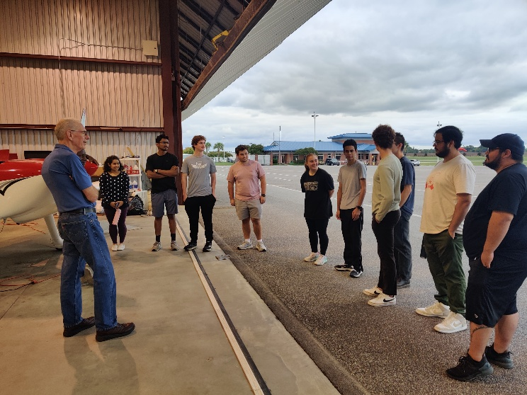
Local Partners
Jim Hamilton L.B. Owens Airport
Triple Tree Aerodrome
Columbia Metropolitan Airport
Celebrate Freedom Foundation
  STEM Education foundation
  Restore decommissioned military helicopters
SC Historic Aviation Foundation
  Currently restoring B-25 at L.B. Owens

Slide 17
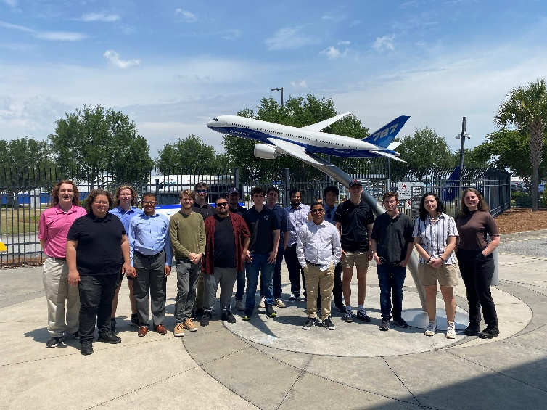
Industry
Boeing (Charleston)
  Close working relationship with USC
  Yearly tour of 787 production line
Gulfstream (Savannah)
  Early stages of relationship
  Begin tours next fall
Lockheed Martin (Greenville)
G.E. Vernova (Greenville)

Slide 18
Table of Contents
About USC AIAA
Challenges of a Growing Organization
Aerospace Collaboration
Bridging the Experience Gap
Implementing Long Term Projects
Expanding Leadership
Closing Remarks

Slide 19
Bridging the Experience Gap
To ensure that club activities are accessible to both new and veteran members, two strategies are implemented:
Introducing multi sectional events
  Offer two similar activities for different skill levels
  Members choose section that is comfortable to them
Increasing frequency of social events
  Enjoyable for members, regardless of experience

Slide 20
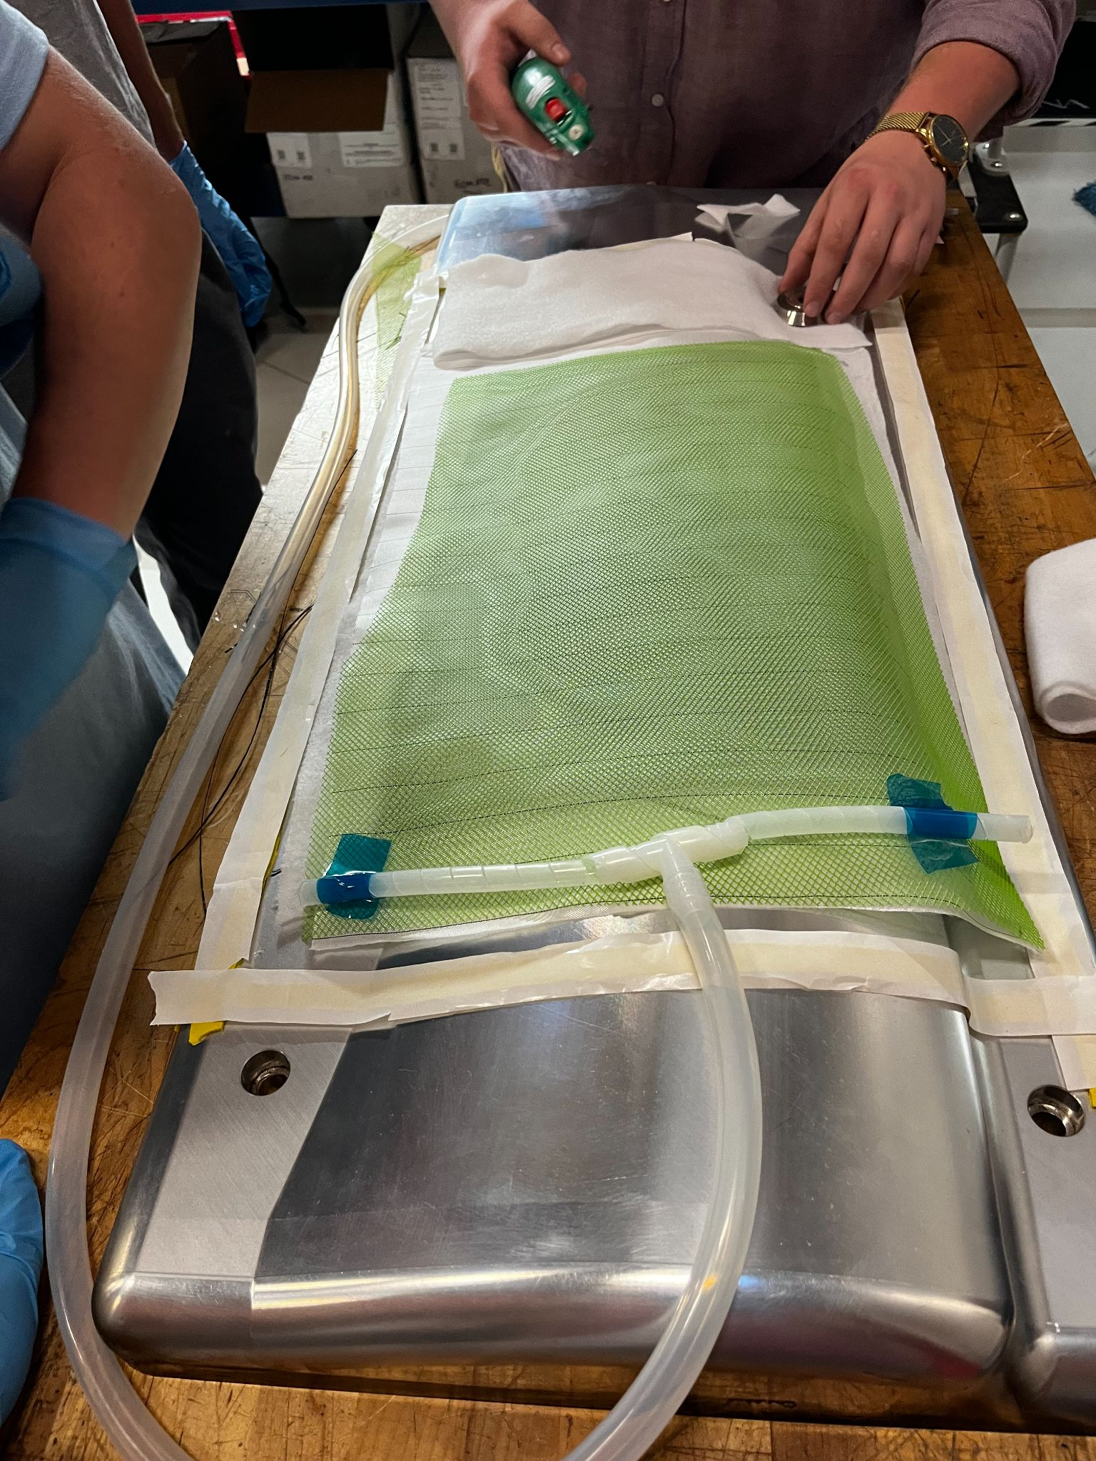
Multi Sectional Events
Catia Workshop
  Introductory section geared towards incoming students
    Covered basic functionality and workflow of software
  Advanced section geared towards upperclassmen and students enrolled in aircraft design
    Detailed seminar on surface modeling
Composite Workshop
  Introductory section involving flat panel wet layup
  Advanced section involving double curved VARTM infusion

Slide 21
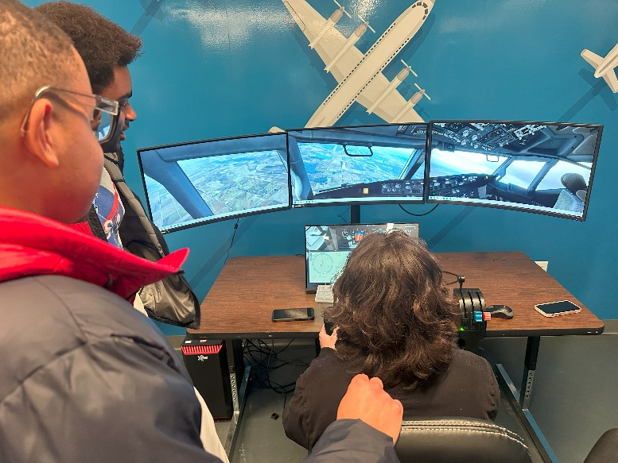
Social Events
Example events
Flight Simulator/Game Night
Movie Night
  All members can interact with these activities
  Opportunities to collaborate with other student organizations
  Less commitment needed from members

Slide 22
Table of Contents
About USC AIAA
Challenges of a Growing Organization
Aerospace Collaboration
Bridging the Experience Gap
Implementing Long Term Projects
Expanding Leadership
Closing Remarks

Slide 23
Implementing Long Term Projects
Several year and multi year projects have been implemented to encourage future member participation in the club:
Design Build Fly
USC Satellite Program

Slide 24
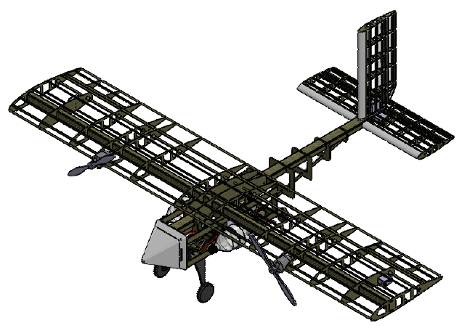
Design Build Fly
Plan to compete next week in AZ
  USC’s first attempt in almost a decade
Incredibly popular among members
Integrated into course work
  Aircraft and Senior Design project
Interest in competing annually moving forward

Slide 25

USC Satellite Program
Attempting to launch South Carolina’s first satellite
Recently accepted for UNP MC program
  Members will be sent to NM to begin planning and designing the mission
Laying the foundation to develop a space program at USC

Slide 26
Table of Contents
About USC AIAA
Challenges of a Growing Organization
Aerospace Collaboration
Bridging the Experience Gap
Implementing Long Term Projects
Expanding Leadership
Closing Remarks

Slide 27
Expanding Leadership
To better manage the club, several new leadership positions were created with the goal of decentralizing responsibilities, allowing for large scale projects to be run more independently and for workload to be distributed amongst the leadership team:
Event organizer
Social Media Manager
Fundraising Committee Head
DBF Committee Head
Small Sat Committee Head

Slide 28
Previous Leadership Structure
President
Vice President
Treasurer
Secretary

Slide 29
Updated Leadership Structure
Elected
President
Treasurer
Vice President
Secretary
Appointed
Fundraising
DBF Committee
Small Sat Committee
Event Organizer
Social Media

Slide 30
Table of Contents
About USC AIAA
Challenges of a Growing Organization
Aerospace Collaboration
Bridging the Experience Gap
Implementing Long Term Projects
Expanding Leadership
Closing Remarks

Slide 31
Closing Remarks
USC AIAA has seen rapid growth over the past years
  over double the number of national members year over year
Growth has led to challenges that may impact member experience
Several changes have been implemented
  Increased collaboration
  Meeting format
  Project implementation
  Leadership expansion
Changes have been well received and can maintain club momentum
Notes:
USC has been very fortunate to see rapid growth over the past years, seeing over double the number of national members year over year. This growth has led to several challenges that have the potential to sour member experience in the club. Considering these challenges, changes were made in how we conduct meetings, engage with members, and structure the leadership of the club. These changes seem to be well received and can possibly preserve club momentum going into the next year.

Slide 32
Closing Remarks
Questions?

