Slide 1
Design and Implementation of a Data Acquisition System for Rocket Motor Testing and Performance Analysis
Saptak Das and Joseph Clary
Georgia Tech
AIAA Region 2 Conference, April 3rd and 4th
Copyright © by Saptak Das and Joseph Clary
Published by the American Institute of Aeronautics and Astronautics, Inc., with permission.

Slide 2
What is a DAQ system?
Definition:
  A DAQ system is designed to capture real-time data from various sensors, ensuring that a rocket motor operates within specified limits.
  These data are transmitted and stored for post-test analysis, allowing engineers to evaluate motor performance, assess safety margins, and detect potential anomalies before incorporating a new motor on a rocket.

Slide 3
Introduction
Purpose: Develop a robust DAQ system for rocket motor testing for Ramblin Rocket Club (RRC).
Key Objectives:
  Ensure DAQ system is safe and reliable.
  Capture thrust, chamber pressure, and temperature data.
  Enable accurate post-test analysis.

Slide 4
System Overview

Slide 5
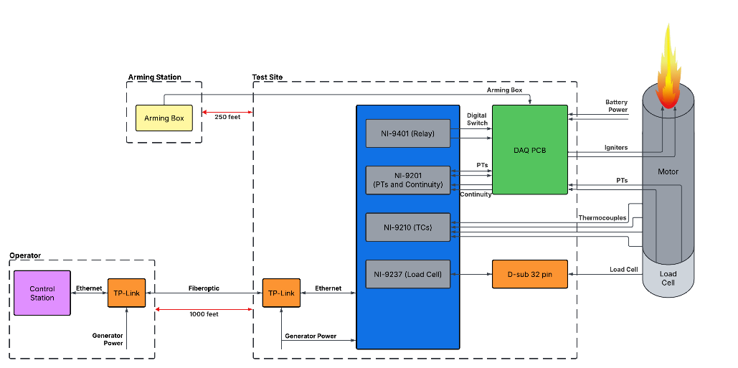
System Overview
Notes:
NI CompactDAQ-based system with sensors for thrust, pressure, and temperature.
Fiber optic communication for long-distance operation.
Custom DAQ PCB for signal interfacing.

Slide 6
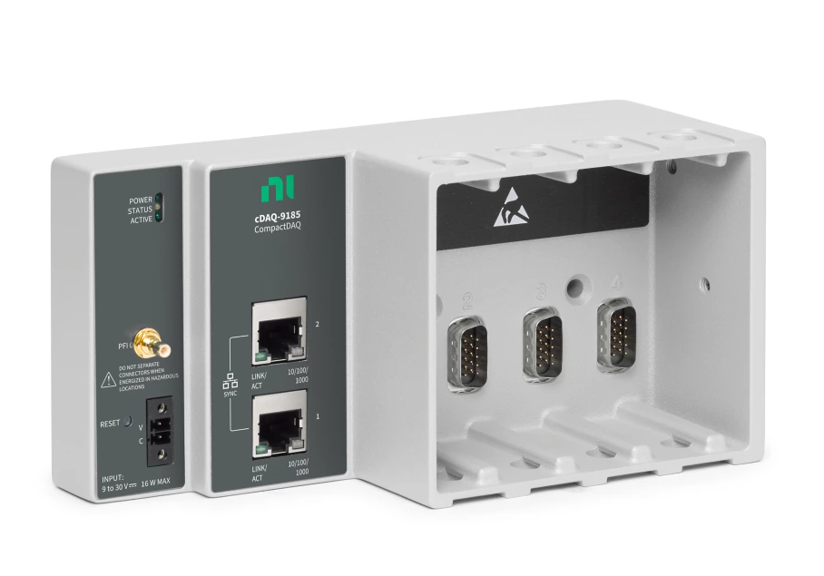
DAQ Choice
Previous system: Arduino-based, unreliable data.
Current system: NI CompactDAQ 9185 with modular expansion.
High sampling rate (500 kS/s), improved data fidelity.

Slide 7
Power Systems
Two diesel generators for primary power.
Distributed power design for reliability.
Two LiPo batteries for DAQ PCB.

Slide 8
Communications
Challenge: Reliable data transfer over 1,000 feet.
Solution: Fiber optic cable with Ethernet converters.
Ensures minimal signal loss and high-speed data transmission.

Slide 9
Sensors
Load Cell: 10,000 lbf capacity for thrust measurement.
Pressure Transducers (PTs): Up to 5,000 psi for chamber pressure.
Thermocouples: Type K for motor casing temperature.

Slide 10
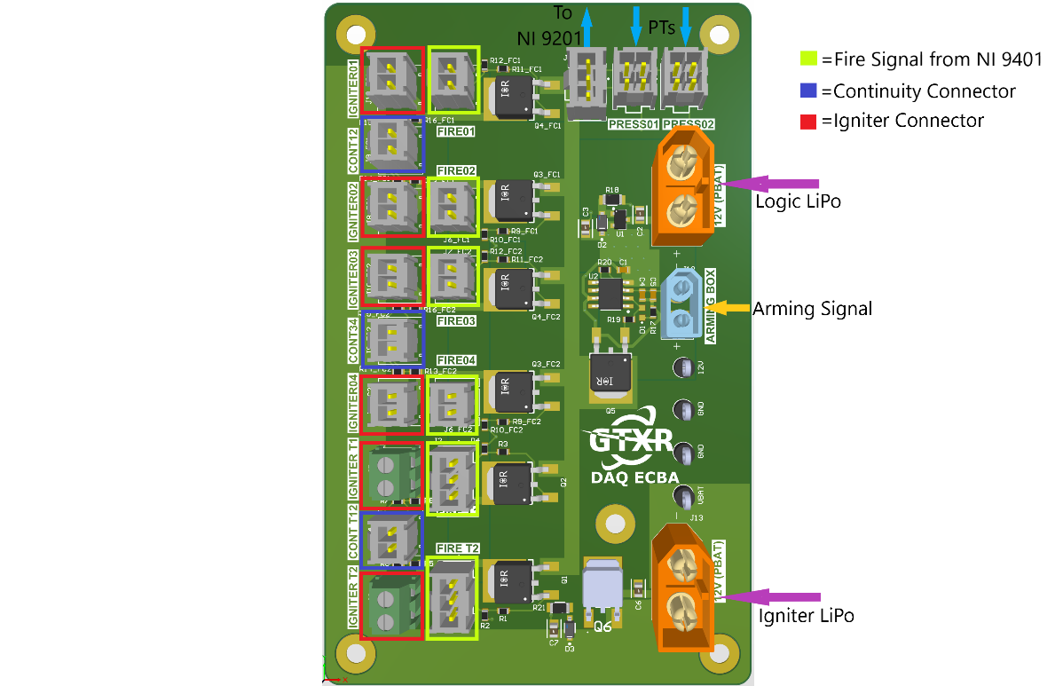
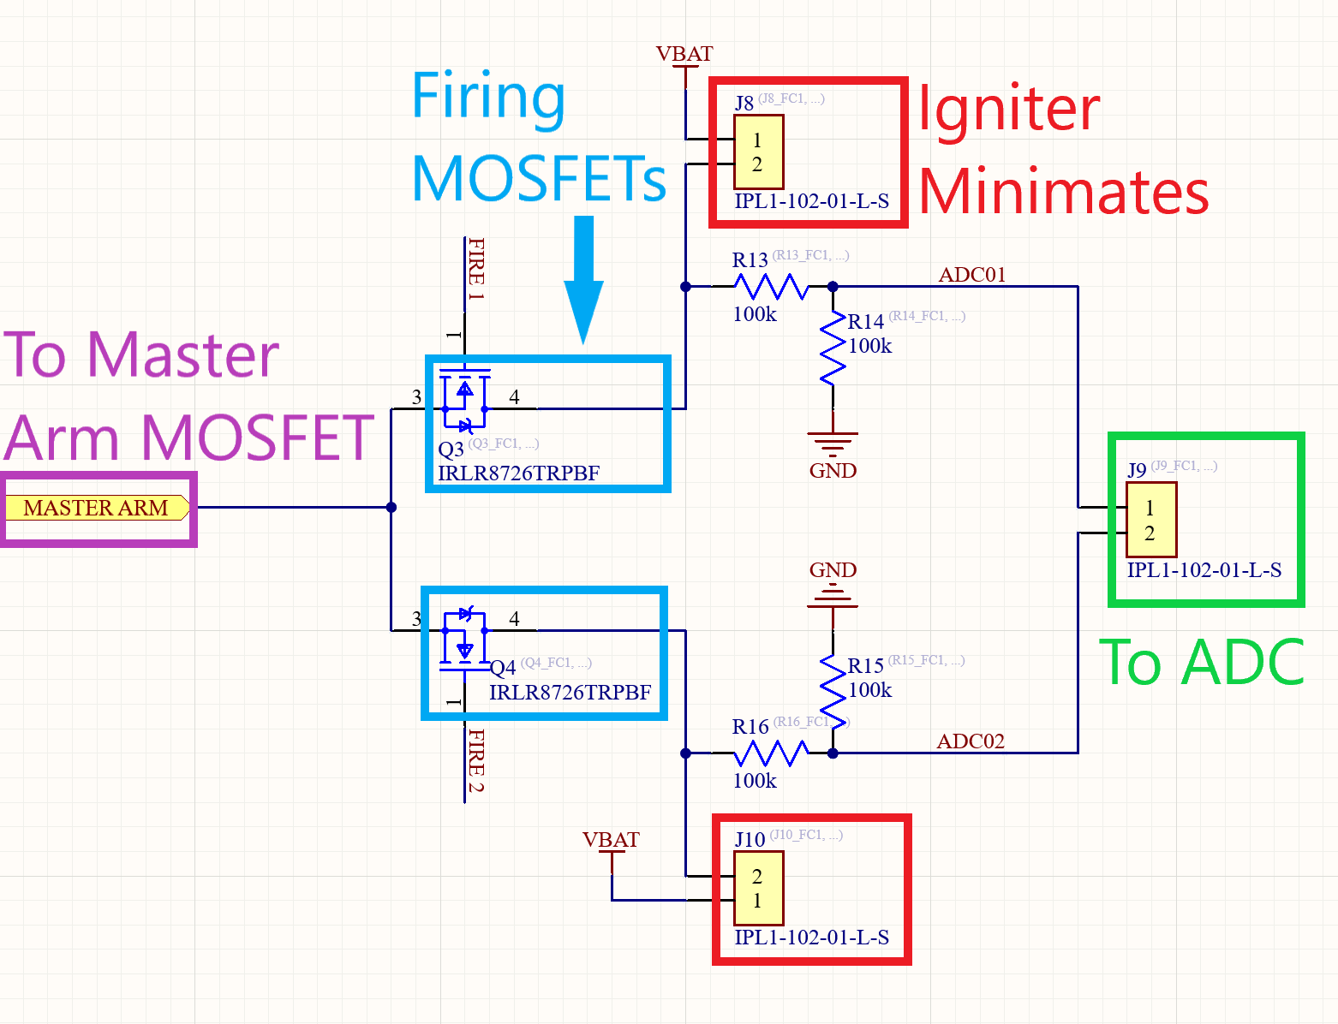
DAQ PCB Design
Custom PCB for interfacing igniters and PTs.
Two independent power sources.
Common ground strategy for accurate sensor readings.

Slide 11
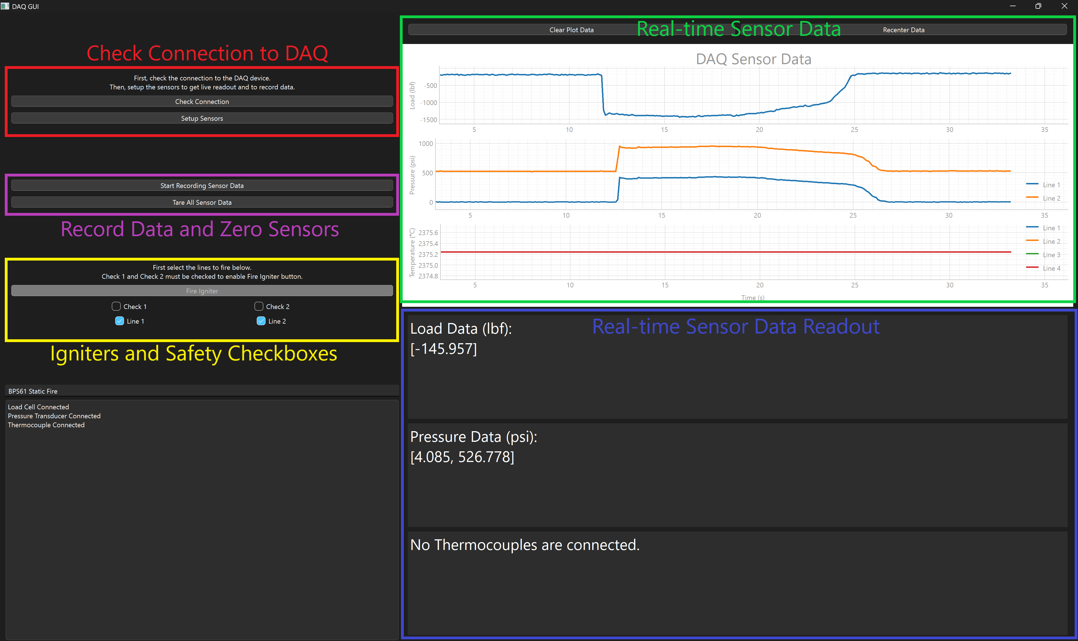
DAQ GUI
Developed in Python with PyQt6.
Features:
  Connect to and setup DAQ.
  Real-time data visualization.
  Check igniter continuity.
  Igniter fire control and safety interlocks.
  Automated data processing.

Slide 12
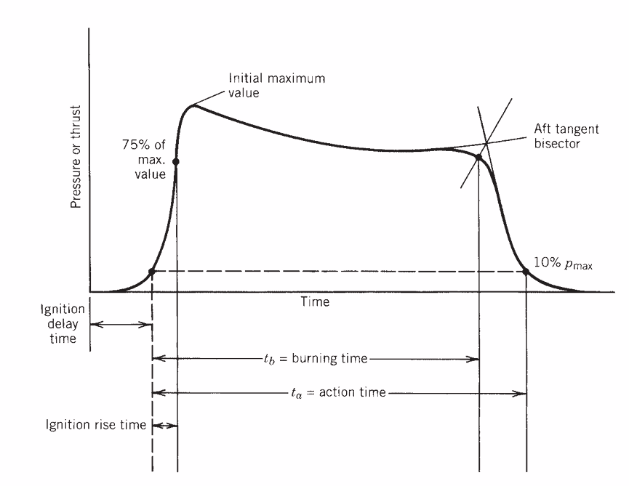
Data Processing and Analysis
Automated bias correction and noise filtering.
Thrust, burn time, and impulse calculations.
Algorithm follows Rocket Propulsion Elements (Sutton).
Image Source: Rocket Propulsion Elements

Slide 13
Data Analysis: Sensor Bias Correction (1)
Problem: Bias in raw sensor data due to thermal drift, electrical offsets, mechanical preloading.
Correction Method: Compute pre-ignition bias by averaging PT and load cell data. Subtract bias from raw data.

Slide 14
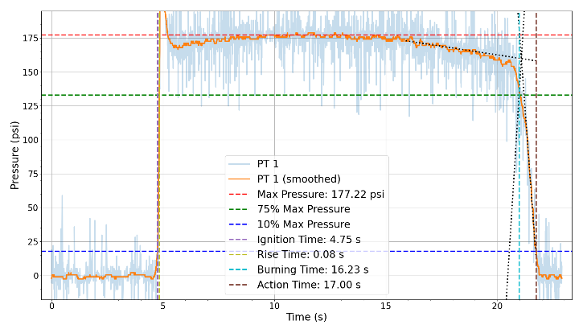
Data Analysis: Noise Reduction with Rolling Median Filter (2)
Problem: Noise is present in signal
Comparison of Methods: Median filter preserves sharp transitions (e.g., ignition, burnout). Superior to low-pass or rolling average filters for outlier rejection.

Slide 15
Data Analysis: Propulsion Performance Metrics (3)
Key parameters calculated:
  Maximum Pressure
  Ignition Delay Time
  Ignition Rise Time
  Burning Time
  Action Time
  Total Impulse
  Specific Impulse

Slide 16
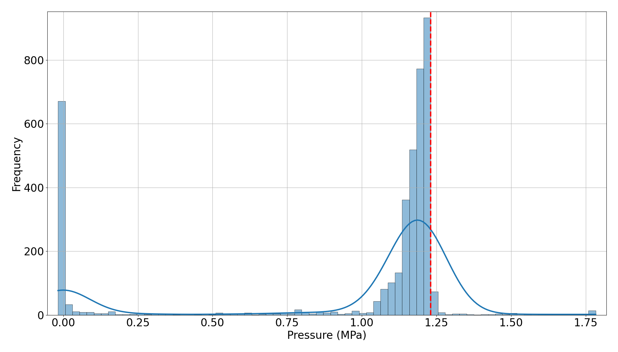
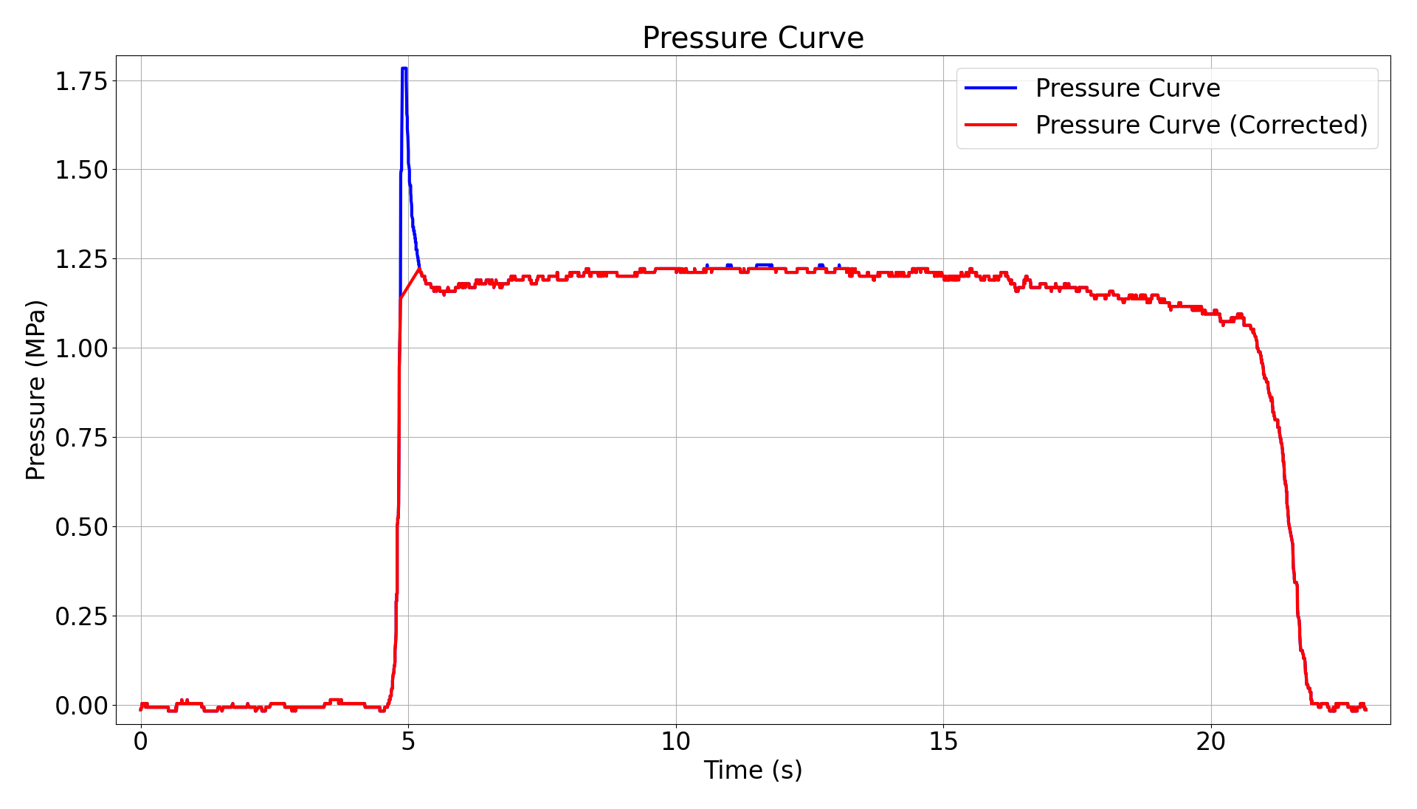
Data Analysis: Maximum Pressure Determination (4)
Issue: Ignition spikes can distort max pressure
Solution: Histogram-based outlier filtering. Bins pressure data. Filters short-lived ignition spikes using a threshold.

Slide 17
Data Analysis: Ignition Delay & Action Time (5)
Definition:
  Ignition delay: Time to first 10% max pressure crossing
  Action time: Duration between two 10% crossings

Slide 18
Data Analysis: Ignition Rise Time Calculation (6)
Definition:
  Ignition Rise Time: Time between 10% and 75% max pressure

Slide 19
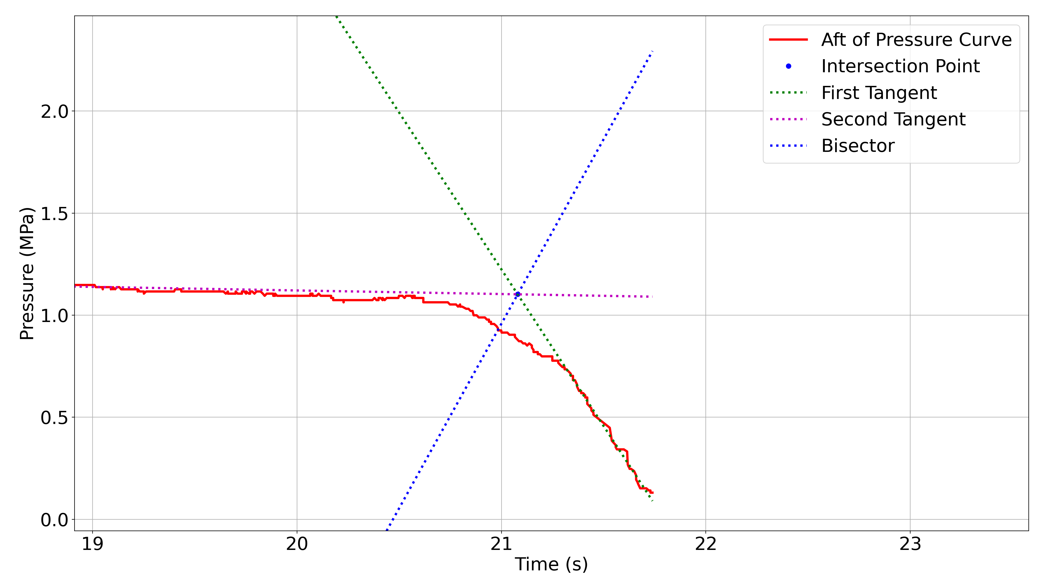
Data Analysis: Burning Time Calculation (7)
Method: Aft Tangent Bisector.
  Two tangents drawn at pressure drop.
  Bisector defines burn end time.
Standardization: Uses MPa for pressure, seconds for time.

Slide 20
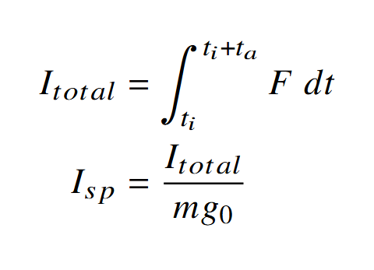
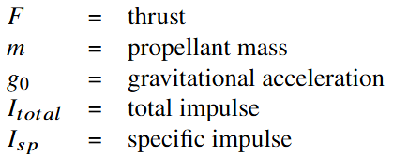
Data Analysis: Total Impulse & Specific Impulse (8)
Total Impulse:
  Numerical integration of load cell data over action time
Specific Impulse:
  Derived from total impulse.

Slide 21
Reliability
Transition from Arduino to NI CompactDAQ improved system robustness and reduced failures.
Arduino DAQ vs NI CompactDAQ
  Limited buffer size causing data loss.
  Low-resolution ADCs leading to noisy measurements.
  Frequent hardware failures and unexpected shutdowns.

Slide 22
Safety
  Critical importance of safety for rocket motor testing
  Control station is located 1000 feet away from test site
  External Arming Box (250 feet from test site)
    Ensures no accidental ignitions during motor integration.
  GUI Firing Safety Checks
    Two checkboxes must be manually selected.
  Hang Fire Continuity Detection
    Monitors igniter continuity to assess ignition failures.

Slide 23
Performance Analysis
using DAQ System

Slide 24
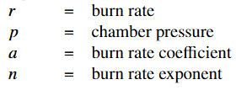

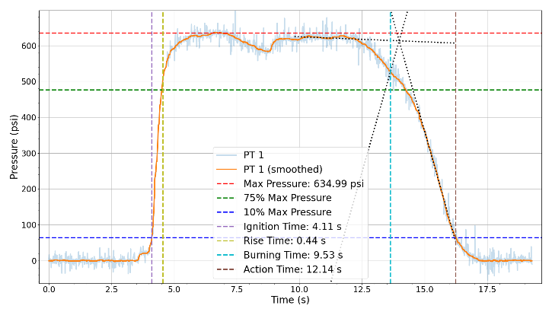
Performance Analysis - Oxamide Propellant Testing
Pressure data captured for multiple nozzle sizes.
Identified transient spikes and erosive burning effects.
Improved propellant burn rate modeling.

Slide 25
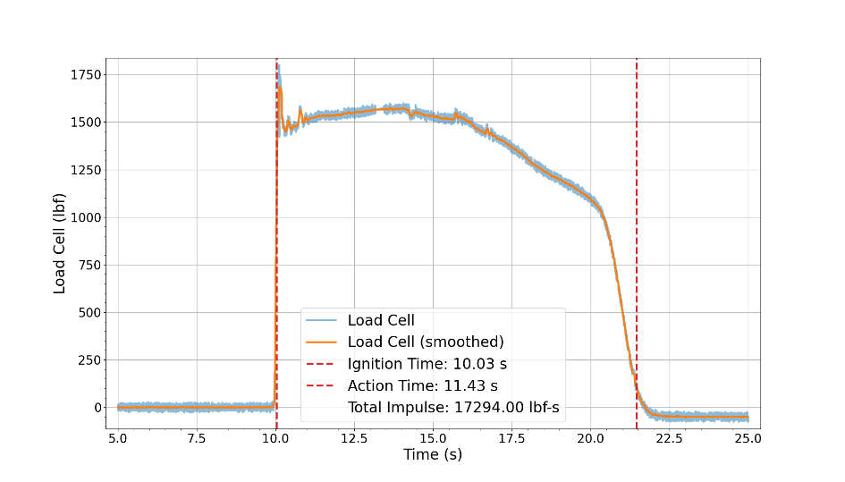
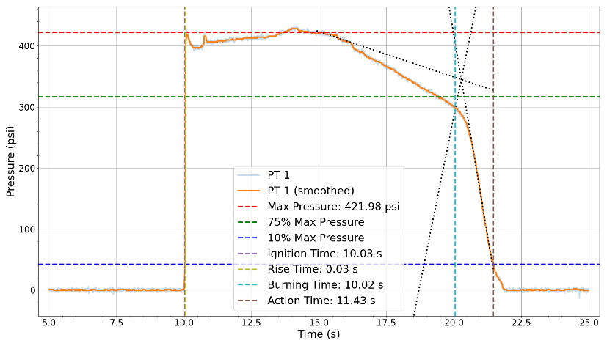
Performance Analysis – BPS61 Static Fire
P-class motor static fire test.
Recorded max pressure: 422 psi.
Computed total impulse: 17,294 lbf·s.
Validated against simulation data.

Slide 26
Conclusion
Enhanced RRC’s propulsion testing capabilities by providing high-fidelity, high sample rate data for performance validation.
DAQ system demonstrated its ability to collect accurate pressure, load, and temperature measurements.
These data-driven insights have been instrumental in refining combustion models, validating motor performance, and informing future design iterations.
Ultimately, the system enhances safety, performance, and reliability in rocket propulsion, reducing risks and contributing to the success of space missions.

Slide 27









Acknowledgments
Student Government Association at Georgia Tech and the Daniel Guggenheim School of Aerospace Engineering.
Ramblin’ Rocket Club’s propulsion and avionics teams.
RRC’s additional financial sponsors.
27

Slide 28
Questions?

