Slide 1
Overview of Bell X-1 Inspired RC Aircraft: USC's Submission for Design Build Fly
Jared Cain, David Bradford, Patrick Bailey, Reese Massett, Connor Barefoot, Nick Carnes, Michael Cargill
University of South Carolina
AIAA Region II, 4/3/2025 - 4/4/2025
Copyright © by Jared Cain, David Bradford, Patrick Bailey, Reese Massett, Connor Barefoot, Nick Carnes, Michael Cargill
Published by the American Institute of Aeronautics and Astronautics, Inc., with permission.

Slide 2
Table of Contents
About the Speakers
Overview of 2025 Design Build Fly Competition
Team Organization
Design
Manufacturing
Closing Remarks and Future Work

Slide 3
Table of Contents
About the Speakers
Overview of 2025 Design Build Fly Competition
Team Organization
Design
Manufacturing
Closing Remarks and Future Work

Slide 4
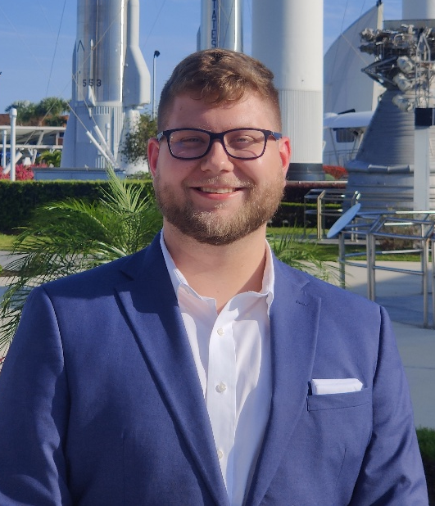
About the Speaker
Michael Cargill
Undergraduate Research Assistant
University of South Carolina
  B.S. Aerospace Engineering (Junior)
Midlands Technical College
  A.A.S. Machine Tool Technology
USC AIAA Chair (2024 – 2026)
Michael Cargill, A.A.S.

Slide 5
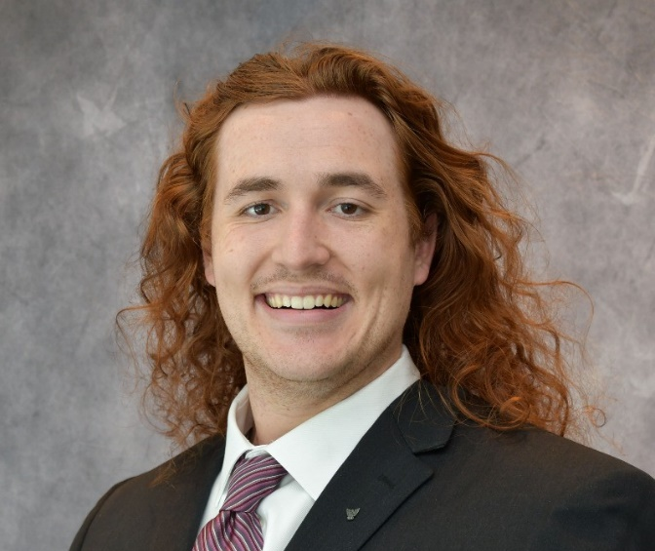
About the Speaker
Patrick Bailey
Graduate Research Assistant
University of South Carolina
  B.S. Aerospace Engineering (2023)
  M.S. Mechanical Engineering (2025)
AIAA Graduate Advisor (2024 – 2025)
Patrick Bailey, B.S.

Slide 6
Table of Contents
About the Speakers
Overview of 2025 Design Build Fly Competition
Team Organization
Design
Manufacturing
Closing Remarks and Future Work

Slide 7
Overview of 2025 Design Build Fly Competition
Tribute to X-1 Bell supersonic aircraft
Teams are tasked with designing a “bomber” style aircraft
  2 pylon payloads
  1 internal payload
  Deployable glider representative of the X-1
Three missions at different configurations

Slide 8
USC at Design Build Fly
First time competing in almost a decade
USC has never completed a mission
Initiative to increase member engagement
Integrated into curriculum
  Aircraft Design
  Senior Design

Slide 9
Table of Contents
About the Speakers
Overview of 2025 Design Build Fly Competition
Team Organization
Design
Manufacturing
Closing Remarks and Future Work

Slide 10
Team Organization
First USC DBF team formed since 2017
Consists of 32 undergraduate and graduate students
  Aerospace Engineering
  Mechanical Engineering
Project Manager oversees three teams
  Aerodynamics
  Structures
  Electrical

Slide 11
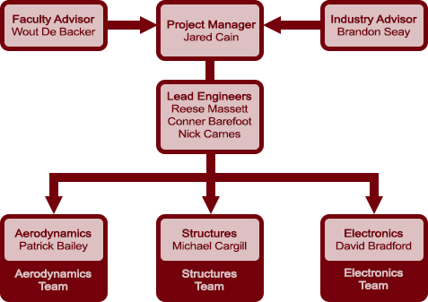
Team Organization

Slide 12
Table of Contents
About the Speakers
Overview of 2025 Design Build Fly Competition
Team Organization
Design
Manufacturing
Closing Remarks and Future Work

Slide 13
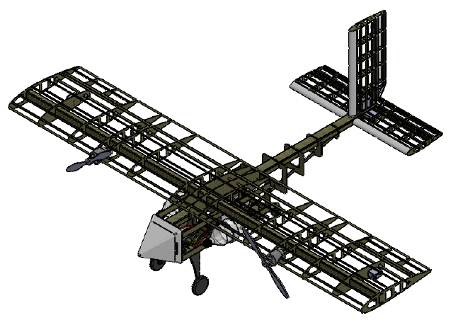
Design
Configuration
  High Wing
  Twin Propeller
  Taildragger
Construction
  Skin-on-Frame
  Monokote style skin
  CFRP Structure

Slide 14
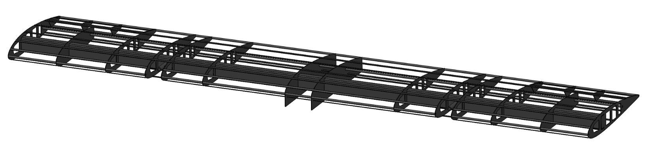
Wing
NACA 2416
  Higher C_{L}
  Favorable stability characteristics
Rectangular Wing
  Subsonic speeds
Structure
  Thermoset CFRP C spar
  Thermoplastic stringers and ribs

Slide 15
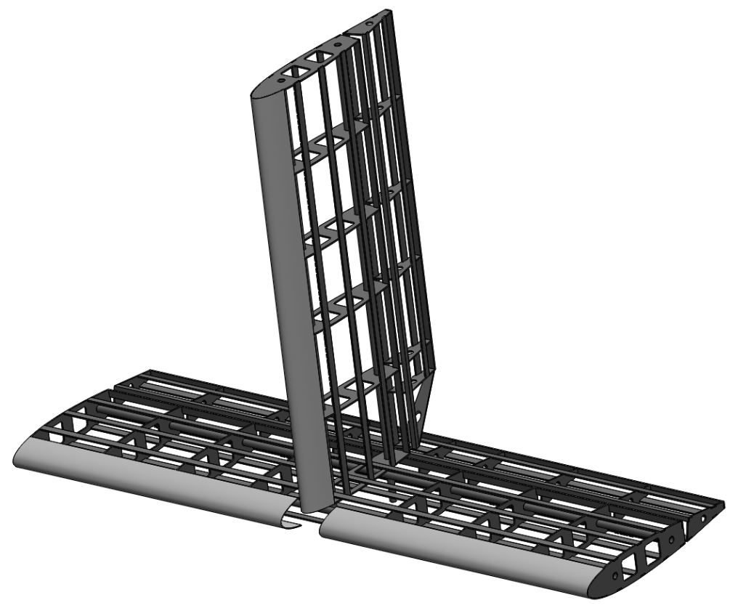
Tail
Conventional tail configuration
Similar construction to wing
  3D printed leading edge

Slide 16
Fuselage
Simple rectangular cross section
  Tapers towards tail
  Sized to house electronics and payload
Hinged Nosecone allows access to interior
Hardpoints incorporated for pylon payloads
Construction
  C Channel spine
  CFRP bulkheads

Slide 17
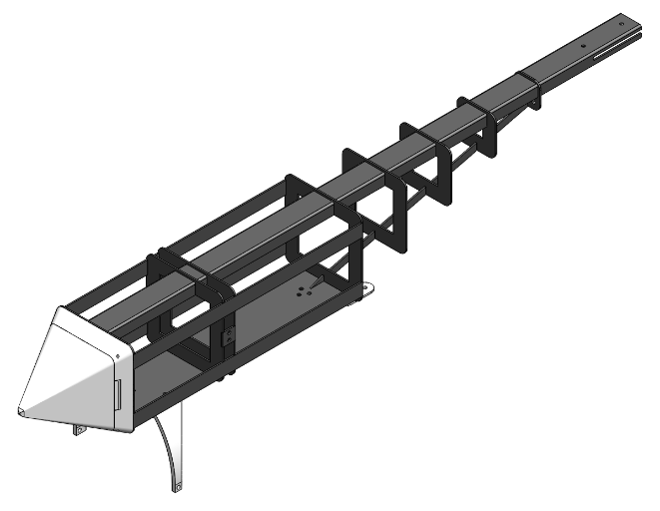
Fuselage

Slide 18
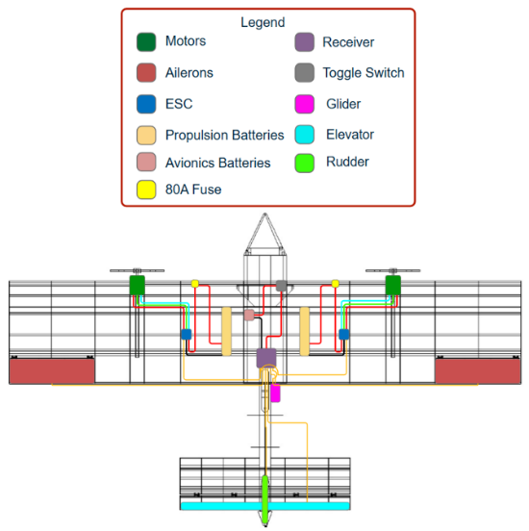
Electrical System
Propulsion
  2 Power 60 Brushless motors
  22.2V 1800mAh LiPo Battery
  80-Amp Brushless Smart ESC
  12x8 propellers
Flight Control
  DX6 G3 Transmitter
  AR637T DSMX Receiver
  Spektrum S6020 Servos

Slide 19
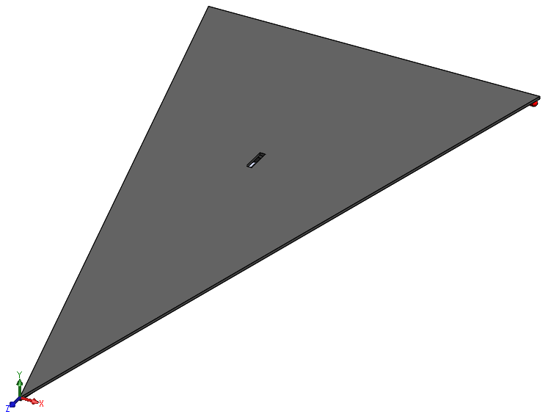
Glider
Composite paper airplane
Electrical
  Circuit for strobe light control
  Pull tab actuated via glider deployment

Slide 20
Table of Contents
About the Speakers
Overview of 2025 Design Build Fly Competition
Team Organization
Design
Manufacturing
Closing Remarks and Future Work

Slide 21
Material Selection
Composites
  Aircraft Structure
    Toray TC1225 UD Tape
    Fibreglast 2120 Thermoset CFRP
Polymers
  Aircraft Components
    PLA
    Monokote style film

Slide 22
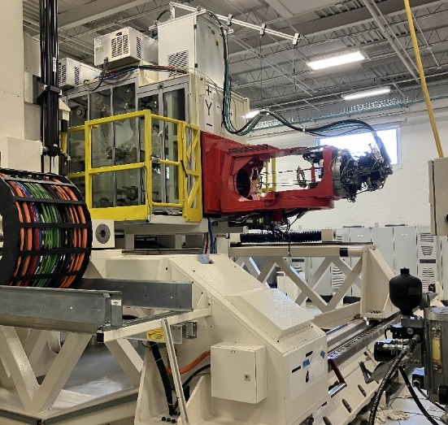
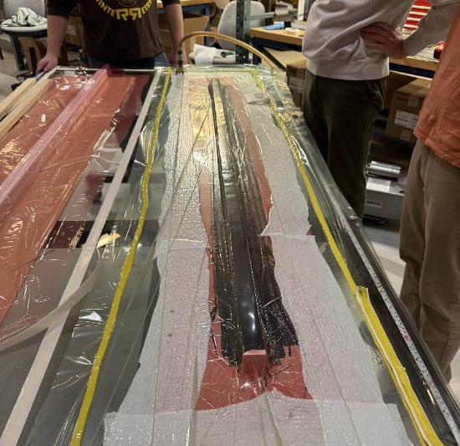
Composite Layup
Thermoplastic
  AFP layup
  8ply and 16ply
  Quasi-isotropic
Thermoset
  Hand layup on PVC tool
  4ply
  0/90 weave

Slide 23
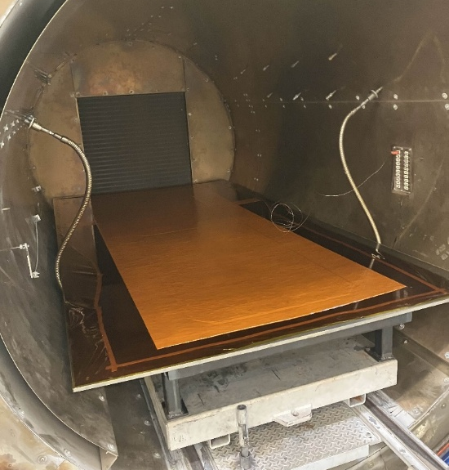
Autoclave Consolidation
AFP panels undergo autoclave consolidation
enhance mechanical properties
establish final material thickness

Slide 24
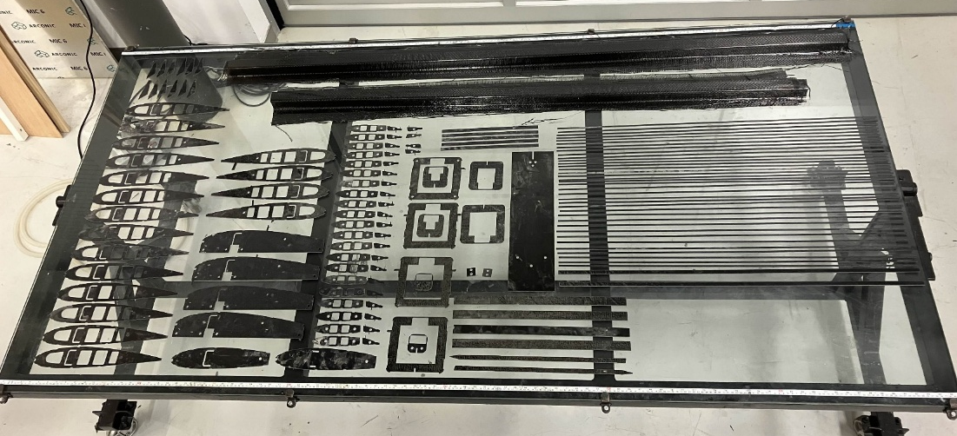
Water Jet Processing
Structural components are cut from panel using abrasive water jet
Easily process CFRP
Slight delamination upon piercing

Slide 25
Assembly
Aircraft is undergoing final assembly
Thickened 2120 resin system used as structural adhesive
Electronics to be integrated at this stage

Slide 26
Table of Contents
About the Speakers
Overview of 2025 Design Build Fly Competition
Team Organization
Design
Manufacturing
Closing Remarks and Future Work

Slide 27
Closing Remarks
Excited to return to DBF next week
Incredibly popular with members
Take lessons learned this year into following competitions
Will be returning in 2026

Slide 28
Closing Remarks
Questions?

