Slide 1

Distributed CubeSat Spectroscopy Network for Martian Surface and Atmospheric Analysis
Ibrahim Arnous & Joseph Colangelo
Embry-Riddle Aeronautical University
2025 Region II Student Conference, 3 April 2025 – 4 April 2025

Slide 2
Mission Overview
The M-STAR mission deploys a constellation of 20 CubeSats into a polar sun-synchronous orbit around Mars, each equipped with either an ultraviolet-visible (UV-Vis) spectrometer or an infrared (IR) spectrometer.

Slide 3
Mission Phases
X: Deployment of 20 CubeSats into 175 km polar sun-synchronous orbit
Phase I
  Deployment of 20 CubeSats into 175 km polar sun-synchronous orbit
  Spectral mapping using UV-Vis (200–700 nm) and IR (0.7–10 μm) spectrometers
  Global coverage achieved in 3 days with 25 km-wide swath scans

Slide 4
Mission Phases
Phase II
  Orbit adjusted for prolonged atmospheric observations (~5-year mission)
  Monitoring dust storms, trace gases, temperature fluctuations
  CubeSats serve as data relays and weather trackers for future missions

Slide 5
Mission Architecture
Platform: 20 CubeSats with modular UV-Vis or IR spectrometers
Orbit: 175 km polar sun-synchronous orbit
Instruments:
  UV-Vis (200–700 nm): Detects organics, volatiles
  IR (0.7–10 μm): Identifies minerals, hydrated materials
Key Tech:
  Chameleon SWIR camera for real-time dust/cloud tracking
  Tunable filters, beam splitters, and onboard calibration
  X-band / Ka-band comms via relay or direct-to-Earth
Power: Solar + battery system, 40 W per CubeSat

Slide 6
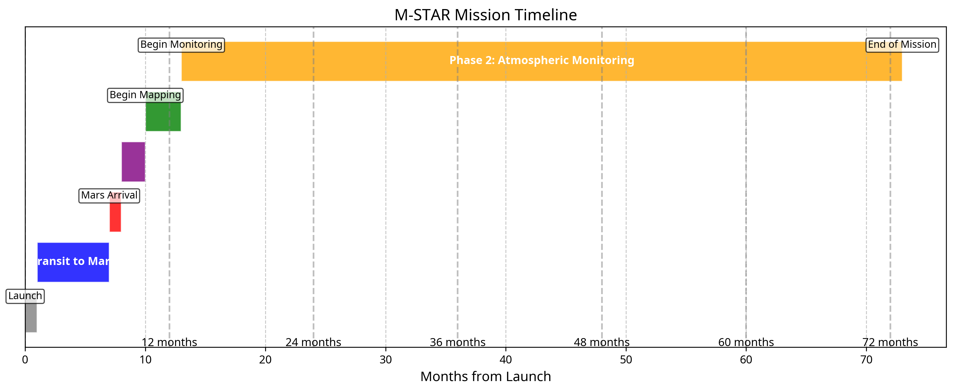
Mission Timeline

Slide 7
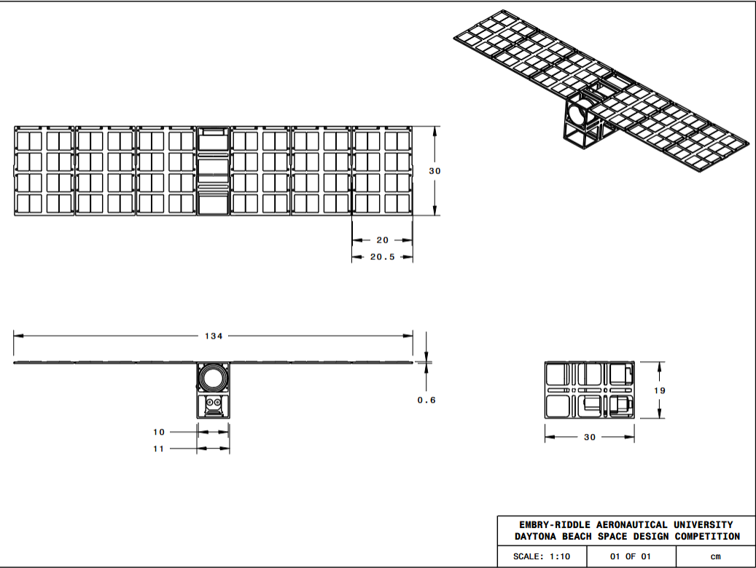
Technical Diagram

Slide 8
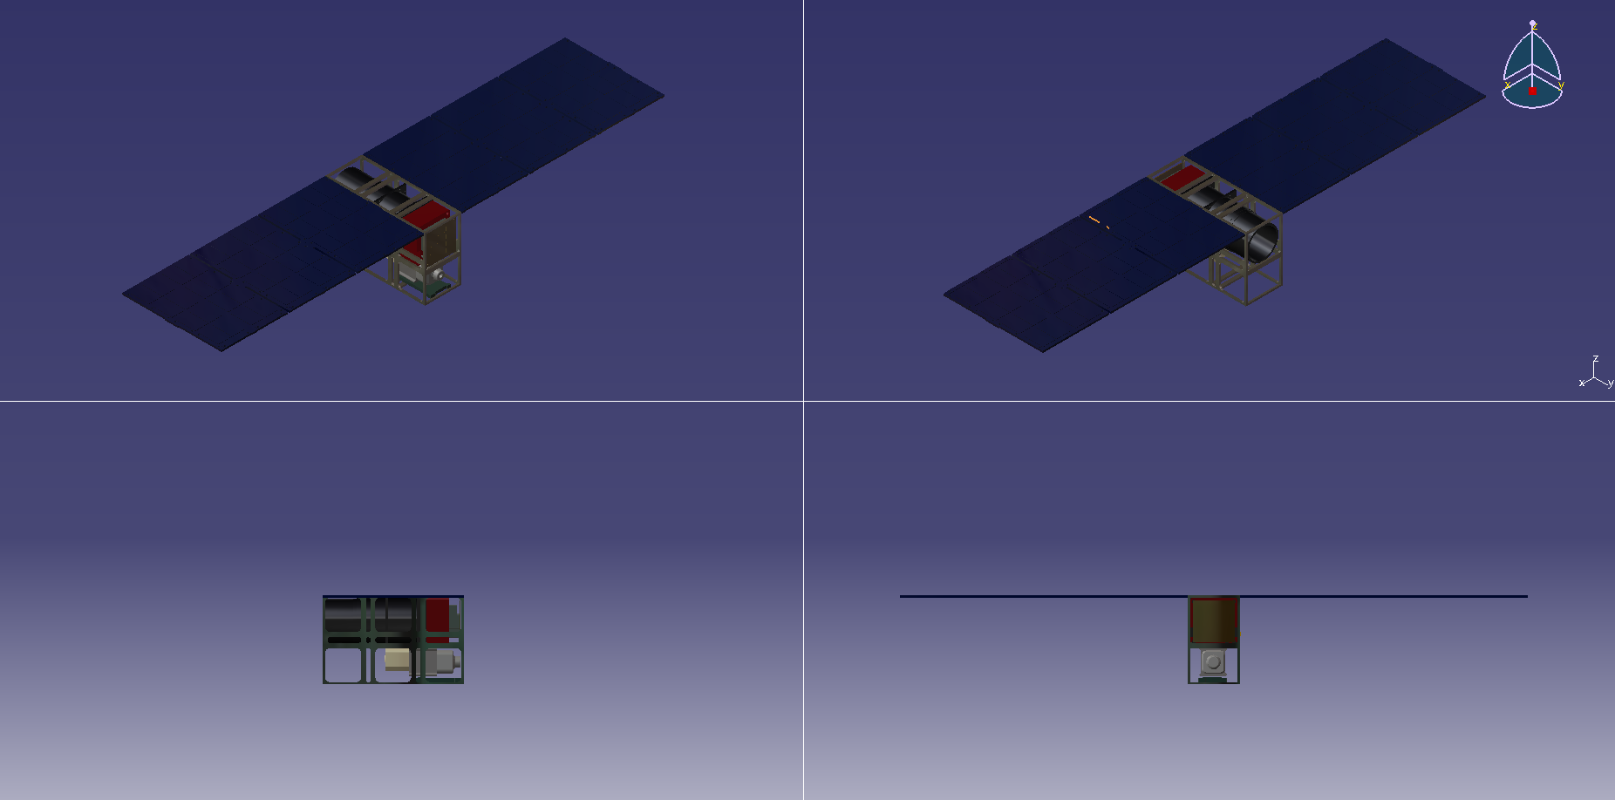
3D Model

Slide 9
Scientific Motivation
Expand spectral coverage with dual-wavelength sensing
Improve spatial and temporal coverage
Long-term climate and atmospheric studies
Demonstrate scalable, low-cost science architecture
Enable safer, more informed Human exploration

Slide 10
Ultraviolet-Visible Spectrometer System
High sensitivity to organic compounds, detect potential biosignatures
Trace volatiles and surface-atmosphere interactions
Map Oxidized Minerals Indicative of Past Water
Monitor Atmospheric Composition and Climate Dynamics
Support Human Exploration and ISRU

Slide 11
Infrared Spectrometer System
Wavelength Range: 0.7–10 micrometers (μm), covering the near to mid-infrared spectrum.
Identify Minerals: Detects mineral compositions (e.g., silicates, carbonates, sulfates) via their characteristic absorption bands within the 0.7–10 μm range.
Detect Hydrated Materials: Identifies water-bearing compounds
Monitor Atmospheric Composition, Water Vapor, Carbon Dioxide, Methane

Slide 12
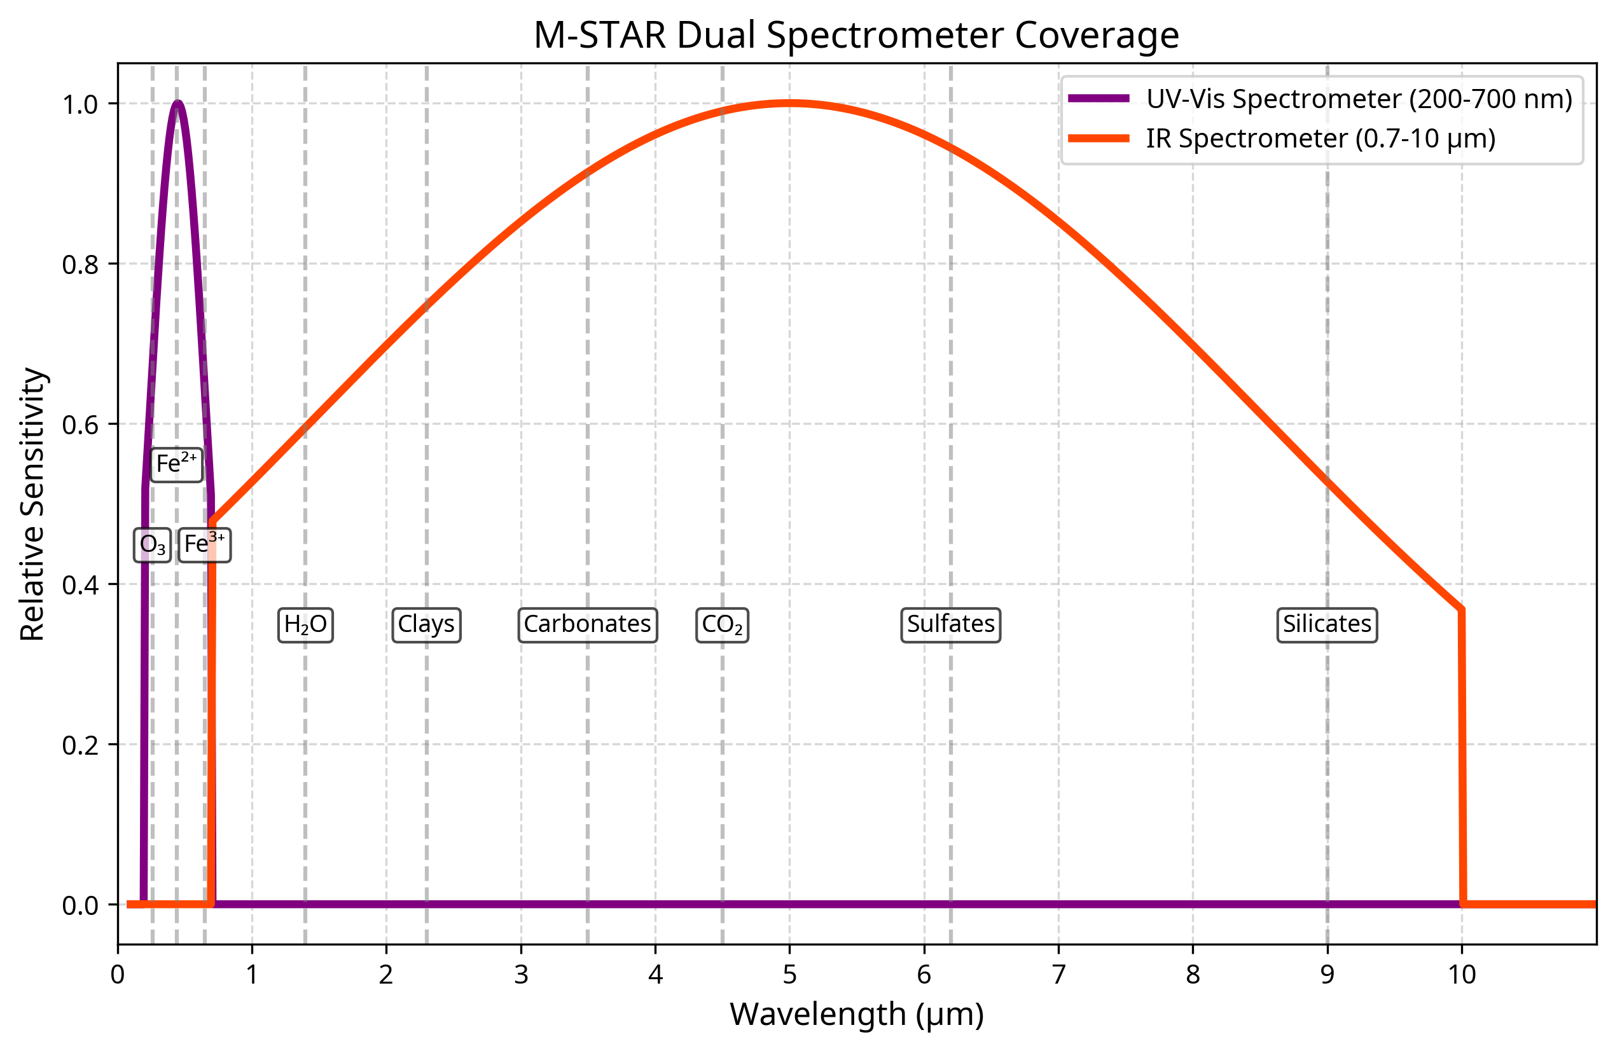
Dual spectrometer coverage

Slide 13
Dual Spectrometer Technology
ALICE (New Horizons): UV-Vis for volatiles
TES (Mars Global Surveyor): IR for minerals
CRISM (Mars Reconnaissance Orbiter): Dual-range mapping
IUVS (MAVEN): UV-Vis for atmosphere
PFS (Mars Express): IR for atmospheric analysis

Slide 14
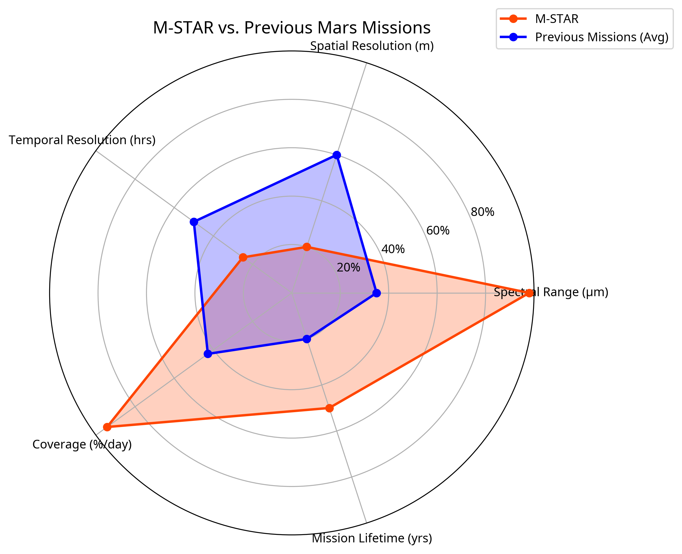
Comparison with Previous Missions

Slide 15
Distributed Network Advantages
  Enhanced spatial and temporal resolution
  Redundancy and mission resilience
  Simultaneous multi-point observations
  Scalable architecture
  Cost-effective approach (CubeSats)

Slide 16
Dual Spectrometer Advantages
  Comprehensive spectral coverage
  Complementary detection capabilities
  Cross-validation between instruments
  Enhanced science return
  Support for multiple science objectives

Slide 17
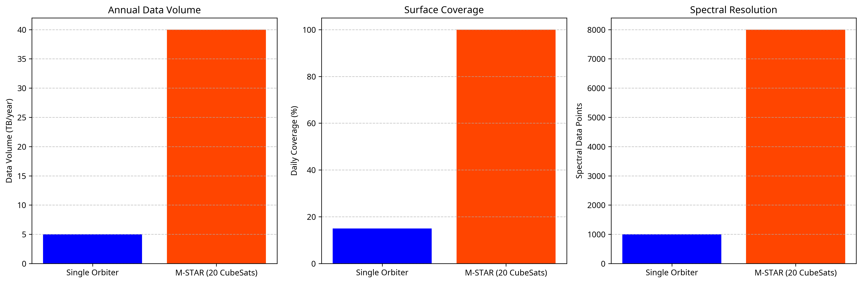
Scientific Impact

Slide 18
Applications and Future Work
Support for Human Exploration
  Resource mapping
  Hazard assessment
  Landing site selection
  In-situ resource utilization (ISRU)
  Weather forecasting

Slide 19
Applications and Future Work
Future Work
  Technology demonstration for future missions
  Adaptation for other planetary bodies
  Integration with other Mars missions
  Advanced data processing algorithms
  Machine learning for data analysis

Slide 20

Website for more Information!!

Slide 21
Questions?

