Slide 1
Design and Analysis of a Vertical Thrust Stand for Liquid Rocket Engines
Vraj Patel, Luke Fritz, Luke Raque, Pierre Bougrat, Jacob Bunch, Zachary Moore, Keller Powell, Vasilios Ekimogloy, Jack Redden, Lucian Stelk
The University of Alabama in Huntsville
AIAA Region II Student Conference, 4/3/2025 - 4/4/2025
Copyright © by Vraj Patel.
Published by the American Institute of Aeronautics and Astronautics, Inc., with permission.

Slide 2
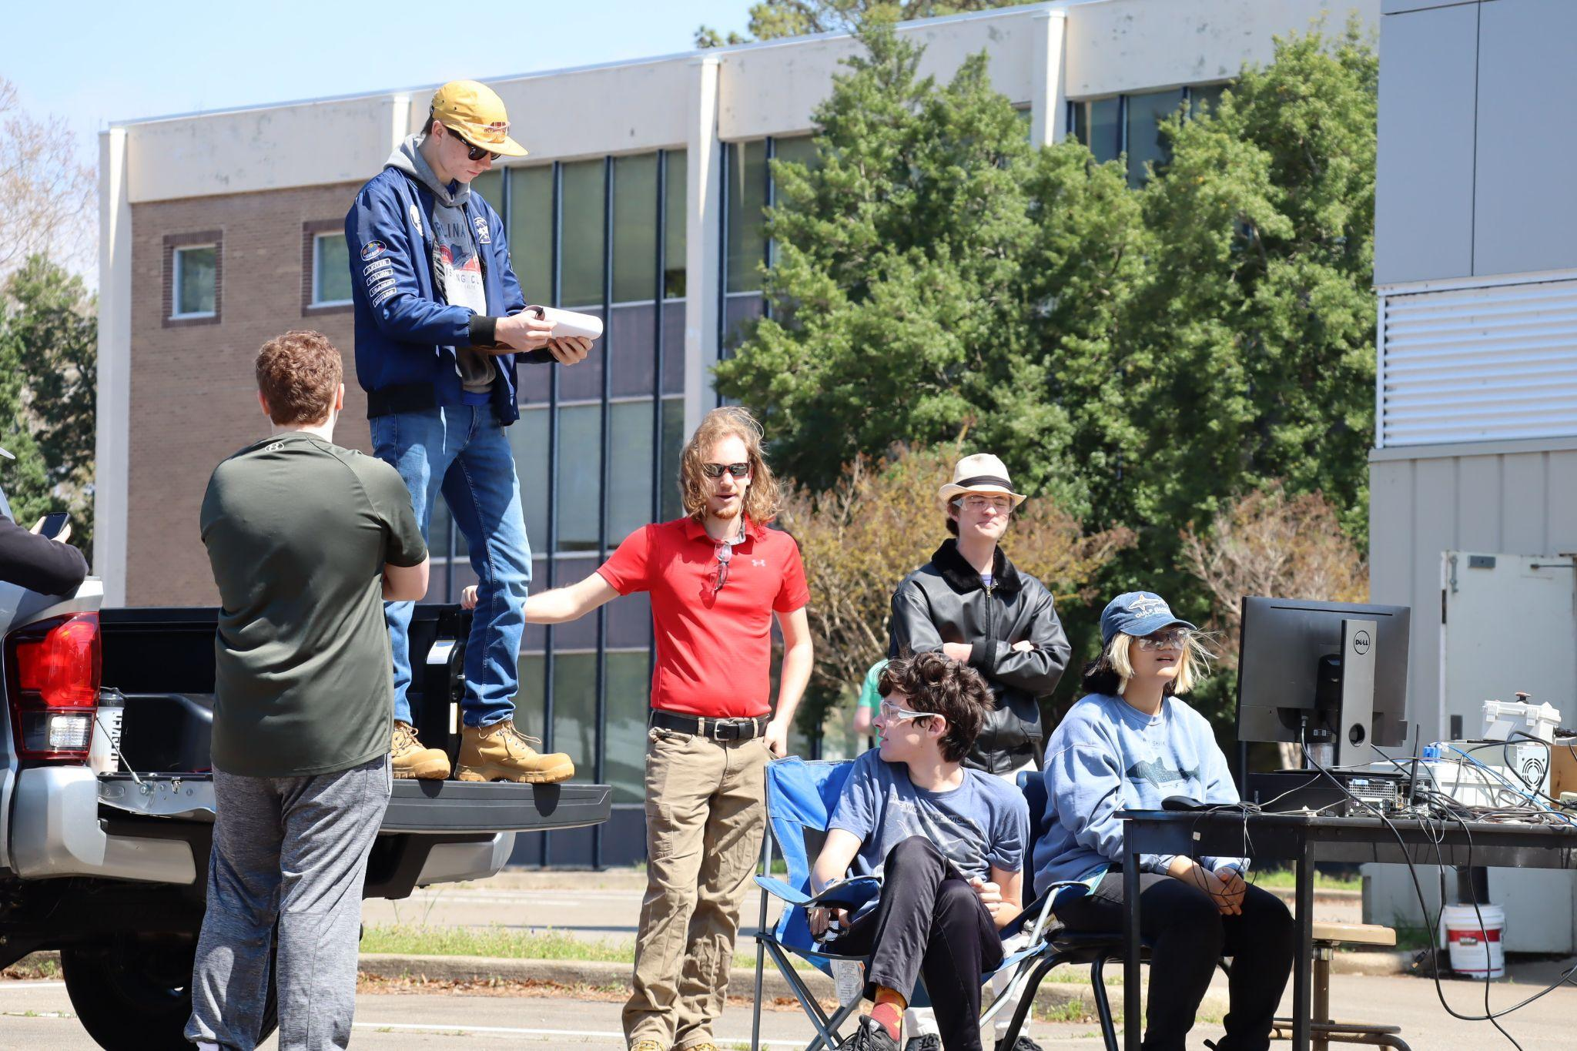
Tartarus Liquid Rocketry
Student-led liquid rocketry research and development
Project in the UAH Space Hardware Club
Propulsion, Fluids, Controls, and Systems subteams
  Fluids oversees feed system and Engine Thrust Structure manufacturing
Working towards Prometheus demonstrator engine hotfire
Coldflow Safety Briefing

Slide 3
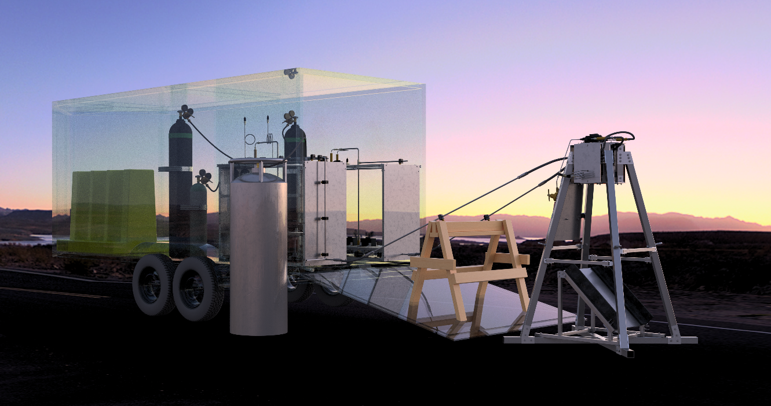
System Requirements
Transportable, durable, reusable
Must be able to withstand Prometheus thrust (280 lbf) with safety factor of 3
  1000 lbf with FOS of 3 with minimal modifications
Must be able to fit within standard truck bed
Flame diverter must withstand 2000°F flame temperatures
Igniter hardware must be built in
Full System Render

Slide 4
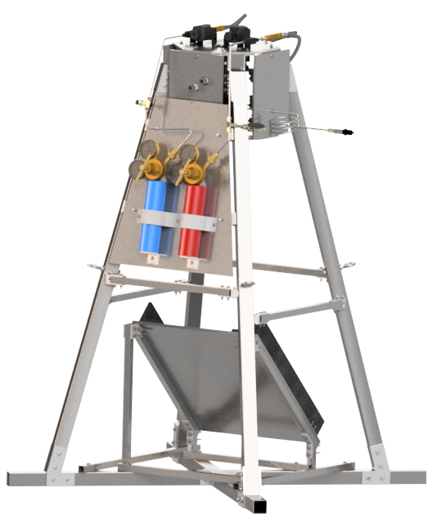
Main Structure Design
Vertical configuration chosen to avoid hardstarts
Simple geometry, avoid welds for manufacturing consistency
Trapezoidal shape chosen for overall strength and stability
  Square base, short height, and cross bracing provide lateral support
All low-carbon structural steel square tubing
42.5 in x 42.5 in x 62.5 in
Engine Thrust Stand CAD

Slide 5
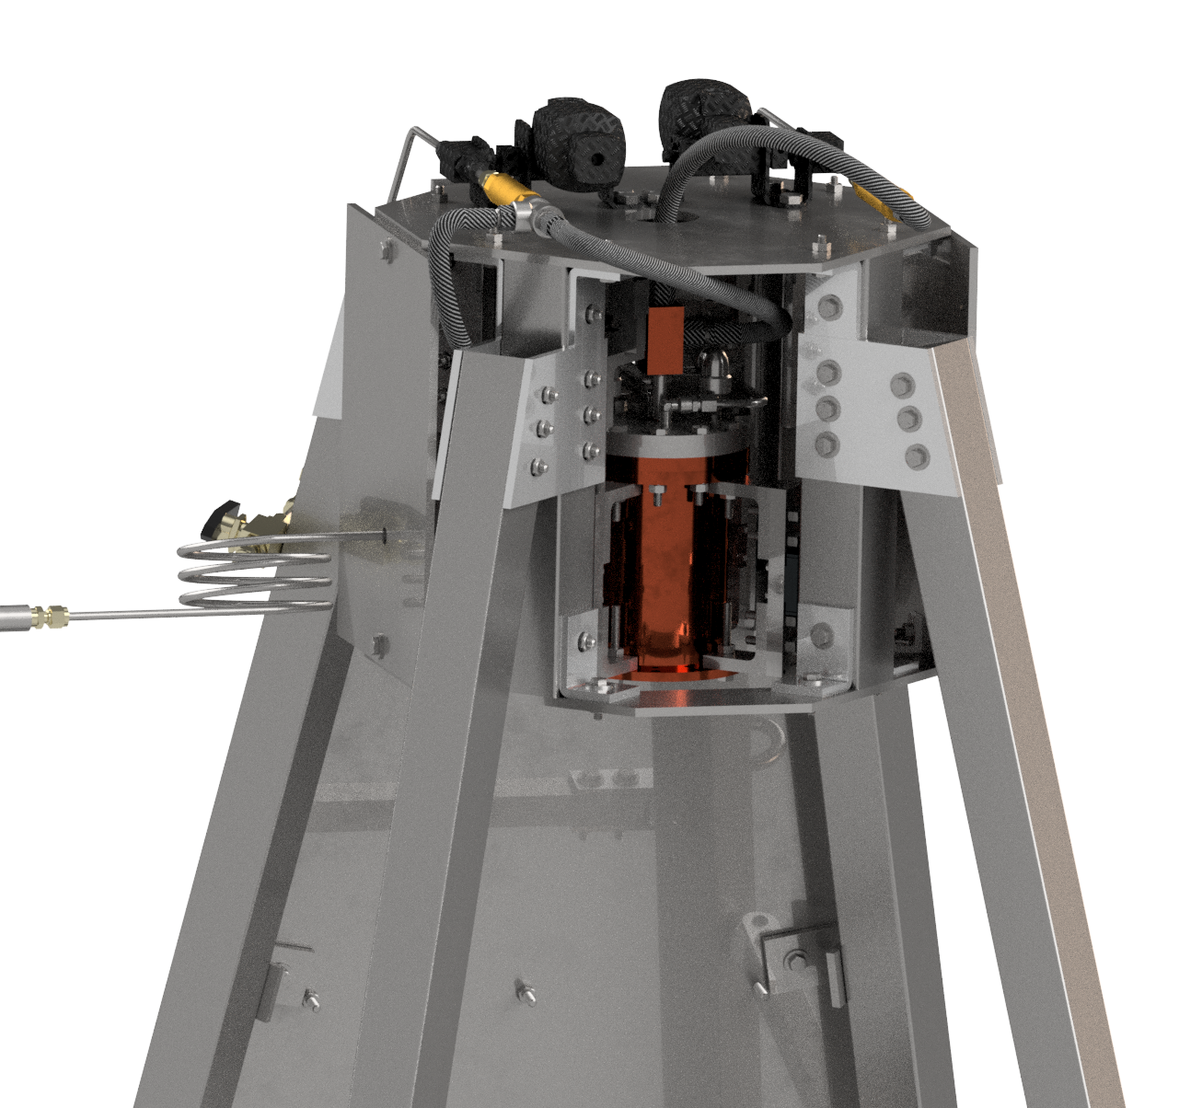
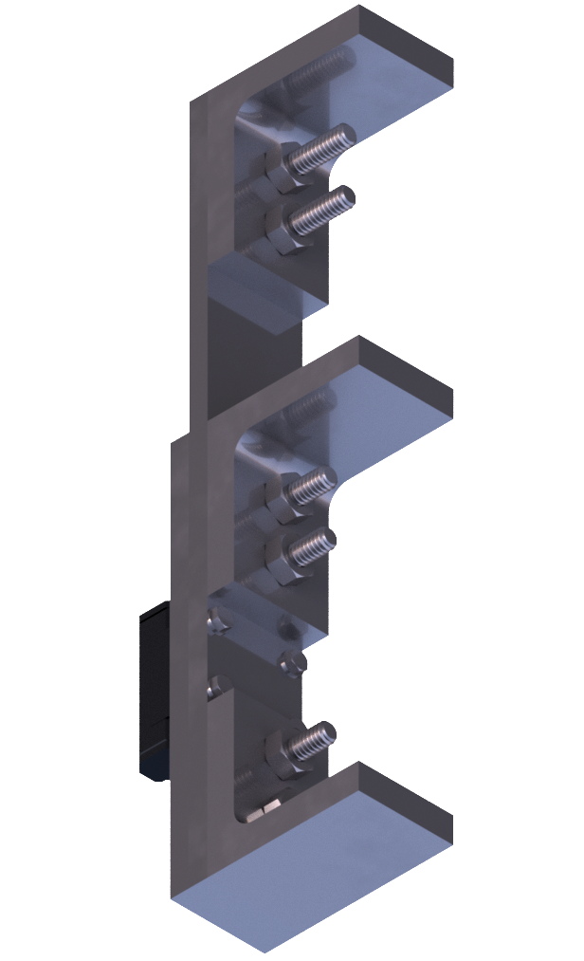
Engine Cage
Octagonal geometry, 4 alternating axial members
Prometheus engine connected to top face using 4 custom brackets
  Rail guides, two load cells
Three blast shield plates
Integrated igniter hardware
Engine cage connected to main axial members using custom gussets
Engine Cage CAD
Engine Bracket

Slide 6
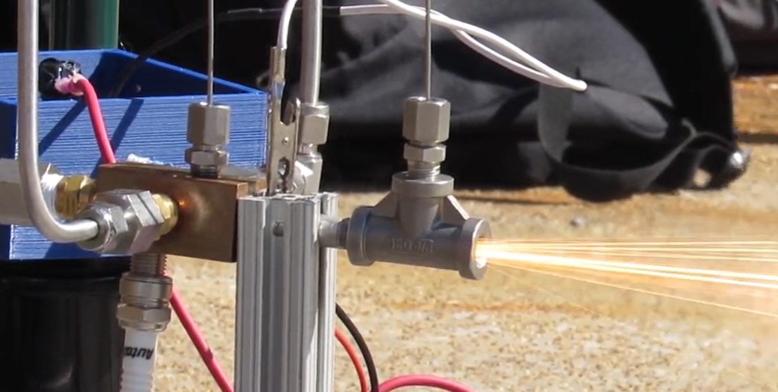
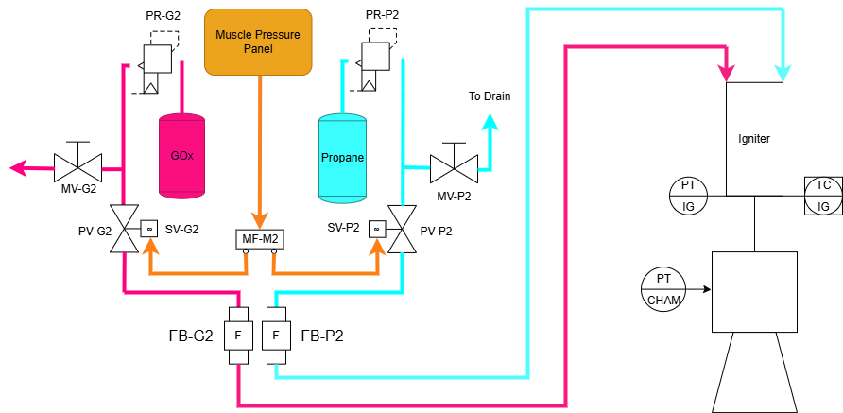
Igniter Fluids Panel
GOx-propane torch igniter vertically mounted on injector
Commercial off-the-shelf propane and GOx tanks on cage backside with regulators
Pneumatic valves, flashback arrestors on top plate
Flashback arrestors prevent high pressure backflow into system
Igniter Test
Igniter P&ID

Slide 7
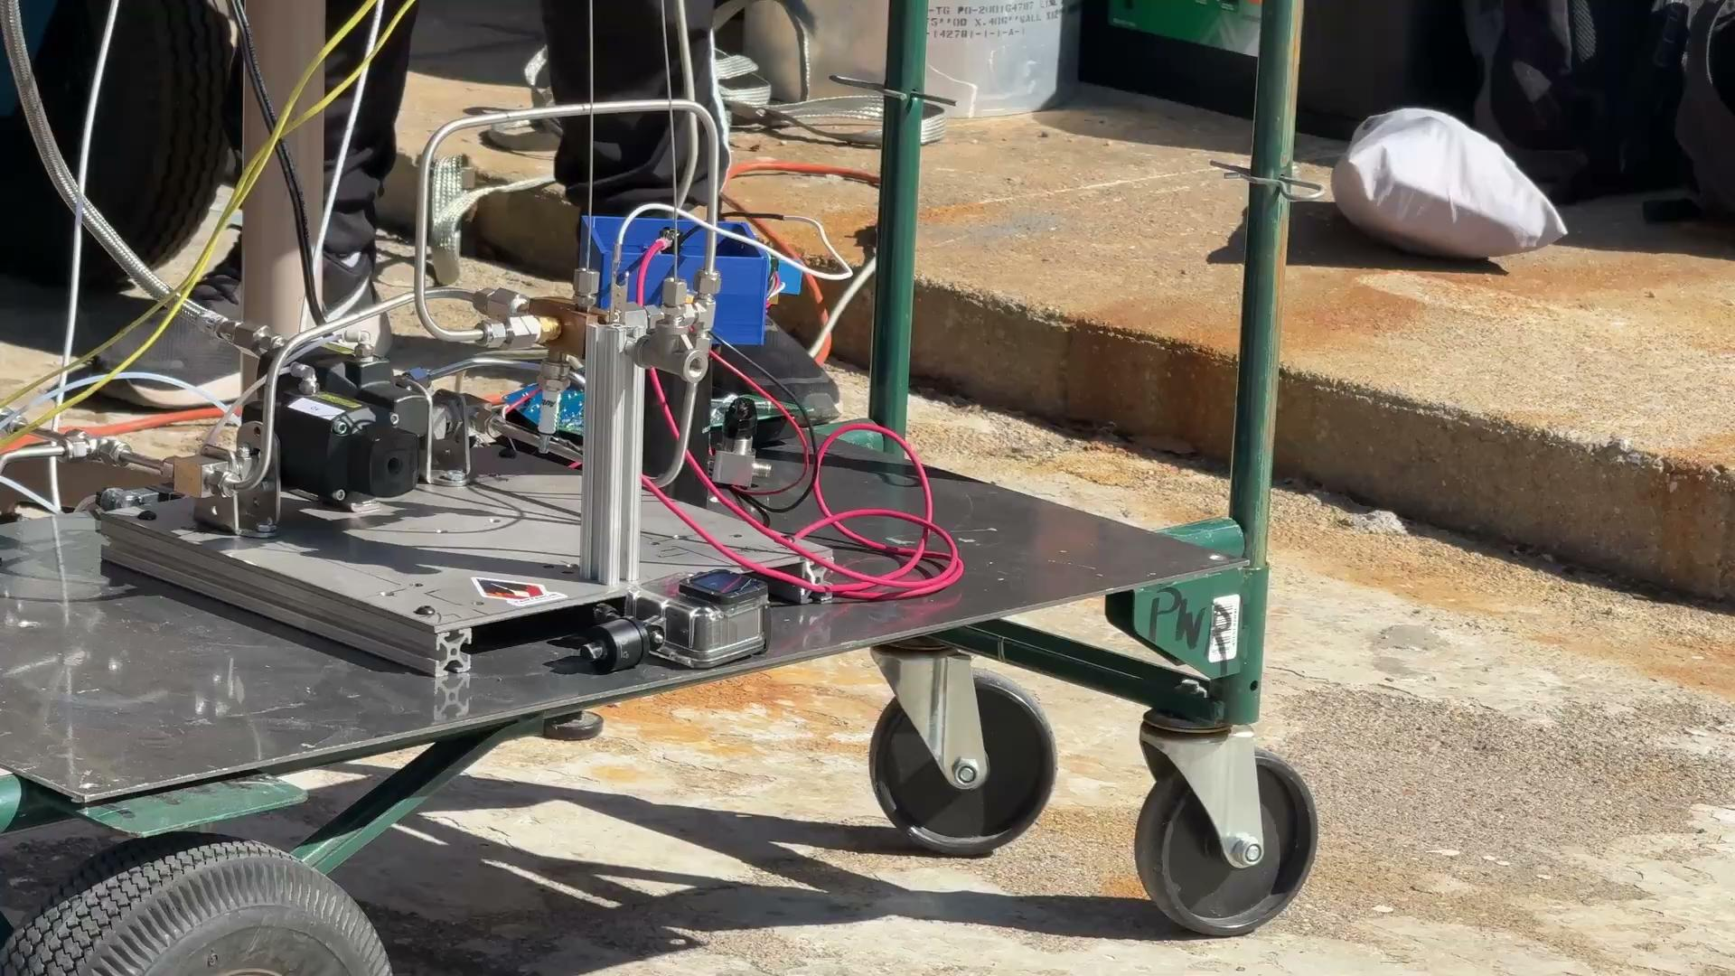

Slide 8
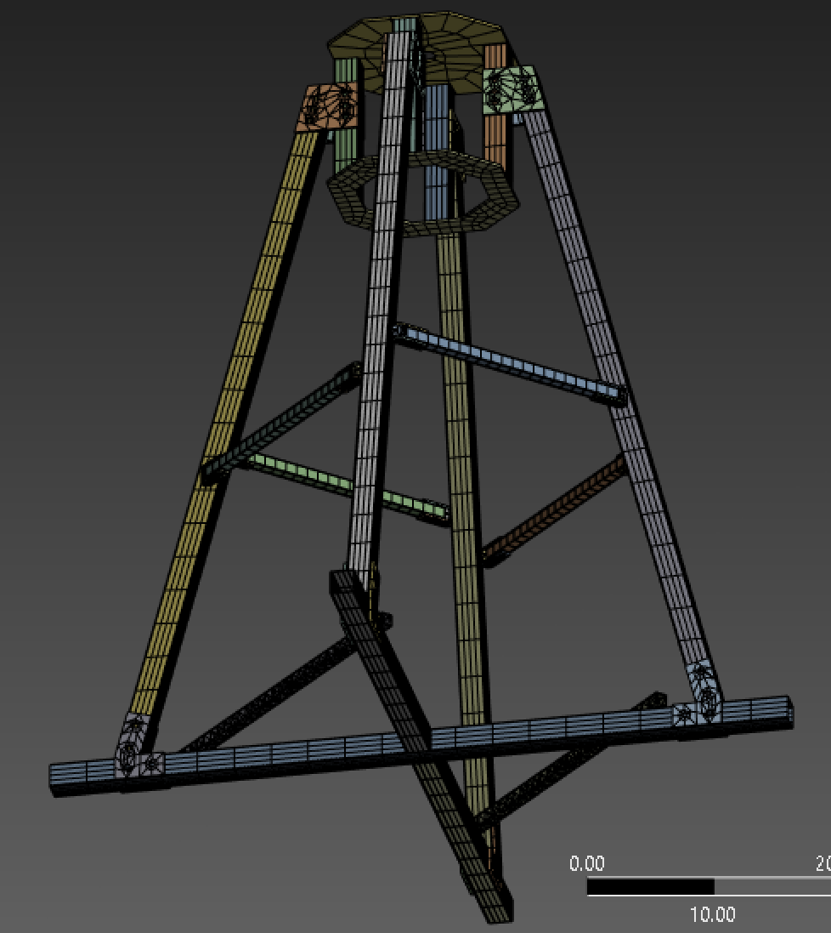
Structural Analysis
Hand calculations indicated main axial stress of around 75 psi
  Base stress = 2700 psi
ANSYS Static Structural used for finite element analysis
Due to mesh constraints, broken up into three subassemblies
  Main structure, Engine Cage, Diverter
A36 steel properties: E = 29000 ksi, yield stress = 36 ksi
Extensive local mesh sizing
Main Structure Mesh

Slide 9
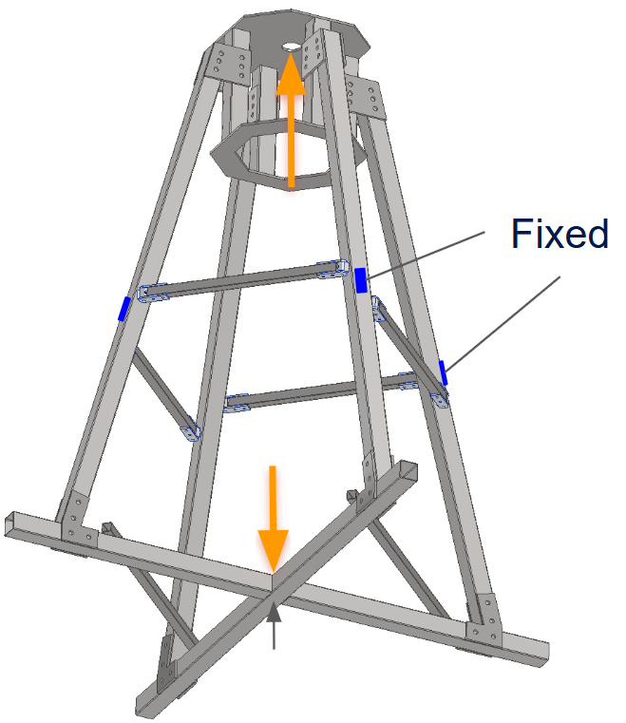
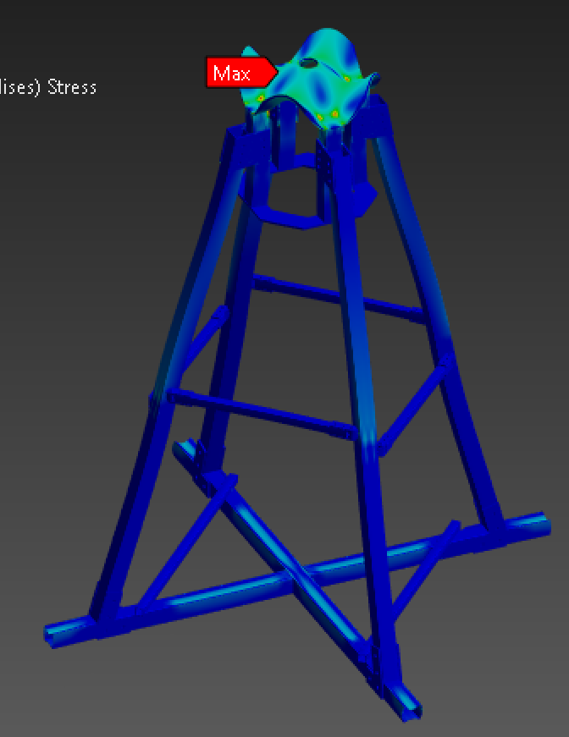
Main Structure FEA
Goal was to provide insight into overall structure behavior
Nonstructural parts omitted
  Engine rail guides, engine brackets, flame diverter
Thrust load applied across whole top plate
Two cells manually fixed as tie down points
FEA Constraints
Stress Results

Slide 10
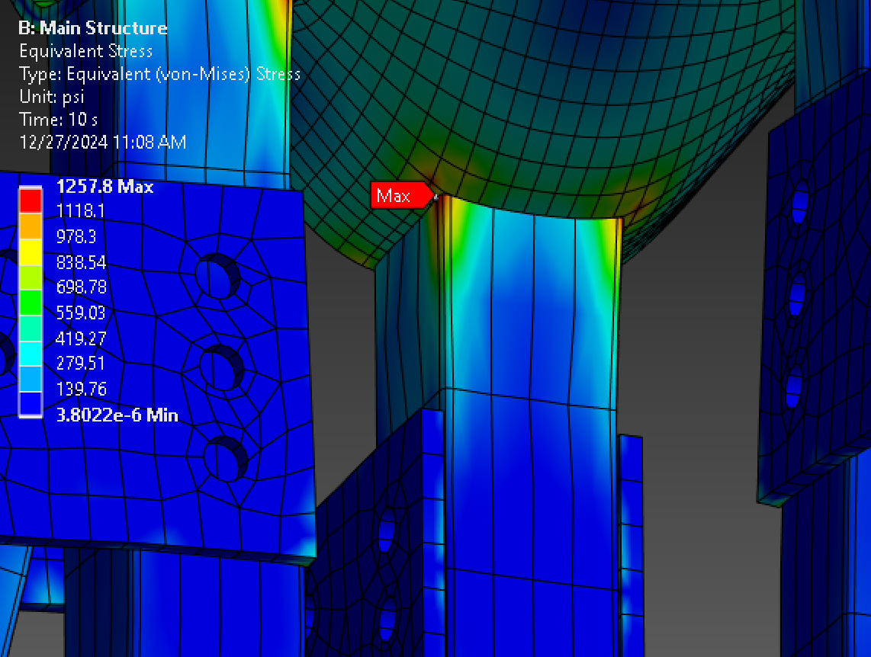
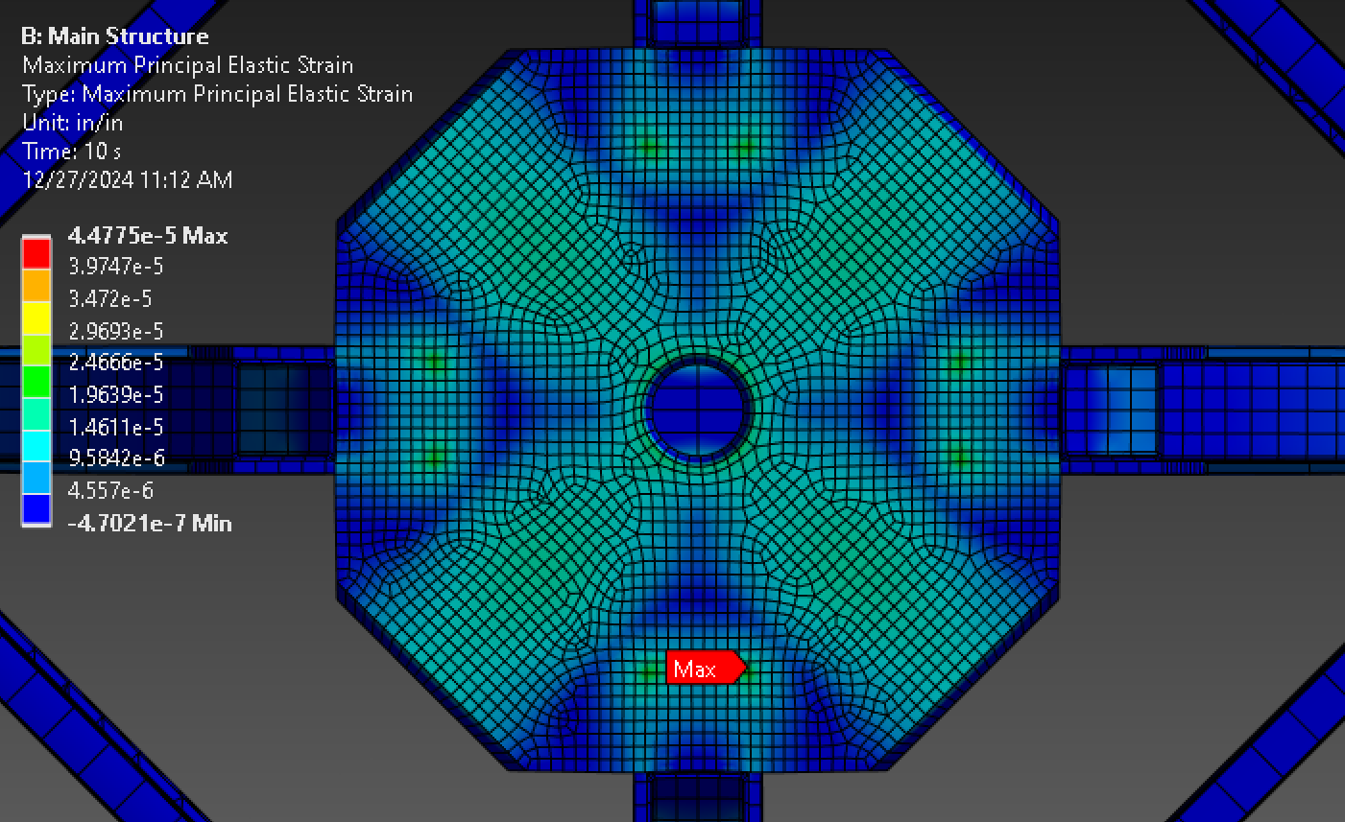
Main Structure FEA Cont.
Stress in main axial members and base quite low
  400psi near tie down points and base
Due to simplifications, deformations on top plate most likely different
Stress concentrations where top plate and vertical members meet (brackets omitted)
Stress Hot-spot
Top Plate Deformation

Slide 11
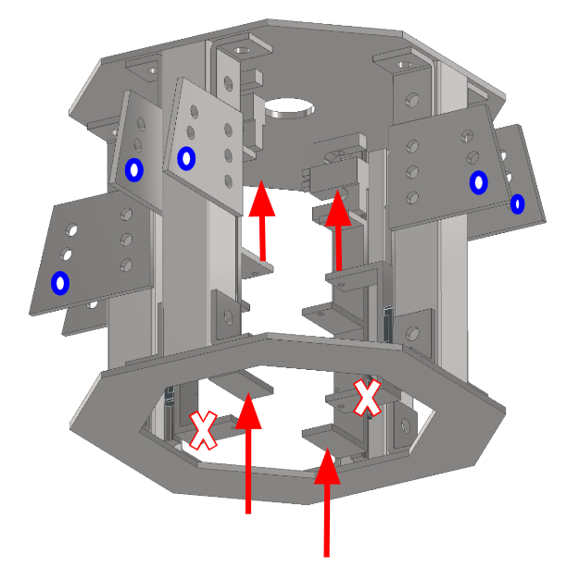
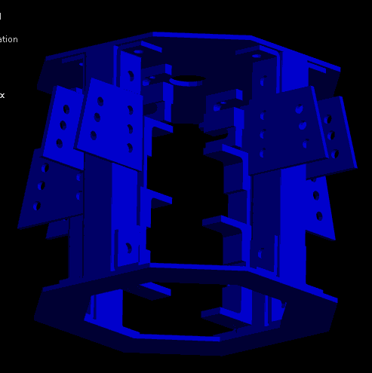
Engine Cage FEA
Higher fidelity engine cage simulation
Gusset holes fixed to simulate main member connection
Rail guides omitted due to complex geometry
Force applied to brackets
  Constrained in x and y, only moves vertically
Simulation Constraints
5 Second Results

Slide 12
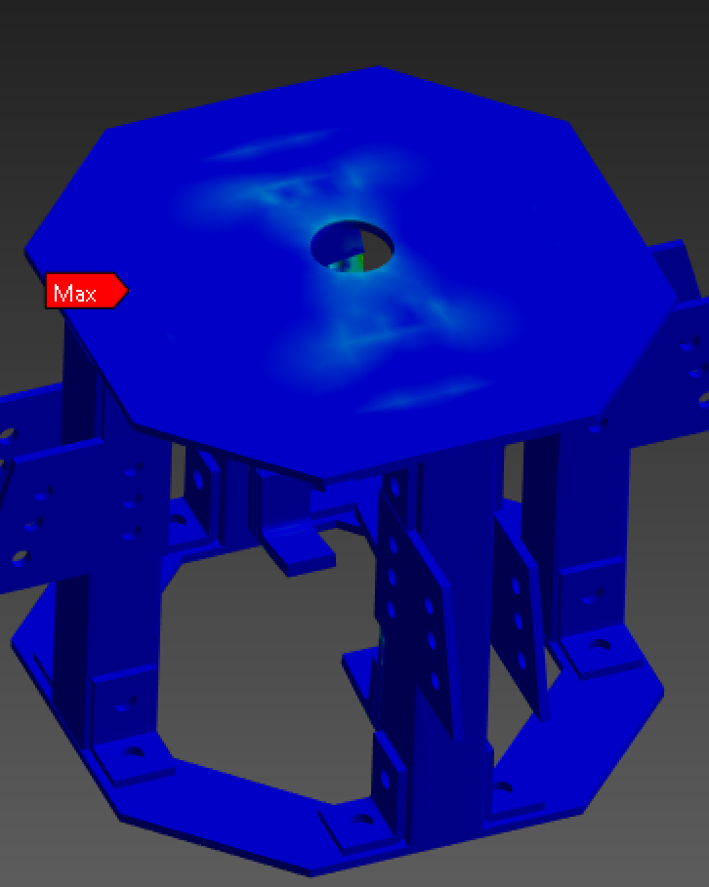
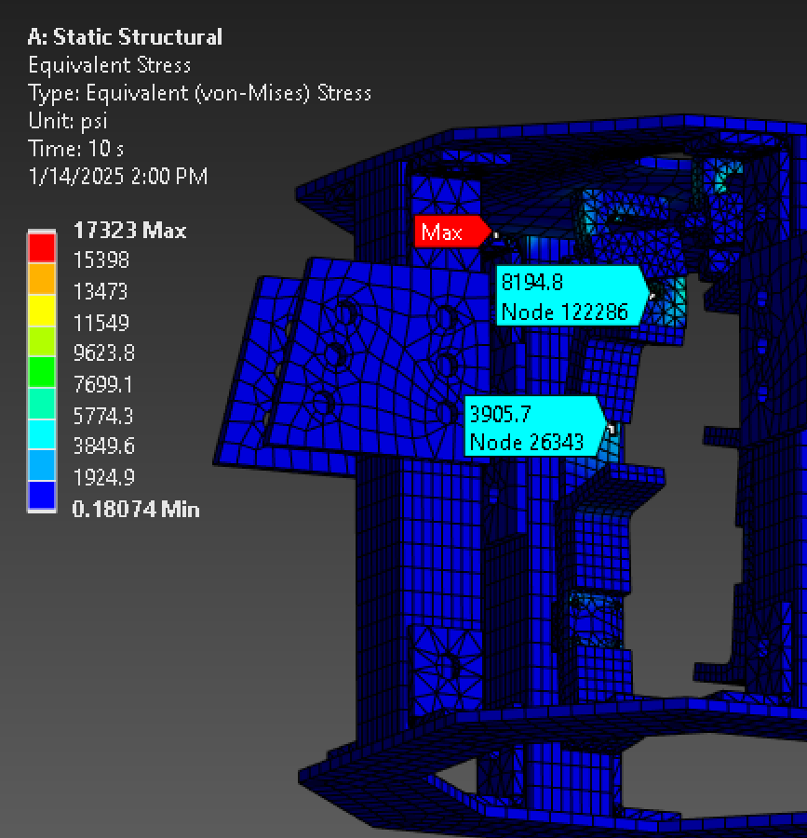
Engine Cage FEA Cont.
Deformations on top plate much less than shown in main structure FEA
  More realistic thrust load path applied
Max stress of 4 ksi on engine brackets due to high bending stress
  Will have to modify for higher thrust hotfires
Strain on Top Plate
Max Stress on Brackets

Slide 13
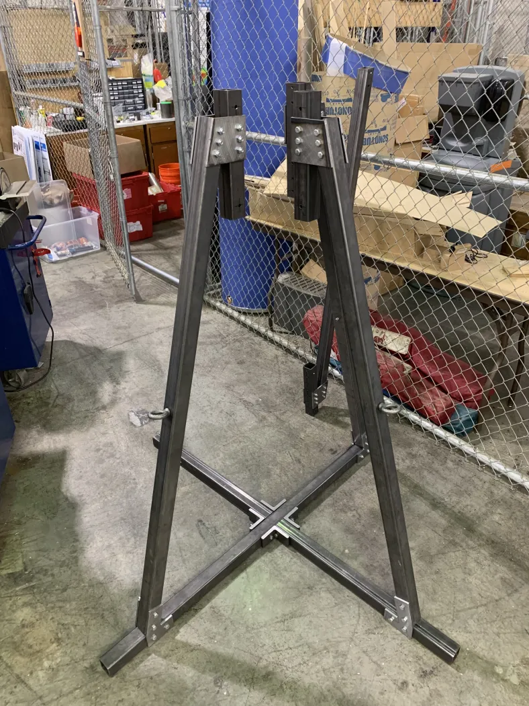
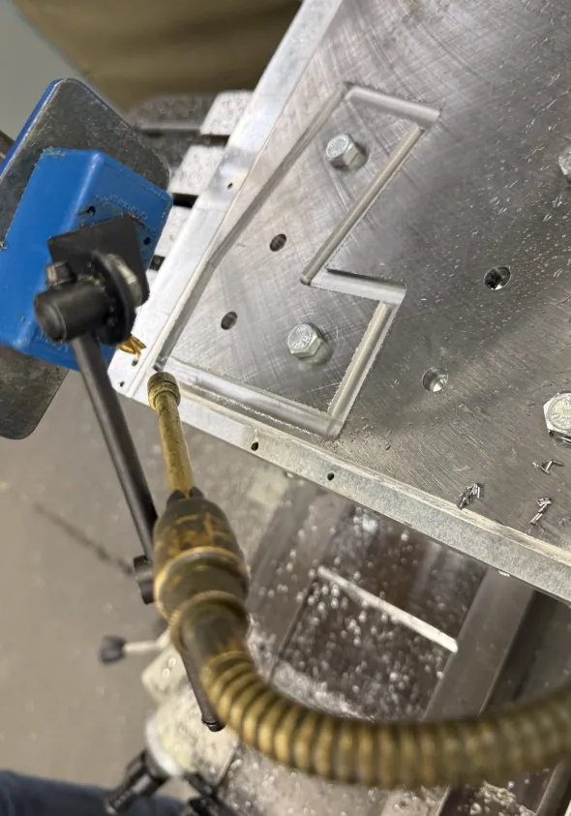
Manufacturing Progress
Manufacturing efforts well underway
  Machining brackets and gussets (plasma cut, mill)
  Base tubing and main axial members fitted together
Upcoming plans
  Machine octagonal plates, begin cage construction, igniter panel
Bracket Machining
Main Structure Progress

