Slide 1

Design and Fabrication of Battery Case with Integrated Internal Cooling Channels Using Binder Jetting Additive Manufacturing
Presenter & Lead Researcher
Henil Patel
Co-Author(s) - Amir Yahyaeian, Dr. Yue Zhou
Aerospace Engineering Department

Slide 2
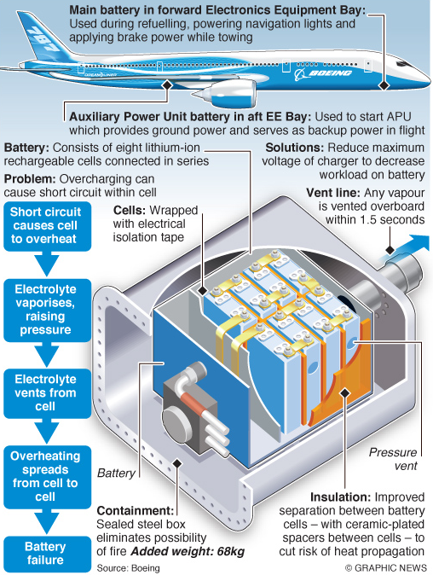

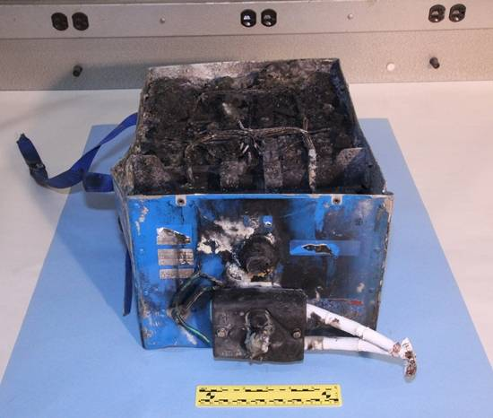
Background
1
[*] See references slide for all three image sources

Slide 3
Introduction
Thermal Management Device
Binder Jetting Additive Manufacturing
Materials
Design of a battery case with internal cooling channels that provide active cooling
Cost efficient production method
Batter case – Stainless steel
Coolant – Water
Fabricates complex internal channel geometries
2

Slide 4
Research Gaps
Little is known about additive manufacturing of thermal management devices using binder jetting method
Fewer studies have been performed that analyzes the shape for the cooling channels to optimize heat transfer efficiency
Fewer studies have been performed that simulates surface roughness and porosity into its CFD data and assess the performance difference
3

Slide 5
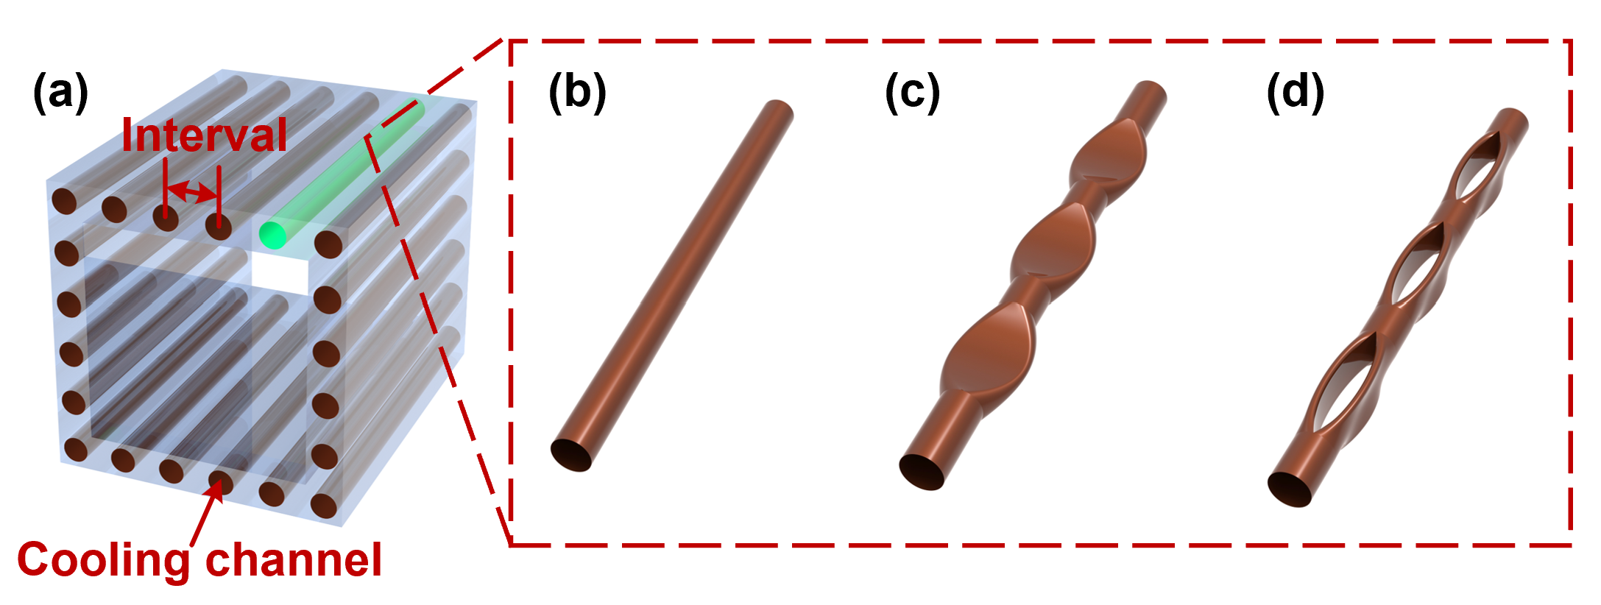
Research Goals
Optimizing the design of internal cooling channels.
  Maximizing the surface contact between fluid and battery case walls
  Maximizing the heat transfer
Identifying the shape with best heat-transfer efficiency
  Determining factors: velocity, temperature and pressure of fluid at inlet and outlet
4

Slide 6
Methodology Overview
Design & Simulation
Fabrication
Testing and Finalization
CAD Modelling of battery case and cooling channels
CFD simulation using ANSYS Fluent
Optimization of the channel designs
Binder Jetting Additive Manufacturing
Curing, debinding, and sintering of green parts
Final prototype of battery case
Micro-hardness and surface roughness measurements
Simulating the impact of surface roughness
Final Technical Report & Presentation
5

Slide 7
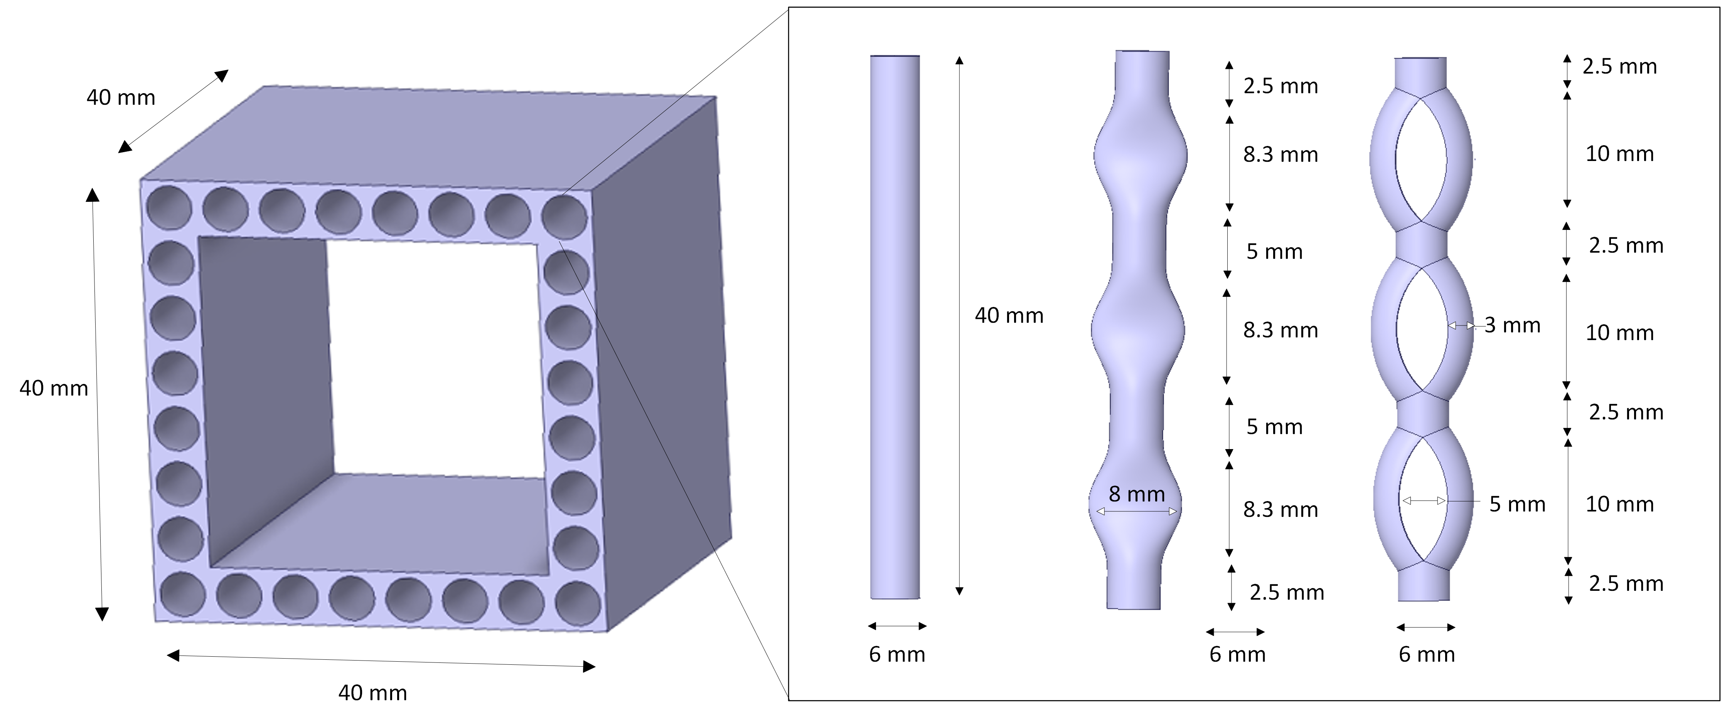
CAD Model - CATIA
Circular Bent Curved
6

Slide 8
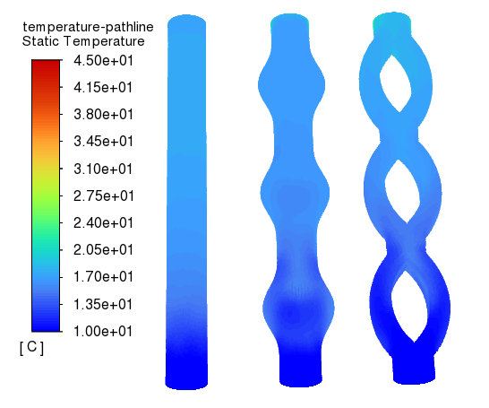
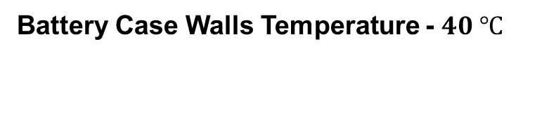
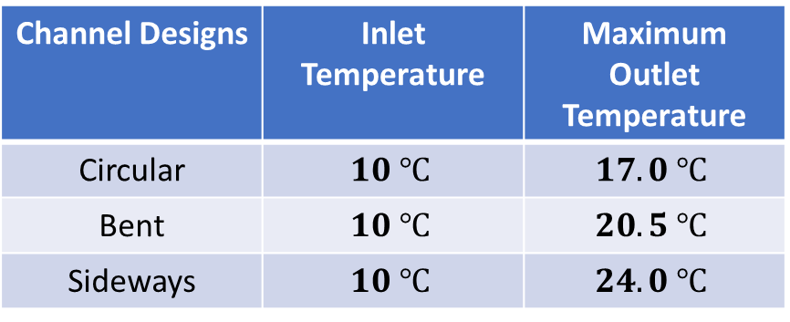
CFD Simulation - Temperature
Battery Case Walls Temperature - $40 ℃$
Channel Designs | Inlet Temperature | Maximum Outlet Temperature
Circular | $$10 ℃$$ | $$17.0 ℃$$
Bent | $$10 ℃$$ | $$20.5 ℃$$
Sideways | $$10 ℃$$ | $$24.0 ℃$$
Best Shape - Curved Channel Design
Maximum outlet temperature of coolant
Maximum coolant contact with surface walls
Net heat transfer rate – 1148 Watts
7

Slide 9
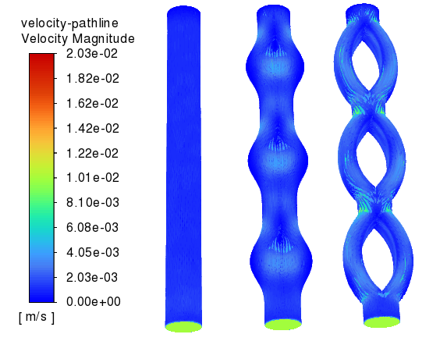

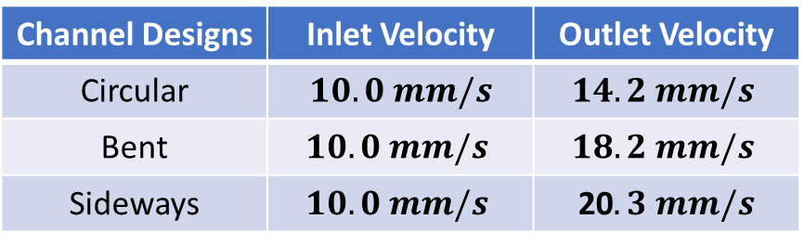
CFD Simulation - Velocity
Inlet Temperature of Water - $10 ℃$
Channel Designs | Inlet Velocity | Outlet Velocity
Circular | $$10.0 mm/s$$ | $$14.2 mm/s$$
Bent | $$10.0 mm/s$$ | $$18.2 mm/s$$
Sideways | $$10.0 mm/s$$ | 20$.3 mm/s$
Best Shape - Curved Channel Design
Maximum outlet velocity of coolant
Higher outlet velocity indicates increased flow rate: improved fluid contact with the surface.
Enhanced convection heat transfer
8

Slide 10
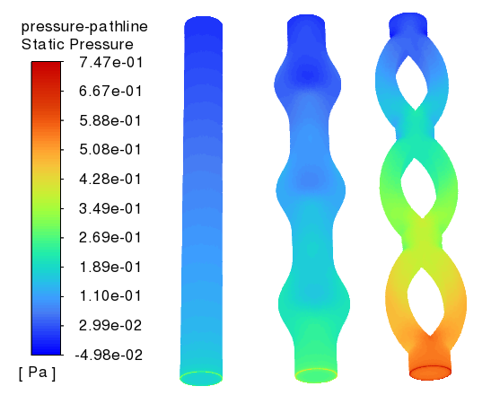
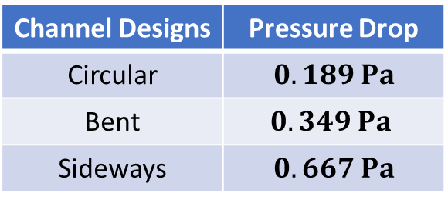
CFD Simulation - Pressure
Channel Designs | Pressure Drop
Circular | $$0.189 Pa$$
Bent | $$0.349 Pa$$
Sideways | $$0.667 Pa$$
Best Shape - Curved Channel Design
Highest pressure drop at the outlet
High pressure (back pressure) at pt. A
Higher pressure creates more resistance to flow, causing the coolant to move slower, hence better heat absorbance.
9

Slide 11
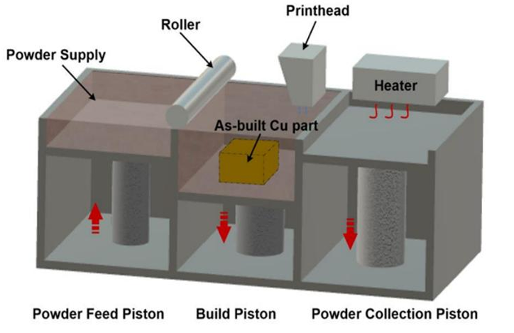
Binder Jetting Additive Manufacturing
10

Slide 12
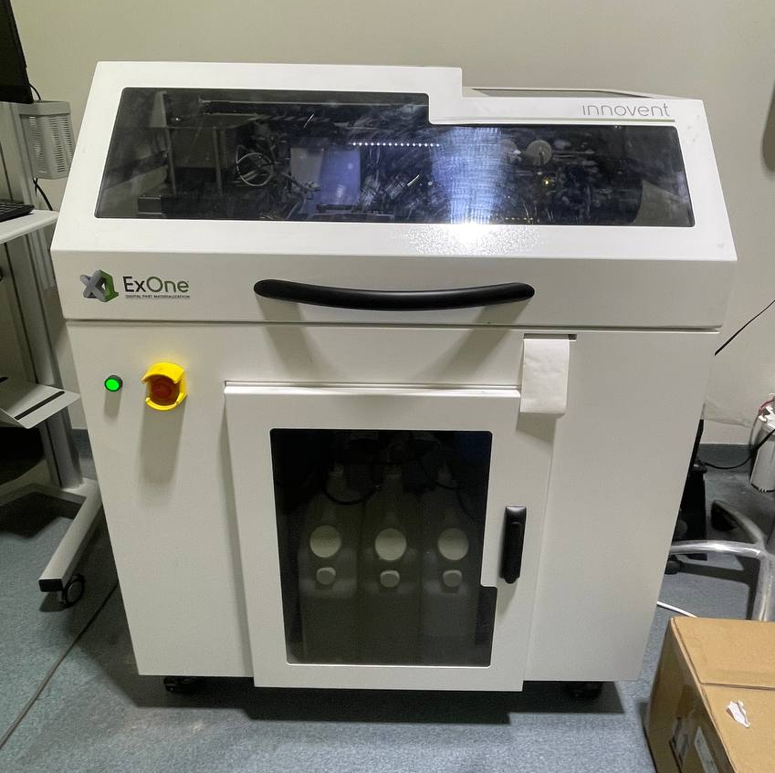
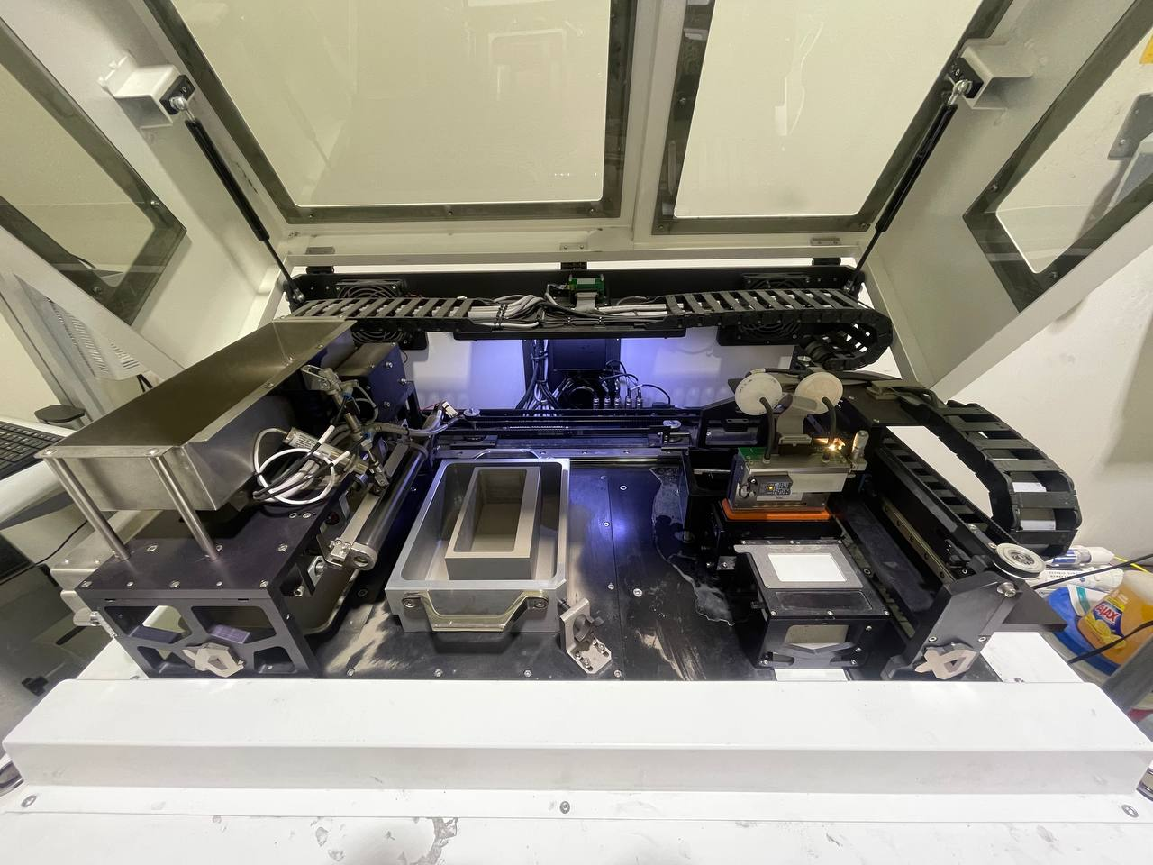
Binder Jetting Additive Manufacturing
Binder, Cleaner, Waste Storage
Powder Supply Roller Build bed Binder & Printhead
11

Slide 13
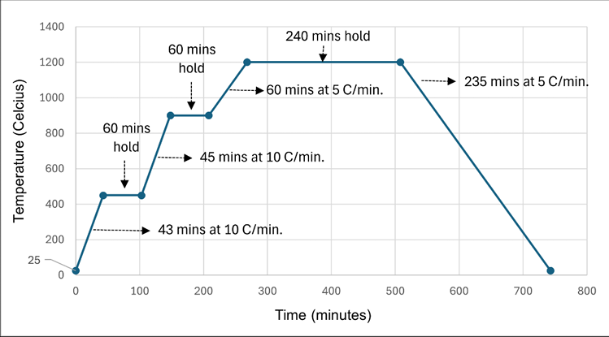
Sintering Profile
12

Slide 14
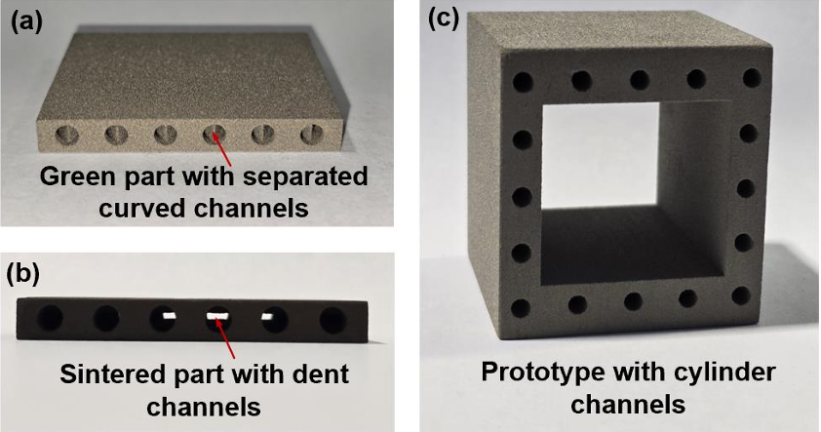
Binder Jetting Printed Parts
13

Slide 15
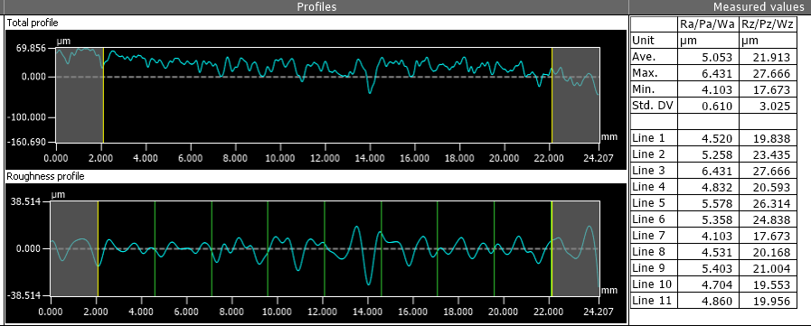
Roughness Analysis Profilometer Results
Average Surface Roughness = 21.9 $μm$
Due to Roughness: Pressure Drop ; Coolant Velocity
14

Slide 16
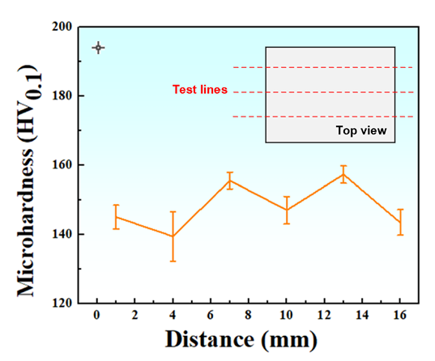
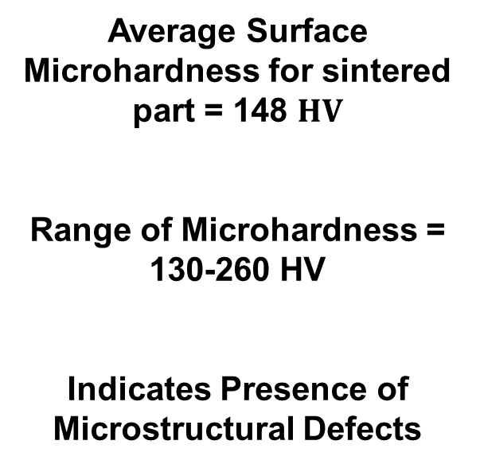
Microhardness Test
Average Surface Microhardness for sintered part = 148 $HV$
Range of Microhardness = 130-260 HV
Indicates Presence of Microstructural Defects
15

Slide 17
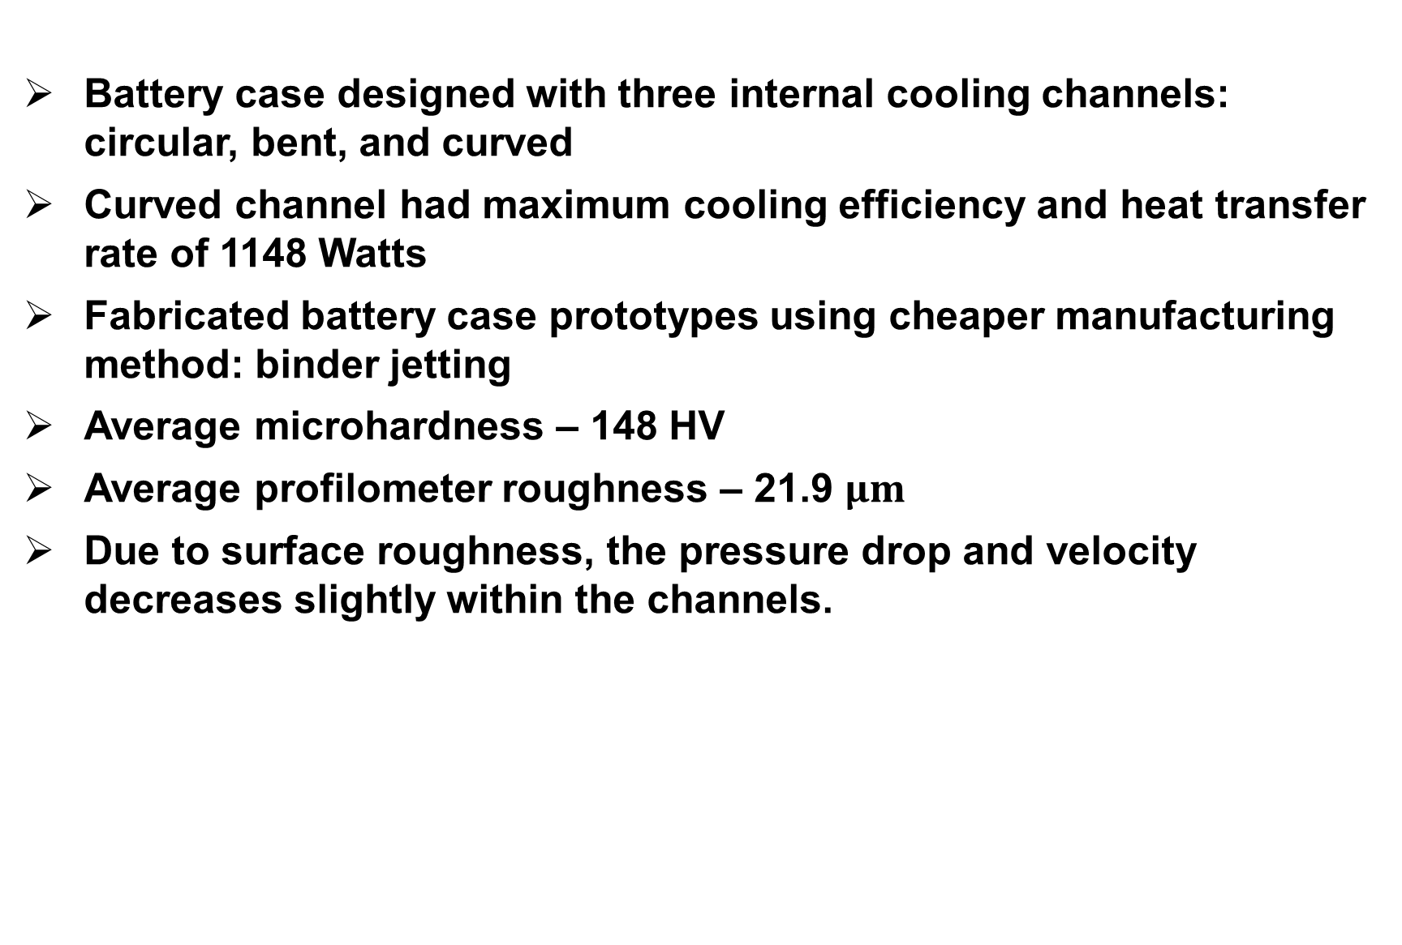
Conclusion
Battery case designed with three internal cooling channels: circular, bent, and curved
Curved channel had maximum cooling efficiency and heat transfer rate of 1148 Watts
Fabricated battery case prototypes using cheaper manufacturing method: binder jetting
Average microhardness – 148 HV
Average profilometer roughness – 21.9 $μm$
Due to surface roughness, the pressure drop and velocity decreases slightly within the channels.
16

Slide 18
Next Steps
Expand prototype design to real-world application for airplane batteries
Analyze the impact of varying the sizes, diameters, and dimensions of the cooling channels
Analyze the impact of varying number of integrated cooling channels in the battery case
Optimize the cooling efficiency and pumping power consumption of the battery case
Modify the process parameters for binder jetting to obtain high-density metallic parts
17

Slide 19

THANK YOU
Questions?
Henil Patel
patelh27@my.erau.edu

Slide 20
References
[*] Sources for images used on slide 2
https://www.nbcnews.com/business/travel/boeing-787-battery-fire-was-difficult-control-flna1c8754339
https://www.theregister.com/2013/01/17/faa_grounds_boeing_787_batteries/
https://engtechmag.wordpress.com/2013/03/19/boeing-dreamliner-787-battery-fix-an-annotated-graphic/
18

