Slide 1
Mitigating Orbital Debris
Caelan Wommack
AIAA Region II Student Conference, April 2-4
Copyright © by Caelan Wommack
Published by the American Institute of Aeronautics and Astronautics, Inc., with permission.

Slide 2

Mitigating Orbital Debris
Why is orbital debris a pressing issue?
  Kessler Syndrome leading to collisions
  Protection of operational objects in space and future missions

Slide 3
Mitigating Orbital Debris
Active Debris Removal (ADR)
  Mitigation techniques, mostly in developmental stages
  Can be divided into contact and noncontact ADRs
  Important to assess which ADRs are most effective and feasible for the future of space exploration

Slide 4
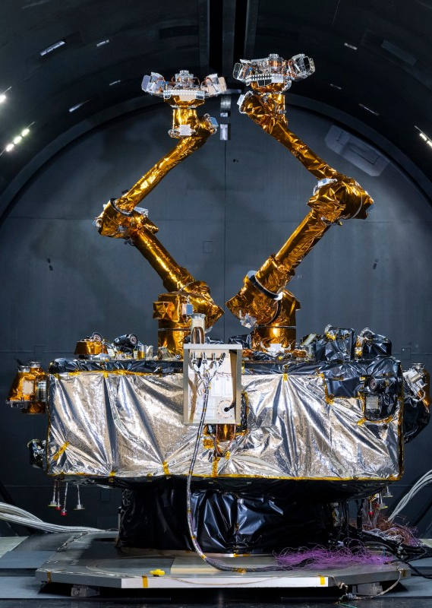
Mitigating Orbital Debris
Contact-based ADRs – Robotic arms
  Arm deorbits the debris or transfers it to another system for disposal
  High accuracy, requires sophisticated GNC systems for successful docking
  Northrop Grumman’s MEV/MRV shows success of this technology in a similar context

Slide 5
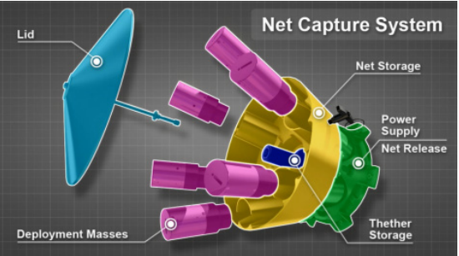
Mitigating Orbital Debris
Contact-based ADRs – Nets
  Nets deploy from a spacecraft and tighten around object
  ESA’s RemoveDEBRIS mission demonstrated this method
  Challenges included precise deployment and ensuring debris remains contained

Slide 6
Mitigating Orbital Debris
Contact-based ADRs – Harpoon
  Harpoons fire a projectile into debris, securing it with barbs or tethers
  ESA’s RemoveDEBRIS mission successfully tested this method
  Challenges include avoiding unintended fragmentation and ensuring target stability

Slide 7
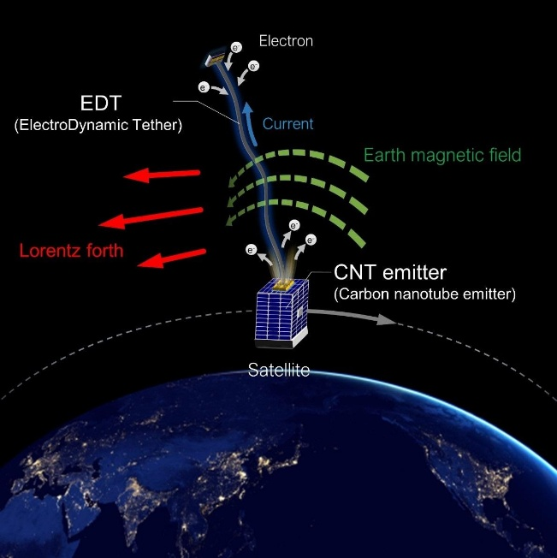
Mitigating Orbital Debris
Contact-based ADRs – Electrodynamic tethers (EDTs)
  EDTs use conductive tethers to generate Lorentz forces, enabling fuel-free deorbiting
  Simulations done by JAXA
  Challenges include ensuring tether reliability

Slide 8
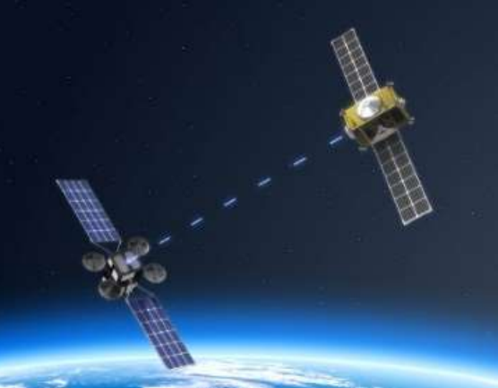
Mitigating Orbital Debris
Noncontact-based ADRs – Lasers
  Lasers induce surface ablation, creating a force that alters a debris object’s orbit
  ESA is developing a laser-equipped deorbit satellite, will start service in 2026
  Challenges include high power demands and precise targeting

Slide 9
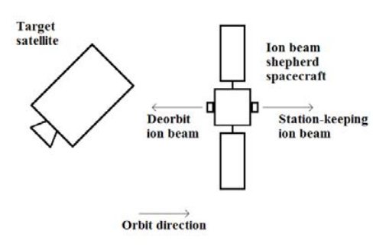
Mitigating Orbital Debris
Contact-based ADRs – Ion Beam Shepherd technique
  Ion thrusters apply a continuous force to alter the orbit of debris
  Half of onboard propellant needed for counteracting the force, limiting efficiency
  Future developments may use ambient atmospheric gases as fuel

Slide 10
Mitigating Orbital Debris
Noncontact-based ADRs – Electromagnetic manipulation
  An adaptable electromagnet can selectively target debris while avoiding operational satellites
  Challenges include handling non-magnetic debris and optimizing energy consumption

Slide 11
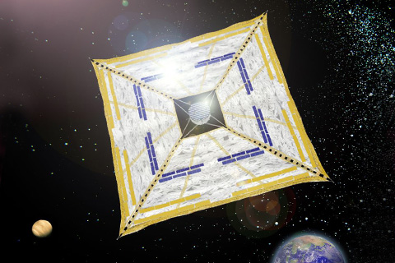
Mitigating Orbital Debris
Noncontact-based ADRs – Solar sails
  Solar sails use solar radiation pressure to alter debris orbits for reentry
  Inspired by missions like JAXA’s IKAROS
  Challenges include deployment complexity and long-term durability in space

Slide 12
Mitigating Orbital Debris
Policy Frameworks for Space Debris Management
  International collaboration is crucial, with growing support for binding regulations on debris mitigation
  UN’s COPUOS guidelines promote debris prevention, proper disposal, and collision avoidance
  ESA’s Space Surveillance and Tracking system enhances debris monitoring and collision prevention

Slide 13
Mitigating Orbital Debris
Conclusion
  A combination of contact and non-contact ADR methods will be needed for effective debris removal
  Global cooperation and stronger regulations are essential
  By integrating technology and policy, we can protect Earth’s orbit for future space exploration

