Slide 1


REAL TIME OPERATING SYSTEMS IN ACTIVE CONTROLLED ROCKETS
Kanav Chugh, Sam Peterson,
Felipe Martins
Guidance, Navigation and Control
Ramblin’ Rocket Club
Georgia Institute of Technology

Slide 2

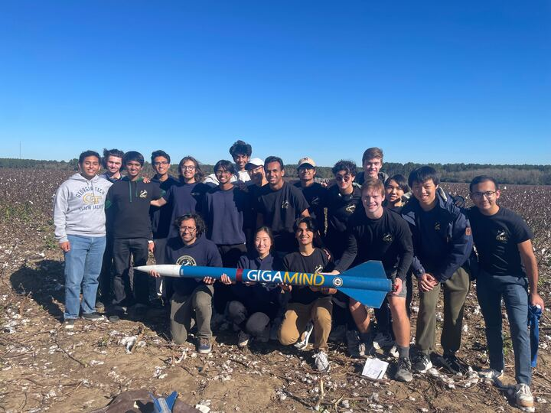
GEORGIA TECH GUIDANCE, NAVIGATION, AND CONTROL
WHO WE ARE
Mission for 2024-25
To become the first collegiate team to utilize jet vanes in a rocket launch.

Slide 3
SOFTWARE REQUIREMENTS
  Data Logging - Writing flight data to storage device
  Sensor Data - Communicating with sensors to receive data
  Controls - Running controls algorithm to update actuator positions
  State Estimation - Predicting position and velocity from sensor data
  Telemetry - Communicating with ground station to command and track rocket

Slide 4
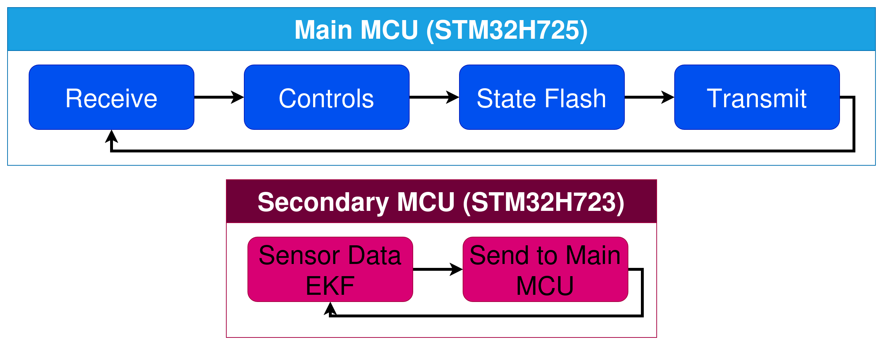
SOFTWARE REQUIREMENTS
  Data Logging - Writing flight data to storage device
  Sensor Data - Communicating with sensors to receive data
  Controls - Running controls algorithm to update actuator positions
  State Estimation - Predicting position and velocity from sensor data
  Telemetry - Communicating with ground station to command and track rocket
*MCU = Microcontroller

Slide 5
PROBLEMS OF TRADITIONAL ROCKET SOFTWARE
  Latency - Tasks are completed sequentially
  Scheduling - How can we run tasks at different time intervals?
  Polling - Wasting time checking status of hardware

Slide 6
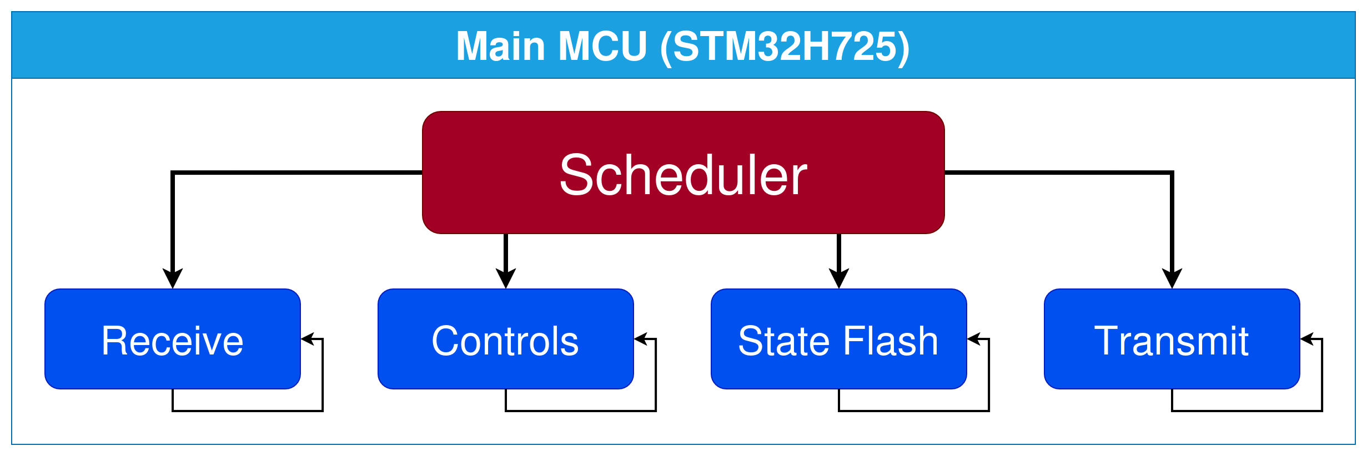
SOLUTION: CONCURRENT LOOPS
  Multiple concurrent loops with:
    Variable priority levels
    Data synchronization
    Defined latencies

Slide 7
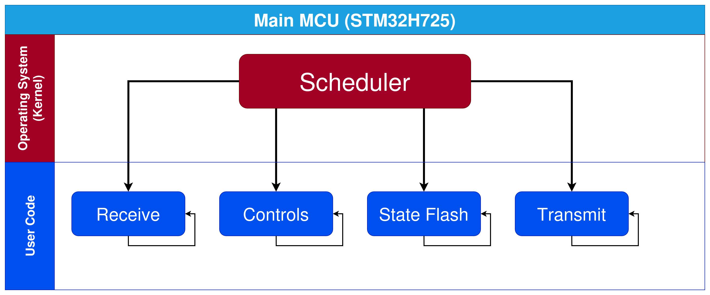
REAL-TIME OPERATING SYSTEMS (RTOS)
  Operating System (OS) - Handles system hardware and task execution
  User Code - Flight software split into tasks
  Real-Time Operating System (RTOS) - OS specialized for time-sensitive applications

Slide 8
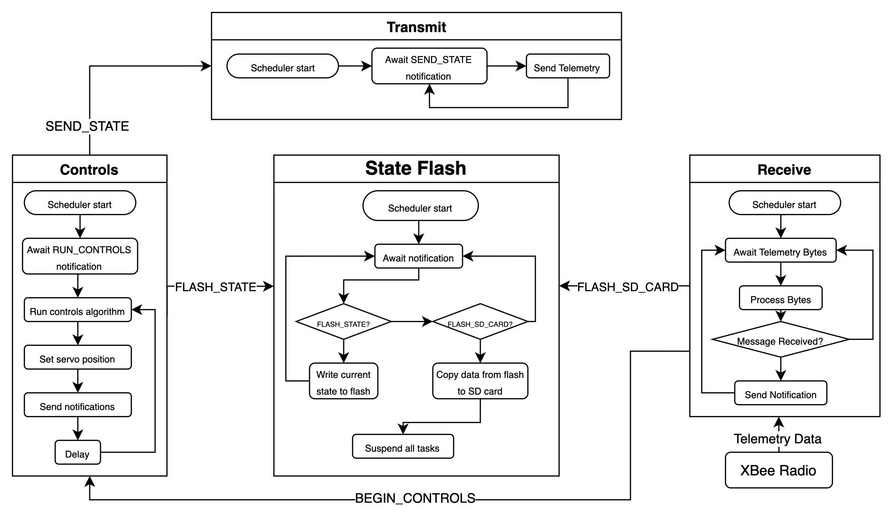
DETAILED TASK ARCHITECTURE

Slide 9
DETAILED TASK ARCHITECTURE

Slide 10
DETAILED TASK ARCHITECTURE

Slide 11
DETAILED TASK ARCHITECTURE

Slide 12
COMPONENTS OF AN RTOS
  Tasks - Concurrent functions that the RTOS executes
    Priority levels
    Task-to-task communication
  Scheduler - Controls which tasks run and when
  Context Switching - Process of switching between tasks

Slide 13
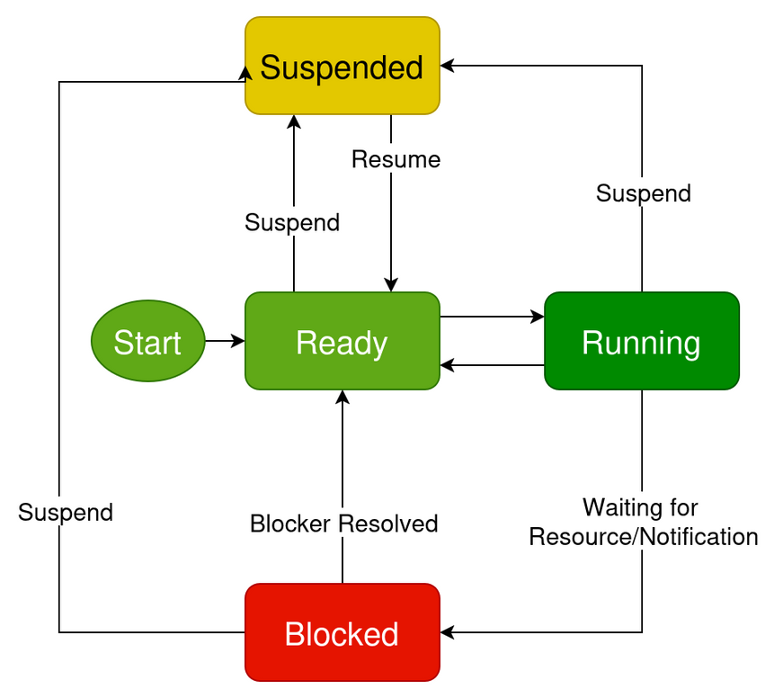
TASKS
Concurrent functions that the RTOS executes
Scheduler controls the task state:
  Ready - Has resources to execute and is waiting for its turn to run
  Running - Actively executing in CPU (only one task at a time)
  Blocked - Waiting for some event
  Suspended - User code can suspend/resume tasks

Slide 14
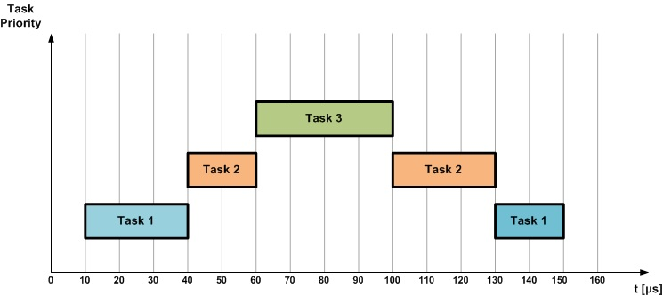
SCHEDULER
Controls which tasks run and when
  Each task has a Priority Level
    Tasks with higher priority are given preference to execute
    Ensure time-critical tasks are completed on time

Slide 15
CONTEXT SWITCHING
Process of switching between tasks
  Context - Position in user code / values of variables
  Context Switch - Scheduler saves current task’s context and restores next task’s context

Slide 16
INTEGRATION ON HIGH-POWER ROCKET

Slide 17

ROCKET INFORMATION
November 2024 Launch of High-Powered Avionics Test Rocket
Parameter | RTOS Approach
Class of Rocket | L2
Microcontrollers | STM32H725 (RTOS) STM32H723 (State Estimation)
Sensors | IMU, GPU, Barometer
Telemetry | XBee Radio
Storage Devices | Flash Chip, SD Card
Apogee | 1700 ft

Slide 18
GENERAL RESULTS
Parameter | RTOS Approach | No RTOS Approach*
Throughput | 3025 DMIPS** | 1210 DMIPS**
Sensor Latency | 187 ns | 5 ms
Telemetry Latency | 3 ms | 50 ms
Flash Latency | 100 ns | 50 ms
Telemetry Data Loss | 3.2% | 25%
Flash Data Loss | 0% | 70%
*Data collected from previous rocket launch in February 2024 with no RTOS
**Dynamic Million Instructions Per Second (DMIPS): Millions of CPU operations per second

Slide 19
SENSOR PERFORMANCE
Sensor Performance Metric | RTOS Approach | No RTOS Approach*
IMU Bias | 0.01 m/s^2 | 1.5 m/s^2
IMU Sampling Rate | 9600 Hz | 100 Hz
IMU Protocol | 3 MHz (SPI) | 400 kHz
GPS Sampling Rate | 30 Hz | N/A
GPS Protocol | 921600 Baud (UART) | N/A
Barometer Sampling Rate | 200 Hz | 182 Hz
Barometer Protocol Speed | 1 MHz (SPI) | 400 kHz
*Data collected from previous rocket launch in February 2024 with no RTOS

Slide 20
STATE ESTIMATION AND CONTROLS
Performance Metric | RTOS Approach | No RTOS Approach*
Real vs Estimated Position | ~10% | ~50%
EKF Frequency | 50 Hz | 10 Hz
Real vs Estimated Quaternion | ~5% | ~25%
Quaternion Frequency | 25 Hz | 10 Hz
Real vs Estimated Actuation | ~5% | ~30%
LQR Frequency | 20 Hz | 10 Hz
*Data collected from previous rocket launch in February 2024 with no RTOS
  EKF (Extended Kalman Filter): Position and velocity estimation from sensor data
  Quaternion: Mathematical representation of 3D rotation
  LQR(Linear Quadratic Regulator): Control algorithm for actuators

Slide 21
CONCLUSION
  Flight results confirm RTOS significantly improves avionics performance of subscale rocketry
    Telemetry - Higher throughput and less data loss
    Data Logging - Higher throughput and less data loss
    State Estimation - Higher frequency and more accurate
  Future work
    Implementation on different microcontrollers

Slide 22


THANK YOU

