Slide 1



Aerodynamic Analysis of a High-Powered, Multi-Stage Rocket
Jason Rupram
Parker Blenk

Slide 2
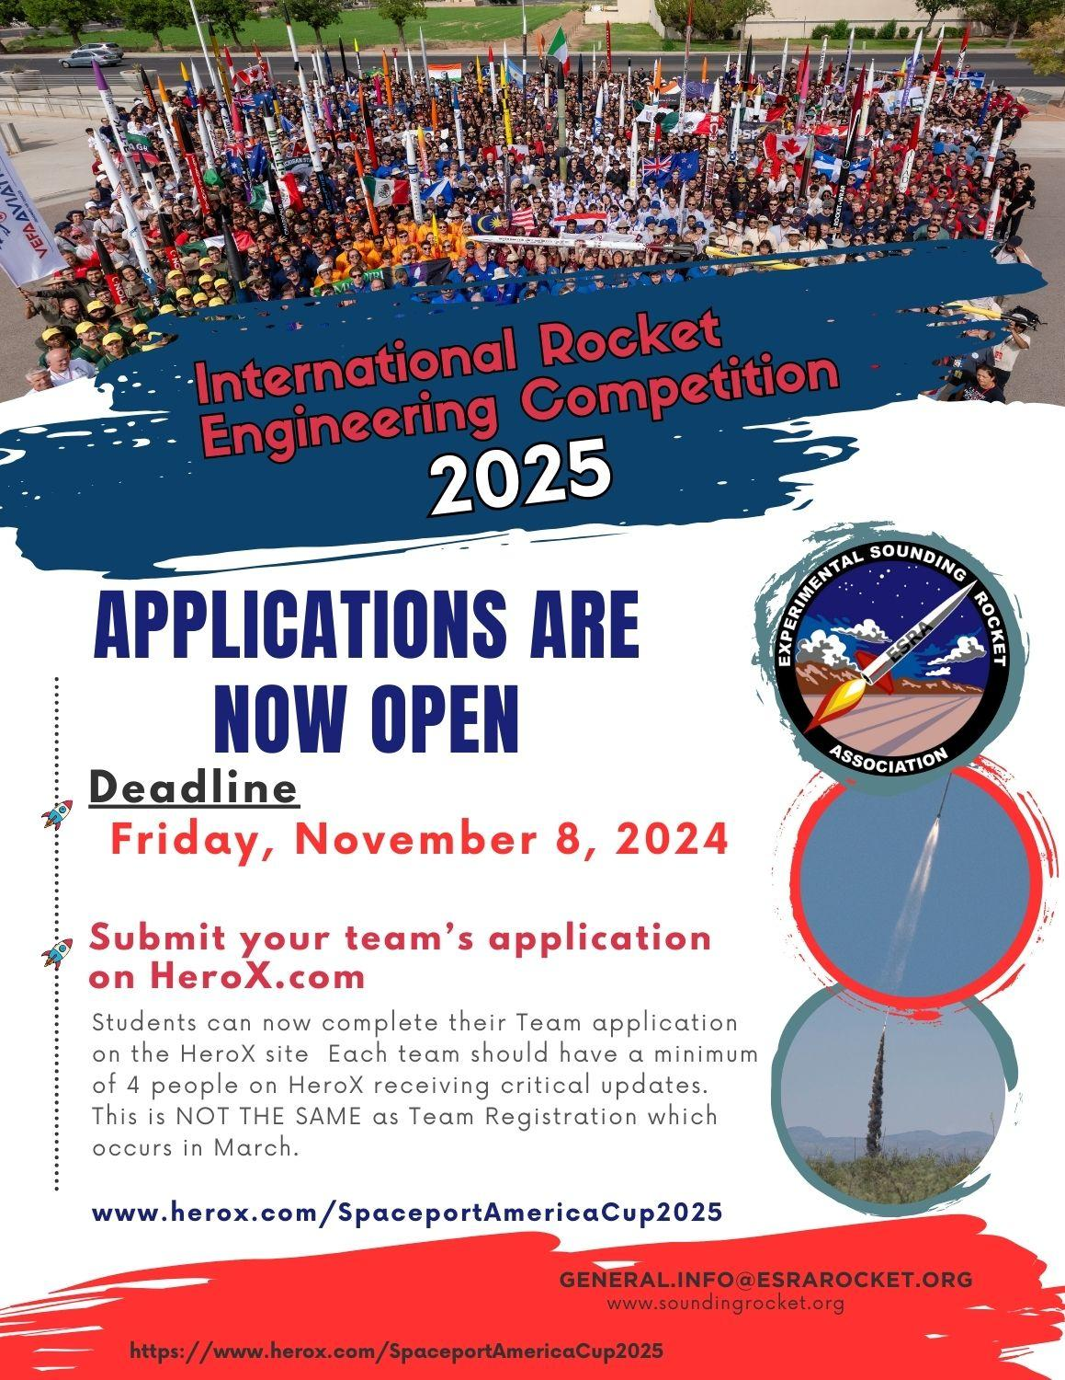
Competition Overview
Rocketry Association, Experimental Sounding Rocket Association (ESRA), hosts the Intercollegiate Rocket Engineering Competition (IREC).
  IREC : Create a rocket that balances performance, stability, and safety.
  Category: Commercial off the Shelf (COTS) : 10,000 Ft. Apogee.
  Systems Engineering: Teamwork and Integration.
Fig 1: IREC Information

Slide 3
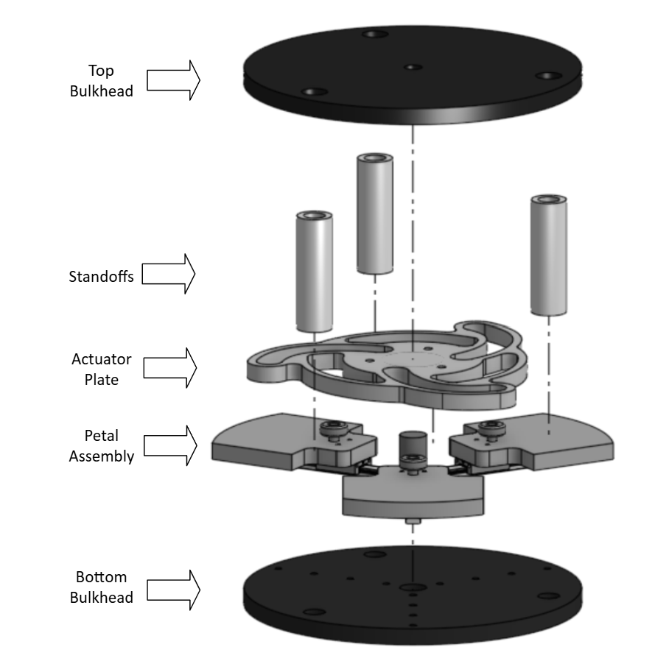
UGA IREC Background
Focus on Airbrake design and integration.
  Airbrakes help control max apogee.
Student Research and Development (SRAD) scoring criteria is benefited.
3-petal design which deploys linearly and radially outwards via servo motor.
Fig 2: Airbrakes Diagram

Slide 4
Objective
Analyze the effectiveness of the airbrakes in controlling the rocket’s velocity, trajectory, and apogee during flight.
  Leverage Computational Fluid Dynamics (CFD) to develop accurate predictions of aerodynamic characteristics.
Inform design team about petal sizing.
Compile drag data at different Mach and altitude and use for flight predictions.

Slide 5
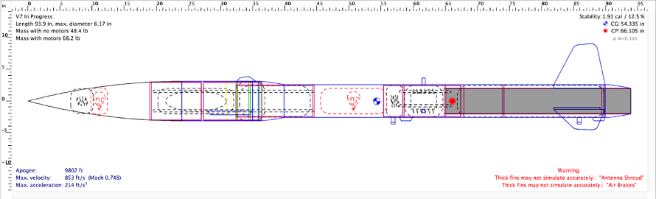
Current Limitations
OpenRocket is a widely accepted simulation tool, used for low-fidelity flight dynamics.
  Uses a 6 Degree of Freedom, 4th-Order Runge-Kutta method - inaccurate for high-speed, complex, turbulent flows.
ANSYS uses Reynolds-Averaged Navier Stokes (RANS) equations.
Airbrakes: Chaotic, High turbulence.
Fig 3: OpenRocket IREC Model

Slide 6
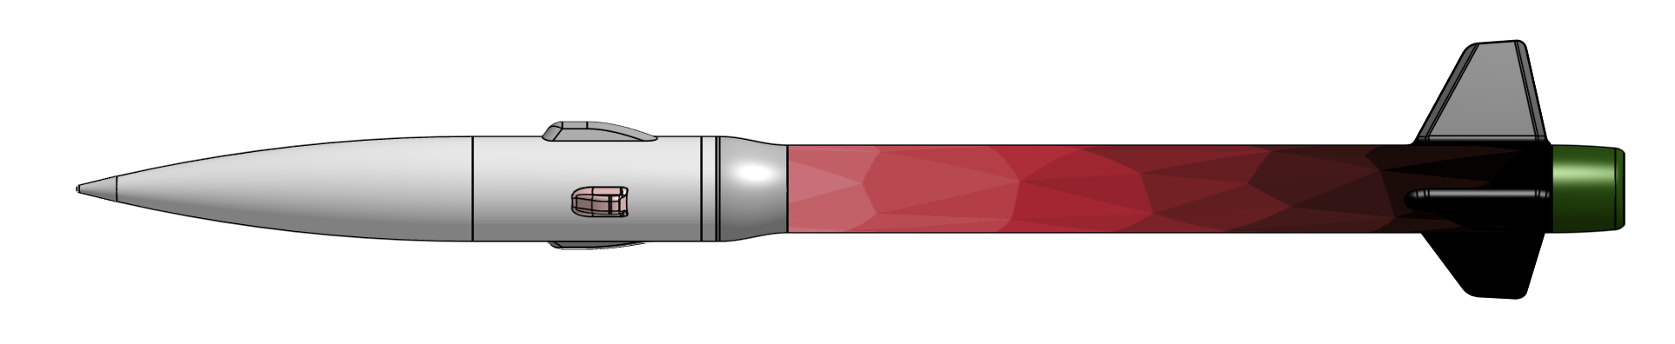
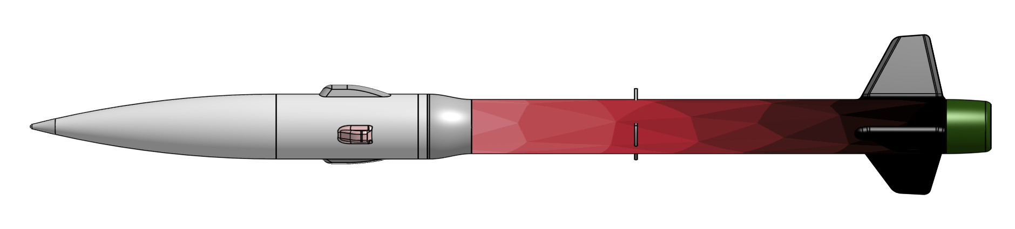
Rocket Geometry
Computer-aided design (CAD) software, OnShape: Rocket models.
6-inch airframe, spanning a total of 1 foot, as well as a 5-inch airframe, totaling 4.5 feet.
  Connected through a transition Von Karman cone.
Fin parameters:
  Distance between root chord and tip chord = 6.41 in
Total length = 8’-3”
Camera housing for video use
Antenna shroud
Fig 4: No Airbrakes Rocket Model
Fig 5: Airbrakes Rocket Model
Notes:
TALK ABOUT SIMPLIFICATIONS

Slide 7
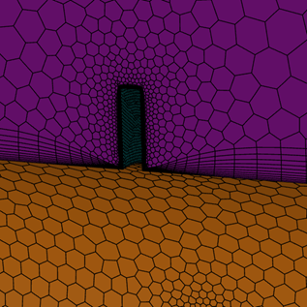

CFD Setup-Meshing
Rocket geometry cut into small sections. Calculations occur in each section.
Local sizings around intricate sections.
Accurate boundary layer representation.
Volume mesh over 6 million cells.
Fig 6: Mesh Refinement Around Airbrakes
Fig 7: Polyhedral Mesh
Notes:
TALK ABOUT REGIONING AND LOCAL SIZING

Slide 8
Table 1: Turbulence Model Weight Chart
CFD Setup-
Turbulence Model
Criterion | Spalart–Allmaras | k–ω SST | k–ε | LES
Computational Cost | 5 | 3 | 3 | 1
Near-Wall Accuracy | 2 | 5 | 1 | 5
Separation Prediction | 2 | 4 | 1 | 5
Adverse Pressure Gradient Handling | 2 | 4 | 1 | 5
Compressible Flow Accuracy | 4 | 4 | 2 | 4
Stability / Robustness | 4 | 4 | 4 | 2
Overall Suitability for Airbrakes | 3 | 5 | 2 | 4
Total | 22 | 29 | 14 | 26
Adopted the k–ω SST (Shear Stress Transport) turbulence model. Density-based solver.
Steady-state simulation
Boundary conditions:
  Pressure far-field: 98000 Pa
  Temperature: 298 K
  Velocity: Mach 0.8
  No-slip wall condition
Sutherland’s Law to model fluid viscosity.
Notes:
WHY K OMEGA AND NOT OTHER SOLVERS

Slide 9
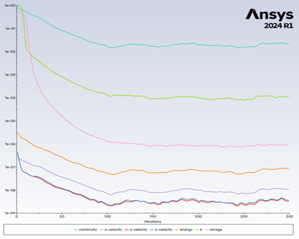
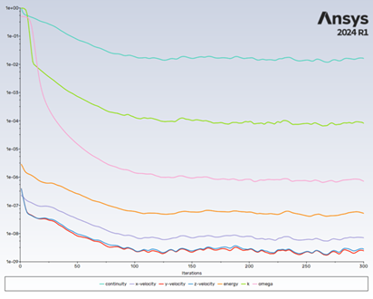
Residuals
Both models were ran for 300 iterations.
Full convergence in the residuals were demonstrated around ~115 iterations.
Fig 8: No Airbrakes Convergence
Fig 9: Airbrakes Convergence
Notes:
WHY K OMEGA AND NOT OTHER SOLVERS

Slide 10
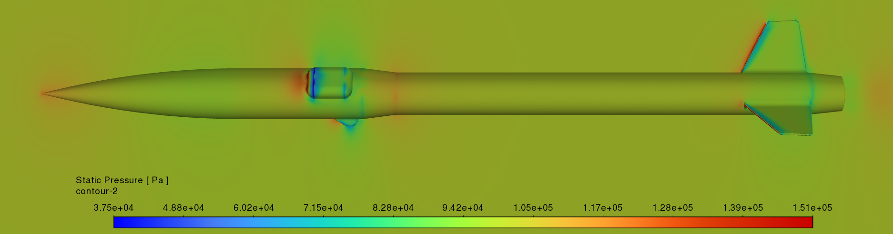
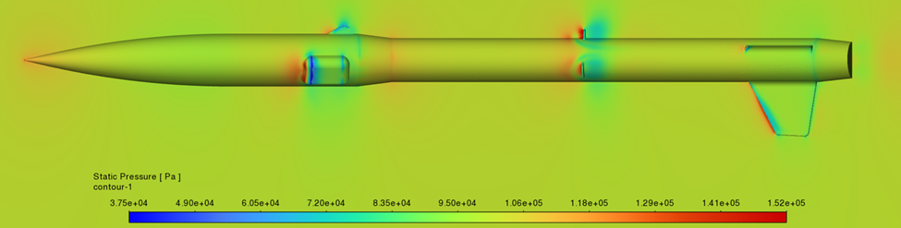
Interpreting CFD Results
High-pressure stagnation point
Fig 10: Static Pressure Contour w/o Airbrakes
Low-pressure wake behind airbrakes
Fig 11: Static Pressure Contour w/ Airbrakes

Slide 11
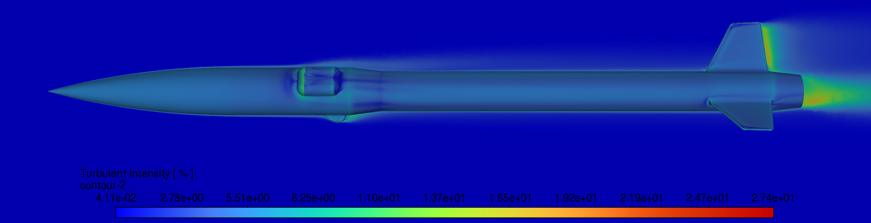
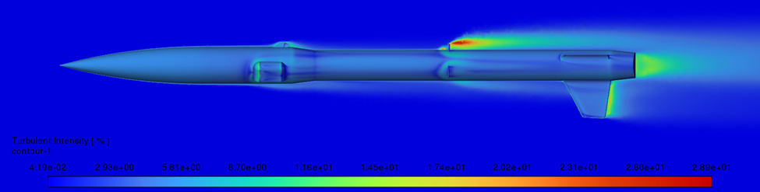
Interpreting CFD Results
Fig 12: Turbulence Intensity % w/o Airbrakes
Introduction of airbrakes elevated turbulence intensity and drastically increased flow separation
Fig 13: Turbulence Intensity % w/ Airbrakes

Slide 12

Interpreting CFD Results
Low pressure region is generated. Pressure differential promotes drag.
Increased pressure drag due to backflow.
Solution: Tailcone can be altered to reduce pressure drag and avoid flow separation.
Fig 14: Particle Pathlines over Airbrakes & Tailcone

Slide 13
Data Comparison
These discrepancies highlight OpenRocket’s tendency to overestimate drag in highly turbulent flow regions.
Emphasizes the need for high-fidelity CFD analysis.
Table 2: C_{D} Comparison
Analytical Model | OpenRocket | ANSYS | Percent Difference
Retracted AB C_{D} | 0.513 | 0.275 | 60.41
Fully Deployed AB C_{D} | 0.770 | 0.395 | 64.38

Slide 14
Discussion
Fully deploying the airbrakes increased the total drag coefficient by ~0.12.
Drag force calculated on each airbrake is ~32 lbf.
  Will be useful for Finite Element Analysis (FEA) on airbrakes.
    Stress analysis, total deflection
  Motor sizing for deployment.
Design constraints had an impact on the total drag created by the airbrakes.
  Reduced effective area of the airbrake petals due to manufacturing limitations.
  Interference from antenna shrouds.

Slide 15
Future Work
Current and most recent work has been spent creating high-fidelity CFD models of both rockets at various Mach numbers and angles of attack.
  Analyze the effect of weather cocking.
  Study the effect of the airbrakes at various positions from the body tube.
No current validation studies have been completed, however, first flight test is currently scheduled for April 12th.

Slide 16
Questions?
Thank you!

