Slide 1

A Practical Approach to Plate-Solving of Astronomical Images Based on Least-Squares Estimation
Cindy Uyen Chi Nguyen and Thomas Alan Lovell
Embry-Riddle Aeronautical University
2025 Region II Student Conference, 3 April 2025 – 4 April 2025
Copyright © by Embry-Riddle Aeronautical University
Published by the American Institute of Aeronautics and Astronautics, Inc., with permission.

Slide 2
A Practical Approach to Plate-Solving of Astronomical Images Based on
Least-Squares Estimation
Plate-Solving
  Registration of an astronomical image
  Direction and spacecraft attitude determination
Common Methodologies
  Compare stars in an image with a known database of simulated images with assumed fields of view
  Match the real image with the database image, typically through a blind search with significant runtime
  Decreased runtime can be achieved through an established direction and orientation
  Astrometry: Most widely-used application for plate-solving

Slide 3
A Practical Approach to Plate-Solving of Astronomical Images Based on
Least-Squares Estimation
Camera and Star Unit Vectors
Direction Cosine Matrix (DCM)
Wahba's Problem
$${\hat{u}}_{CAM}=\left[\begin{matrix}{\left.{\hat{u}}_{1}\right|}_{CAM} & {\left.{\hat{u}}_{2}\right|}_{CAM} & {\left.{\hat{u}}_{3}\right|}_{CAM}\end{matrix}\right]$$
$${\hat{u}}_{J2K}=\left[\begin{matrix}{\left.{\hat{u}}_{1}\right|}_{J2K} & {\left.{\hat{u}}_{2}\right|}_{J2K} & {\left.{\hat{u}}_{3}\right|}_{J2K}\end{matrix}\right]$$
$$Q_{CAM}^{J2K}=\left[\begin{matrix}{\left.{\hat{u}}_{1}\right|}_{J2K} & {\left.{\hat{u}}_{2}\right|}_{J2K} & {\left.{\hat{u}}_{3}\right|}_{J2K}\end{matrix}\right]∗{\left[\begin{matrix}{\left.{\hat{u}}_{1}\right|}_{CAM} & {\left.{\hat{u}}_{2}\right|}_{CAM} & {\left.{\hat{u}}_{3}\right|}_{CAM}\end{matrix}\right]}^{−1}$$
$$J\left(Q_{CAM}^{J2K}\right)=\frac{1}{2}\sum_{k=1}^{N}{a_{k}{\left|{\hat{u}}_{J2K}−Q_{CAM}^{J2K}{\hat{u}}_{cam}\right|}^{2}}$$

Slide 4
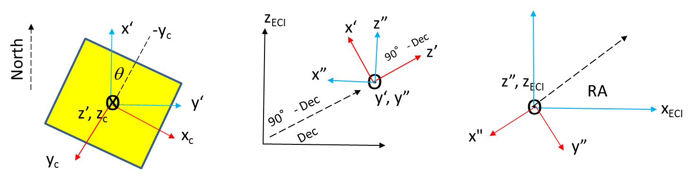
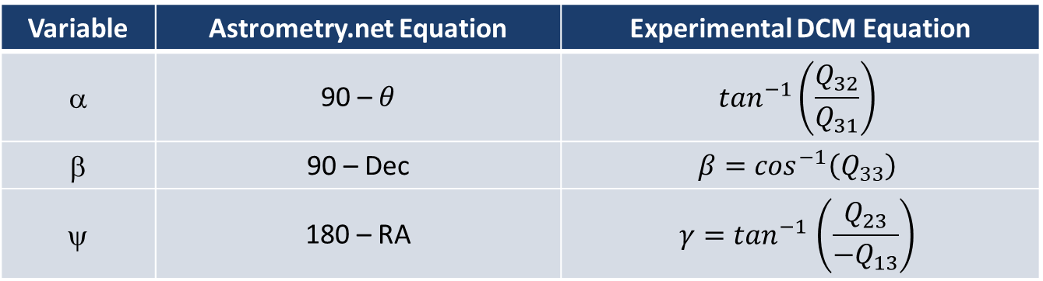
A Practical Approach to Plate-Solving of Astronomical Images Based on
Least-Squares Estimation
Euler Angles
Variable | Astrometry.net Equation | Experimental DCM Equation
α | 90 – $θ$ | $$\tan^{−1}\left(\frac{Q_{32}}{Q_{31}}\right)$$
β | 90 – Dec | $$β=\cos^{−1}\left(Q_{33}\right)$$
ψ | 180 – RA | $$γ{=tan}^{−1}\left(\frac{Q_{23}}{{−Q}_{13}}\right)$$

Slide 5
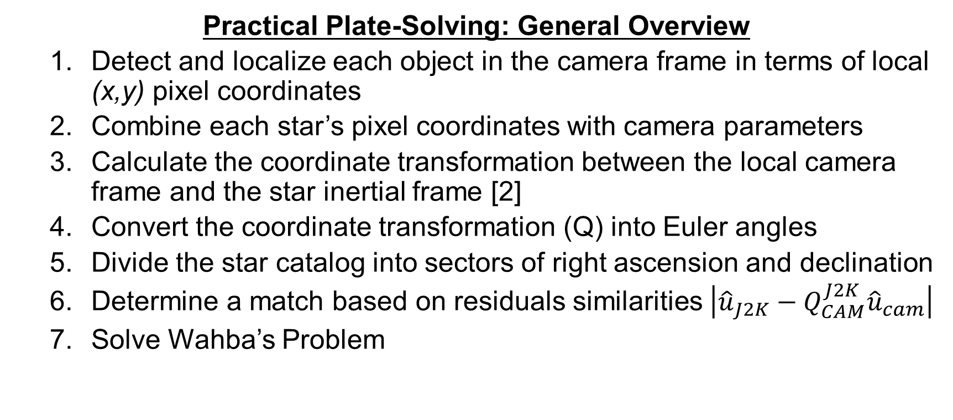
A Practical Approach to Plate-Solving of Astronomical Images Based on
Least-Squares Estimation
Practical Plate-Solving: General Overview
  Detect and localize each object in the camera frame in terms of local (x,y) pixel coordinates
  Combine each star’s pixel coordinates with camera parameters
  Calculate the coordinate transformation between the local camera frame and the star inertial frame [2]
  Convert the coordinate transformation (Q) into Euler angles
  Divide the star catalog into sectors of right ascension and declination
  Determine a match based on residuals similarities $\left|{\hat{u}}_{J2K}−Q_{CAM}^{J2K}{\hat{u}}_{cam}\right|$
  Solve Wahba’s Problem

Slide 6
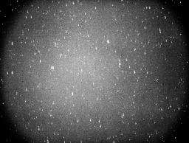
A Practical Approach to Plate-Solving of Astronomical Images Based on
Least-Squares Estimation
Method: Vector Selection
Plate-solve an image using Astrometry, obtaining the “corr.fits” file
Use the output to calculate camera and star unit vectors for 7 stars
For the first 7 stars in the list, convert each image centroid into a camera frame unit vector and convert each catalog RA and Dec into a J2000 unit vector

Slide 7
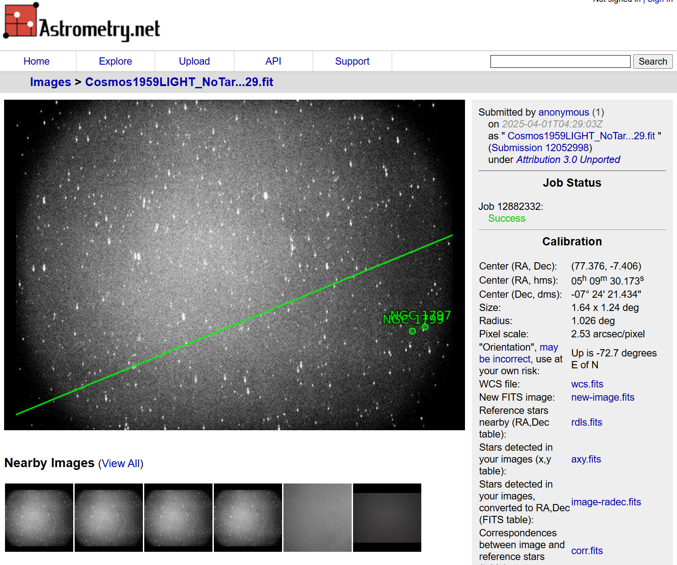
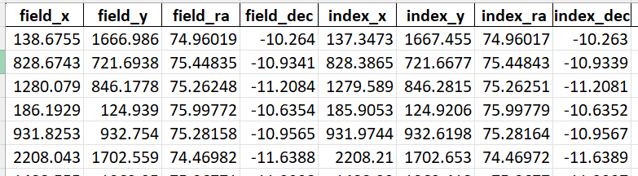
A Practical Approach to Plate-Solving of Astronomical Images Based on
Least-Squares Estimation
Astrometry.net Solution
Python “corr.fits” File Processing

Slide 8
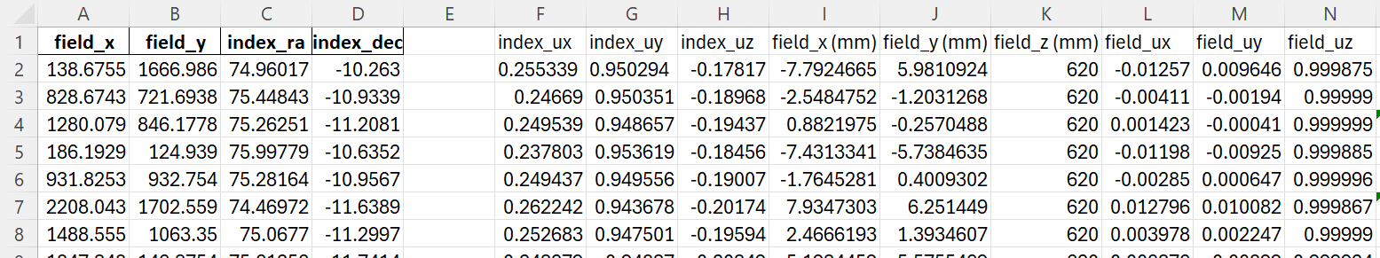
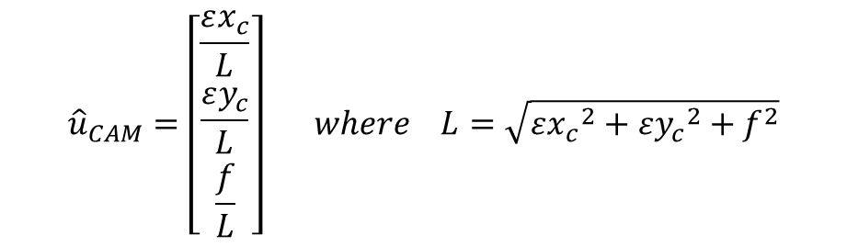

A Practical Approach to Plate-Solving of Astronomical Images Based on
Least-Squares Estimation
Unit Vector Calculation
$${\hat{u}}_{CAM}=\left[\begin{matrix}\frac{εx_{c}}{L} \\ \frac{εy_{c}}{L} \\ \frac{f}{L}\end{matrix}\right] where L=\sqrt{{εx_{c}}^{2}+{εy_{c}}^{2}+f^{2}}$$
$${\hat{u}}_{J2K}=\left[\begin{matrix}\cos\left(index_{dec}\right)\cos\left(index_{RA}\right) \\ \cos\left(index_{dec}\right)\sin\left(index_{RA}\right) \\ \sin\left(index_{dec}\right)\end{matrix}\right]$$
Notes:
* Epsilon x

Slide 9
A Practical Approach to Plate-Solving of Astronomical Images Based on
Least-Squares Estimation
Method: Euler Angle Solutions
4. Solve for the direction cosine matrix and convert to Euler Angles
Histogram chart of Euler Angle solutions of all star comparisons
Continue this process for 3 cases to validate the investigation
$$Q_{CAM}^{J2K}=\left[\begin{matrix}{\left.{\hat{u}}_{1}\right|}_{J2K} & {\left.{\hat{u}}_{2}\right|}_{J2K} & {\left.{\hat{u}}_{3}\right|}_{J2K}\end{matrix}\right]∗{\left[\begin{matrix}{\left.{\hat{u}}_{1}\right|}_{CAM} & {\left.{\hat{u}}_{2}\right|}_{CAM} & {\left.{\hat{u}}_{3}\right|}_{CAM}\end{matrix}\right]}^{−1}$$
$$α=\tan^{−1}\left(\frac{Q_{32}}{Q_{31}}\right)$$
$$β=\cos^{−1}\left(Q_{33}\right)$$
$$γ=\tan^{−1}\left(\frac{Q_{23}}{{−Q}_{13}}\right)$$

Slide 10
A Practical Approach to Plate-Solving of Astronomical Images Based on
Least-Squares Estimation
Method: 3 Cases
Case 1: Camera Pointing Known, Like Pairs (One Image)
  Same image, same objects
  Pair with true counterparts
Case 2: Camera Pointing Known, Unlike Pairs (One Image)
  Same image, different objects
  Vectors are located in the same sectors but not belonging to the same object
Case 3: Camera Pointing Unknown (Multiple Images)
  Different Images
  No correlation between stars

Slide 11
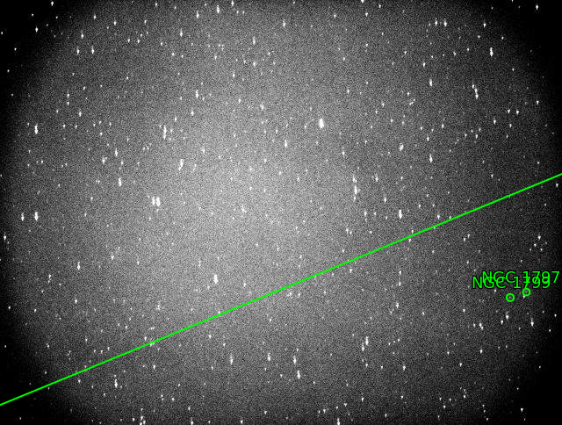
A Practical Approach to Plate-Solving of Astronomical Images Based on
Least-Squares Estimation
Expected Values:
α = 161.700 degrees
β = 101.124 degrees
γ = 104.735 degrees

Slide 12
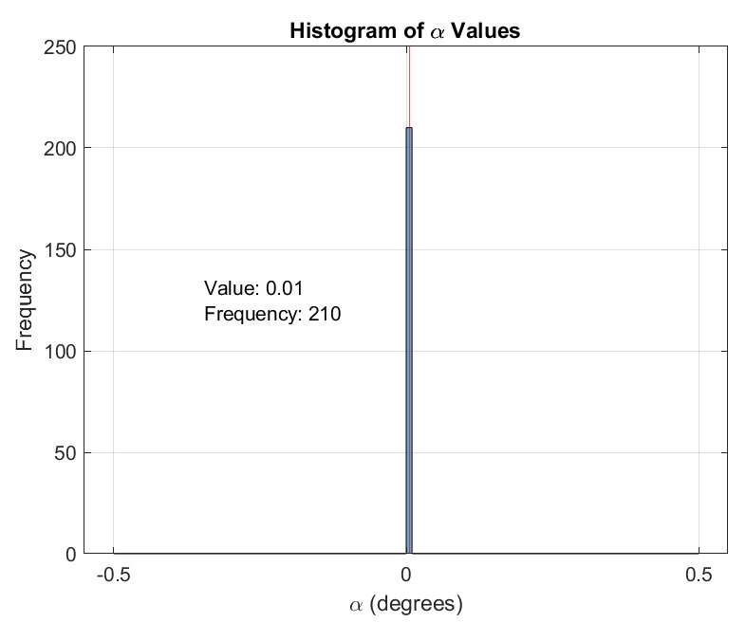
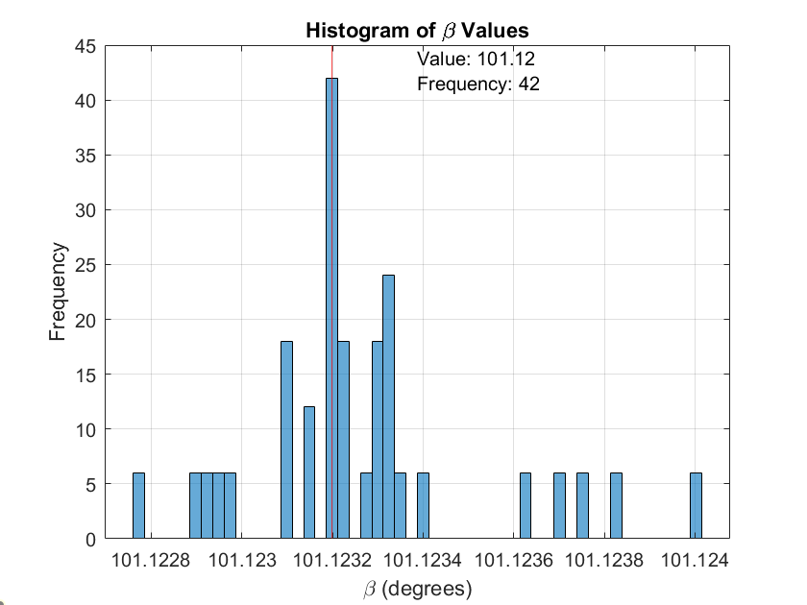
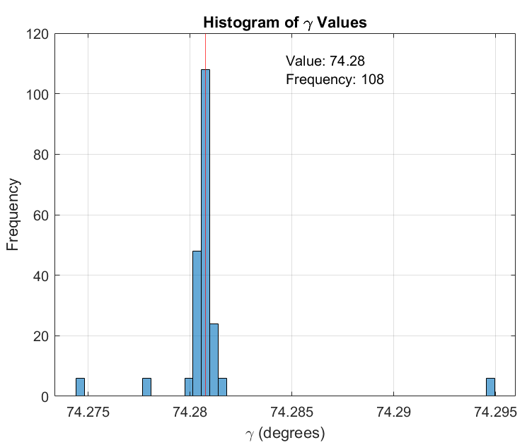
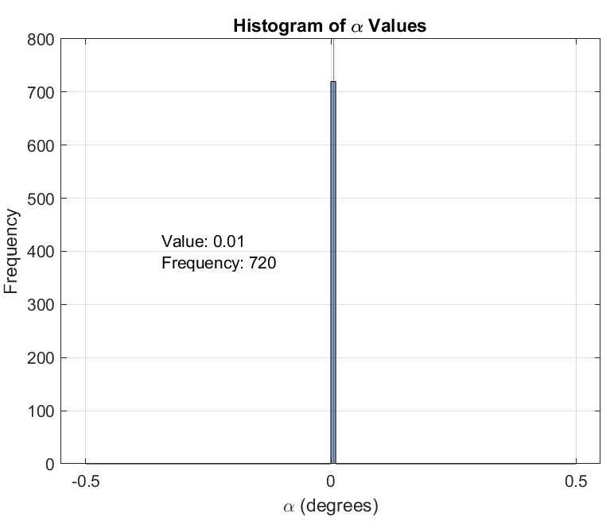
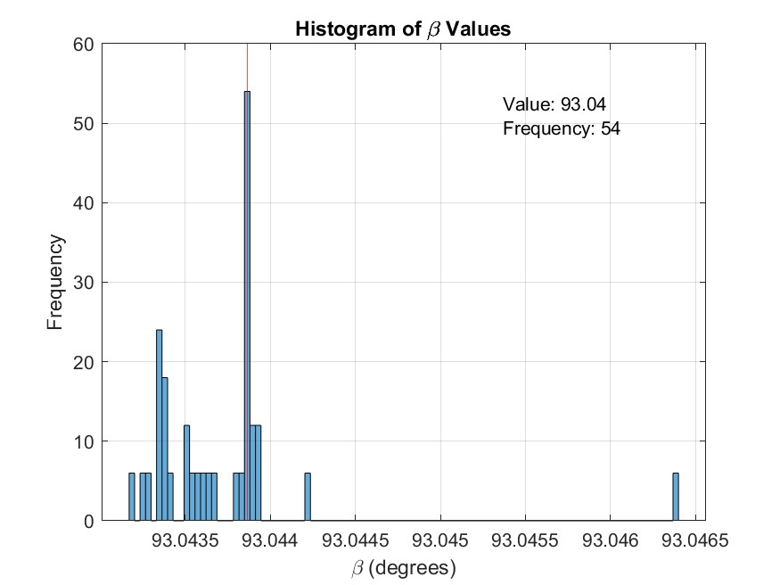
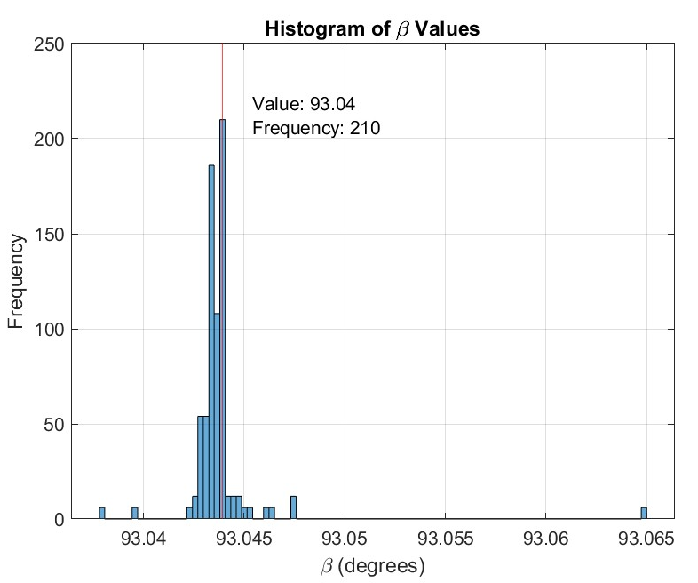
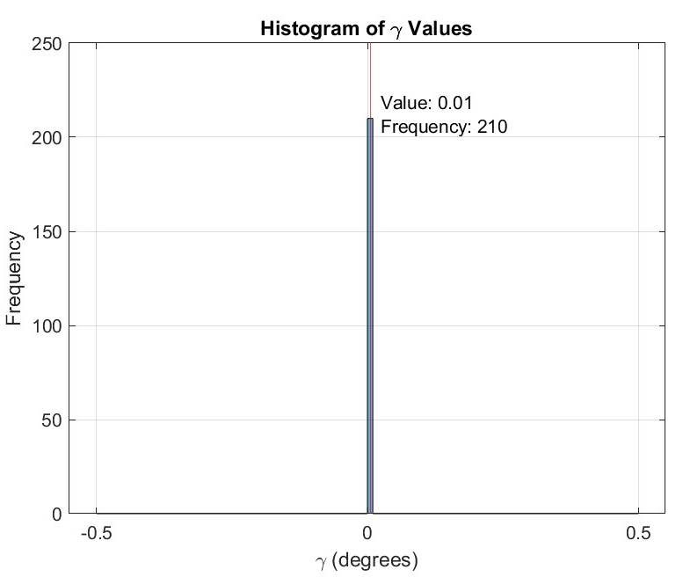
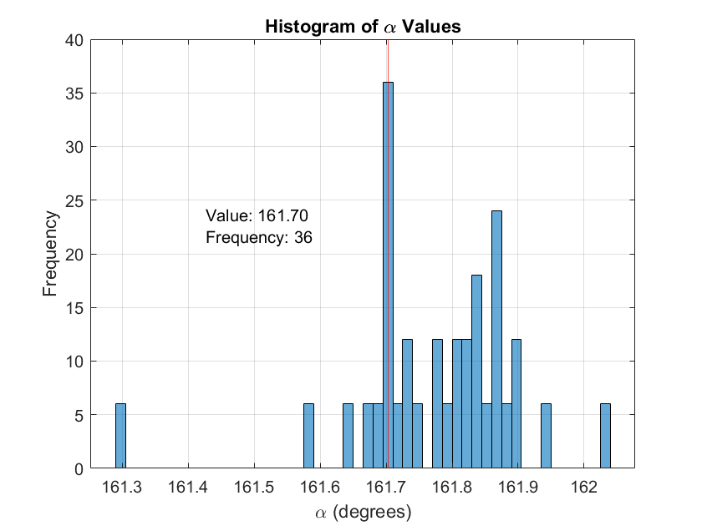
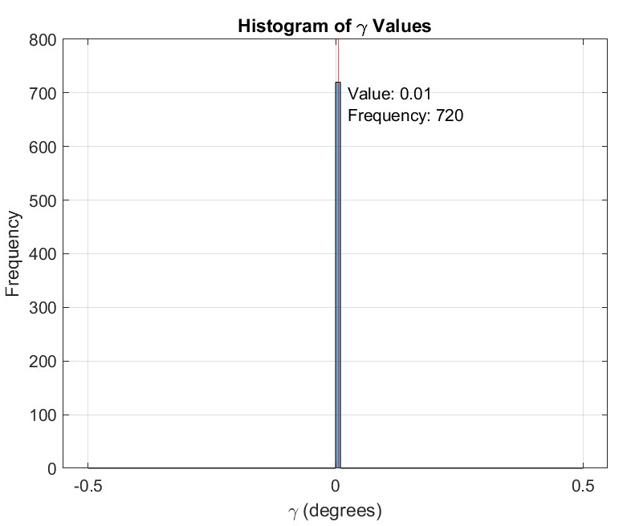
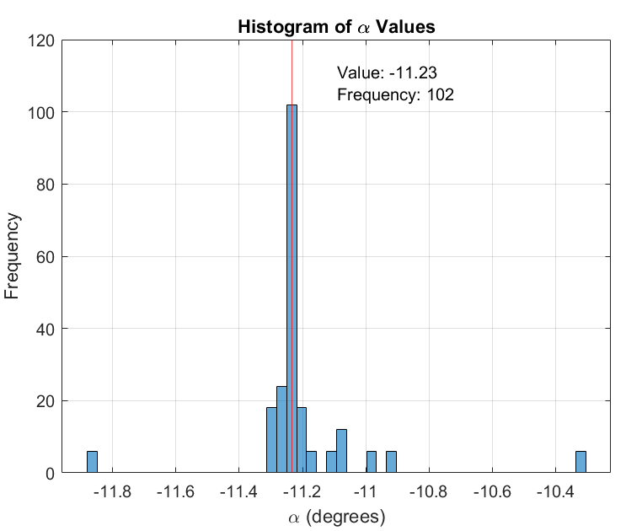
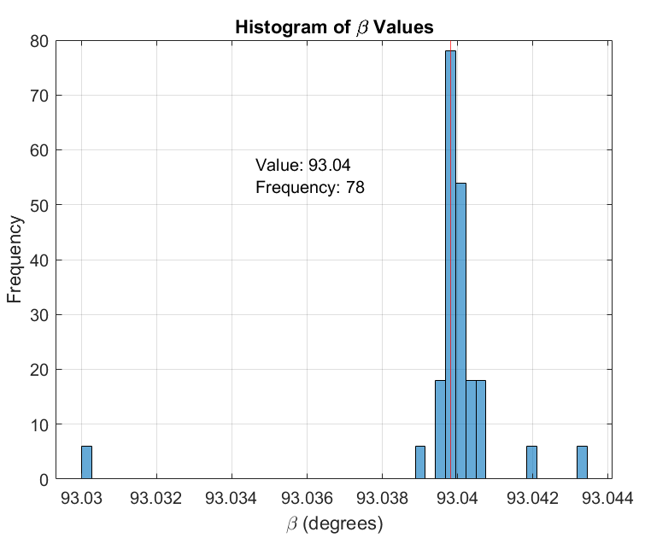
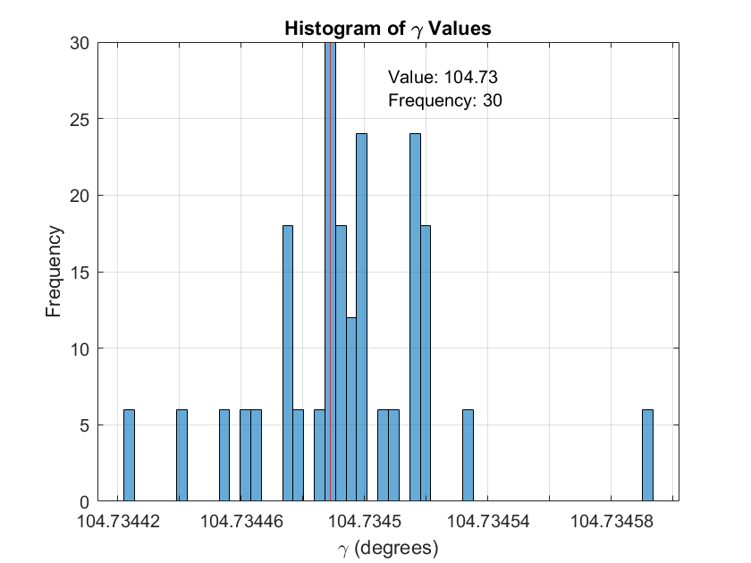
A Practical Approach to Plate-Solving of Astronomical Images Based on
Least-Squares Estimation
    Results
    Case 1: Known Camera Pointing: Like Triplets​

Slide 13
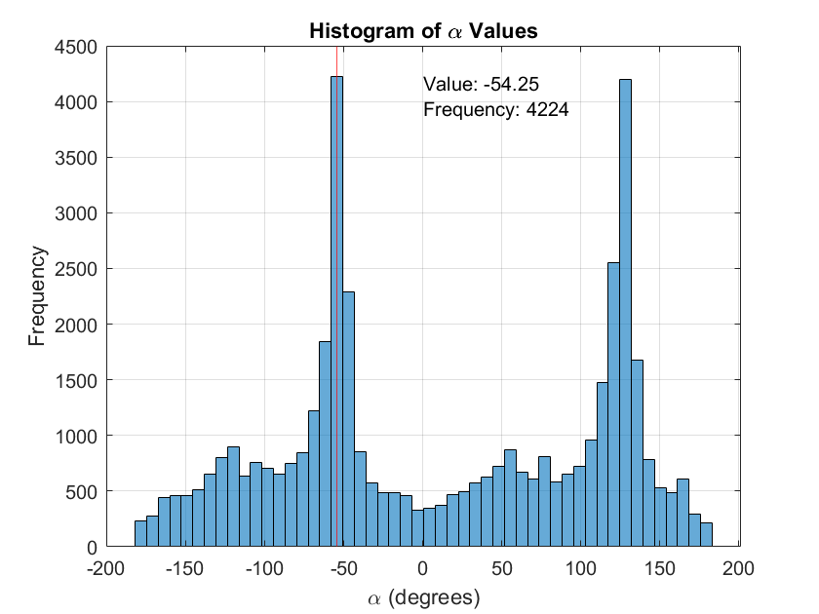
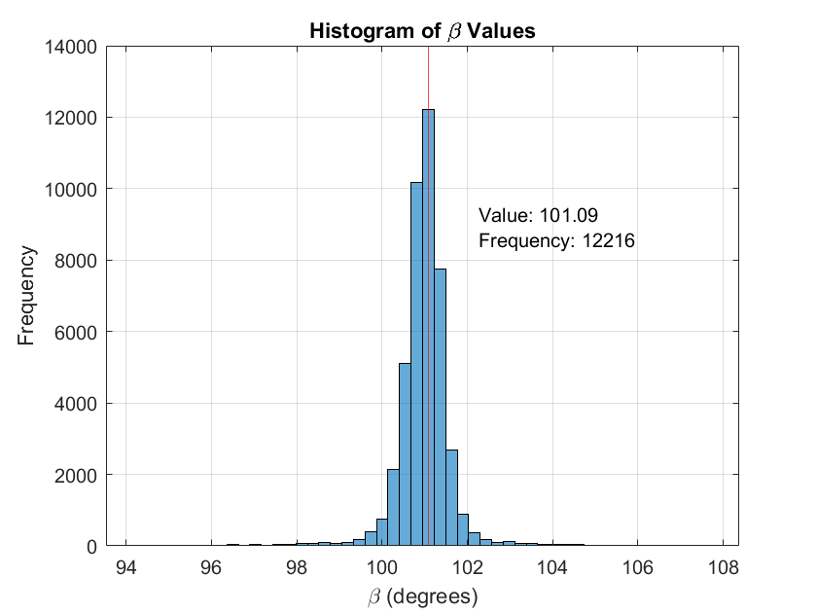
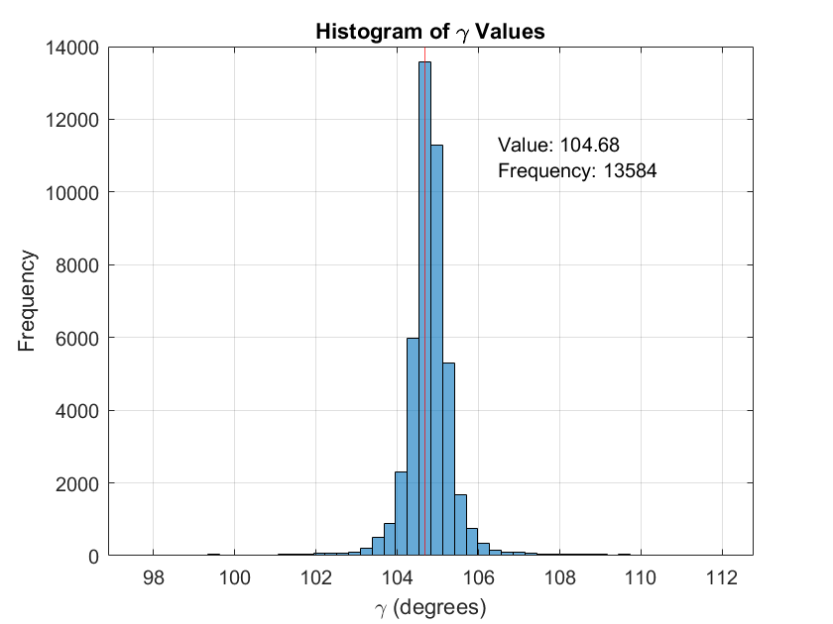
A Practical Approach to Plate-Solving of Astronomical Images Based on
Least-Squares Estimation
    Results
    Case 2: Known Camera Pointing: Unlike Triplets​

Slide 14
A Practical Approach to Plate-Solving of Astronomical Images Based on
Least-Squares Estimation
    Results
Case 3: Camera Pointing Unknown
  Will be testing different images
  Expecting no correlation between the calculated Euler angles due to investigating different sectors of space
  Completing Case 3 will properly validate this algorithm and lead to solving Wahba’s problem

Slide 15
A Practical Approach to Plate-Solving of Astronomical Images Based on
Least-Squares Estimation
Summary
This paper aims to create an efficient method of plate-solving
Three cases are used to determine the validity of this method
  General consistency among solutions in Case 1
    Nearly all triplets of camera frame unit vectors undergo the same coordinate transformation into their known correct counterpart triplets of J2000 unit vectors
    Discrepancies may be due to photo quality
  Unique aggregation for incorrect pairings in Case 2, can be an indicator for correct sector identification

Slide 16
A Practical Approach to Plate-Solving of Astronomical Images Based on
Least-Squares Estimation
Next Steps
Proceeding with least-squares estimation/solving Wahba’s Problem:
  Divide the star catalog into sectors of right ascension and declination
  Solve Wahba’s Problem and calculate the residuals in RA and Dec between the unit vectors
Can lead to a more efficient plate-solving method
$$J\left(Q_{CAM}^{J2K}\right)=\frac{1}{2}\sum_{k=1}^{N}{a_{k}{\left|{\hat{u}}_{J2K}−Q_{CAM}^{J2K}{\hat{u}}_{cam}\right|}^{2}}$$

Slide 17
A Practical Approach to Plate-Solving of Astronomical Images Based on
Least-Squares Estimation
Sources
[1] Lang, D. W. Hogg, K. Mierle, M. Blanton, and S. Roweis, “Astrometry.net: Blind astrometric calibration of arbitrary astronomical images,” Oct. 2009.
[2] Curtis, D., “Orbital mechanics for engineering students,” 4th edition.
[3] Shuster, M.D., “The generalized Wahba problem,” The Journal of the Astronautical Sciences, 2006.
[4] Hog E., Fabricius C., Makarov V.V., Urban S., Corbin T., Wycoff G., Bastian U., Schwekendiek P., Wicenec A., “The Tycho-2 Catalogue of the 2.5 Million Brightest Stars,” 2000.

Slide 18
Thank you!
Cindy Uyen Chi Nguyen and Thomas Alan Lovell
Embry-Riddle Aeronautical University
2025 Region II Student Conference, 3 April 2025 – 4 April 2025
Copyright © by Embry-Riddle Aeronautical University
Published by the American Institute of Aeronautics and Astronautics, Inc., with permission.

