Slide 1
B.A.T.M.A.N: Battery Automated Transfer Module for Aerial Network
Alexander “Sasha” Herzog, Sophia Incer, Darlene Adalenda Umukundwa
Mississippi State University
2025 Region II Student Conference, 3-4 April 2025, Greensboro, NC
Notes:
Sophia

Slide 2



Meet the Team – Roles and Responsibilities
Name: Sophia Incer
Team role: Project Lead & Concept Developer
Fun Fact: I love PLANTS!
Name: Alexander “Sasha” Herzog
Team role: Electrical Systems & Technical Writer
Fun Fact: Has run a marathon
Name: Darlene Adalenda Umukundwa
Team role: Concept Development & Project Management
Fun Fact: Speaks Multiple Languages
Notes:
Sophia then Sasha then Darlene

Slide 3
Presentation Outline
Project Scope
Mission Objectives
Assumptions made
Process
Mechanical Design
Results & Observations
Acknowledgments
Notes:
Darlene

Slide 4
Project Scope
This project lays the groundwork for an autonomous battery swapping system using 3D modeling and system-level analysis.
Reducing manual intervention to reduce limited scalability especially in applications such as surveillance, delivery, and disaster response.
Notes:
Darlene

Slide 5
Mission Objective
The objective of this project is to explore the feasibility & reliability of autonomous battery swapping technology and its potential applications to improve efficiency of UAS deployed in all industries.
Notes:
Darlene

Slide 6
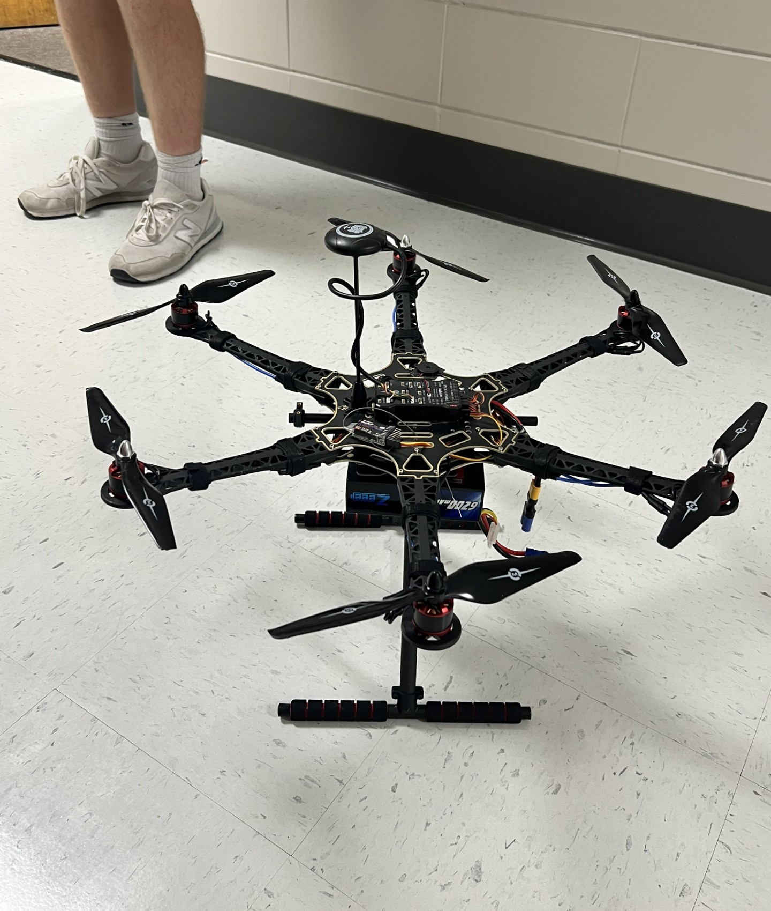
Assumptions and Requirements for Design
Max charging distance of ~5-8mm¹
Wall thickness between coils: ~1–3 mm.
Uses nonmetallic material.
Designed for 2 batteries.
Notes:
Sophia

Slide 7
Process: Arrival to Departure
Low battery detection
Landing at the base station: Unlocking the battery
Fully charged battery is inserted & drone departs
Empty battery goes to the charging station
Notes:
Sasha

Slide 8
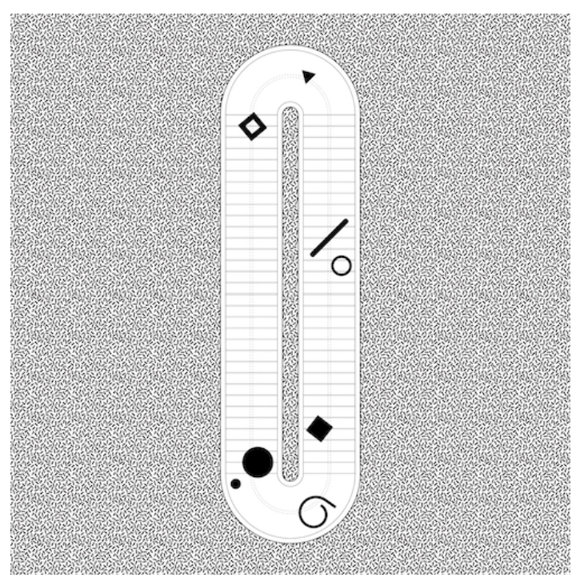
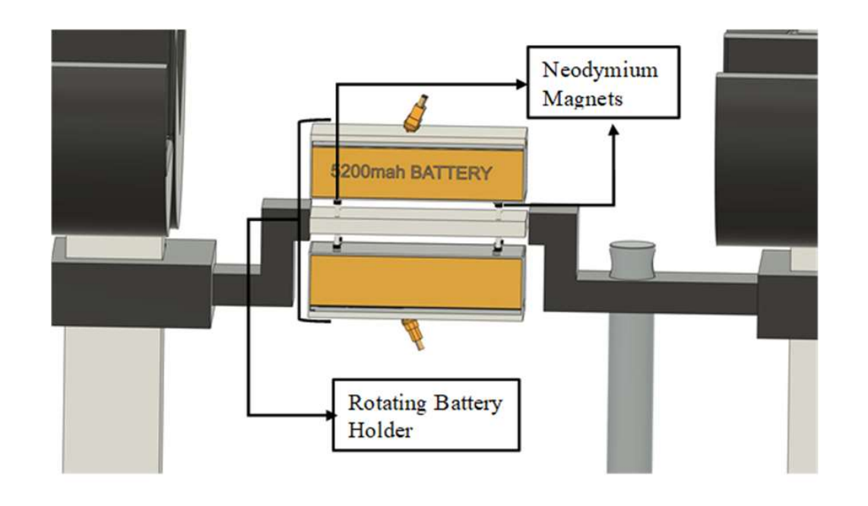
Initial Designs and Inspiration
Rotating Mechanism⁵
Conveyor²
Notes:
Sophia or Darlene

Slide 9
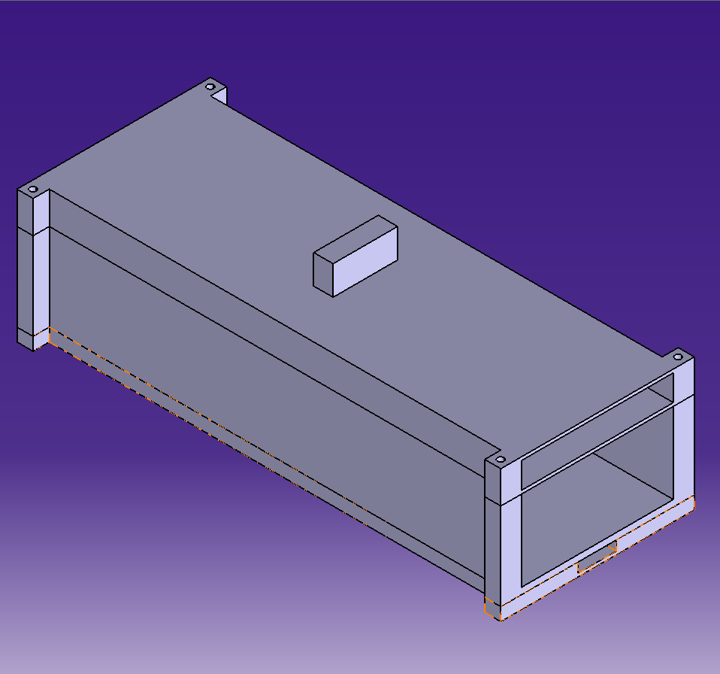
Mechanical Design: Battery Case
Pin based locking mechanism.
Printed in PLA.
Inductive Coil embedded in bottom section.
Connector to drone in top section.
Notes:
Sophia

Slide 10
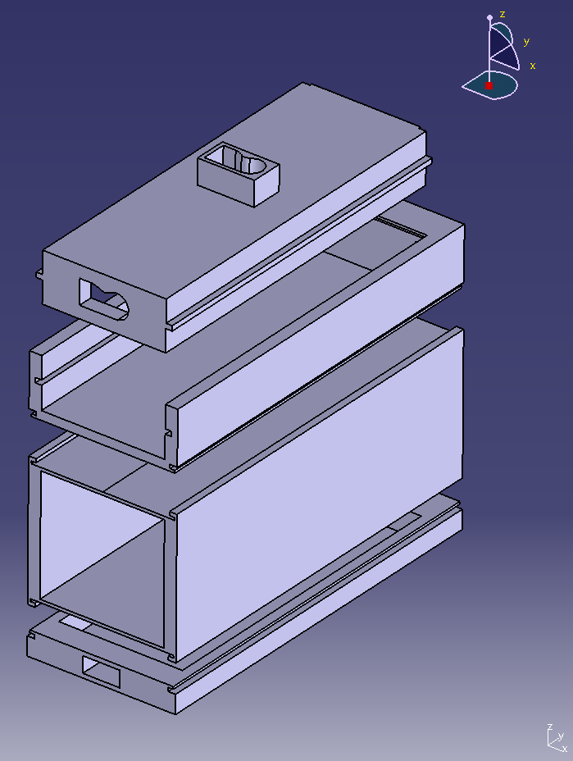
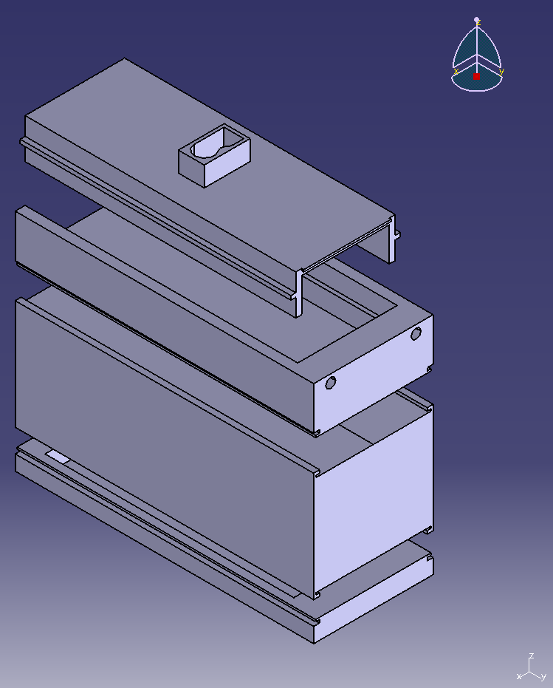
Mechanical Design: Final Design of the Case
Front View
Back View
Notes:
Sophia

Slide 11
Mechanical Design: Charging Mechanism
Inductive coil wireless charging
  Coils in the battery case base section and under the conveyor belt.
Charging LiPo batteries requires specific hardware.
  Charging in the 10W range.³
Notes:
Sophia

Slide 12
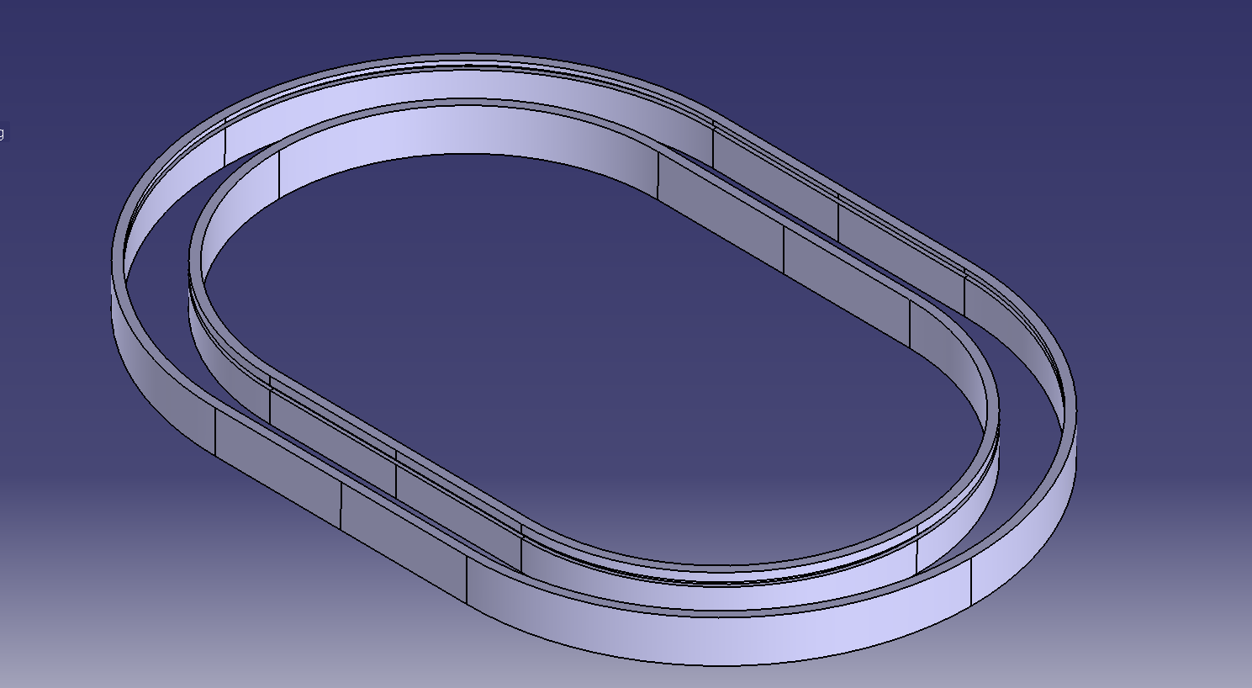
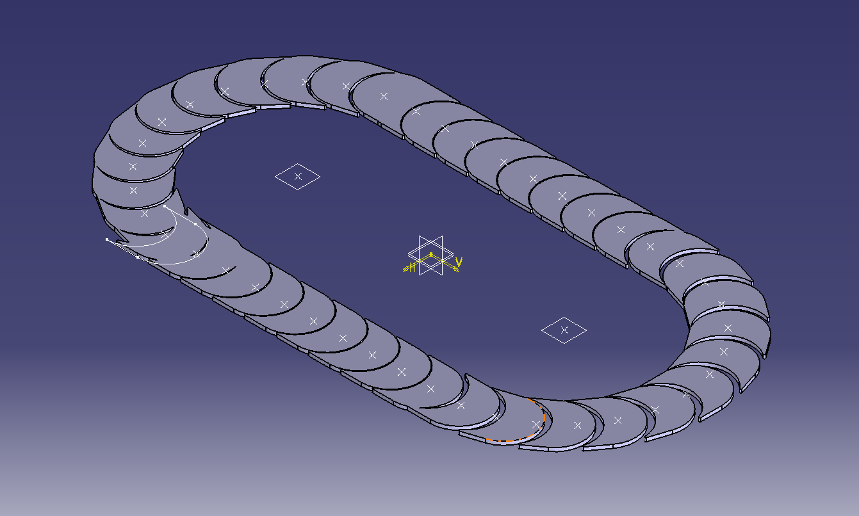
Mechanical Design: Conveyor Belt
Conveyor Railing
Conveyor Belt
Notes:
Sophia

Slide 13
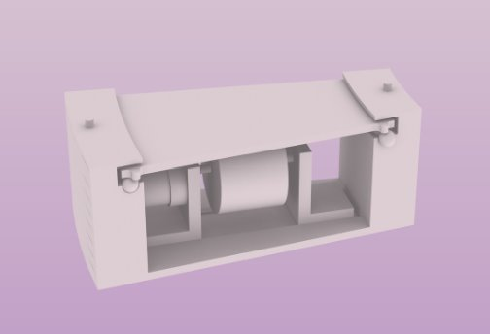
Mechanical Design: Movement System²
3D Printed Parts.
Propelled with multiple stepper motors with individual motor controllers.
Long board wheels used for drive system.
Notes:
Sophia

Slide 14
Results and Observations
Demonstrated proof of concept.
  Established the system is possible.
  Designed system is capable of meeting all goals.
Wireless charging systems for LiPo batteries can achieve desired charging rates.³
  Analysis of power loss and efficiency out of scope for this project.
Prototype construction was delayed due to restraints.
Notes:
Sasha

Slide 15
Next Steps
Integrate automated UAS landing and home-seeking behavior.
Sustained testing under multi-drone load.
  Seek to simulate real-world conditions.
For faster power transfer.
  Explore wired charging.
Notes:
Sasha

Slide 16
Acknowledgements
Brandon Lasseinge and Calvin Walker
Christopher White and the team at Raspet
Mississippi State Aerospace Department
Robert Wolz for guidance and emotional support
Notes:
Sasha

Slide 17
References
Adafruit. Universal Qi Wireless Receiver Module. https://www.adafruit.com/product/1901.
Gonzalez, Marianna. Rod Detail. https://fab.cba.mit.edu/classes/863.19/Architecture/people/Marianna/index.html
Karthikeyan, D., Koley, S., Bagchi, M., Bhattacharya, A., & Vijayakumar, K. (2020). Wireless charging scheme for medium power range application systems. International Journal of Power Electronics and Drive Systems, 11(4), 1979. https://pdfs.semanticscholar.org/b024/41cf03944274d47a98cbe8e9a385b9a4d2fd.pdf.
K. P. Jain and M. W. Mueller, Flying batteries: In-flight battery switching to increase multirotor flight time, IEEE International Conference on Robotics and Automation (ICRA), Paris, France, 2020, pp. 3510-3516, doi: 10.1109/ICRA40945.2020.9197580.
Nadig, N., Minde, P., Gautam, A., Branesh Asokan, A., and Singh Malhi, G., “Conceptual Design of Aerostat-Based Autonomous Docking and Battery Swapping System for Extended Airborne Operation,” Drones and Autonomous Vehicles, SCIE Publishing Limited, 1, 3, 2024, pp. 10013–10013. https://doi.org/10.70322/dav.2024.10013.
Zhang, Yusheng. "Analysis of battery swapping technology for electric vehicles–using NIO’s battery swapping technology as an example." SHS Web of Conferences. Vol. 144. EDP Sciences, 2022.

Slide 18
Questions?
Thank you
Notes:
All

Slide 19


