Slide 1
Advancing EVA Suit Design: A Comparative Study of Mechanical Counter-Pressure Forearm Sleeves
Erin Fenderson, Katelyn Gibbs, Jessica Harder, and Kaylie Sorrel
Mississippi State University
AIAA Region II Student Conference, April 3-4, 2025
Notes:
Erin

Slide 2
Agenda
  Background and Motivation
  Problem Statement
  Design Process
  Testing and Results
  Future Objectives
  Conclusion
Notes:
Erin

Slide 3
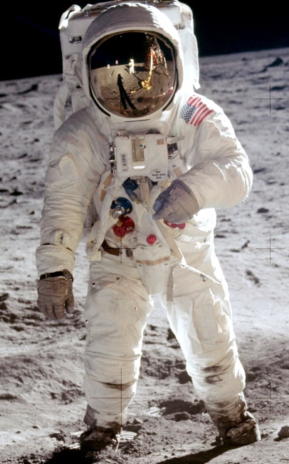
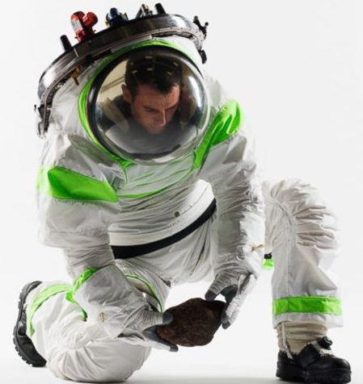
Background and Motivation
Gas-Pressurized Extravehicular Mobility Unit Suits:
  Required livable pressure for EVA suits: ~4.3 psia (29.6 kPa).
  Limited mobility
  Hot spots
  Injuries requiring medical attention
Notes:
Kaylie

Slide 4
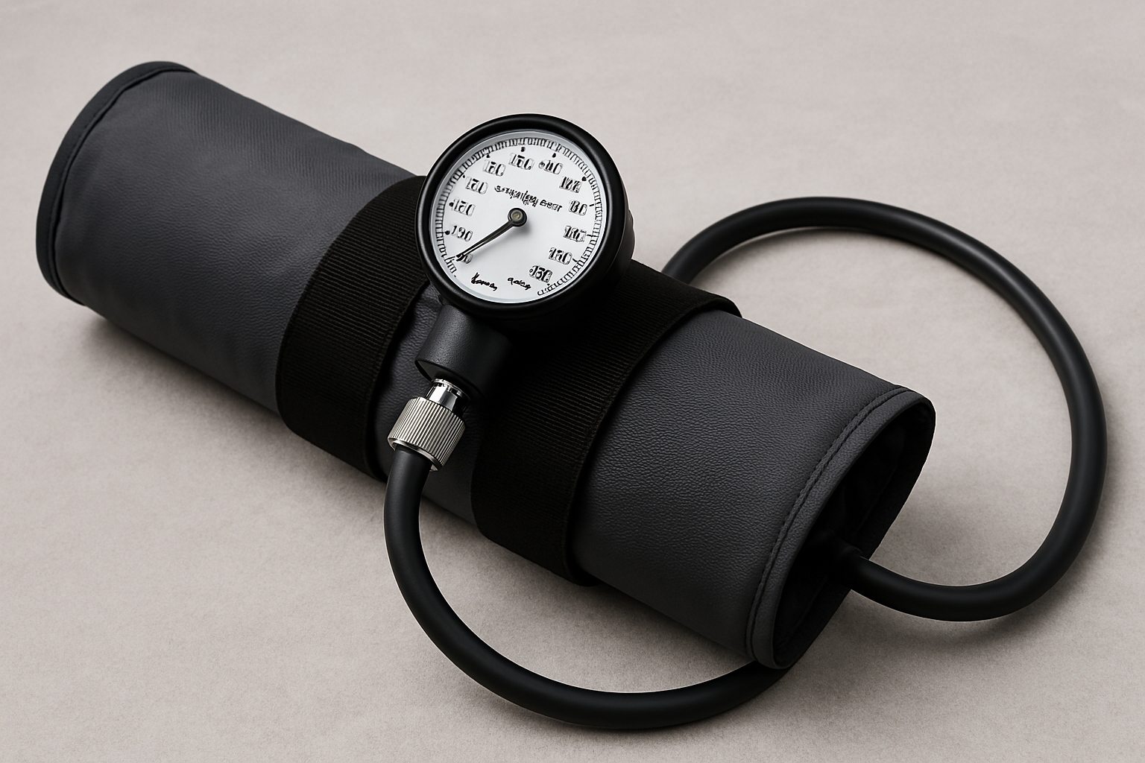
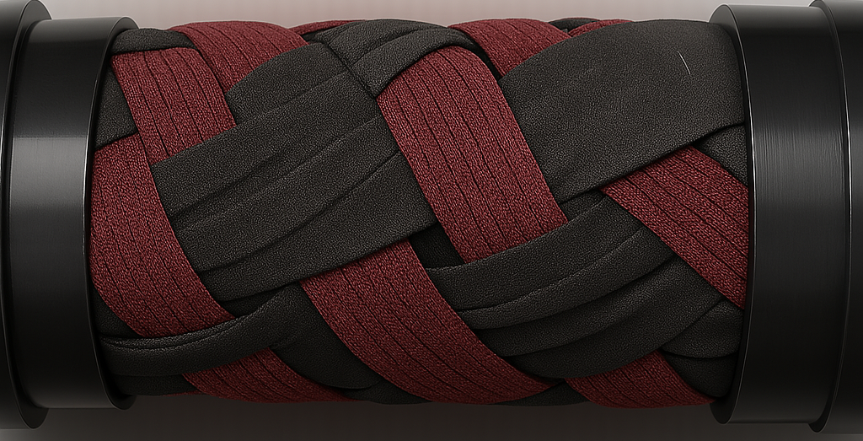
Problem Statement
Mechanical Counter-Pressure Extravehicular Implementation:
  Application of stable pressure against the skin.
  Two proof-of-concepts:
    Air Bladder Compression Sleeve
    Braided Lattice with Axially Applied Tension
Notes:
Kaylie

Slide 5
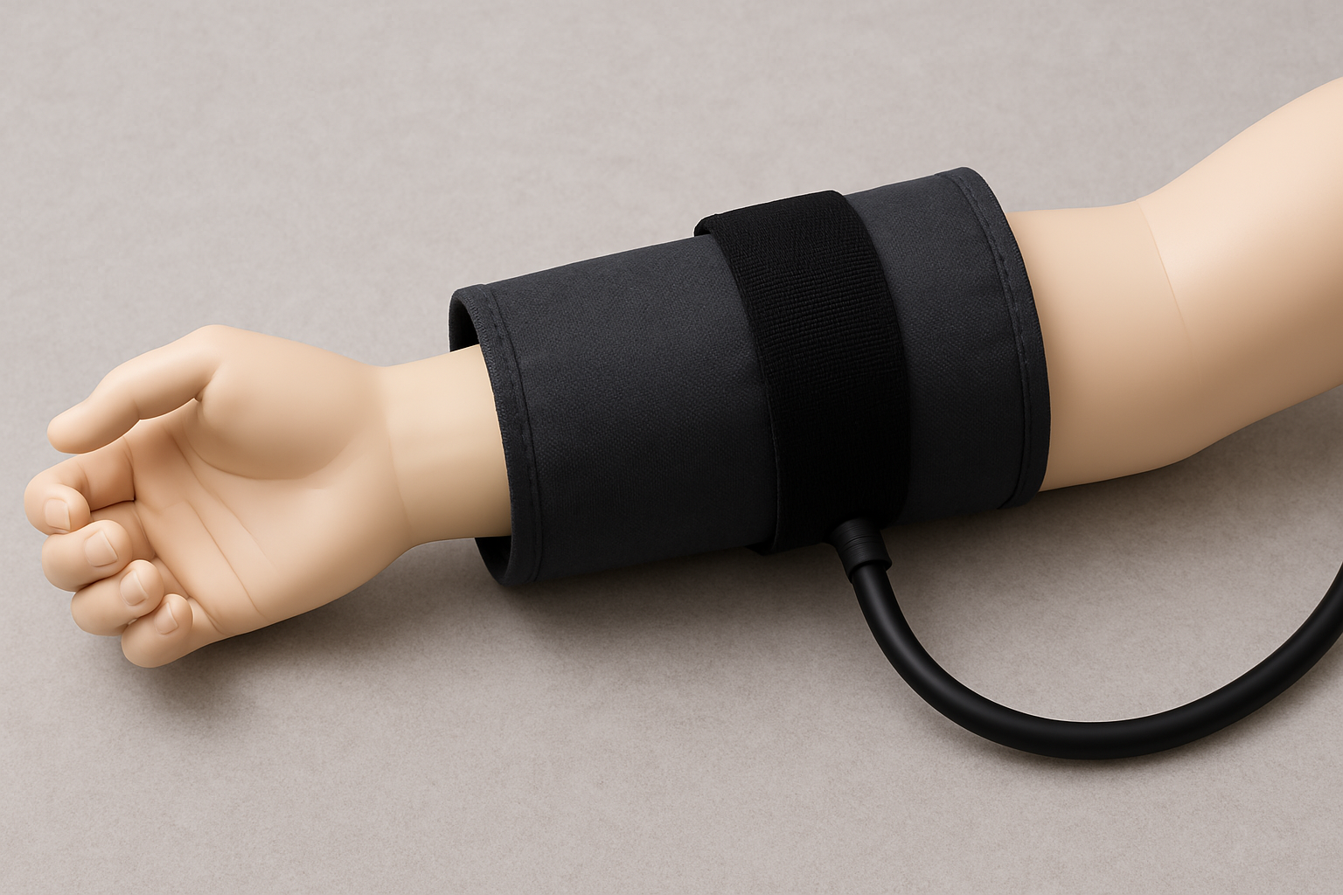
Design Process
Design One: Air Bladder Compression Sleeve
Mechanism:
  Based on pneumatic compression principles.
  Functions like a medical blood pressure cuff, using inflatable bladders to apply uniform circumferential pressure around the limb.
Notes:
Kate

Slide 6
Design Process
Design One: Air Bladder Compression Sleeve
Material and Layer Composition:
  Polyvinyl Chloride (PVC) bladder selected for elasticity, durability, and ease of fabrication.
  Material thickness and low breathability require integrated cooling for user comfort.
  Structural and Operational Considerations:
  Provides uniform pressure in high-mobility regions.
  Must withstand repeated pressurization cycles without fatigue or leakage.
  Limited flexibility makes this design more suitable for large, low-mobility areas.
Notes:
Kate

Slide 7
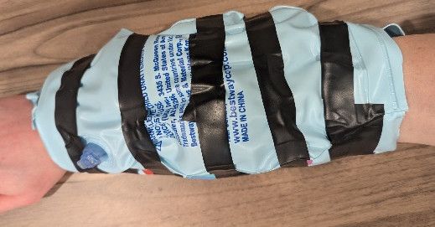
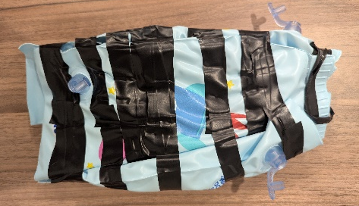
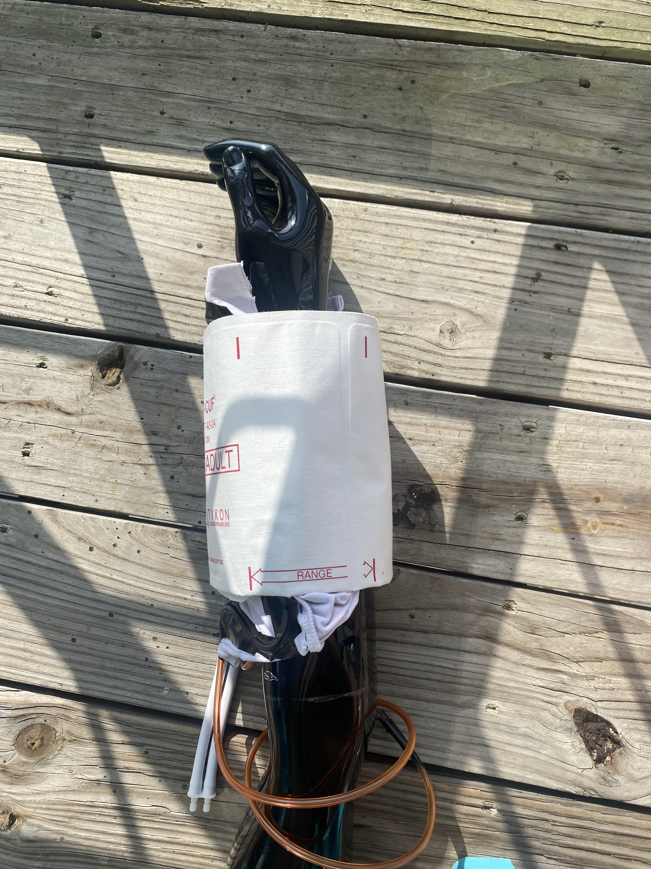
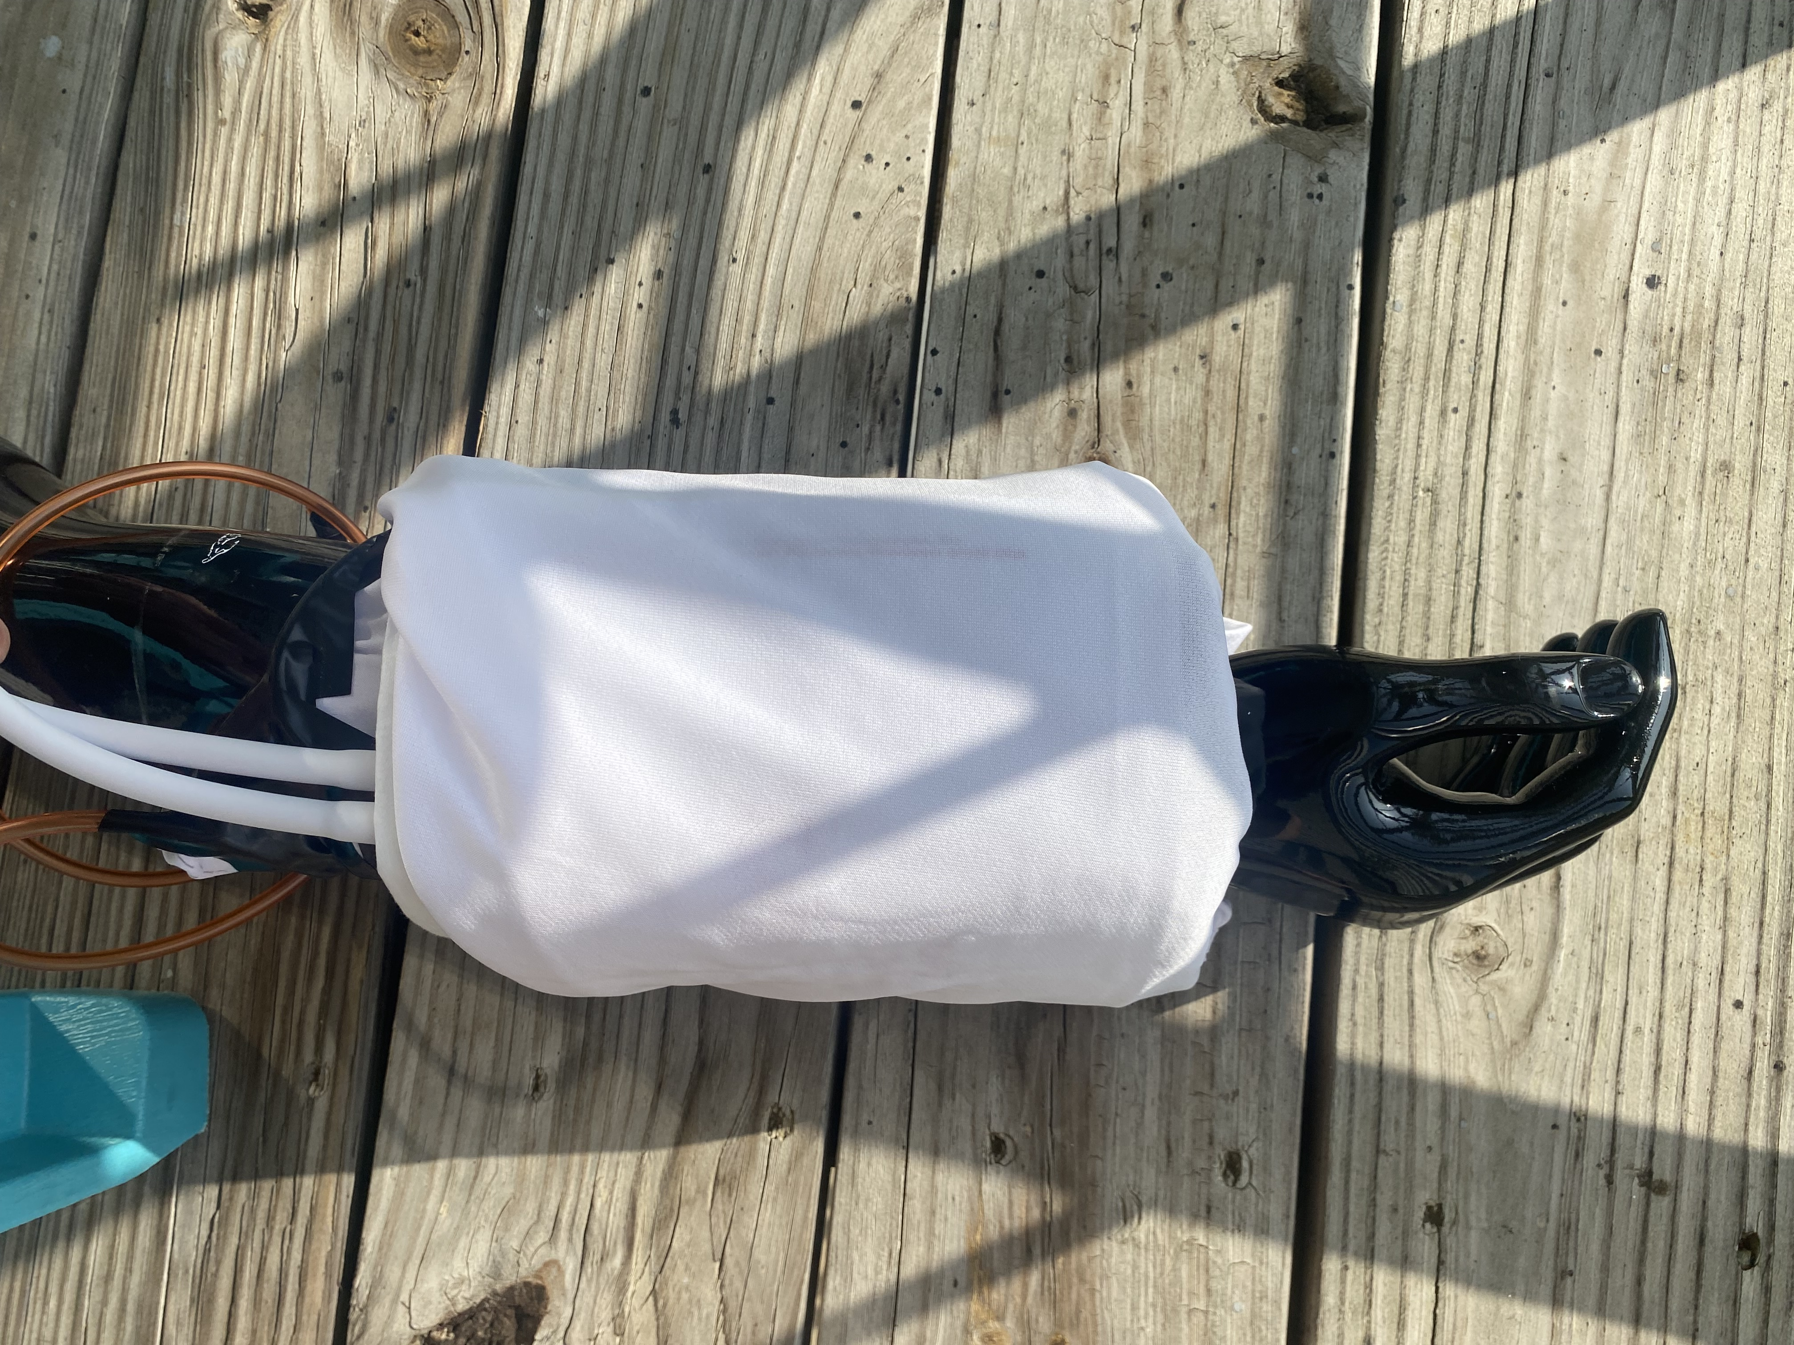
Design Process
Design One: Air Bladder Compression Sleeve
First Iteration:
Second Iteration:
Notes:
Kate

Slide 8
Design Process
Design Two: Braided Lattice with Axially Applied Tension
Mechanism:
  Biaxially woven design patterned to optimize fit and coverage of the forearm.
  Custom connectors 3D-printed in Polylactic Acid (PLA) filament and locking mechanisms for the woven structure.
Notes:
Erin

Slide 9
Design Process
Design Two: Braided Lattice with Axially Applied Tension
Material and Layer Composition:
  Polylactic Acid (PLA) filament for connectors
  Heavy Stretch Knit Elastic for lattice
  Structural and Operational Considerations:
  Functional and ergonomic design ensures a secure, comfortable fit with full range of motion.
  Biaxial weave for controlled tension preventing excessive tightness or looseness
  Designed to conform to the natural contours of the astronaut’s arm
Notes:
Kate

Slide 10
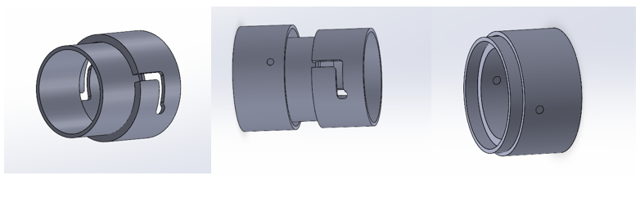
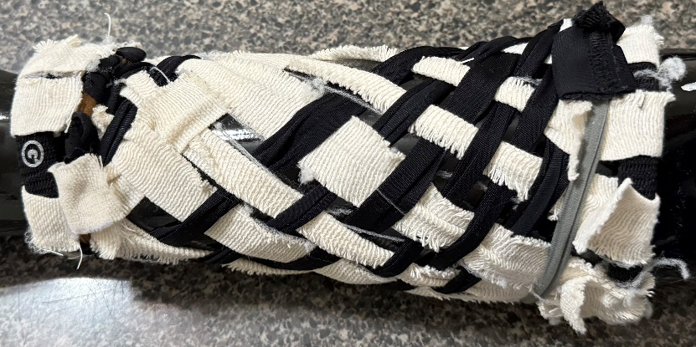
Design Process
Design Two: Braided Lattice with Axially Applied Tension
First Iteration:
Notes:
Jessica

Slide 11
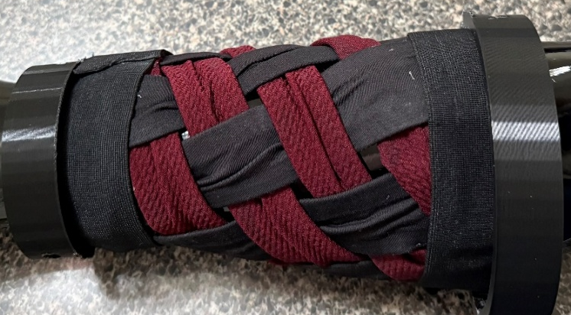
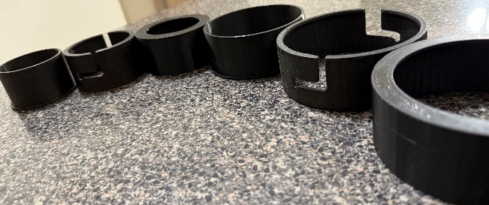
Design Process
Design Two: Braided Lattice with Axially Applied Tension
Second Iteration:
Notes:
Jessica

Slide 12
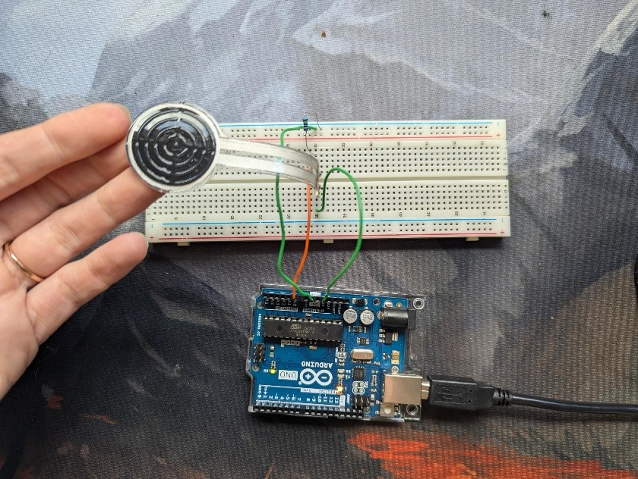
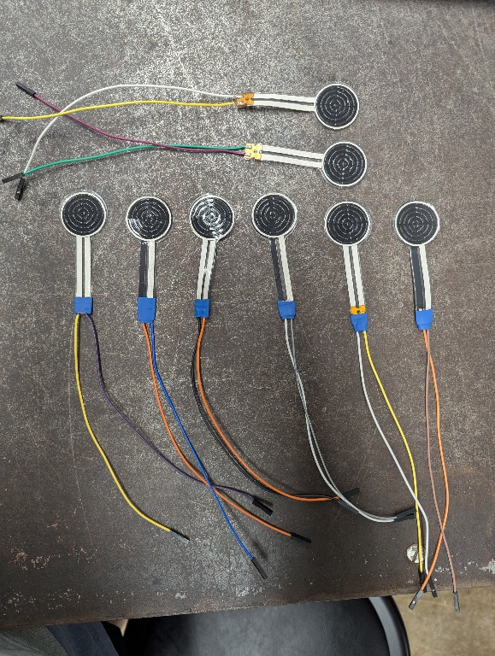
Testing and Results
Parker FlexSense Pressure Sensors:
  Capacitance-based sensors provided by MSU Athlete Engineering
  Arduino found incompatible due to resistor-based processing method
  Switched to MSU-provided software
Notes:
Kaylie—Can the highlighted portion be conveyed without being up there?

Slide 13
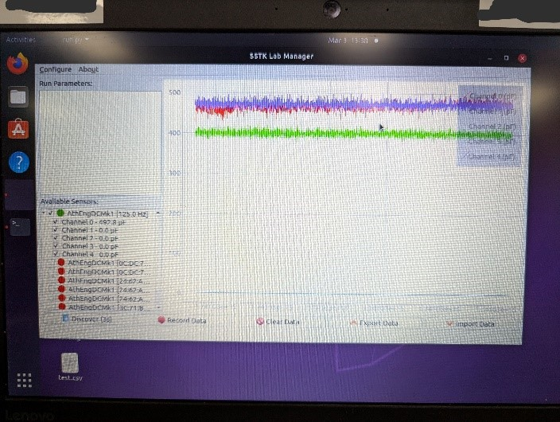
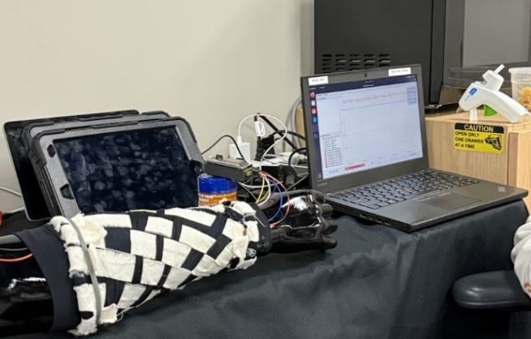
Testing and Results
Parker FlexSense Pressure Sensors
  Four sensors placed on the forearm.
  Sensors calibrated using weights (1– 4.5 lbs).
  Data correlated to pressure readings.
  Mounted using a compression sleeve
Notes:
Kaylie

Slide 14
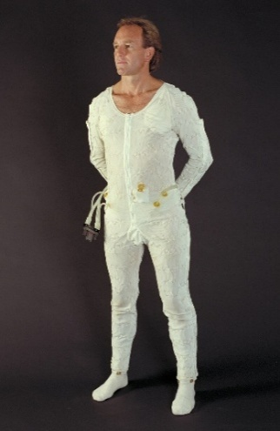
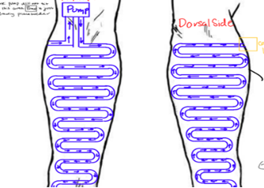
Future Objectives
Thermal Regulation Unit
  Utilization of 3/16-inch outer diameter tubing for fluid circulation.
  Optimized layout for even heat dissipation across the suit.
  Works in conjunction with compression layers to regulate temperature
Dynamic regulation of pressure to maintain consistent mechanical counterpressure.
Notes:
Jessica—should we just include formulas and excel sheets used when studying niti

Slide 15
Future Objectives
Implementation of Nickel Titanium (NiTi)
  Integration into a micro-version of braided lattice
  Maintain amperage < 0.1
Notes:
Jessica—should we just include formulas and excel sheets used when studying niti

