Slide 1

Field Falcon: A Multirotor Drone for Assessing Farm Conditions After Severe Weather
Future Flyers of America (FFA)
North Carolina State University
Aerospace Senior Design

Slide 2






Personnel
Tyler Kibble
Manufacturing Lead
Payload and Avionics
Andrew Strawn
Financial Lead
Structures
Karson Lange
Test/Safety Lead
Propulsion
Thomas Gigon
Systems Engineer
Stability and Control
Abhi Temmanaboyina
Communications Lead
Aerodynamics
Benjamin Ashley
Project Manager
CAD/Simulation

Slide 3
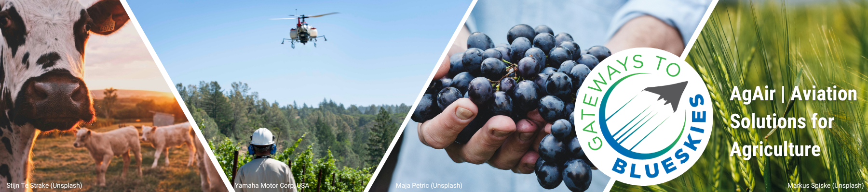
Blue Skies Project Description
In the 2025 Blue Skies Competition, teams will conceptualize novel aviation systems that can be applied to agriculture by 2035 or sooner with the goal of improving production, efficiency, environmental impact, and extreme weather/climate resilience¹.
[1]

Slide 4
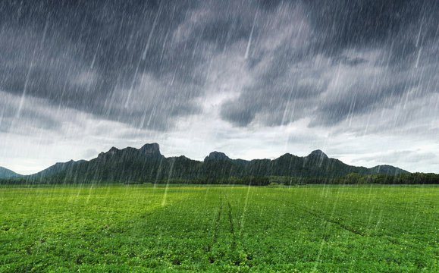
Motivation
[2]
Mitigation of farm equipment risks and damages
Increase in field surveillance efficiency
Optimization of field management and crop health monitoring
Generation of comprehensive field and crop maps

Slide 5
Mission Statement
The Future Flyers of America will design a lightweight, battery powered hexacopter UAV that will be used to assist farmers with pinpointing hazardous field conditions after severe weather. This entails supporting a single payload while collecting overhead images of the field and completing post-flight data processing.

Slide 6
Project Design Constraints
The Field Falcon shall
Not be a quad-rotor design
Fit in the trunk a regular car sedan when disassembled
  Dimensions: 5 ft by 3 ft by 2 ft
Have real time communication with the ground station
  Shall be controlled by operating pilot
Be flown in line of sight
Be built and manufactured by the team from scratch
  Shall not be a modified version of an existing multi-rotor vehicle
Be assembled and operated by a maximum of 2 people
Be battery operated and powered
Broadcast Remote ID

Slide 7
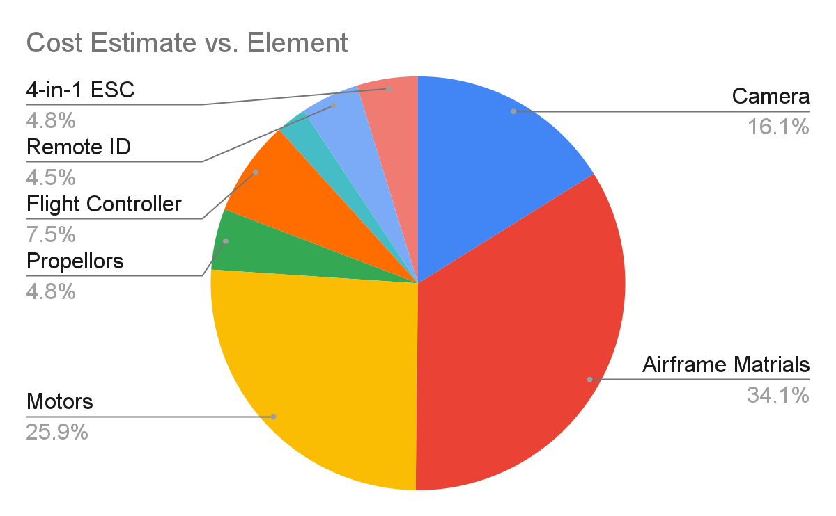
Budget
Element | Description | Cost Estimate
Camera | CADDXFPV Walnut Action Camera | $142.00
Airframe Materials | Carbon Fiber, ABS plastic | $300.00
Motors | SunnySky V3506 | $227.94
Battery | 4S LiPo Battery | Found in Design Shop
Propellers | Eolo Carbon Fiber Reinforced Nylon | $41.94
Flight Controller | SpeedyBee F405 V4 BLS 55A 30x30 FC&ESC Stack | $65.99
GPS | BZGNSS BZ-251 From Speed Bee | $20.99
Remote ID | Holy Stone Drone Remote ID Module | $39.99
4-in-1 ESC Module | SpeedyBee 55A BLHeli_S 4-in-1 ESC - 30x30 | $41.99
Total |  | $880.87
The $119.13 remaining are held in reserve in case one of the components breaks out of warranty as well as to account for taxes and shipping costs. We hope to lower material cost through parts available in senior design shop.

Slide 8
Bill of Materials
Subsystem | Component | Construction | Quantity | Unit Cost | Total Cost
Payload | CADDXFPV Walnut Action Camera | CADDXFPV | 1 | $142.00 | $142.00
 | Battery | N/A | 1 | N/A | N/A
Structure | Ultra-Strength Lightweight Carbon Fiber Tube .86" | McMaster-Carr | 2 | $121.56 | $243.12
 | ABS Filiment | N/A | 1 | $56.88 | $56.88
 | Fasteners | N/A | N/A | N/A | N/A
Controls | Flight Controller SpeedyBee F405 V4 BLS 55A 30x30 FC&ESC Stack | Speed Bee | 1 | $65.99 | $65.99
 | GPS BZGNSS BZ-251 From Speed Bee | Speed Bee | 1 | $20.99 | $20.99
 | Remote ID Holy Stone Drone Remote ID Module | Holy Stone | 1 | $39.99 | $39.99
Propulsion | Motor SunnySky V3506 | Sunny Sky | 6 | $37.99 | $227.94
 | Propellor Eolo Carbon Fiber Reinforced Nylon | Eolo | 3 | $13.99 | $41.97
 | SpeedyBee 55A BLHeli_S 4-in-1 ESC - 30x30 | Speed Bee | 1 | $41.99 | $41.99
Total |  |  |  |  | $880.87

Slide 9
Surveillance Goals
Hazardous Area Detection
  Use cameras to survey and identify hazardous areas, such as rocky or muddy patches
  Ensure high-resolution imaging to detect subtle changes in terrain that could indicate risks.
  Develop automated algorithm to classify and maps hazardous zones in real-time for improved safety.
Vegetation Monitoring
  Utilize cameras to capture aerial imagery for vegetation analysis
  Apply VARI, GLI and other VI’s to assess plant health, coverage, and density.
    VARI - an index using visible light to estimate vegetation greenness while minimizing atmospheric effects.
    GLI - measures the greenness of vegetation based on green light reflectance relative to to other visible wavelengths.
    VI - a general term for indices that assess vegetation health and density using spectral data.

Slide 10
Functional Requirements
FR # | Description
1 | The Field Falcon shall have a maximum all-up weight of 10 pounds.
2 | The Field Falcon shall maintain real-time communication with the ground station.
3 | The Field Falcon shall use a battery as a power source.
4 | The Field Falcon shall adhere to size restrictions, fitting within a 5 ft x 3 ft x 2 ft space when disassembled.
5 | The Field Falcon shall broadcast Remote ID as required by FAA regulations.
6 | The Field Falcon shall be operable and assembled by no more than two people.
7 | The Field Falcon shall demonstrate stability in various agricultural environments and under standard flight conditions.
8 | The Field Falcon shall stay within a total budget of $1,000.
9 | The Field Falcon shall incorporate modular and reconfigurable components for mission adaptability.

Slide 11
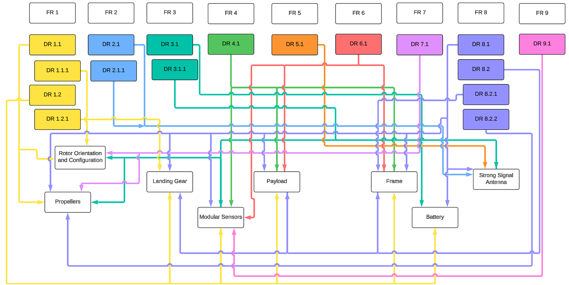
Functional and Form Mapping

Slide 12
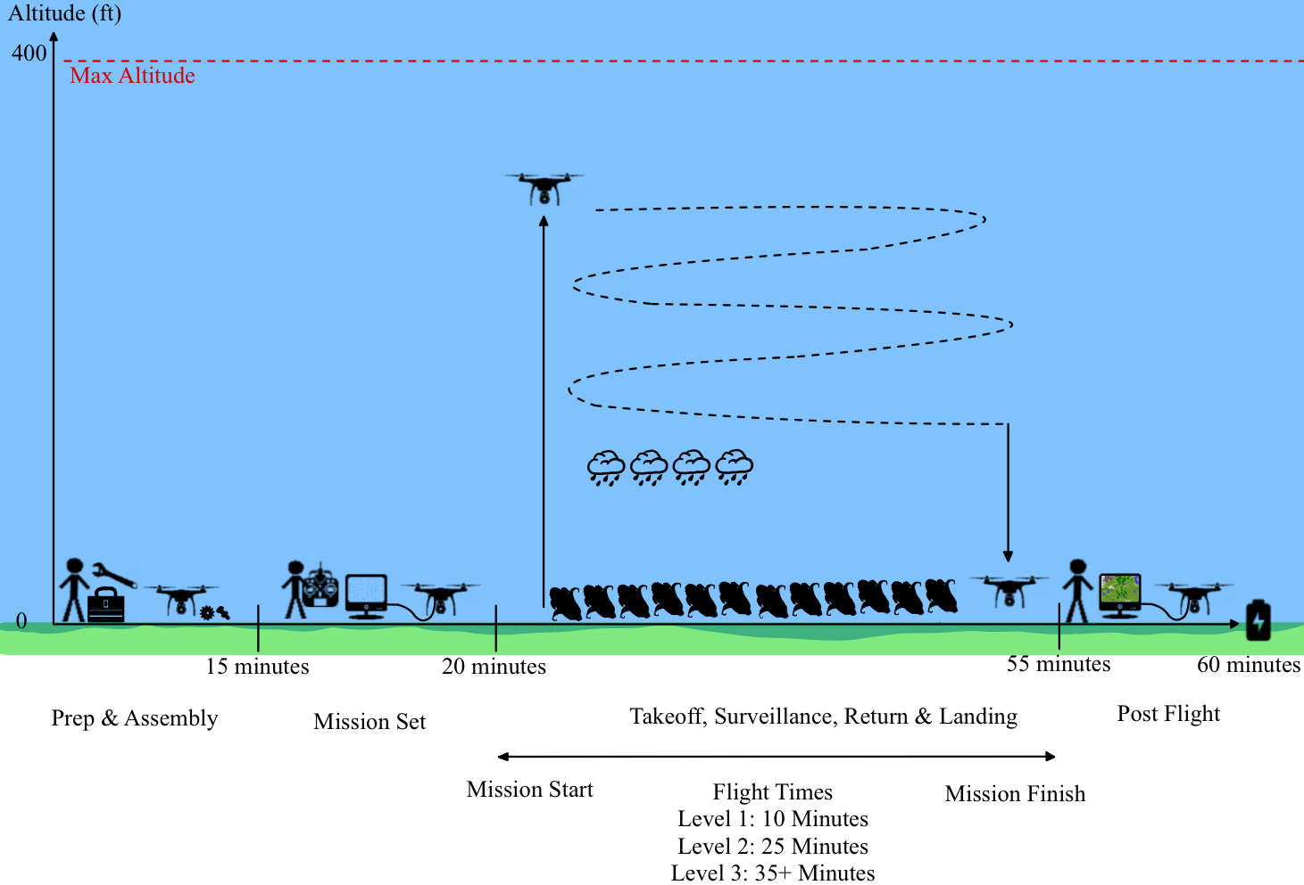
Concept of Operations

Slide 13
Benefits to Customers
Decreases risks associated with expensive damage to farm equipment from mud or rocks
Reduces human labor and time required to check on-ground field conditions
Reduces time that can be wasted attempting to get machines unstuck from mud and the downtime for farm equipment while being fixed
Offers competitive drone performance and features at a low cost to consumers

Slide 14
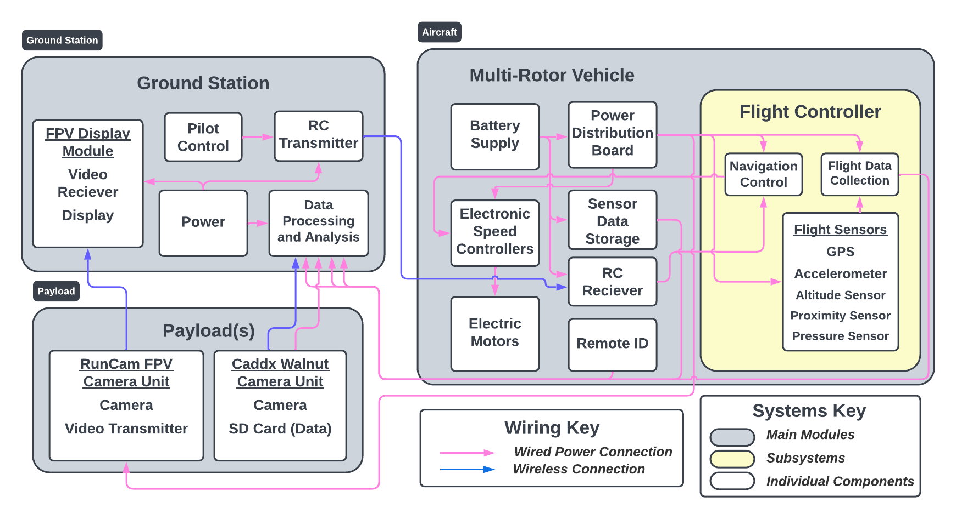
Functional Block Diagram
Notes:
Changes Made from the Original (PDD) FBD:
- Removed three of the arrows which made a connection between the power distribution board and the individual sensor cluster components. The updated version only has one arrow going to the sensor cluster as a whole. This change increases the simplicity and readability of the diagram and the individual connections.
- Added an arrow from the Flight Controller’s Flight Data Collection to the On-Ground Data Processing and Analysis. This change was made according to a customer request and concern with the original FBD. This addition adds clarity to the FBD and the system’s interconnections.
- Changed the term Altitude under the Flight Controller’s Flight Sensors to Altitude Sensor. This change was made due to a suggestion by the customer. The updated change provides greater clarity to the sensor itself as well as its purpose within the system as a whole.
- Added a Pressure Sensor to the Flight Controller’s Flight Sensors. This additional sensor was added to the FBD as ongoing flight controller research revealed that barometers or pressure sensors have become ubiquitous within the flight controller hardware.

Slide 15
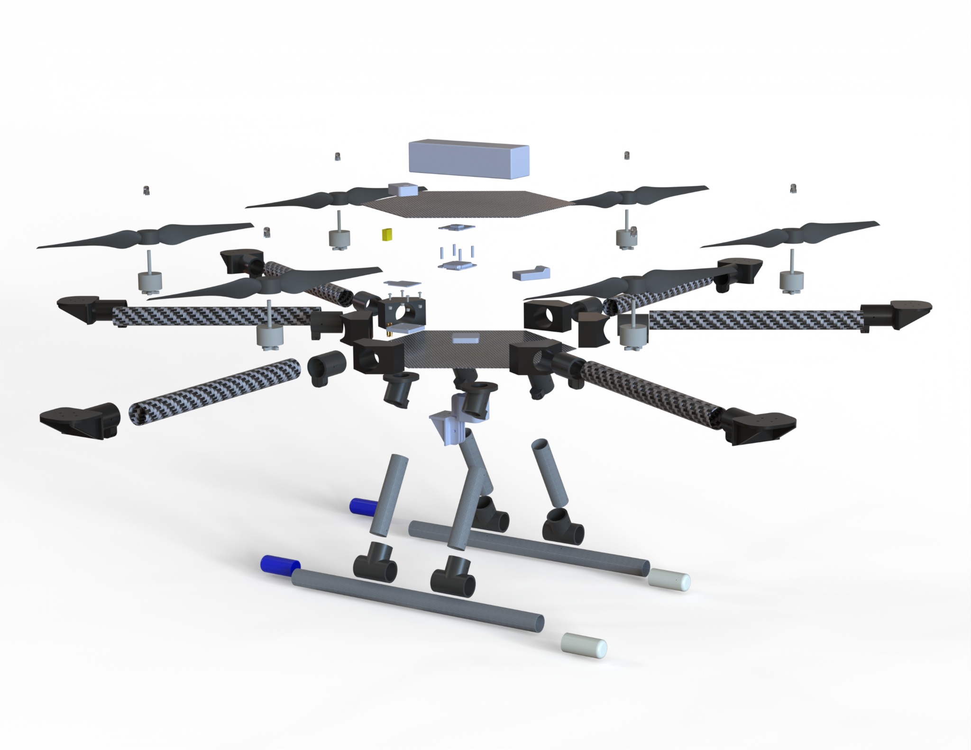
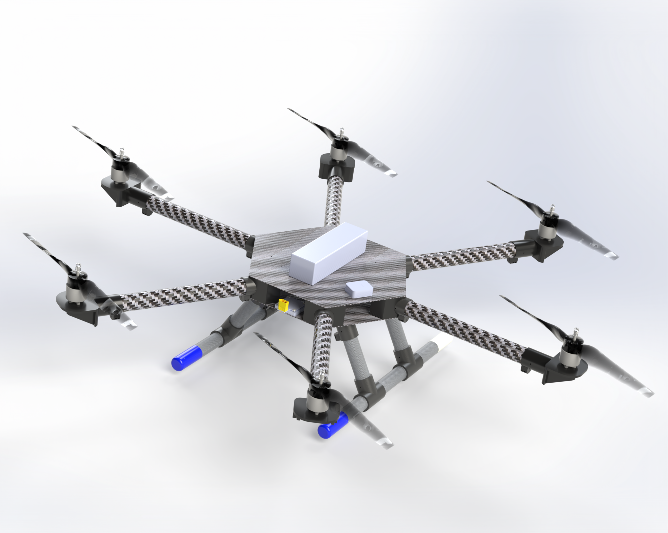
Design Solution

Slide 16
Design Solution
Electronics
Battery | Zeee 10000 mAh 120C 4S Lithium Polymer (LiPO)
Flight Controller | SpeedyBee F405 V3
ESCs | BL Heli_S 50A and 55A 4-in-1 Module
GPS | BZGNSS BZ-251 GPS and Compass
Remote ID | Holy Stone Drone Remote ID Module
Receiver | FlySky FS-IA6B
Transmitter | FlySky FS-I6X
Propulsion
Propellers | EOLO 13x5 (x3 CW and x3 CCW)
Motors | SunnySky V3506 650 KV (x6)
Structures
Landing Gear | Carbon Fiber Tube & PLA Connections
Frame Plates | Carbon Fiber Sheets/Plates
Arms | Carbon Fiber Tubes
Motor+Arm Mounts | 3D Printed (PETG)
Camera Mount | 3D Printed (PETG)

Slide 17
Design Solution
Flight Performance
Max Altitude | 400 ft
Max Speed (During Tests) | 20.36 mph (9.11 m/s)
Max Flight Time¹ | 13.40 minutes
Max Range | 500 m
Max Total Coverage² | ≈ 325 Acres
Vehicle Properties
Size | Height: 8.5 in Major Diameter: 36.5 in Minimum Diameter: 31 in Weight: 6.65 lb
M3 Screws | 56 Total Screws
M2 Screws | 42 Total Screws with 28 Washers
Payload
Camera | CADDXFPV Walnut Action Camera
¹ Assuming Hover Throttle and 80% Battery Discharge Rate
² Product of Max Speed, Max Flight Time, and Camera FOV

Slide 18
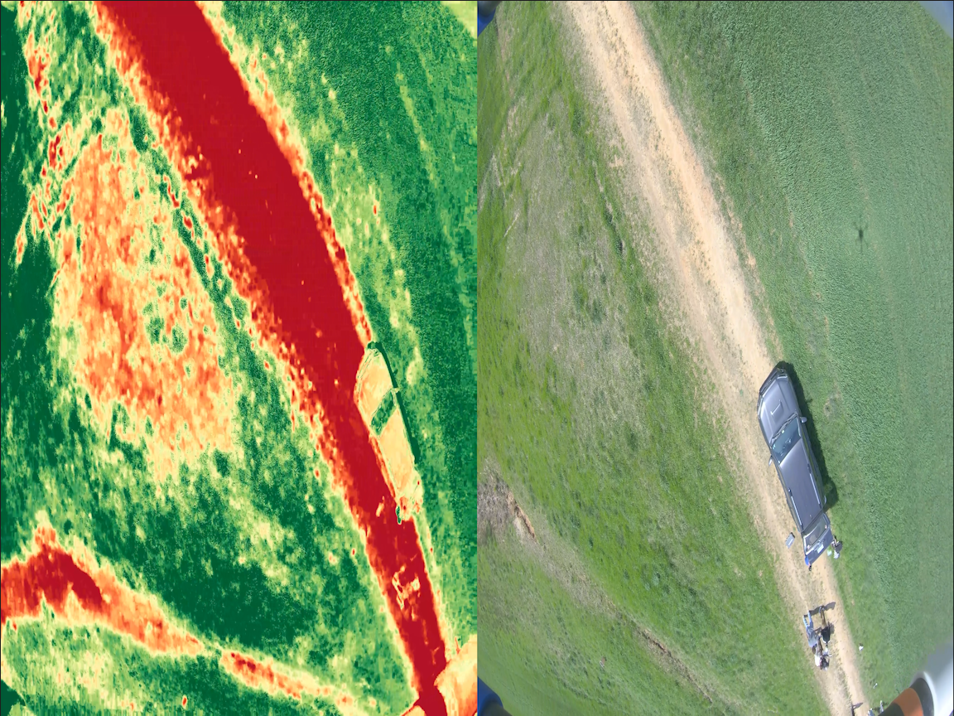
Image Processing
The image processing computes a VI green index for the recorded flight video. This highlights areas of the field that are not homogenous to the rest of the field. The use of this index allows for easy identification of hazards, such as mud or rocks, as well as issues with the crop.

Slide 19
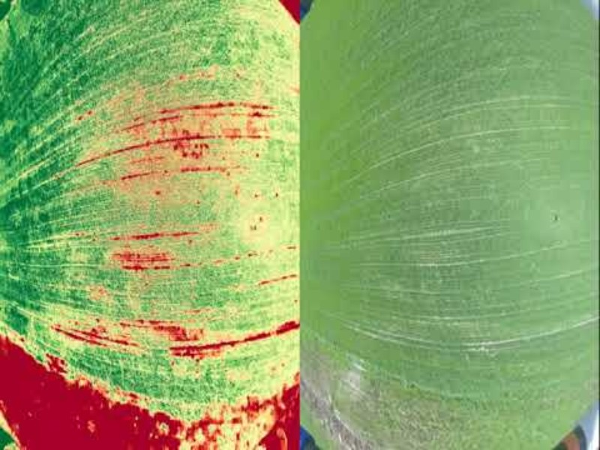

Slide 20
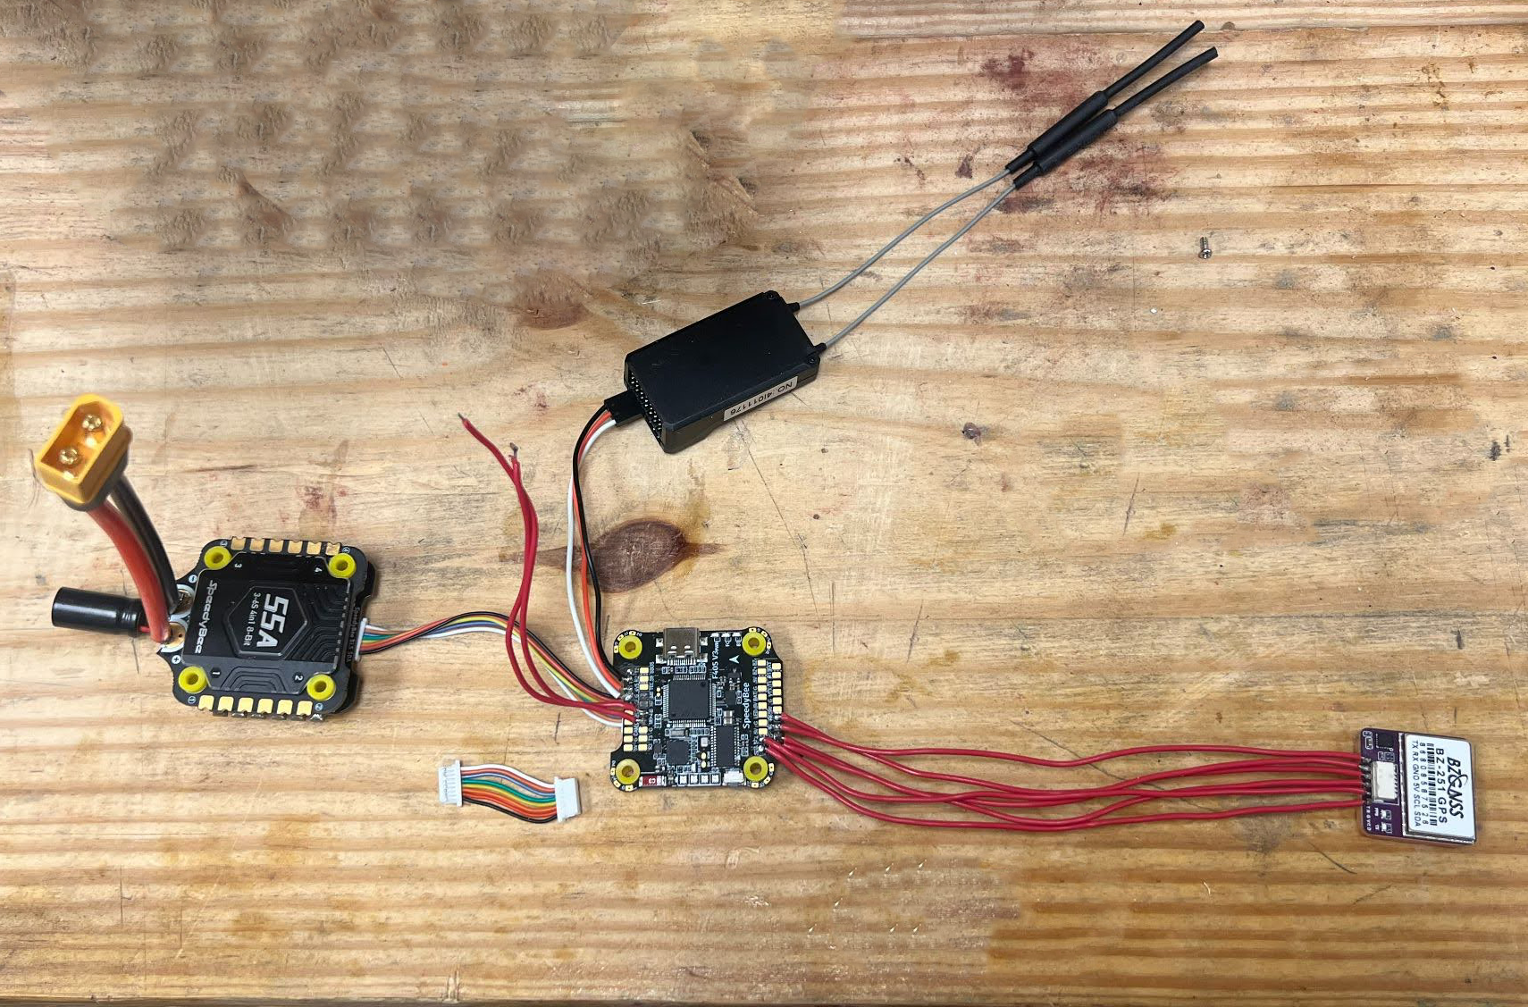
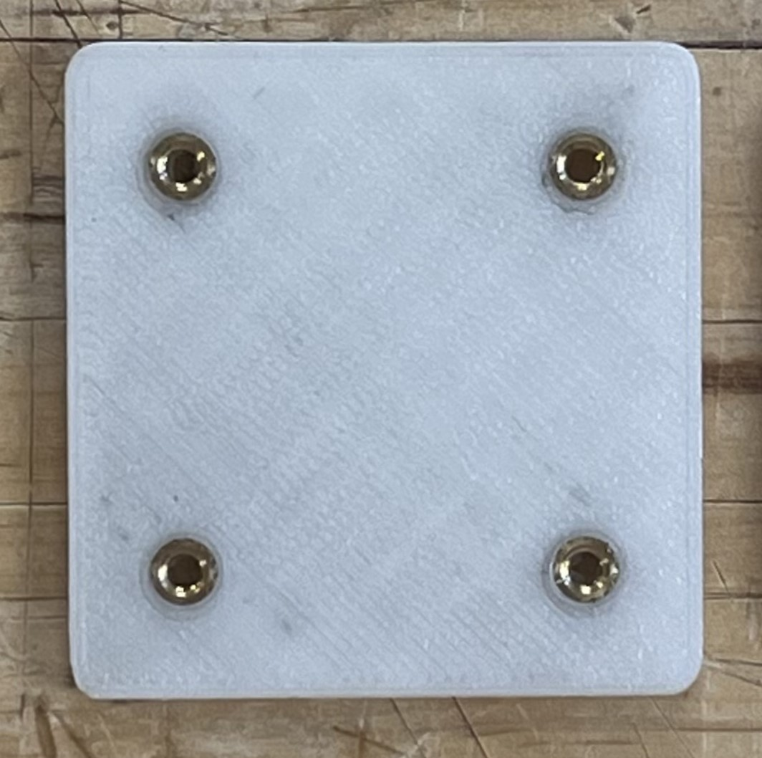
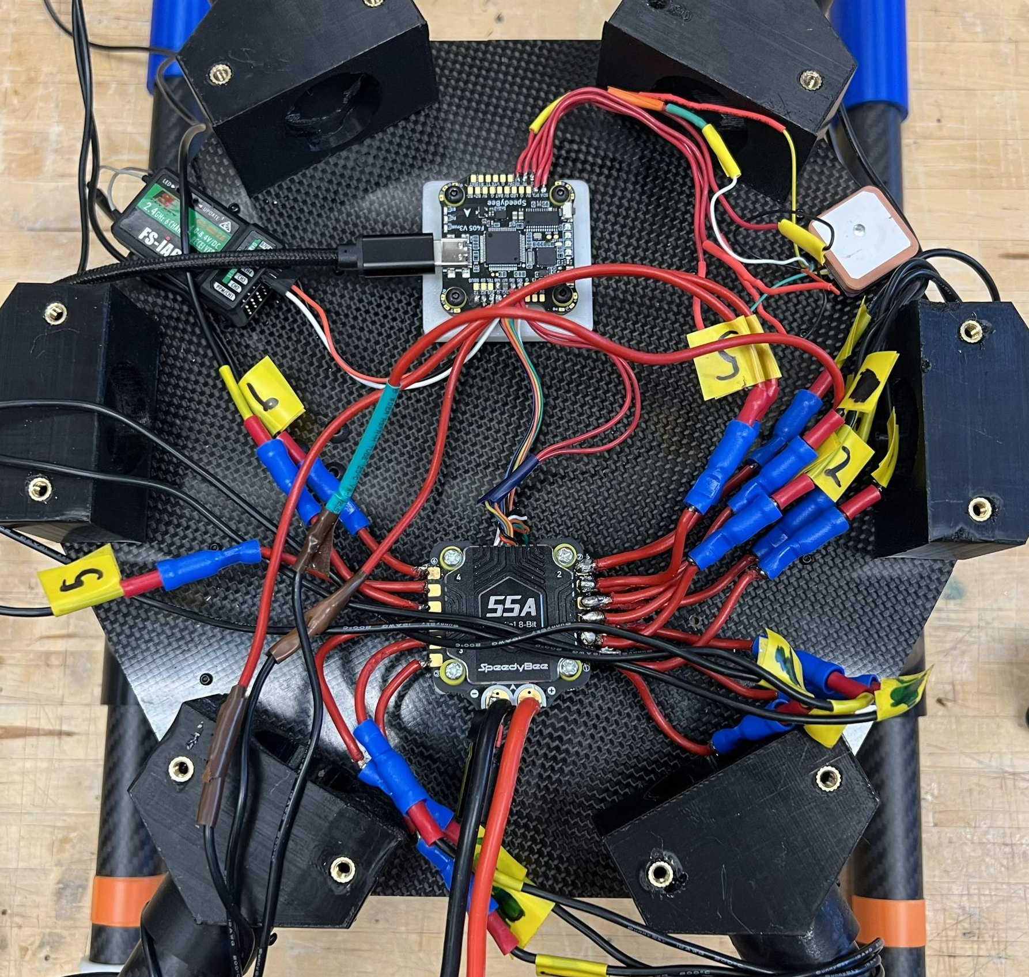
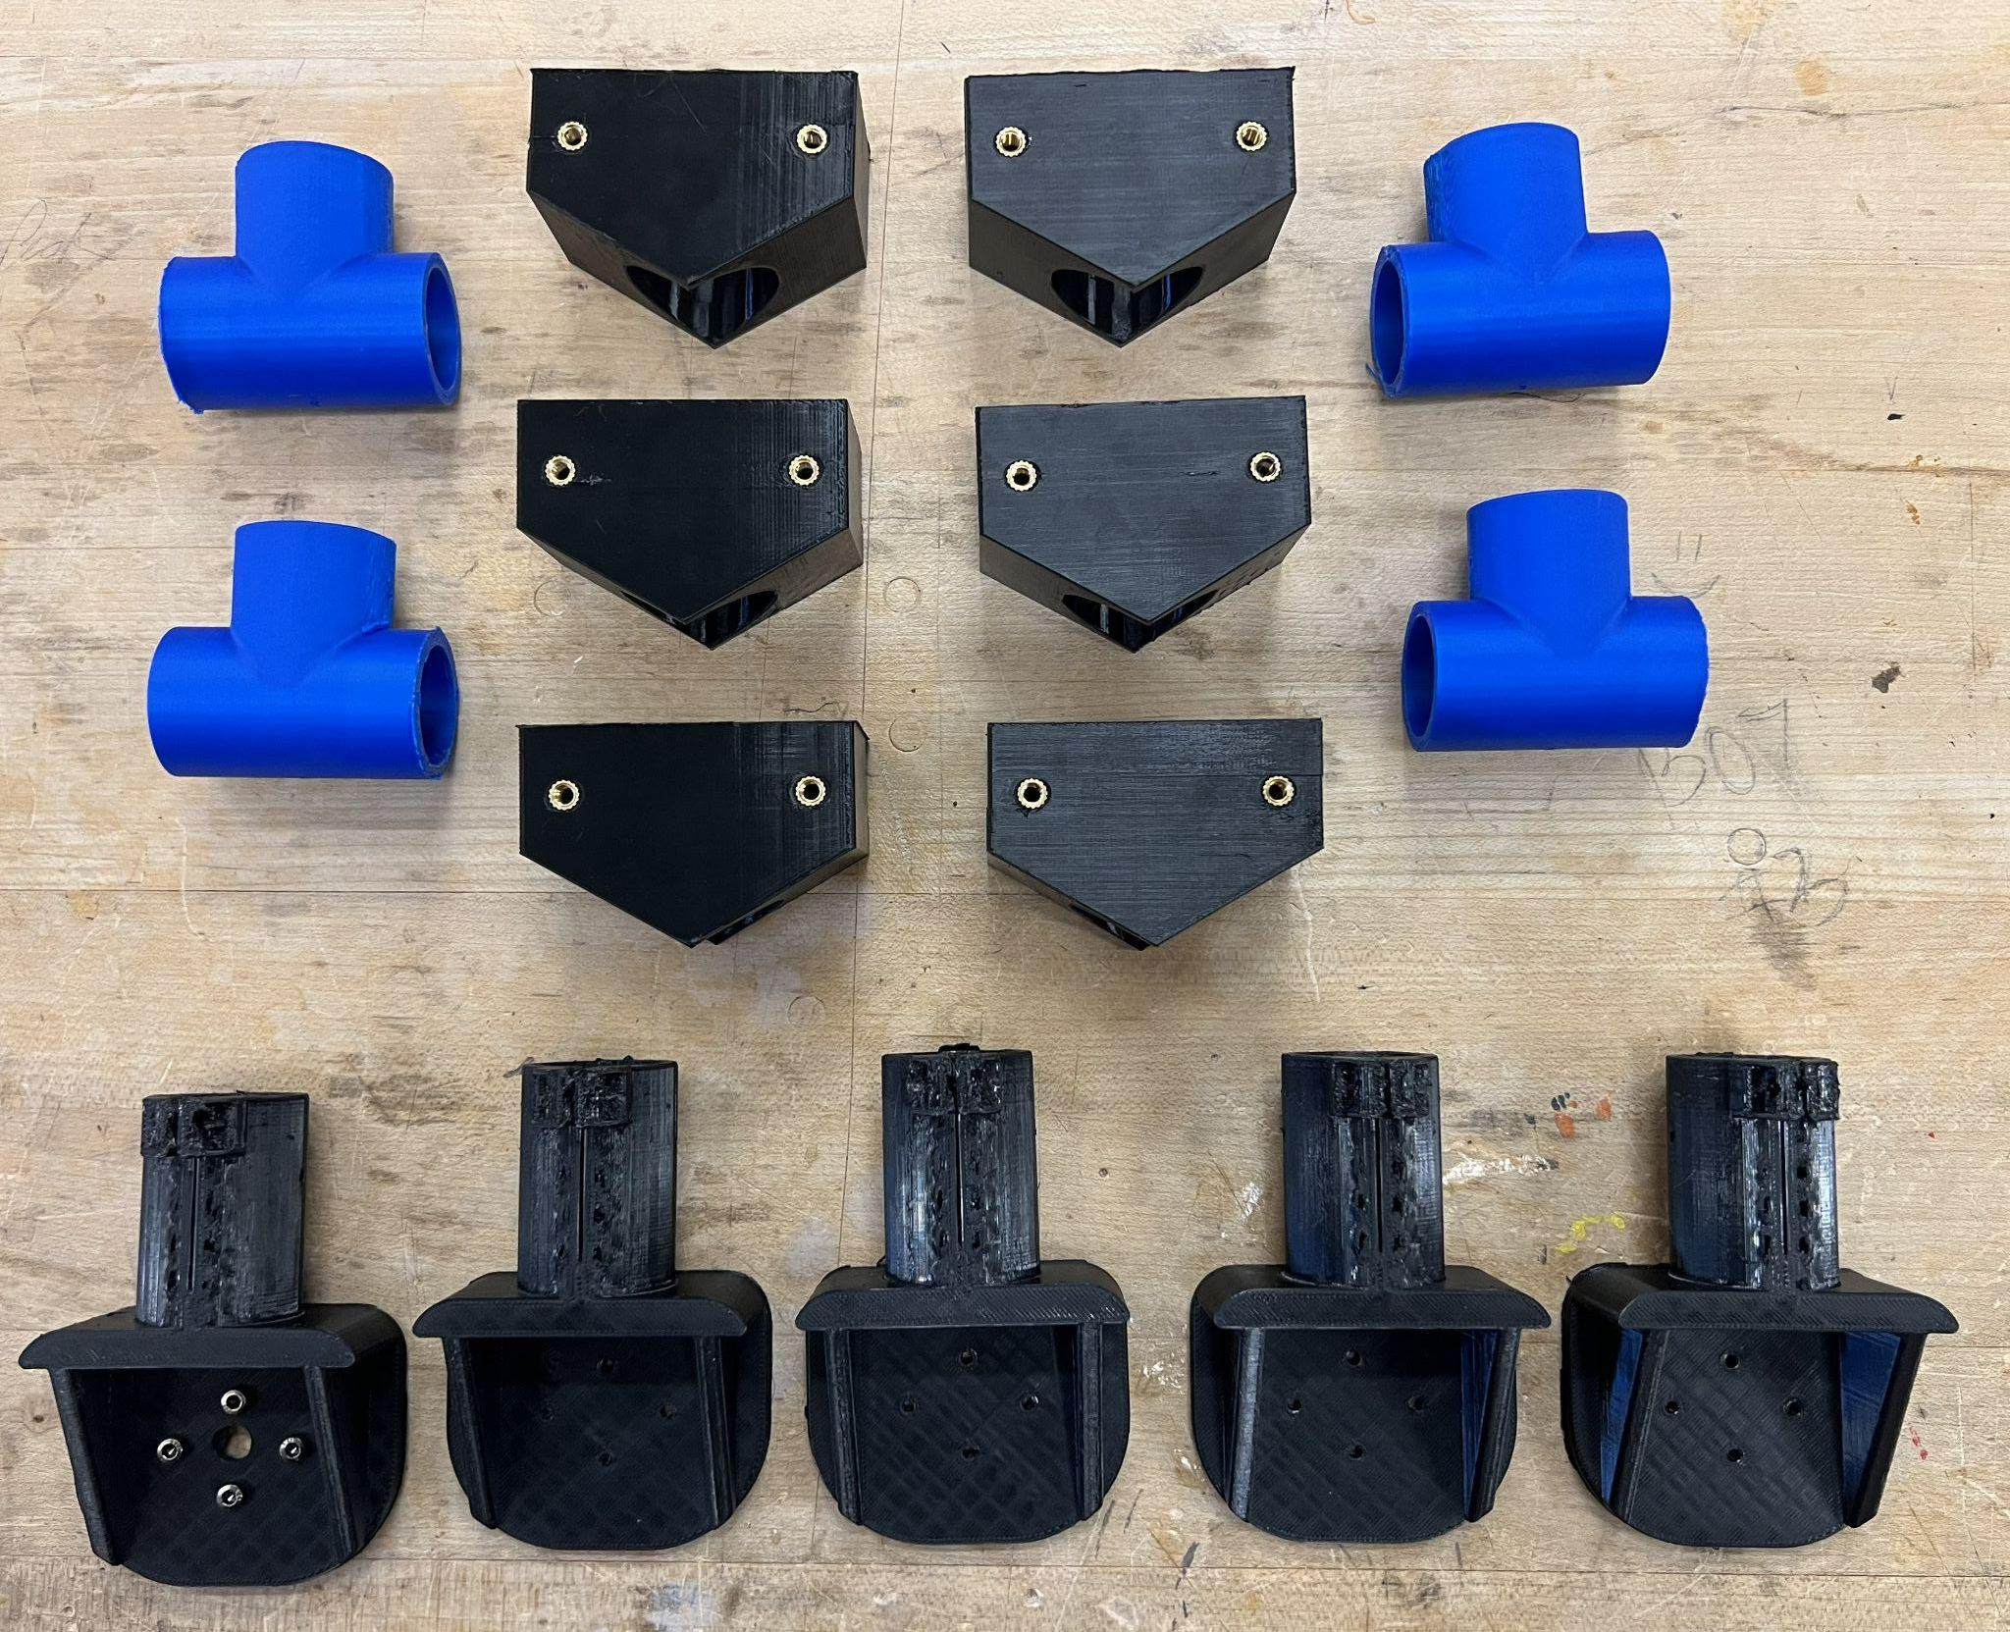
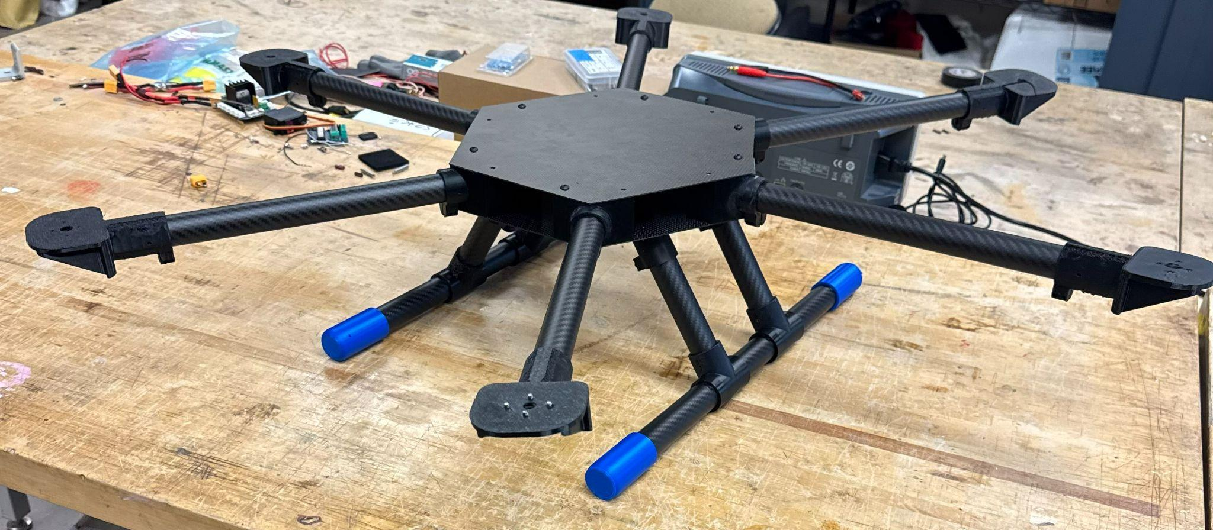
Manufacturing
Mounting
Soldering
Assembly
3D Printing
Drone Frame Assembly

Slide 21
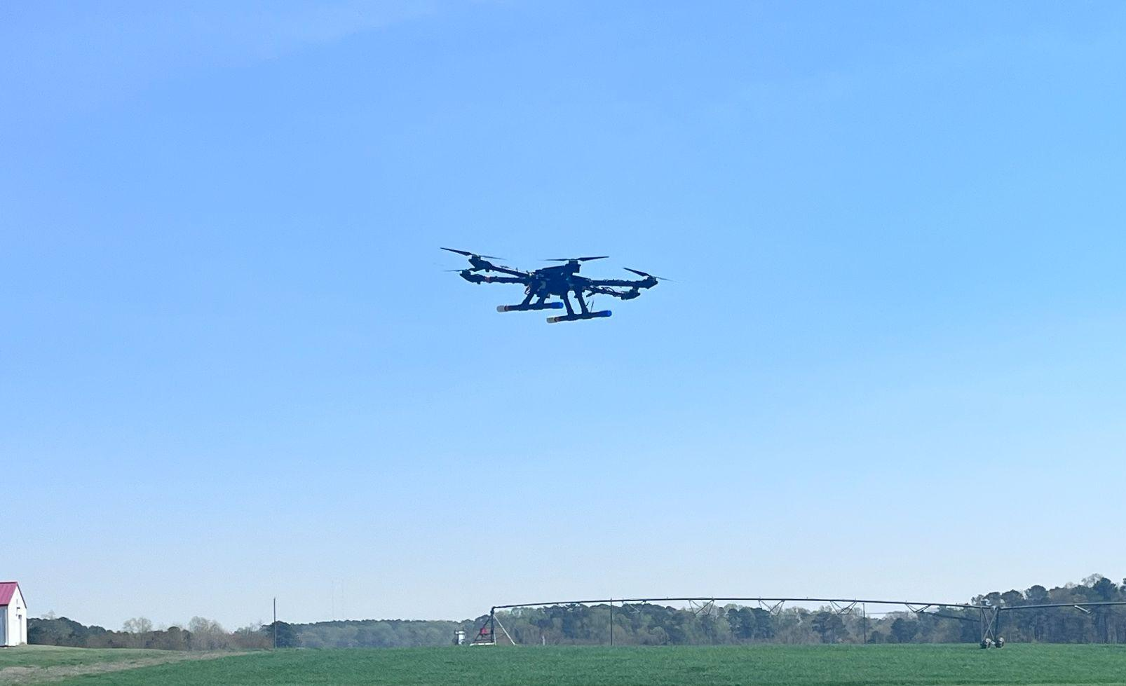
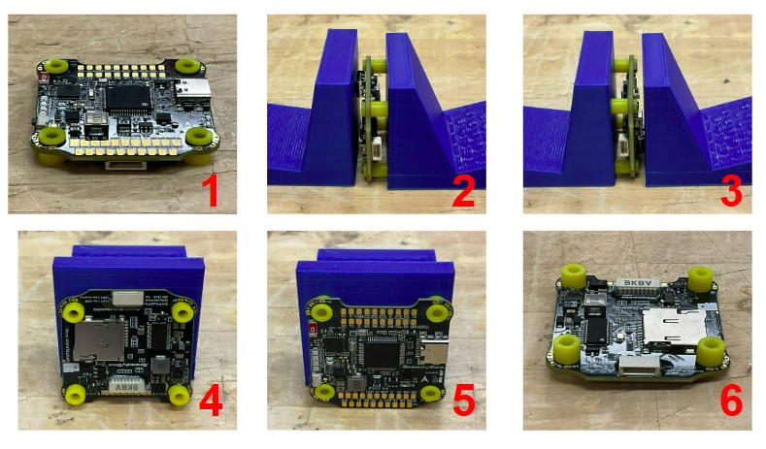
Verification Tests
Hover Test: Verify the Field Falcon can loiter stably in wind conditions.
Throttle Range Test: Verify that the motors are responsive to R/C inputs.
On-Board Sensors Test: Verify gyroscope and barometer readings.
Remote ID: Verify that the Remote ID of the drone continuously updates.

Slide 22
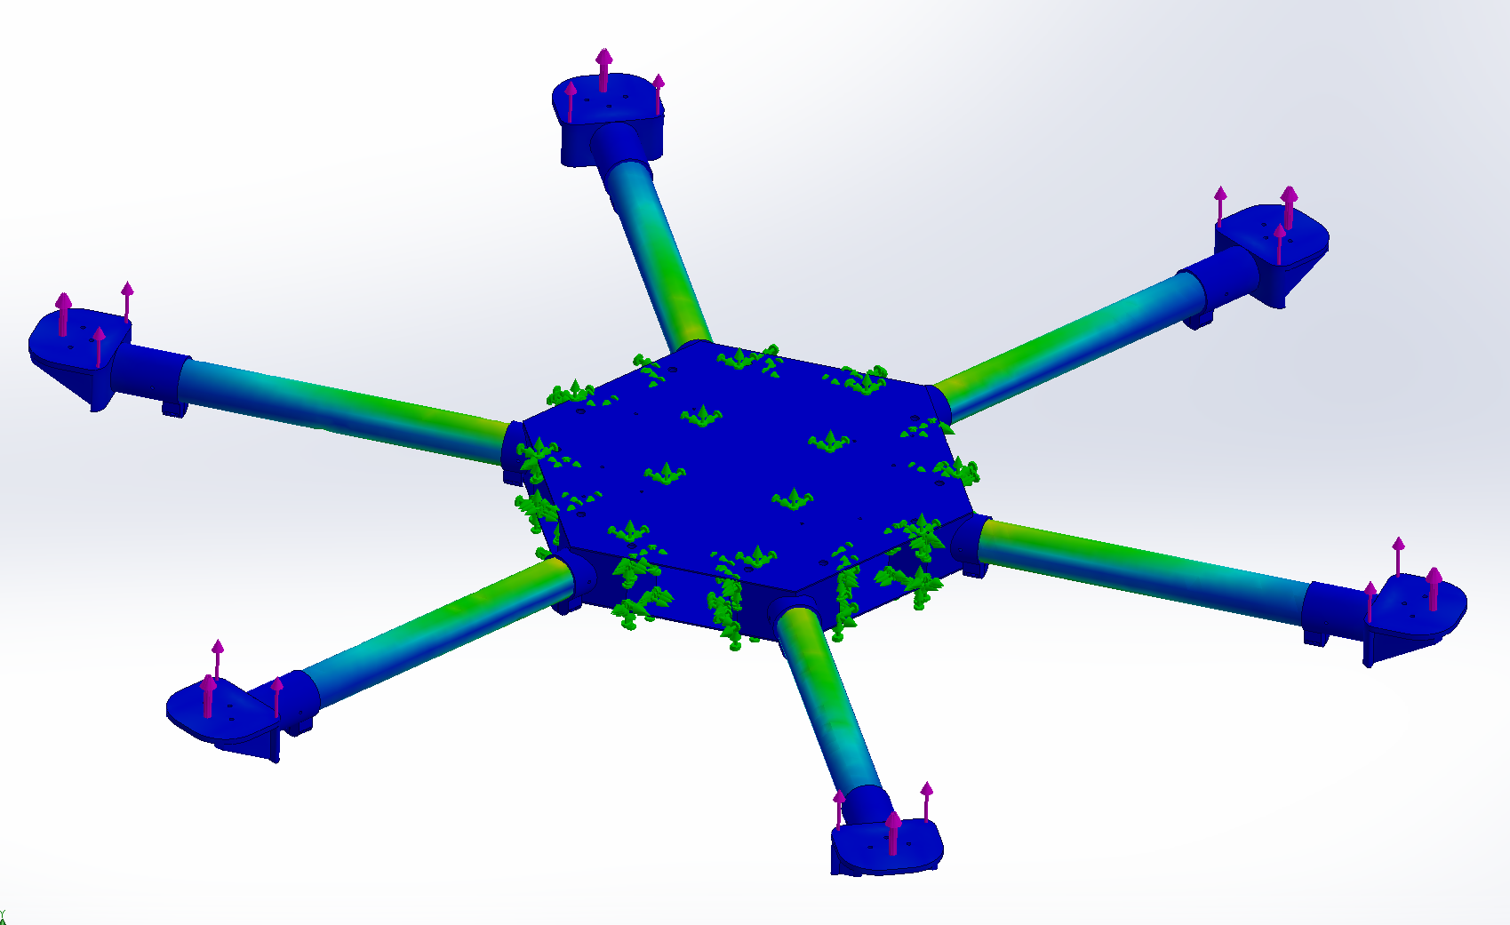
Verification Tests cont.
FEA Tests: Verify the carbon fiber arms can withstand thrust exertion.
Drop Test: Verify the landing gear can withstand a drop of three feet.

Slide 23
Risk Management
Risk | Component(s) Associated with Risk | Severity of Risk | Likelihood/Frequency of Risk
R1. Overheating | Battery | Moderate | Low Likelihood
R2. Motor Failure | Motors | Critical | Unlikely
R3. Hard Landing | Landing Gear, Arms, Frame | Marginal | Very Likely
R4. Arm Breaks | Arms, Frame | Catastrophic | Low Likelihood
R5. Broken Propeller | Propellers | Marginal | Low Likelihood
R6. Signal/ Communication Loss | GPS, Flight Controller | Critical | Somewhat Likely

Slide 24
Risk Management cont.
Risk | Component(s) Associated with Risk | Severity of Risk | Likelihood of Risk
R7. Power Loss | Battery | Catastrophic | Low Likely
R8. Camera Lense Dirty/Damaged | Camera | Marginal | Very Likely
R9. Connection Shear | Firmware | Critical | Unlikely
R10. Obstacle Entanglement | Arms, Frame, Propellers | Moderate | Very Likely

Slide 25
Risk Management
Risk Matrix
Likelihood | Negligible | Marginal | Moderate | Critical | Catastrophic
Unlikely |  |  |  | R2, R9
Low Likelihood |  | R5 | R1 |  | R4, R7
Somewhat Likely |  |  |  | R6
Very Likely |  | R3, R8 | R10
Almost Certain

Slide 26
Risk Management Mitigation Plan
Risk | Mitigation Plan
R1. Overheating | Ventilate battery
R2. Motor Failure | Program switches on transmitter to turn off select motors in order to maintain stability if a motor fails
R3. Hard Landing | Flexible design/material to absorb impact
R4. Arm Breaks | Structural bracing or reinforcement
R5. Broken Propeller | Include extra propellers
R6. Signal/ Communication Loss | Ensure drone is within line of sight

Slide 27
Risk Management Mitigation Plan
Risk | Mitigation Plan
R7. Battery Loses Power | Ensure that the battery is fully charged before each flight
R8. Camera Lense Dirty/Damaged | Clean off/inspect camera before use and utilize a screen protector/tear-offs on the lense
R9. Connection Shear | Use heat inserts rather than threading, add extra points of connection
R10. Obstacle Entanglement | Ensure the drone stays at least ~30 feet above ground while surveying to avoid lower elevation obstacles

Slide 28
Risk Management Mitigation Plan
Post Mitigation Risk Matrix
Likelihood | Negligible | Marginal | Moderate | Critical | Catastrophic
Unlikely |  | R5 | R1, R2, R9 |  | R4, R7
Low Likelihood |  |  |  | R6
Somewhat Likely | R8
Very Likely | R3 | R10
Almost Certain

Slide 29
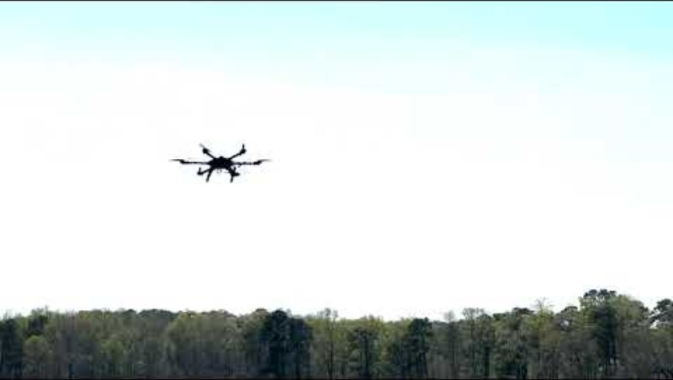
Test Flight

Slide 30
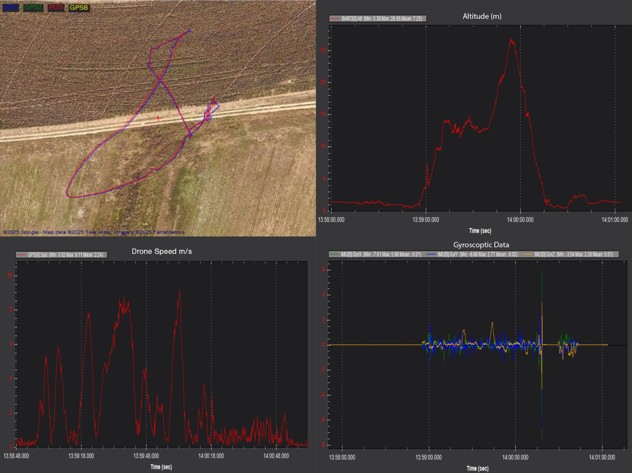
Test Flight Data
[1]
[2]
GPS Flight Path
Altitude (m)
Drone Speed (m/s)
On-Board Gyroscopic Readings
[3]
[4]

Slide 31
Areas for Growth After Test Flight
Linking the video and GPS data to better locate hazards identified during post processing
Compiling the video into a map of the field with areas of interest highlighted and marked
Automated flight will allow us to cover more ground while not overlapping or missing sections of the field
Integrating real time image processing through transmitting the video live during flight
Gyroscopically stable camera mount

Slide 32
Conclusion
The Field Falcon is used for efficient land surveying to save farmers time and money
Image processing helps monitor crop health and identify field obstructions
Field Falcon will be an affordable option for mass production
Designed for stable flight and high quality images
Risk assessment of potential failure modes
Future plans for integration into mass production and a more competitive product

Slide 33
References
[1] National Institute of Aerospace. "NASA Gateway to Blue Skies Competition." National Institute of Aerospace, 2024. Accessed April 2, 2025. https://blueskies.nianet.org/competition/.
[2] Adobe Stock. "Rain Agriculture - Stock Images." Adobe Stock, 2024. Accessed April 2, 2025. https://stock.adobe.com/search/images?k=rain+agriculture.
[3] Speedy Bee. (n.d.). “BZGNSS BZ-251 GPS with 5883 Compass.” Speedy Bee. Retrieved November 14, 2024, from https://www.speedybee.com/bzgnss-bz-251-gps-with-5883-compass/
[4] Holy Stone. (n.d.). “Holy Stone Drone Remote ID Module.” Holy Stone. Retrieved November 14, 2024, from https://store.holystone.com/products/holy-stone-drone-remote-id-module
[5] SpeedyBee. "SpeedyBee F405 V4 BLS 55A 30×30 FC & ESC Stack." SpeedyBee, 2024. Accessed April 2, 2025. https://www.speedybee.com/speedybee-f405-v4-bls-55a-30x30-fc-esc-stack/#Parameters.
[6] CaddxFPV. "Caddx Walnut Action Camera." CaddxFPV, 2024. November 14, 2024. https://caddxfpv.com/products/caddx-walnut-action-camera.

Slide 34


Thank you

Slide 35
Questions

