Slide 1
Impacts of Metasurface Antenna Technology on the Aerospace Industry
Daria G. Astaire and Peyton D. Hay
Florida Institute of Technology
AIAA Region II Student Conference Name, April 3-4
Published by the American Institute of Aeronautics and Astronautics, Inc., with permission.
Notes:
Good morning, everyone. Thank you all for being here. [title]
My name is.... I'm a [class] in the [department] at the Florida Institute of Technology.
And my name is.... I'm a [class] in the [department] at the Florida Institute of Technology.
Our discussion revolves around metasurfaces, where we'll introduce the research behind them and talk about how their characteristics could improve upon current technological constraints within the space industry.
This topic is both broad and specific at the same time: Broad in terms of antennas in space communications, but specific in terms of the technology.
With this, there is some background information we'll look at before getting into the topic.

Slide 2
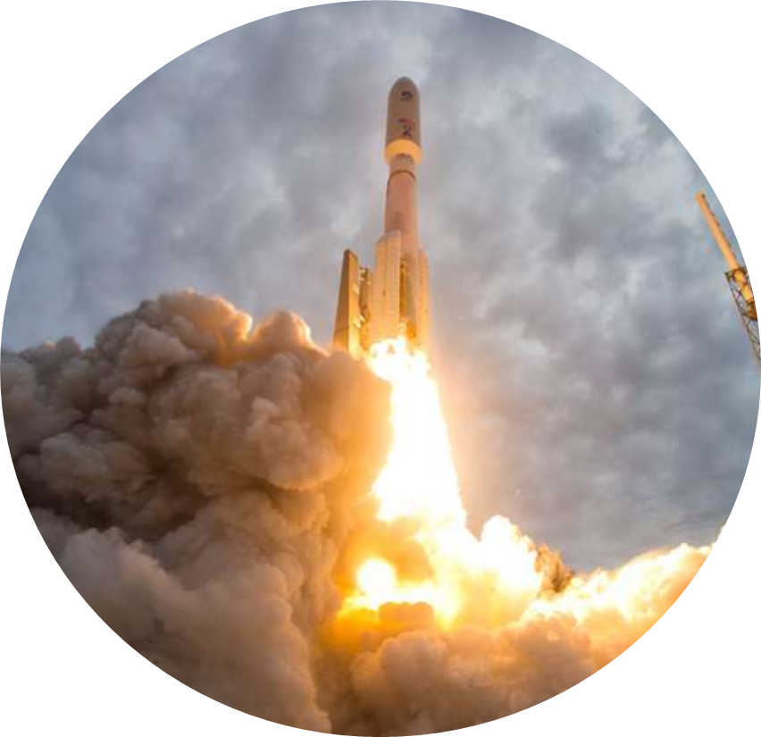
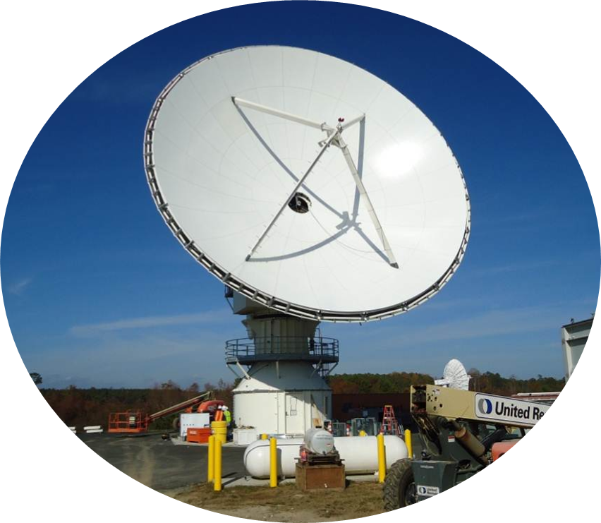
Antennas and Space Operations
Antennas are highly significant to all space operations
They serve as our single connection to spacecraft
"GOES-U" is in the Public Domain, "Rocket" is in the Public Domain
Notes:
(Big picture) - Daria
(Continuing from last slide) As of June 2024, we have over 10,000 satellites and interplanetary probes active in space.
with this, it's easy to see how space communications has turned into a billion-dollar industry over the past nearly 70 years since the first successful satellite in 1957.
Today, satellites provide a variety of services, such as deep space exploration from the Voyager probes, to LEO global internet coverage in Starlink.
[Need transition sentence here]
Our constraints primarily come from the limitations of the antennas used, which depends on the services provided.

Slide 3
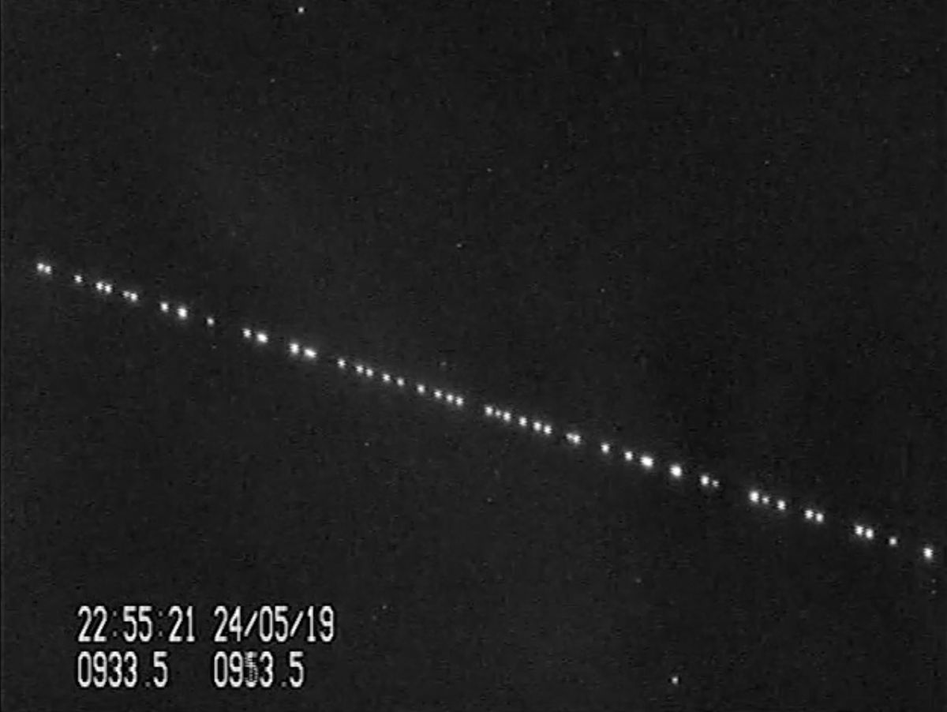
Antennas and Space Operations
As of June 2024, we have over 10,000 satellites and space probes
Services range from exploration in deep space, to global internet coverage in Low Earth Orbit (LEO)
"Starlink satellites" is in the Public Domain
Notes:
(Big picture) - Daria
(Continuing from last slide) As of June 2024, we have over 10,000 satellites and interplanetary probes active in space.
with this, it's easy to see how space communications has turned into a billion-dollar industry over the past nearly 70 years since the first successful satellite in 1957.
Today, satellites provide a variety of services, such as deep space exploration from the Voyager probes, to LEO global internet coverage in Starlink.
[Need transition sentence here]
Our constraints primarily come from the limitations of the antennas used, which depends on the services provided.

Slide 4
Antennas and Space Operations
Current antenna technology reached scalability and reliability limitations
Metasurface antenna technology will:
  Mitigate the trade-offs between size, mass, cost, and reliability
  Enable scalable solutions across space manufacturing, communications, exploration, and transportation systems
Notes:
(Impacts of technology) - Daria
With current antenna technology, we've reached scalability and reliability limitations that lead to high costs and system compromises.
When it comes to transportation systems, we can only reduce the size and mass of our payloads by so much. And in space, we can only optimize current antennas until their complexity reaches reliability limits.
Of course, the larger, heavier, and more complex our designs are, the more expensive the product becomes.
Metasurface antenna technology will not only mitigate the trade-offs between size, mass, cost, and reliability, but will also enable scalable solutions across space manufacturing, communications, exploration, and transportation systems.

Slide 5
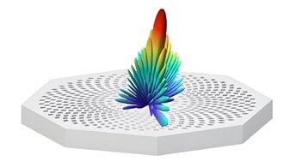
What are Metasurfaces?
Artificial, planar (2D) devices that interact with electromagnetic (EM) waves
20+ years of research
From metamaterials (3D)
"Meta" means "beyond"
"Metasurface" by SannyTelecom
Notes:
(What are metasurfaces?) - Peyton
Metasurfaces are artificial, planar devices that interact with electromagnetic waves.
Research ongoing for 20+ years, even before the term “metasurface” was coined in research around 2011.
Surprisingly, research in these two-dimensional (2D) surfaces came about after their three-dimensional (3D) counterparts, known as metamaterials.
The word “meta” - a Greek word translating to “beyond” - is a fitting descriptor for these surfaces, as their properties can “go beyond” what is found in nature.

Slide 6


How Do Metasurfaces Work?
Materials are classified by:
Averages of homogeneous materials
Electric Polarization
Magnetization
Notes:
(How do metasurfaces work? 1/2) - Peyton
To create materials that interact with EM waves, their material properties have to be tailored to result in a desired effect.
In the context of electromagnetics, we look at two primary values: electric permittivity, ɛ, and magnetic permeability, μ.
These values quantify how well materials polarize and magnetize, respectively.
These quantities are averages of homogeneous materials, where it is assumed that the material is of uniform density and thickness.

Slide 7
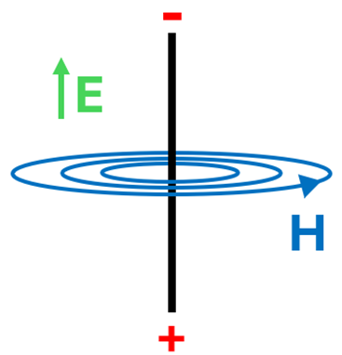
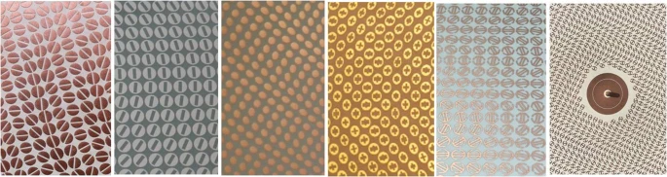
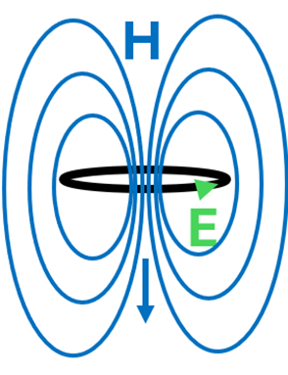
How Do Metasurfaces Work?
Consist of "meta-atoms"
Produce a net, “bulk” effect due to relative size of wavelength
"Patterned Surfaces" is licensed under CC BY 4.0
Notes:
(How do metasurfaces work? 2/2) - Peyton
To make materials with these values, we have to design their constituent elements to produce their own effects.
Metasurfaces consist of tiny, subwavelength elements referred to as "meta-atoms" or "scatters" that each have an electric/magnetic response, and together, produce a bulk effect on an incident wave.
Here, the wavelengths of interest are much larger than the size and spacing of the meta-atoms.
And since the wavelengths of interest are much larger, electromagnetic waves see metamaterials as homogeneous structures rather than individual meta-atoms and feel their bulk effects.
In very basic terms, we can look at the electric and magnetic effects of "loops" and "rods" from physics
In the presence of an EM field [Explain from Image]

Slide 8
Metasurface Antennas
The designable electromagnetic properties of metasurfaces make them excellent candidates for antenna applications
Two examples:
1. LEO – phased array antennas for beam steering
2. Deep Space – Parabolic dish antennas for high directivity
Notes:
(Metasurface Antennas) - Peyton
The designable electromagnetic properties of metasurfaces make them excellent candidates for antenna applications.
We'll look at two examples of how metasurfaces could be good alternatives for common antennas:
In LEO, satellites pass over regions of earth for about 15 minutes, so they use electrical beam steering to point their waves in a specific direction.
In Deep Space, directivity is important for efficient long-distance transmission and reception. Parabolic dishes are commonly used to achieve this.

Slide 9
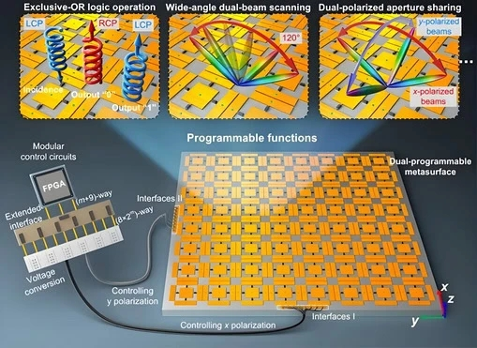
Metasurfaces in LEO
Electrical Beam Steering
Phased Arrays use active phase shifters (power hungry, heavy, and bulky)
Metasurfaces use semi-passive elements (less power, mass, and size)
"Polarization & EBS" by SannyTelecom
Notes:
(Metasurface Antennas) - Peyton
In the case of commonly used phased array antennas, metasurfaces possess the same beam steering capability [8] (Fig. 2) in a smaller, lighter package. By taking advantage of passive elements rather than active ones, such as phase shifters, which are large, bulky, and power hungry. Metasurfaces are less lossy and more energy efficient.

Slide 10
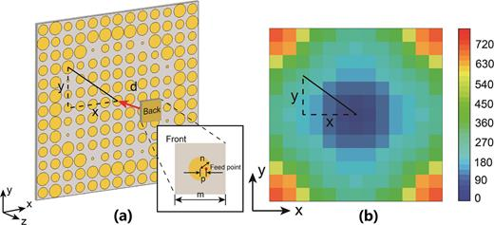
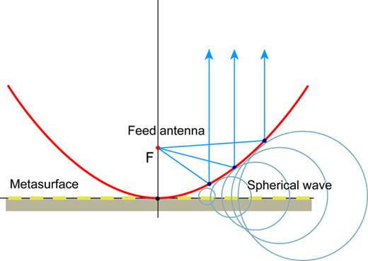
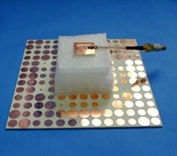
Metasurfaces in Deep Space
High Directivity
Parabolic Dishes are large, costly, and heavy (other options are complex)
Metasurfaces are smaller, cheaper to manufacture, and lighter
"Parabolic Dish Metasurface" is licensed under CC BY 4.0
Notes:
(Metasurface Antennas) - Peyton
The designable electromagnetic properties of metasurfaces make them excellent candidates for antenna applications.
Whether incorporated as part of an antenna or even replacing the antenna entirely, metasurfaces can enhance wave propagation while alleviating pitfalls of conventional antenna systems.
In the case of commonly used phased array antennas, metasurfaces possess the same beam steering capability [8] (Fig. 2) in a smaller, lighter package. By taking advantage of passive elements rather than active ones, such as phase shifters, metasurfaces are less lossy and more energy efficient.
In the case of highly directional antennas, metasurfaces alone cannot overcome the directivity achieved by the parabolic dish. However, the size, mass, and complexity involved in this design, due to its large dish reflector and bulky mechanical beam steering components, make these highly capable antennas less than ideal. Instead of replacing the antenna, research shows similar performance when replacing the parabolic reflector with a flat metasurface. By tailoring the meta-atoms to produce a greater phase shift radially outward from the center, Yao. M et.al.[10] were able to mimic the electromagnetic effects of the curved dish (Fig. 3).

Slide 11
Pitfalls of Metasurface Antennas
Electrically reconfigurable metasurfaces:
Increased losses, bandwidth limitations from complex circuitry
Manufacturing:
Minimum distance between meta-atoms
Testing and Evaluation:
Time and money
Notes:
(Pitfalls of Metasurfaces) - Peyton
Metasurfaces are not, however, without their limitations - at least not without further research and development.
While significant advancements have been made in developing metasurfaces with comparable performance characteristics to traditional antennas, there remain drawbacks in some areas of their optimization.
To name a few, (1) electrically reconfigurable metasurfaces, such as those designed for electronic beam steering, can face increased losses and bandwidth limitations resulting from necessary, but complex circuitry [3].
(2) In terms of manufacturing, limitations were found in the minimum distance within and surrounding the meta-atoms that make up the structure in Ref. [11], which can be challenging as frequency increases with this design.
(3) Lastly, a major hurdle to overcome will be the testing and evaluation of these new systems in space, likely to last a significant amount of time prior to widespread development and manufacturing.

Slide 12
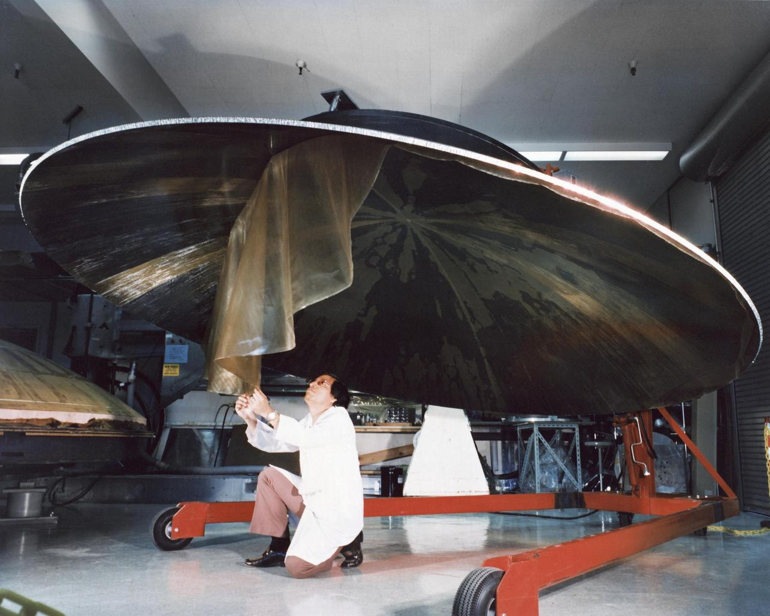
Why Metasurface Antennas in Aerospace?
Traditional antennas: Large, heavy and power hungry, relying on mechanical steering and phased arrays
Metasurface antennas: No moving parts, reducing maintenance and extending satellite lifetimes
"Voyager: Antenna Dish Construction" is in the Public Domain
Notes:
Daria
- Traditional antennas in space are large, heavy, and power-hungry. They rely on mechanical steering or phased arrays, both of which increase cost and complexity. Metasurface antennas solve this. They are compact, lightweight, and don’t require moving parts, making them ideal for space applications.
- A major advantage is power efficiency—metasurface antennas consume far less energy than phased arrays, freeing up power for other spacecraft systems. They’re also software-defined, meaning they can be reconfigured in orbit to support different missions, increasing flexibility.
And since they have no moving parts, they’re far more reliable and durable, reducing maintenance and extending satellite lifetimes.

Slide 13
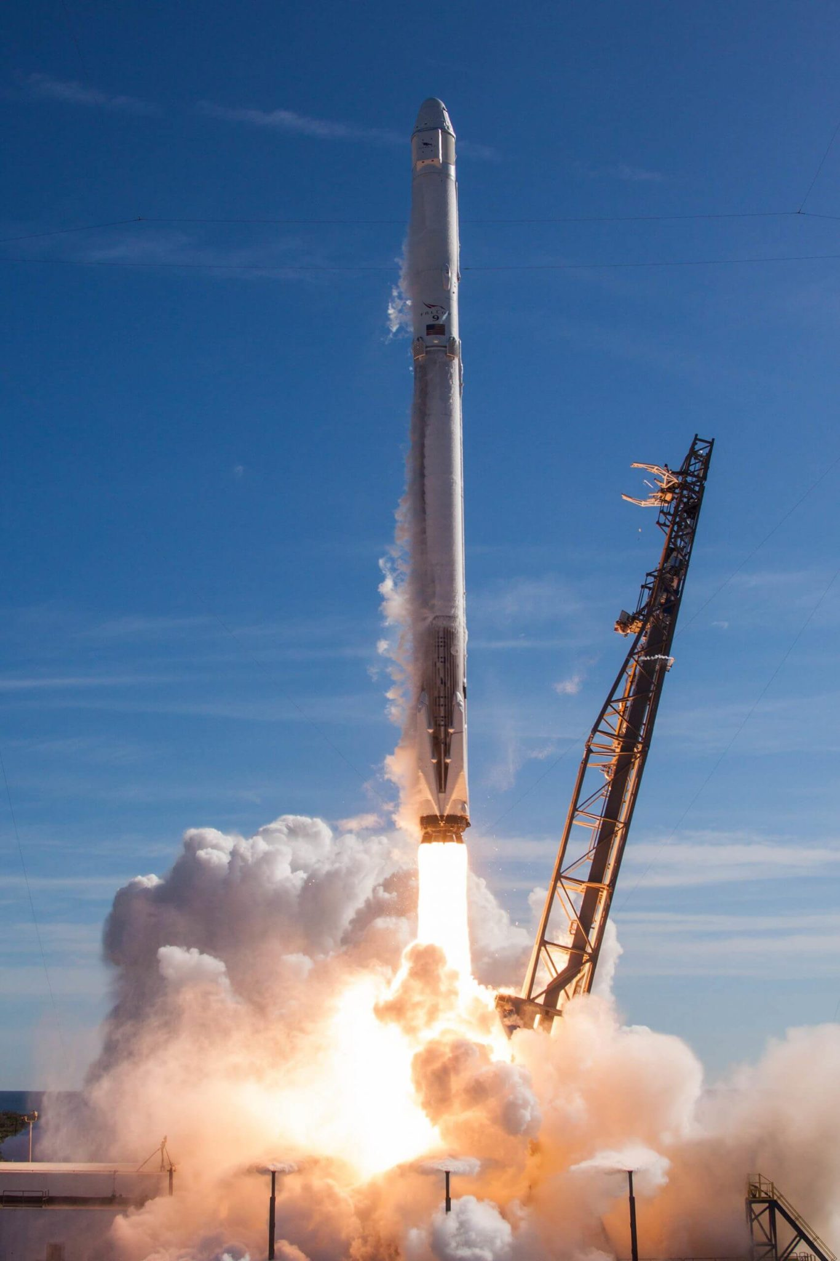
Cost and Efficiency
Falcon 9 Rideshare Breakdown:
Desired Orbit: LEO
100kg Payload: $0.65M
20kg Payload: $0.33M
Reduced mass Reduced launch costs
"SpaceX Falcon 9 " is in the Public Domain
Notes:
(Subtopic) - Daria
Reducing mass means reducing launch costs. Since launch prices are based on weight, replacing a 100-kg parabolic antenna with a 20-kg metasurface antenna could save hundreds of thousands per satellite. (Talk about the rideshare information, include picture)
With Falcon 9 rideshare missions costing between $50,000 and $80,000 per kilogram [14, 15], replacing a 100kg parabolic dish with a 20kg metasurface antenna - using 20kg as an arbitrary example - would save $480,000 per satellite.

Slide 14
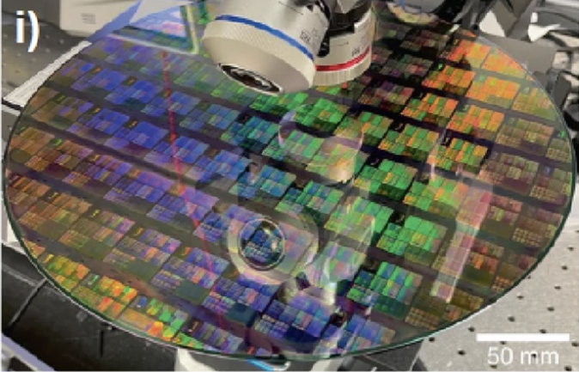
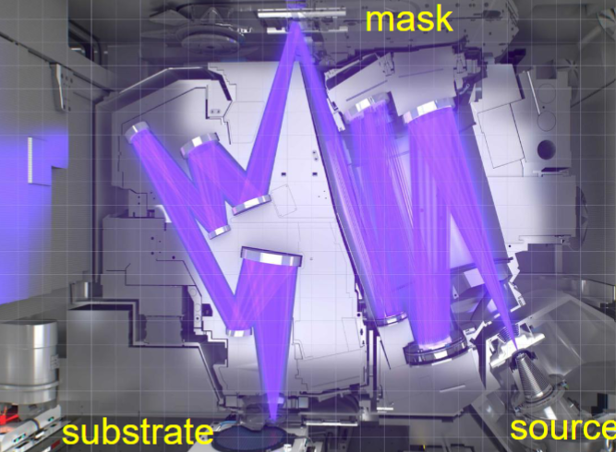
Cost and Efficiency
Fabricating costs are lowered through common manufacturing techniques such as lithographic printing
“Cost-Effective Environmentally Friendly Mass Manufacturing” is in the Public Domain
Notes:
Manufacturing is cheaper too—traditional antennas require complex components, while metasurface antennas can be produced with low-cost, scalable fabrication methods can be produced using cost-effective techniques such as lithographic printing.
Operational costs drop as well. No mechanical failures, no need for frequent replacements, and easy updates via software rather than hardware modifications.
When applied to large constellations, these savings scale dramatically, making metasurface antennas a cost-effective choice for future missions.

Slide 15
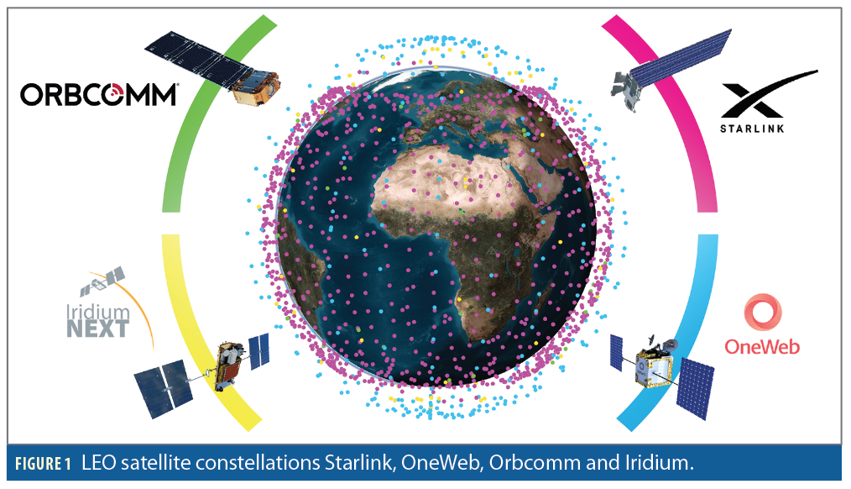
Direct Industry Application
“LEO Satellite Signals of Opportunity” is in the Public Domain
Notes:
-Small satellites and CubeSats benefit the most. Metasurface antennas fit within their strict size and power constraints while still delivering high-performance communication.
-In LEO constellations, these antennas enable dynamic beam shaping, reducing signal congestion and optimizing coverage (speak on example)
-For deep-space exploration, they can enhance optical communication, making high-speed data transfer between planets more feasible.

Slide 16
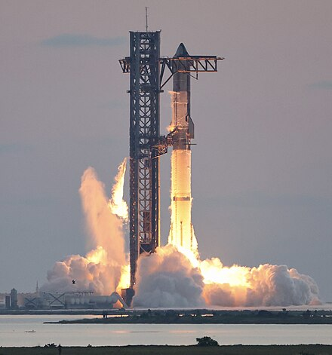
Future Industry Application
On-orbit reconfigurability: Adaptive mission updates in real time
More efficient communications, bringing faster data from distant spacecraft
" SpaceX Starship" is in the Public Domain
Notes:
-The biggest shift will be on-orbit reconfigurability. Instead of replacing satellites, metasurface antennas allow for adaptive mission updates in real time.
-Deep-space missions could see higher-bandwidth, more efficient communications, bringing faster data from distant spacecraft.
-Military and defense applications also stand to gain as secure, reconfigurable satellite communications provide a significant tactical advantage.

Slide 17
Key Takeaways
The designable and inherent properties of metasurfaces make them excellent candidates for space antenna applications
The use of metasurface antennas in space can:
  Mitigate the trade-offs between size, mass, cost, and reliability
  Enable scalable solutions across space manufacturing, communications, exploration, and transportation systems
Notes:
(Subtopic) - Daria

