Slide 1
Overcoming Lunar and Martian Dust
Challenges
Yash S Chaudhari
Embry-Riddle Aeronautical University
AIAA Region II Student Conference, April 2-5, 2025
Copyright © by Yash S Chaudhari,
Published by the American Institute of Aeronautics and Astronautics, Inc., with permission.

Slide 2
Introduction & Problem Statement
Imagine exploring the Moon and Mars, only to find your mission compromised by tiny dust particles.
Lunar and Martian dust significantly threaten spacecraft, equipment, astronaut health, clog mechanical systems, damage equipment, reduce visibility, and pose severe health risks.
Notes:
Imagine preparing for years, investing immense resources into missions to the Moon and Mars, only to have tiny particles of dust jeopardize your entire operation. These microscopic dust particles pose a serious threat by clogging critical systems, reducing visibility, and harming astronauts' health. Today, we'll explore why this is such a significant issue.

Slide 3
Apollo and Mars Missions
Apollo Missions:
Equipment failure and respiratory issues
Thermal radiator efficiency reduced by 50%
Spacesuits lost joint flexibility by 40%
Mars Missions:
Global dust storms impact (Opportunity rover)
Electrostatic adherence reduced solar-powered system efficiency by 40%
Dust accumulation ended Opportunity’s mission (2018)

Slide 4
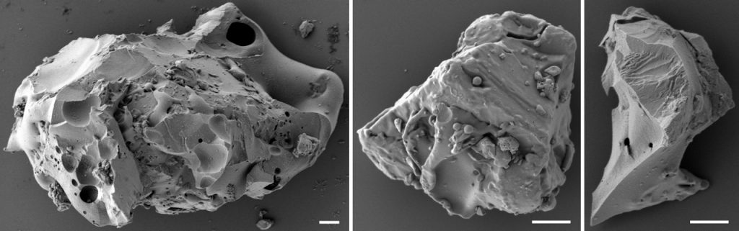
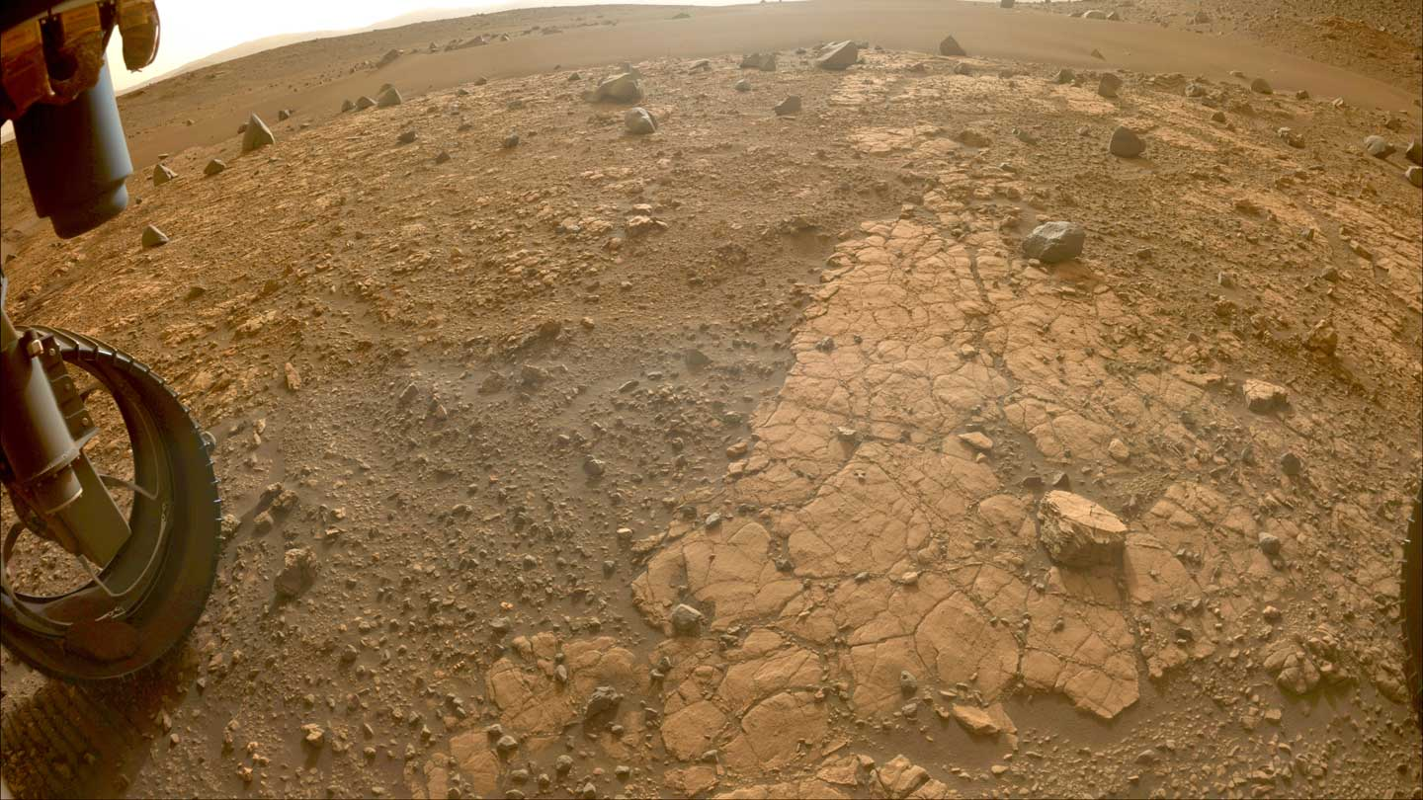
Dust Composition
Lunar dust: Basaltic, abrasive, electrostatically charged
Martian dust: Basaltic, enriched with sulphur and chlorine, corrosive

Slide 5

Effect on human
Lunar dust: Respiratory irritation, potential long-term lung damage
Martian dust: Contains toxic perchlorates causing metabolic disorders

Slide 6
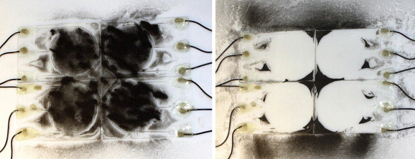
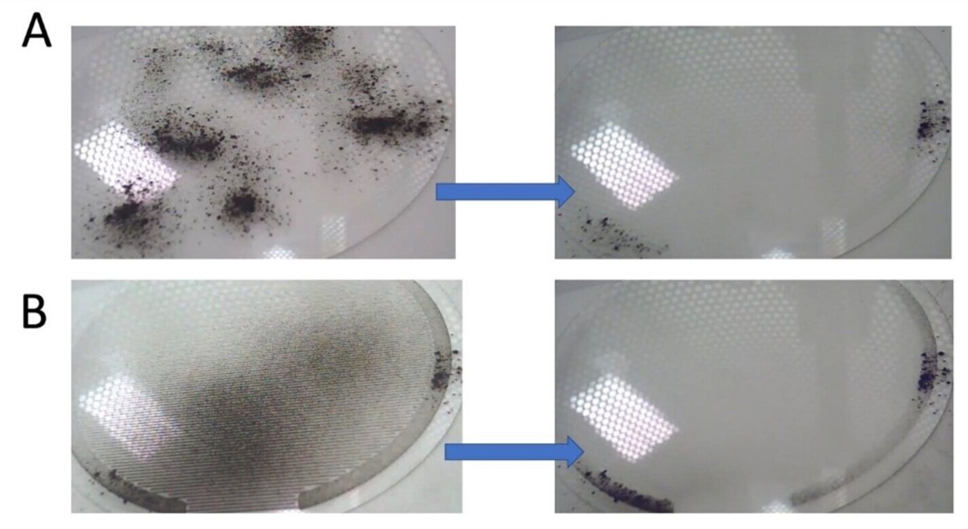
Current Solutions
Electrodynamic Dust Shield (EDS): Removes over 99% dust using electric fields
Surface Coatings: Lotus-leaf-inspired materials reduce dust adherence
Acoustic Removal: Vibration-based dust removal systems

Slide 7
Conclusion & Future Work
Promising solutions include EDS, advanced coatings, acoustic removal
Essential for sustainable human presence on the Moon and Mars
Future Work: Self-cleaning spacesuits, autonomous dust removal systems, In Situ Resource Utilization (ISRU)

Slide 8
Questions ?
Email: yashapana@gmail.com

