Slide 1
High-Altitude Balloon Satellite
Amare Johnson, Madden Pierce, Maria Ivey
University of South Carolina
Region II Student Conference, 2025
Copyright © by Amare Johnson, Madden Pierce, and Maria Ivey
Published by the American Institute of Aeronautics and Astronautics, Inc., with permission.

Slide 2
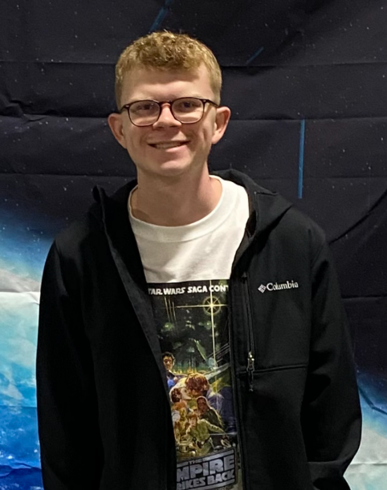


Design Team
Amare Johnson
Irmo, SC
Aerospace Engineering
Maria Ivey
York, SC
Aerospace Engineering
Madden Pierce
Turbeville, SC
Aerospace Engineering

Slide 3
Assignment Details
UofSC Senior Design Project
Assignment: Design, manufacture, and test a high-altitude balloon system capable of reaching 30 km while capturing photos and transmitting real-time temperature and humidity data to the ground.
Commercially sourced
Recoverable, reusable
Comply with FAA, NFPA, and FCC

Slide 4
Mission and Project Objective Statement
Project Objective Statement: “Develop and design a high-altitude balloon satellite system using a budget of $1250 within 3 months using commercially sourced products”
Mission Statement: “Deliver a recoverable data acquisition payload to the stratosphere (30km) and transmit telemetry data to a ground station”

Slide 5
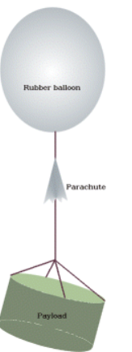
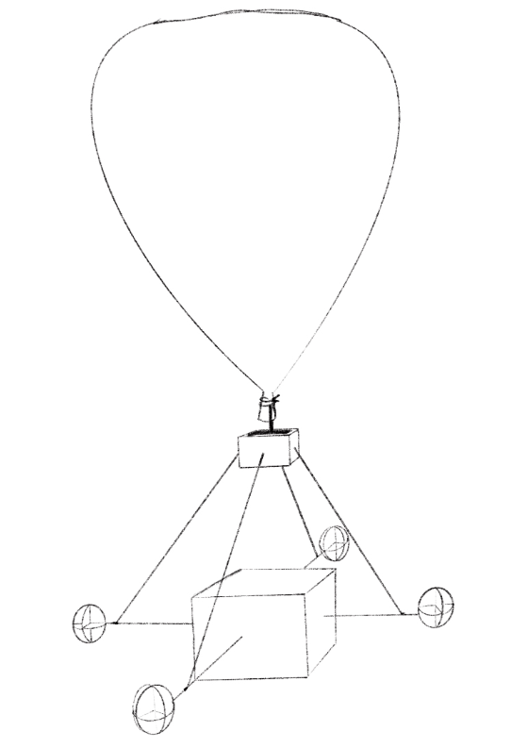
Conceptual Design Phase
Initial design improvements:
Crossbars to increase coupling between balloon neck and payload
Air scoops to dampen rotation

Slide 6
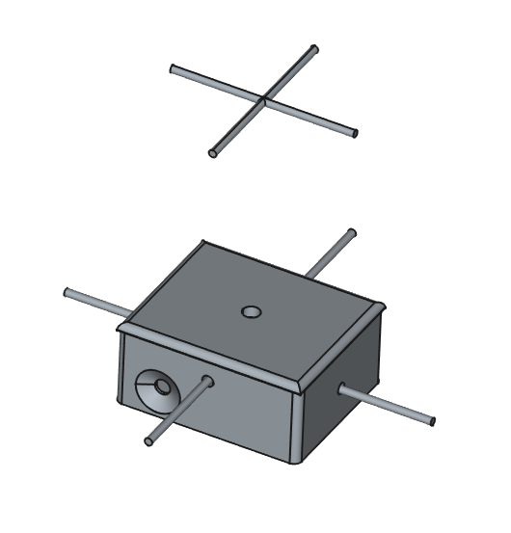
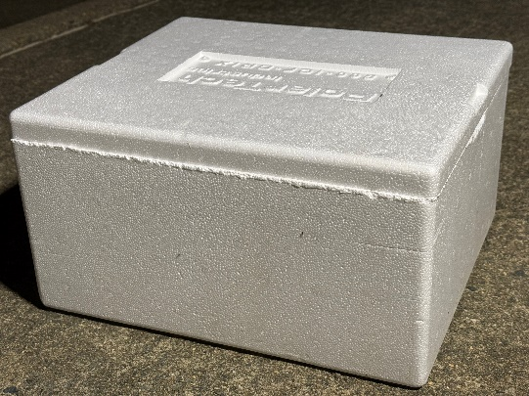
Final Design Configuration
FAA §101.35
Double crossbar instead of parachute basket
Foam payload housing
  5 x 10 x 12 in
  Insulation
PVC crossbars
40 lb fishing line
Lightweight, simple to assemble

Slide 7
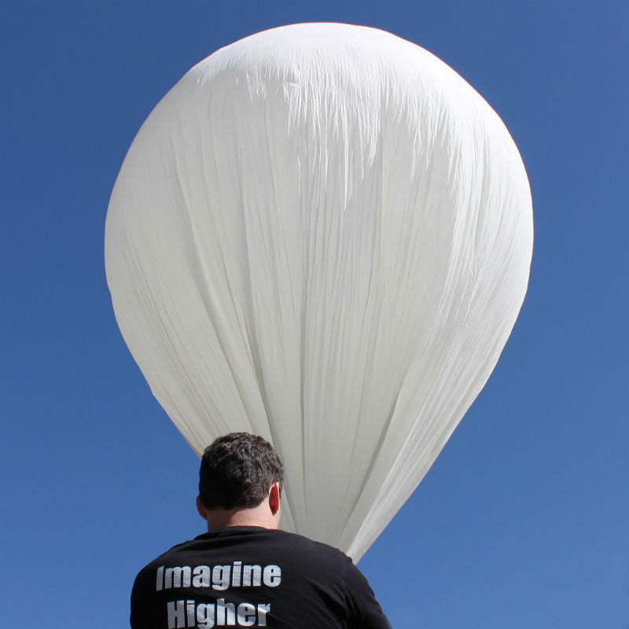
Balloon and Parachute Selection
Parachute: 3 ft diameter
Weight: 2.4 oz
Descent rate: < 25 ft/s
1500 g balloon
Burst Altitude: 35 – 40 km

Slide 8
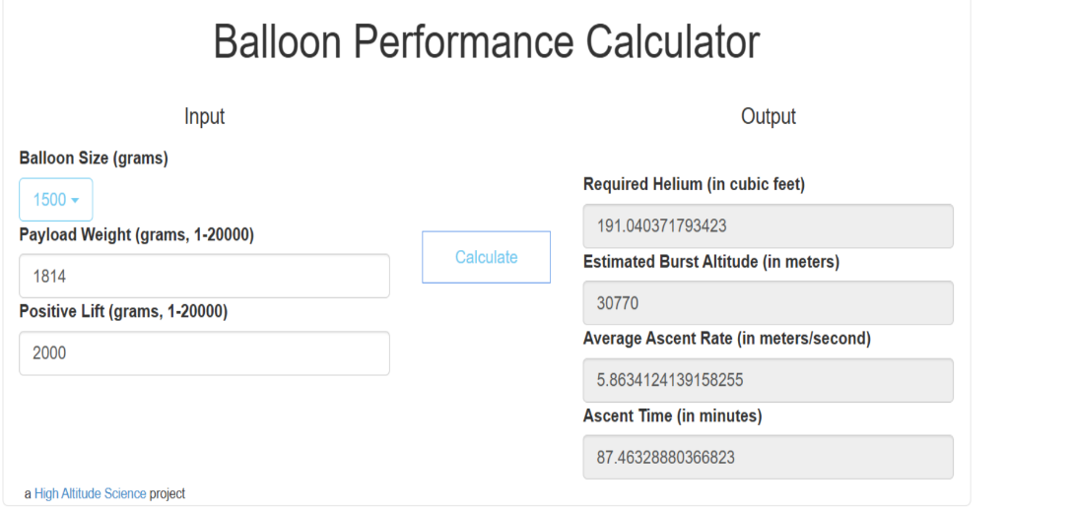
Helium Calculation
NFPA 55
~ 28 grams of lift/cu. ft. of helium
For a 1500 g balloon:
< 4 lb payload
Target ascent rate: 5.8 m/s
Total ascent time: ~ 87 min
191 cubic ft. of helium
“Balloon Performance Calculator Tutorial” High Altitude Science

Slide 9
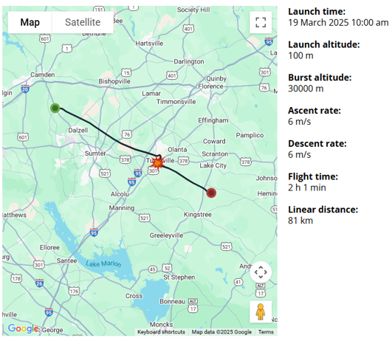
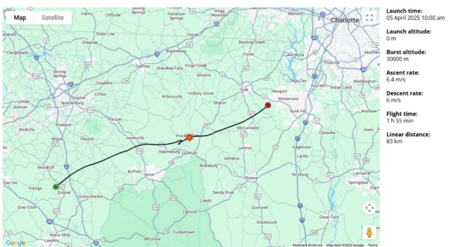
Flight Path Predictability
FAA §101.37
Launch from Spartanburg, SC
Launch from Camden, SC
“Predicting the Flight Path” Stratoflights

Slide 10
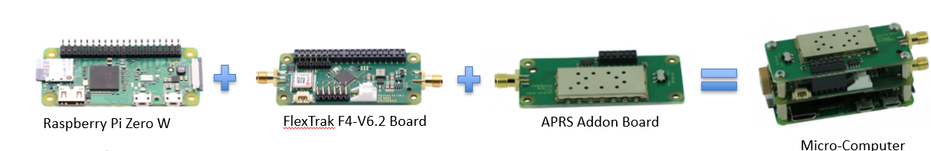
Computer System
Single-board computer
GPS receiver
Radio transmitter
APRS functionality

Slide 11
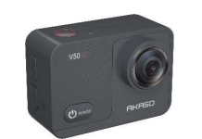
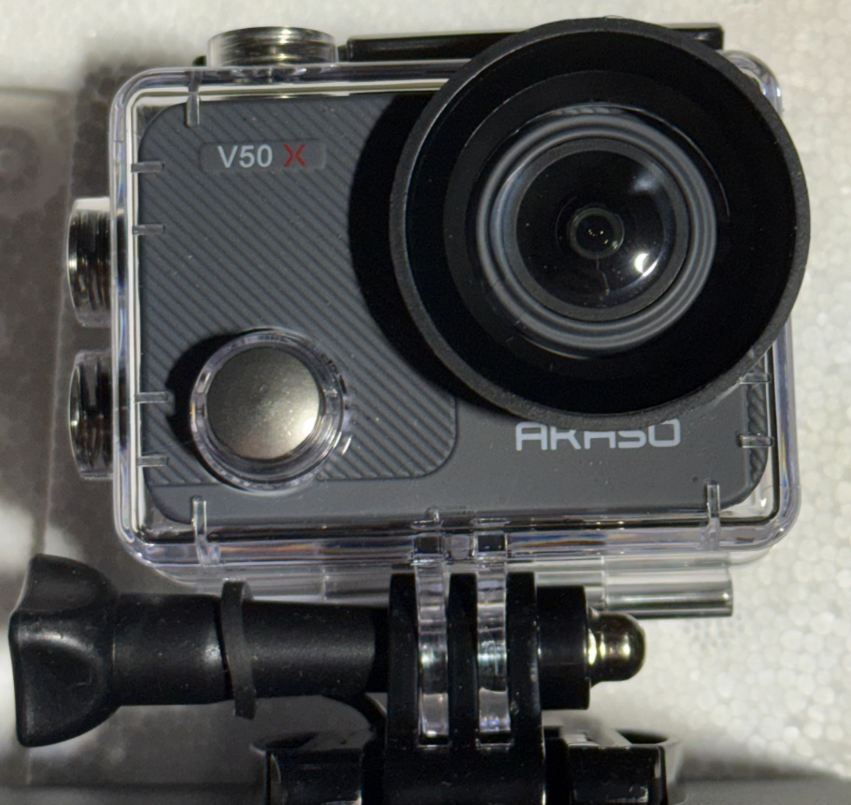
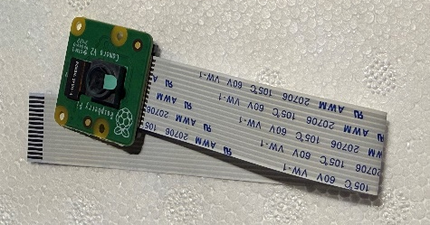
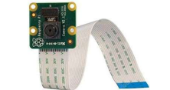
Imaging
AKASO V50X Action Camera
HD video – 720p for 180 min
Internal battery
Raspberry Pi Camera Module
1080p
AKASO V50X
V2-8 Camera Module

Slide 12

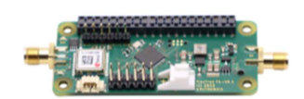

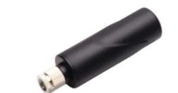

Communications
FCC§97.5, §FAA 101.9
434 MHz transmitter, APRS
Ground station operating range: 400 – 460 MHz
Local tracking – 200 ft
Raspberry Pi Zero W
APRS
Tile tracker
GPS Stubby Antenna
RG174 Tail Antenna

Slide 13
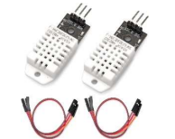

Data Acquisition
Temperature/humidity
  Operating range: -40 to 80 °C
  Accuracy of +/- 2% RH and +/- 0.5 °C
CO2
  Accuracy of +/- 3%
DHT22
Senseair K30

Slide 14
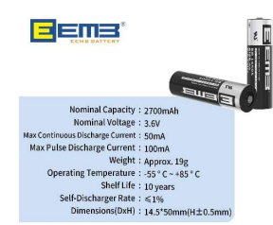
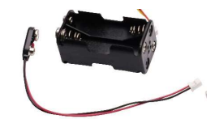
Power System
Four lithium AA batteries
3.6 V per battery
Operating temp -55 to 85 °C
~ 11 hours operating time

Slide 15
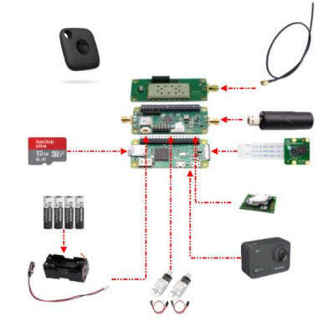
Expected Layout

Slide 16
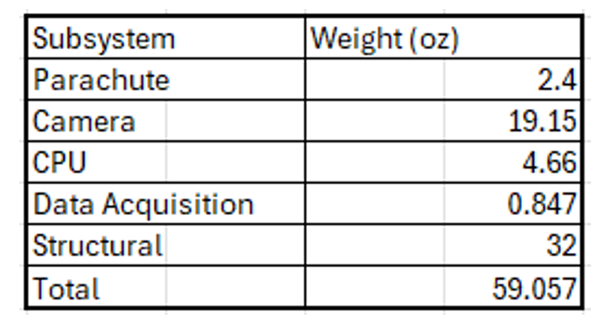
Weight Breakdown
< 4 lb payload complies with FAR §101.1

Slide 17
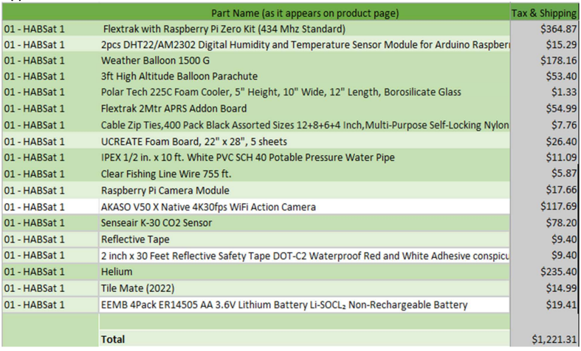
Budget Breakdown
$1250 budget

Slide 18
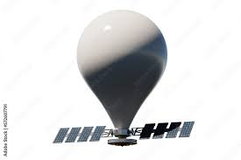
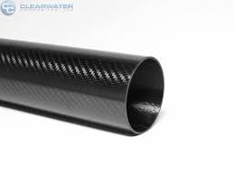
Possible Improvements
Solar panels for additional power
Higher freq. transmission
Hydrogen for lower cost
Higher quality hardware
Carbon fiber structure
Aerodynamic payload housing

Slide 19

APPLICATIONS
Climate research
Weather forecasting
Disaster monitoring

