Slide 1
Pressure Distribution Analysis for Aerodynamic Characterization Across Varying Flight Regimes
Mason Roddy, University of Tennessee
Christian Pack, University of Tennessee

Slide 2
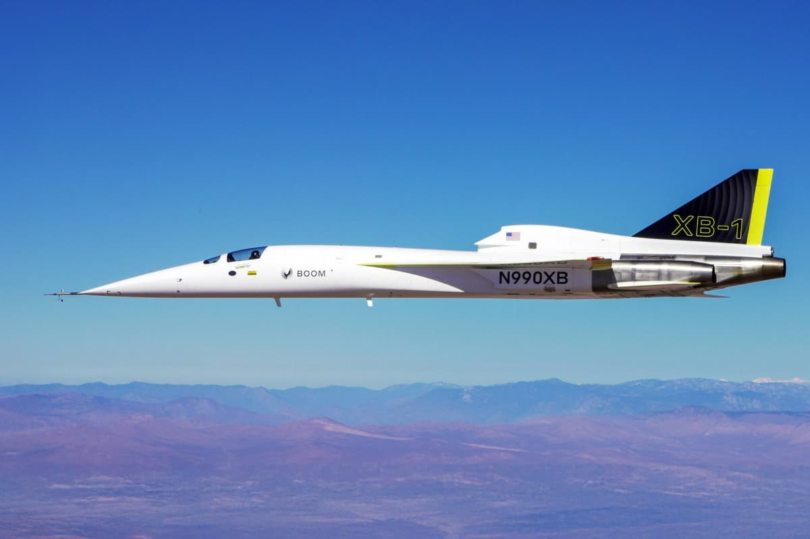
Overview
Objective/Purpose:
Compare analytical methods of pressure coefficient determination to understand applicability and limitations– crucial for aerodynamic design.
Outline:
Pressure Coefficient Overview
Compressible Flow Review
Analytical Methods
Computational Fluid Dynamics (CFD)
Results and Discussion

Slide 3
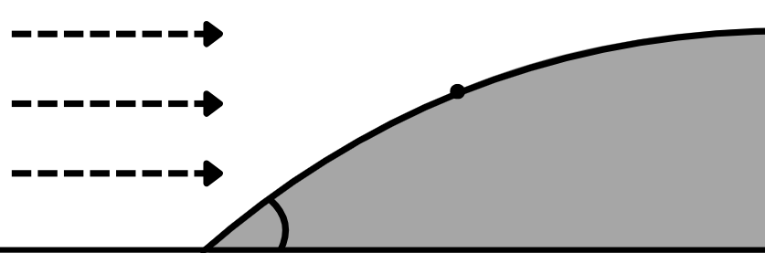

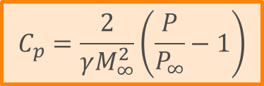


Pressure Coefficient
Dimensionless number, representing the pressure seen on a surface
$$C_{p}≡\frac{P−P_{∞}}{\frac{1}{2}ρ_{∞}V_{∞}^{2}}$$
$$P_{∞}$$
$$P$$
Useful Derivation for Mach Implementation
$$C_{p}=\frac{2}{γM_{∞}^{2}}\left(\frac{P}{P_{∞}}−1\right)$$

Slide 4
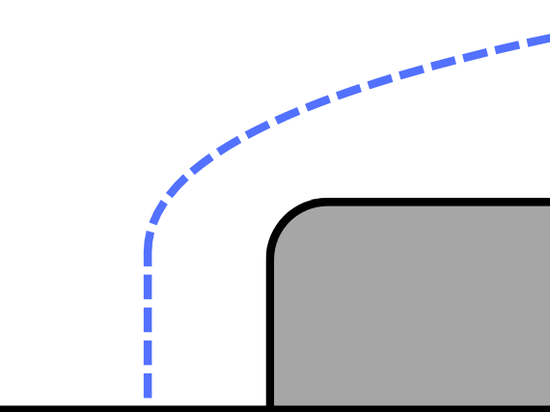
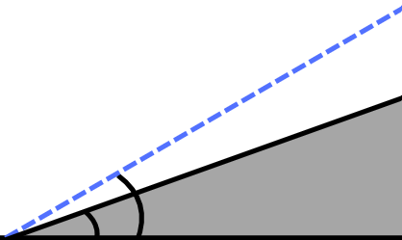

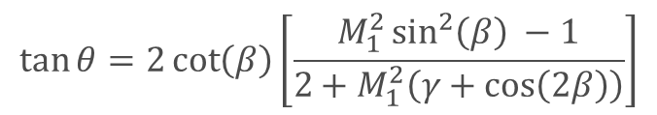
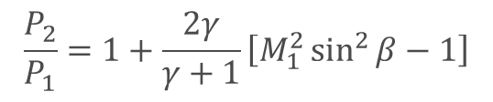
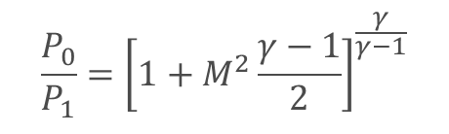
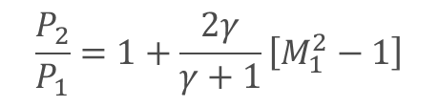

Compressible Flow Review
1. Isentropic Relations
$$\frac{P_{0}}{P_{1}}={\left[1+M^{2}\frac{γ−1}{2}\right]}^{\frac{γ}{γ−1}}$$
2. Normal Shock Relations
1
2
O/S
$$\frac{P_{2}}{P_{1}}=1+\frac{2γ}{γ+1}\left[M_{1}^{2}−1\right]$$
N/S
3. Oblique Shock Relations
2
$$\frac{P_{2}}{P_{1}}=1+\frac{2γ}{γ+1}\left[M_{1}^{2}\sin^{2}{β}−1\right]$$
1
$$\tan{θ}=2\cot\left(β\right)\left[\frac{M_{1}^{2}\sin^{2}\left(β\right) −1}{2+M_{1}^{2}\left(γ+\cos\left(2β\right)\right)}\right]$$
$$β$$
$$θ$$

Slide 5
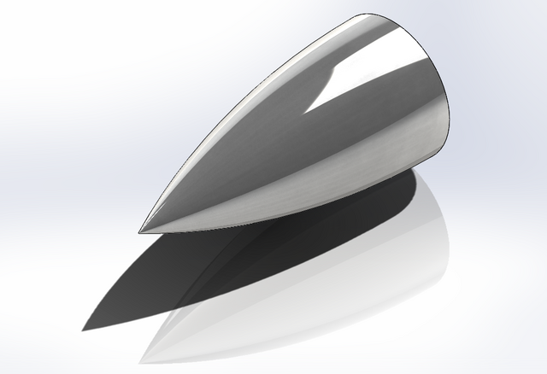
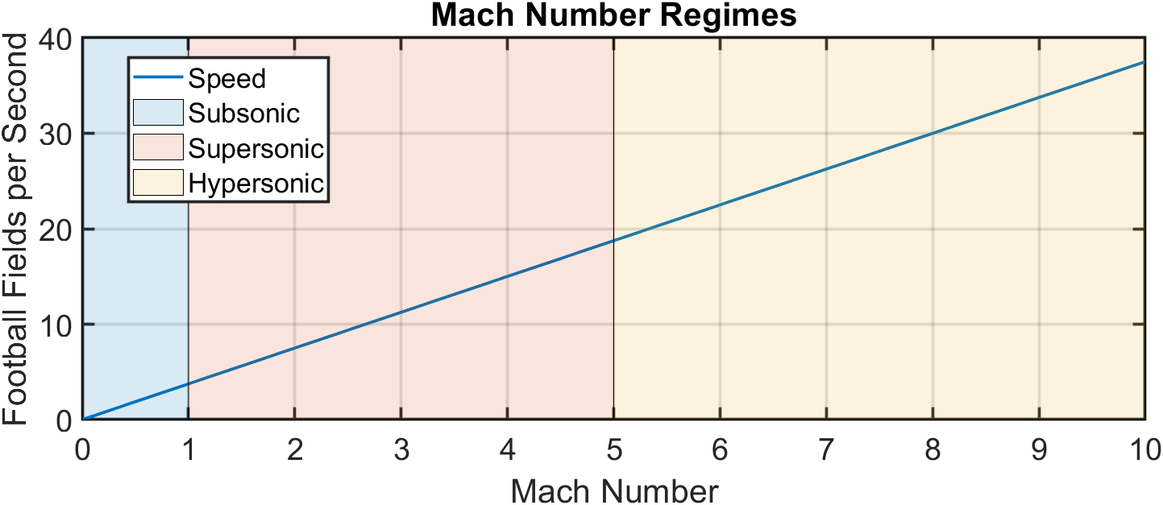

Analytical Methods
Supersonic Flow (1.0 < M < 5.0)
Linearized Supersonic Theory
Hypersonic Flow (M > 5)
Newtonian
Modified Newtonian
Tangent Wedge
Shock Expansion Theory
Tangent Ogive
used for analysis
$$l/d=3 and 6$$

Slide 6
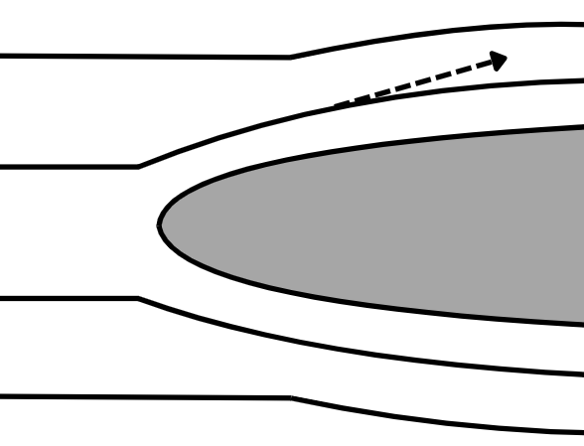
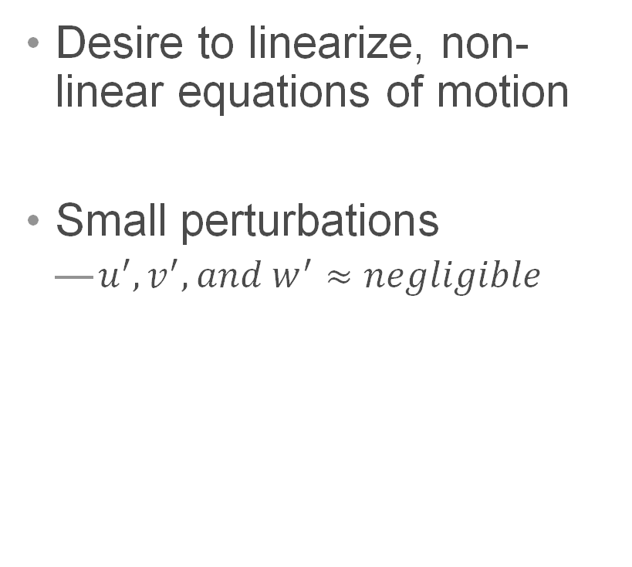

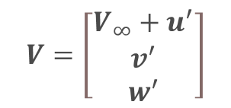
Linearized Supersonic Theory
Desire to linearize, non-linear equations of motion
Small perturbations
  $u^{′},v^{′},and w^{′}≈negligible$
$$V=\left[\begin{matrix}V_{∞}+u^{′} \\ v^{′} \\ w^{′}\end{matrix}\right]$$
$$V_{∞}$$

Slide 7
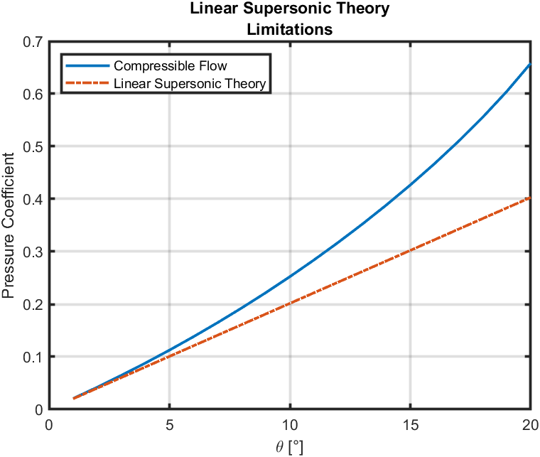
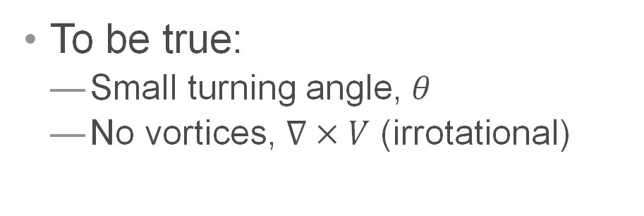
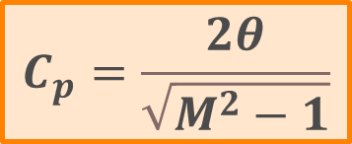
Linearized Supersonic Theory
To be true:
  Small turning angle, $θ$
  No vortices, $∇×V$ (irrotational)
$$C_{p}=\frac{2θ}{\sqrt{M^{2}−1}}$$

Slide 8
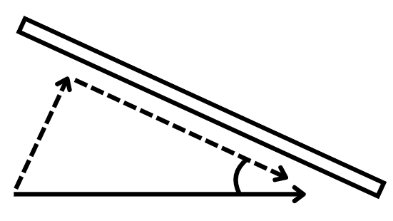

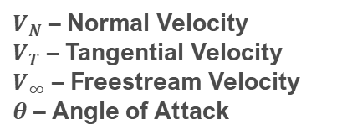




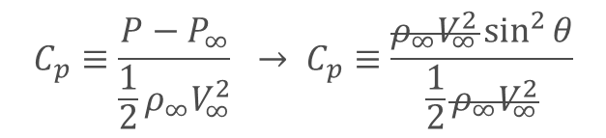

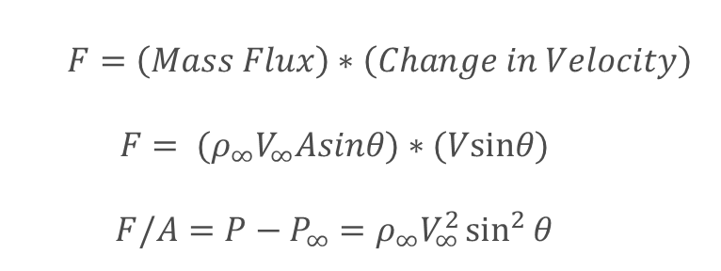
Newton’s Methods – Classical Derivation
From Newton’s Second Law of motion, force is the rate of change of momentum with respect to time:
  $$F=\left(Mass Flux\right)∗\left(Change in Velocity\right)$$
  $$F= (ρ_{∞}V_{∞}Asinθ)∗(Vsinθ)$$
  $$F/A=P−P_{∞}=ρ_{∞}V_{∞}^{2}\sin^{2}{θ}$$
$V_{N}$ – Normal Velocity
$V_{T}$ – Tangential Velocity
$V_{∞}$ – Freestream Velocity
$θ$ – Angle of Attack
Projected Area $=A\sin{θ}$
Plug into pressure coefficient equation:
$V_{N}$
$V_{T}$
$$C_{p}≡\frac{P−P_{∞}}{\frac{1}{2}ρ_{∞}V_{∞}^{2}} → C_{p}≡\frac{ρ_{∞}V_{∞}^{2}\sin^{2}{θ}}{\frac{1}{2}ρ_{∞}V_{∞}^{2}}$$
$$θ$$
$V_{∞}$
$$C_{p}=2\sin^{2}{θ}$$

Slide 9
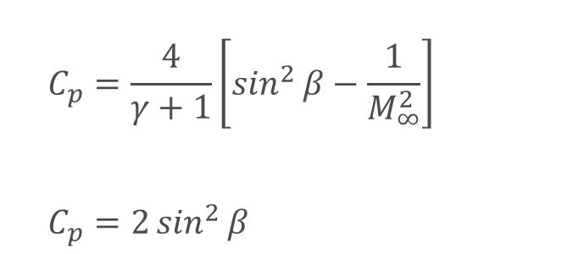
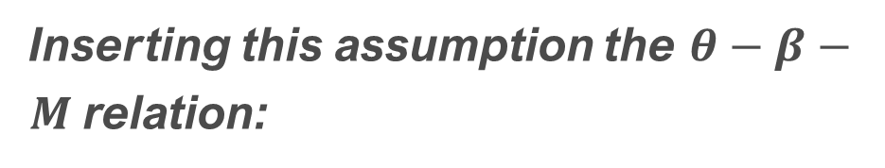
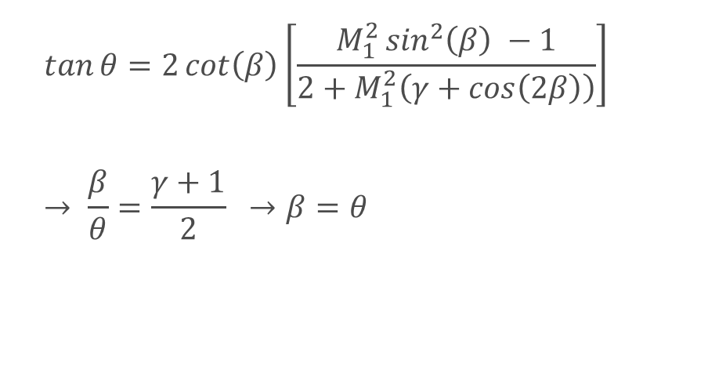
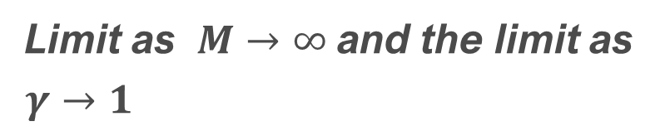

Newton’s Methods – Modern Derivation
Limit as $M→∞$ and the limit as $γ→1$
Inserting this assumption the $θ−β−M$ relation:
  $$C_{p}=\frac{4}{γ+1}\left[\sin^{2}{β}−\frac{1}{M_{∞}^{2}}\right]$$
  $$C_{p}=2\sin^{2}{β}$$
  $$\tan{θ}=2\cot\left(β\right)\left[\frac{M_{1}^{2}\sin^{2}\left(β\right) −1}{2+M_{1}^{2}\left(γ+\cos\left(2β\right)\right)}\right]$$
  $$→ \frac{β}{θ}=\frac{γ+1}{2} →β=θ$$
$$C_{p}=2\sin^{2}{θ}$$

Slide 10
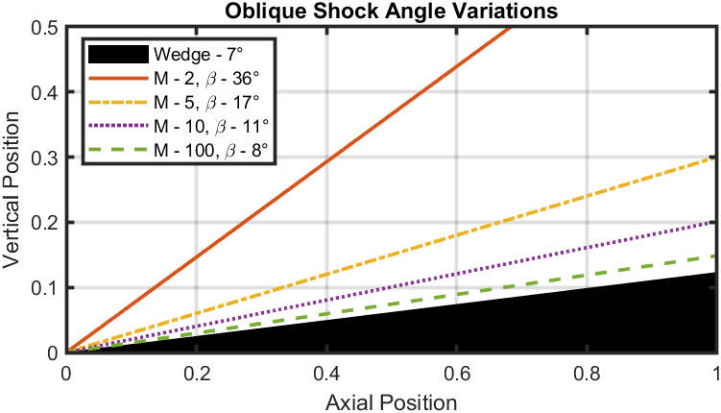
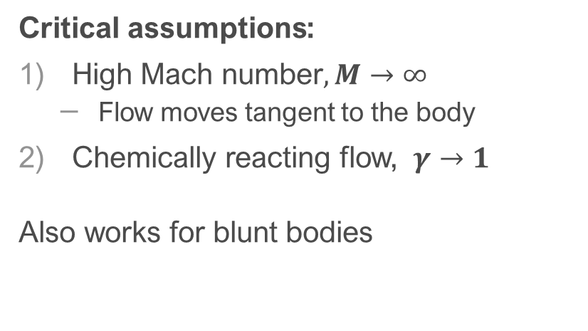


Newton’s Method
Critical assumptions:
High Mach number$,M→∞$
  Flow moves tangent to the body
Chemically reacting flow, $γ→1$
Also works for blunt bodies
Modern $→$ Classical
$$C_{p}=2\sin^{2}{θ}$$

Slide 11


Modified Newton’s Method
Adds Mach number dependence to Newton’s Method
$$C_{p}=C_{p_{max}}\sin^{2}{θ}$$
$$C_{p_{max}}= \frac{P_{02}−P_{∞}}{\frac{1}{2}ρV_{∞}^{2}}=\frac{2}{γM_{∞}^{2}}\left[\frac{P_{02}}{P_{∞}}−1\right]$$
$$\frac{P_{02}}{P_{∞}}=\frac{P_{01}}{P_{∞}}\frac{P_{02}}{P_{01}} or$$
$$\frac{P_{02}}{P_{∞}}={\left[\frac{\left(γ+1\right)M_{1}^{2}}{2}\right]}^{\frac{γ}{γ−1}}{\left[\frac{\left(γ+1\right)}{2γM_{1}^{2}−γ+1}\right]}^{\frac{1}{γ−1}}$$
1
2

Slide 12
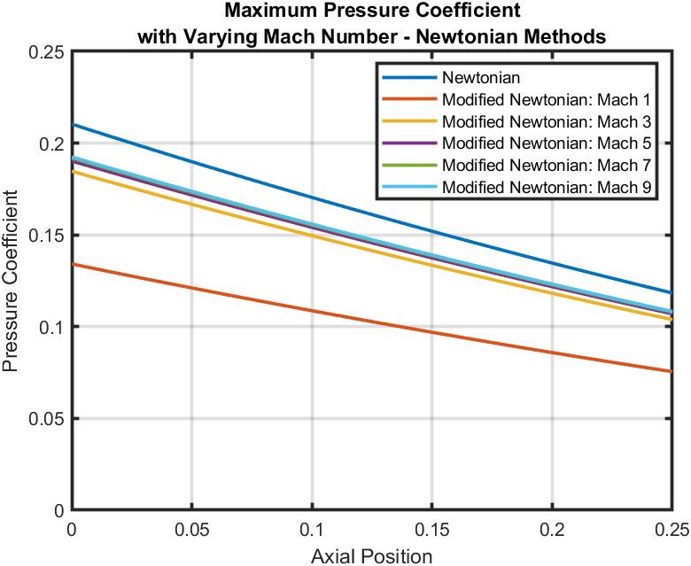
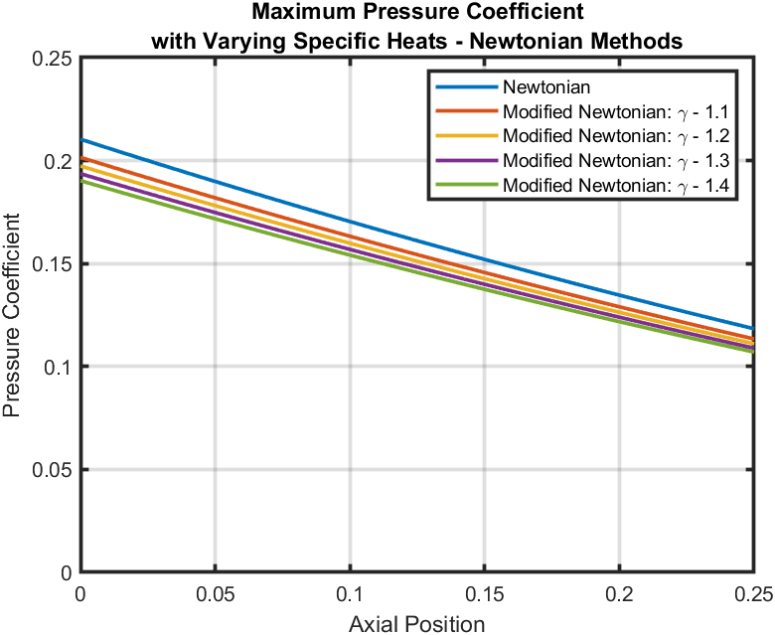
Modified Newton’s Method

Slide 13
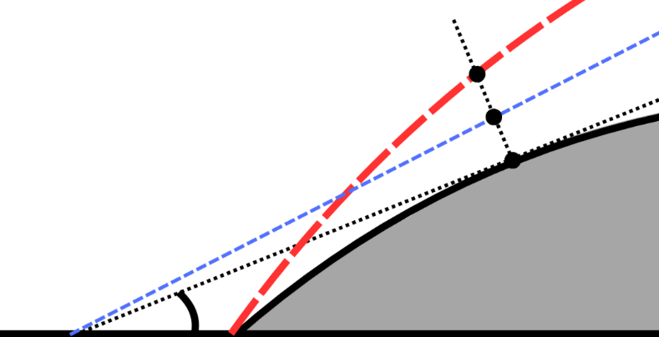
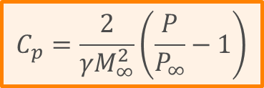

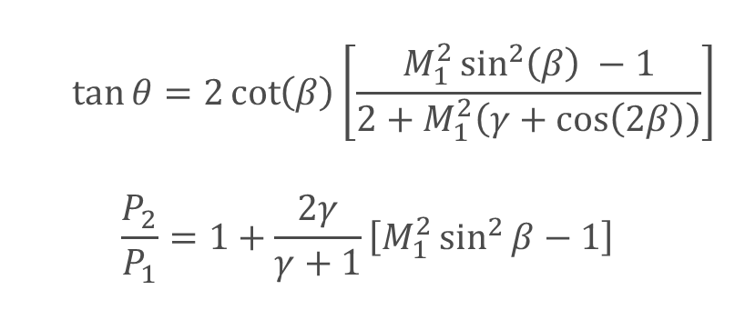



Tangent Wedge Method
Draw a theoretical wedge tangent to the surface
Actual Shockwave
Oblique Shock Relations
Theoretical
Oblique Shock
  $$\tan{θ}=2\cot\left(β\right)\left[\frac{M_{1}^{2}\sin^{2}\left(β\right) −1}{2+M_{1}^{2}\left(γ+\cos\left(2β\right)\right)}\right]$$
  $$\frac{P_{2}}{P_{1}}=1+\frac{2γ}{γ+1}\left[M_{1}^{2}\sin^{2}{β}−1\right]$$
$$a$$
$$b$$
Theoretical Wedge
$$i$$
$$C_{p}=\frac{2}{γM_{∞}^{2}}\left(\frac{P}{P_{∞}}−1\right)$$
$$θ_{i}$$

Slide 14
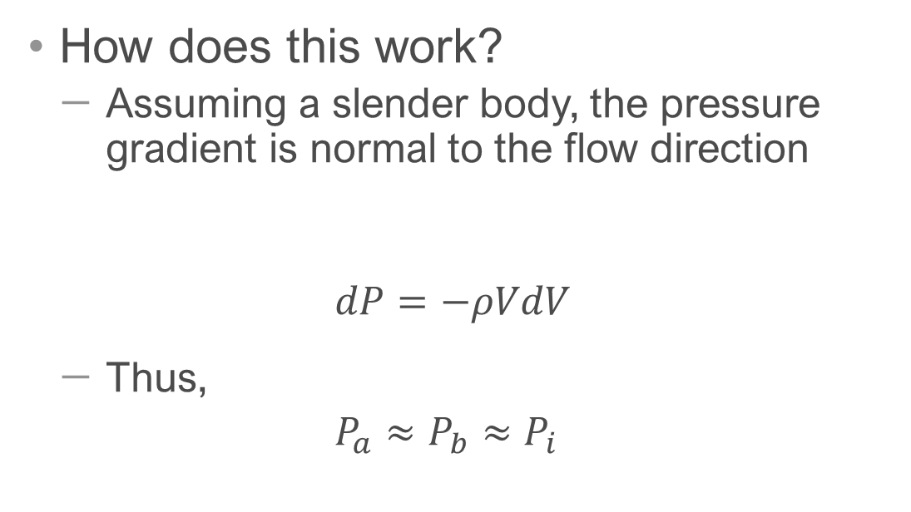
Tangent Wedge Method
How does this work?
  Assuming a slender body, the pressure gradient is normal to the flow direction
  $$dP=−ρVdV$$
  Thus,
  $P_{a}≈$ $P_{b}$ $≈$ $P_{i}$
Actual Shockwave
Theoretical
Oblique Shock
$$a$$
Euler’s Equation
$$b$$
Theoretical Wedge
$$i$$
$$θ_{i}$$

Slide 15
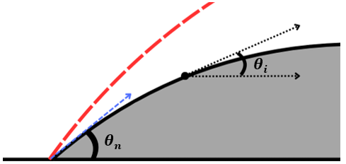
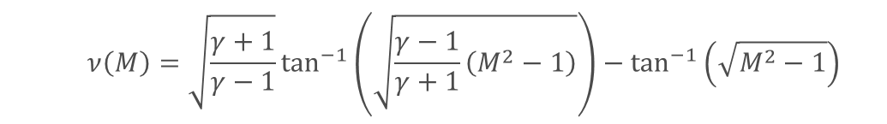


Shock Expansion Method
An oblique shock forms at the nose ${(θ}_{n})$, then small expansions occur along the body due to convex shape ($θ_{i})$
Prandtl-Meyer Expansion Equations ($θ_{i}$)
  $$∆θ=ν\left(M_{i}\right)−ν(M_{n})$$
  $$ν\left(M\right)=\sqrt{\frac{γ+1}{γ−1}}\tan^{−1}\left(\sqrt{\frac{γ−1}{γ+1}\left(M^{2}−1\right)}\right)−\tan^{−1}\left(\sqrt{M^{2}−1}\right)$$

Slide 16
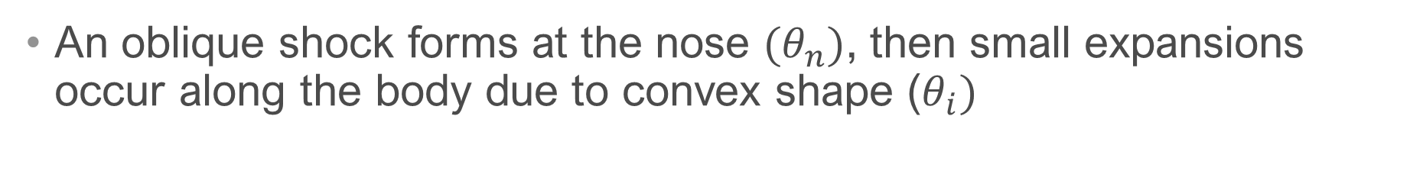

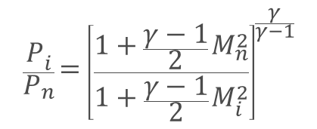
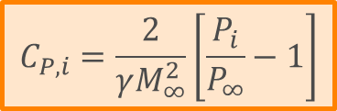
Shock Expansion Method
An oblique shock forms at the nose ${(θ}_{n})$, then small expansions occur along the body due to convex shape ($θ_{i})$
Pressure Ratio for Expansion Waves ($θ_{i}$)
$$\frac{P_{i}}{P_{n}}={\left[\frac{1+\frac{γ−1}{2}M_{n}^{2}}{1+\frac{γ−1}{2}M_{i}^{2}}\right]}^{\frac{γ}{γ−1}}$$
$$\frac{P_{i}}{P_{∞}}=\frac{P_{i}}{P_{n}}\frac{P_{n}}{P_{0n}}\frac{P_{0n}}{P_{01}}\frac{P_{1}}{P_{∞}}$$
$$C_{P,i}=\frac{2}{γM_{∞}^{2}}\left[\frac{P_{i}}{P_{∞}}−1\right]$$

Slide 17
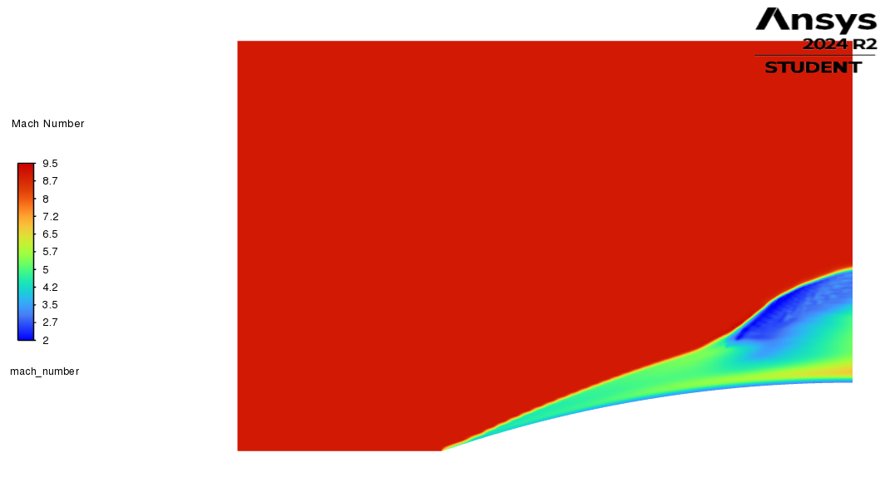
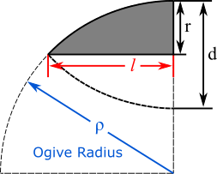
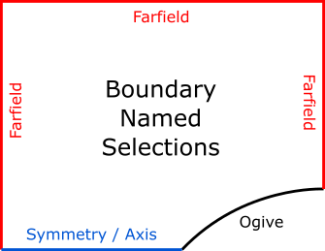
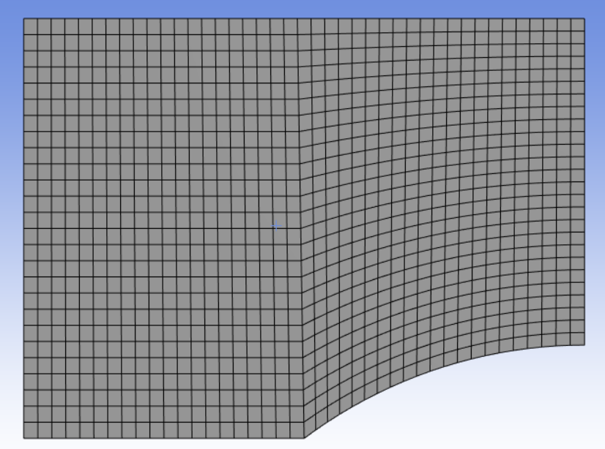

Computation Fluid Dynamics (CFD)
Geometry Creation >> Named Boundaries >> Mesh and Refinement
  Farfield boundary conditions set to atmospheric pressure @ 300 K
  “Symmetry” for 2D or “Axis” for 3D with Axisymmetric Solver
$$l/d=3 and 6$$

Slide 18

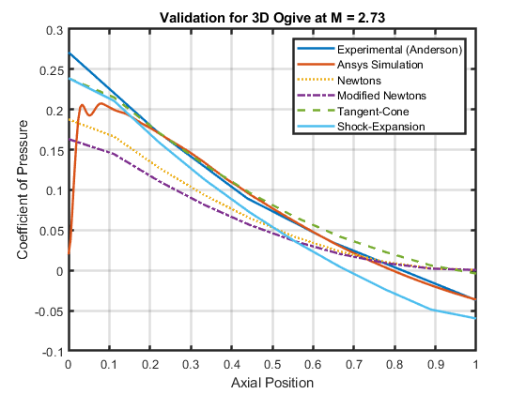
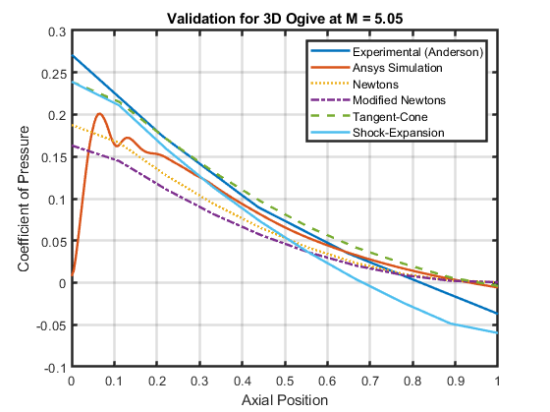

Computation Fluid Dynamics (CFD)
Comparison to wind tunnel experimental data
$$l/d=3$$

Slide 19
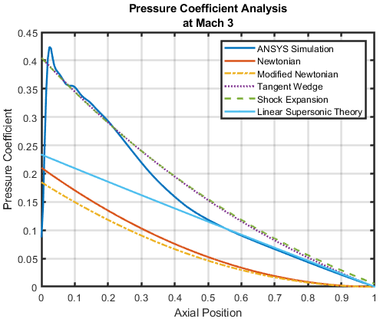
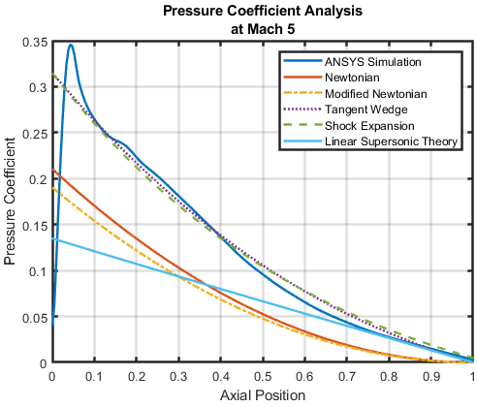
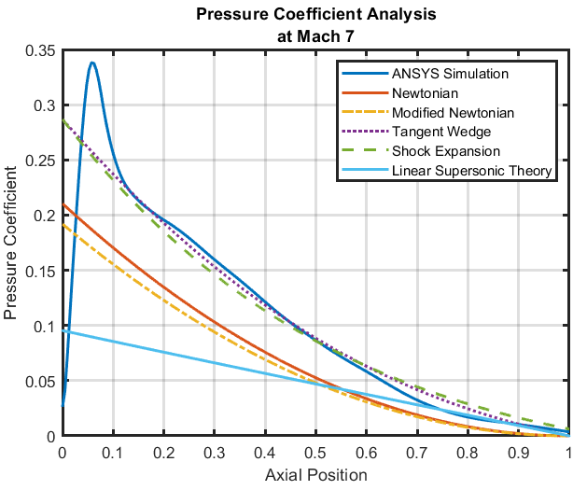
2D Simulation Comparison

Slide 20

Notable Effects
Viscous Interactions –
  Increased pressure at the leading edge

Slide 21

Notable Effects
Rotational Flow –
  Vortices caused by entropy gradients

Slide 22

Notable Effects
High Temperature Effects –
  As temperature changes the chances of chemistry occurring increases, breaking the calorically perfect assumption
Reflected Shock Waves–
  At lower speeds, expansion waves have a chance to reflect off of the shockwave and effect pressure measurements
Three-Dimensional Pressure Relief–
  As temperature changes so does the specific heat ratio

Slide 23

2D Simulation Comparison

Slide 24

Summary
Study provided understanding for applications of each method
Method | Equation | Assumptions
Newtonian Methods | $$C_{p}=2\sin^{2}{θ}$$ or $$C_{p}=C_{p_{max}}\sin^{2}{θ}$$ | Flow is tangent to the surface: $M→∞$ and $γ→1$ Good for blunt bodies
Tangent Wedge | $$C_{p}=\frac{2}{γM_{∞}^{2}}\left(\frac{P_{i}}{P_{∞}}−1\right)$$ where $P_{i}$ is the local pressure behind an oblique shockwave | Slender bodies with attached shockwaves
Shock Expansion | $$C_{p}=\frac{2}{γM_{∞}^{2}}\left(\frac{P_{i}}{P_{∞}}−1\right)$$ where $P_{i}$is the local pressure behind an oblique and expansion wave | Slender bodies with attached shockwaves
Linear Supersonic | $$C_{p}=\frac{2θ}{\sqrt{M^{2}−1}}$$ | Irrotational and isentropic flow with small perturbations (thin bodies)

