Slide 1
Development of a Butterfly Inspired Micro Aerial Vehicle with Figure 8 Wing Motion
Caroline Waugh^{[1]}, Jorge Mares Zamora^{[1]}, and Chang-kwon Kang^{[2]}
University of Alabama in Huntsville
Huntsville, Alabama
2025 AIAA Region II Student Conference, Greensboro, NC, April 4-6
[1] AIAA Student Member
[2] AIAA Associate Fellow

Slide 2
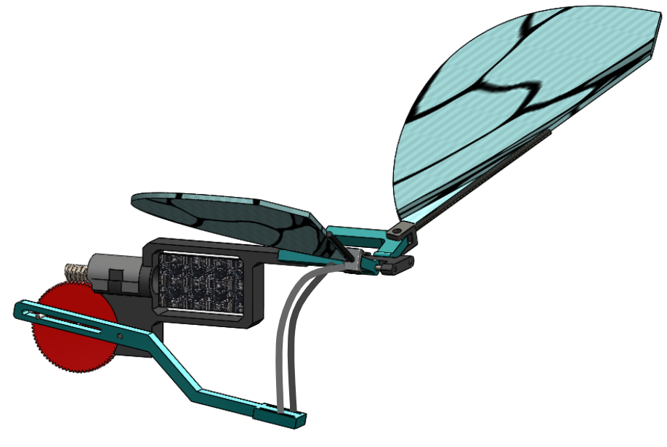
Introduction

Slide 3
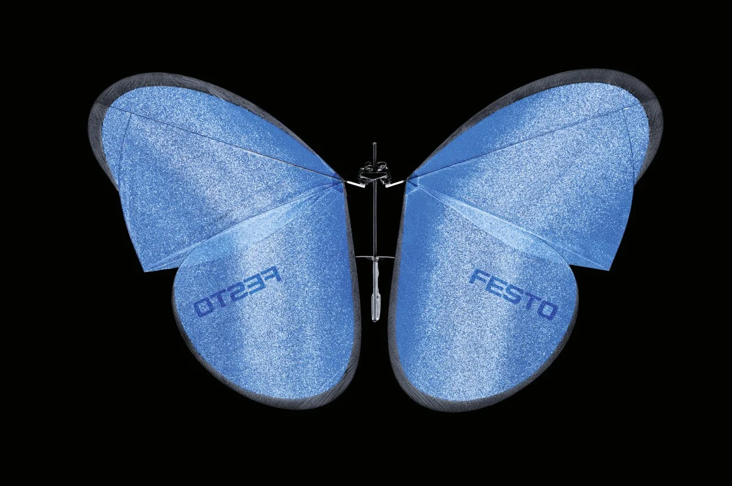
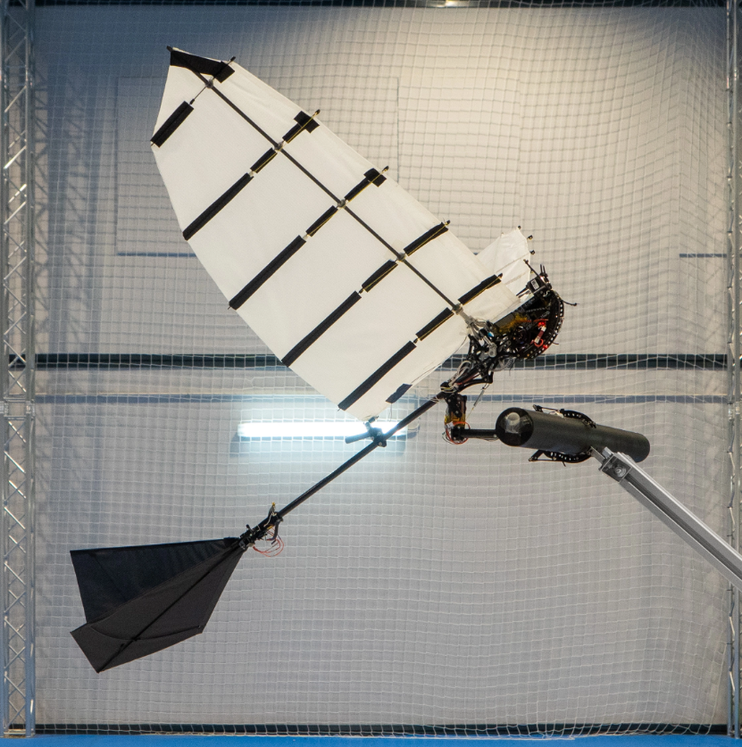
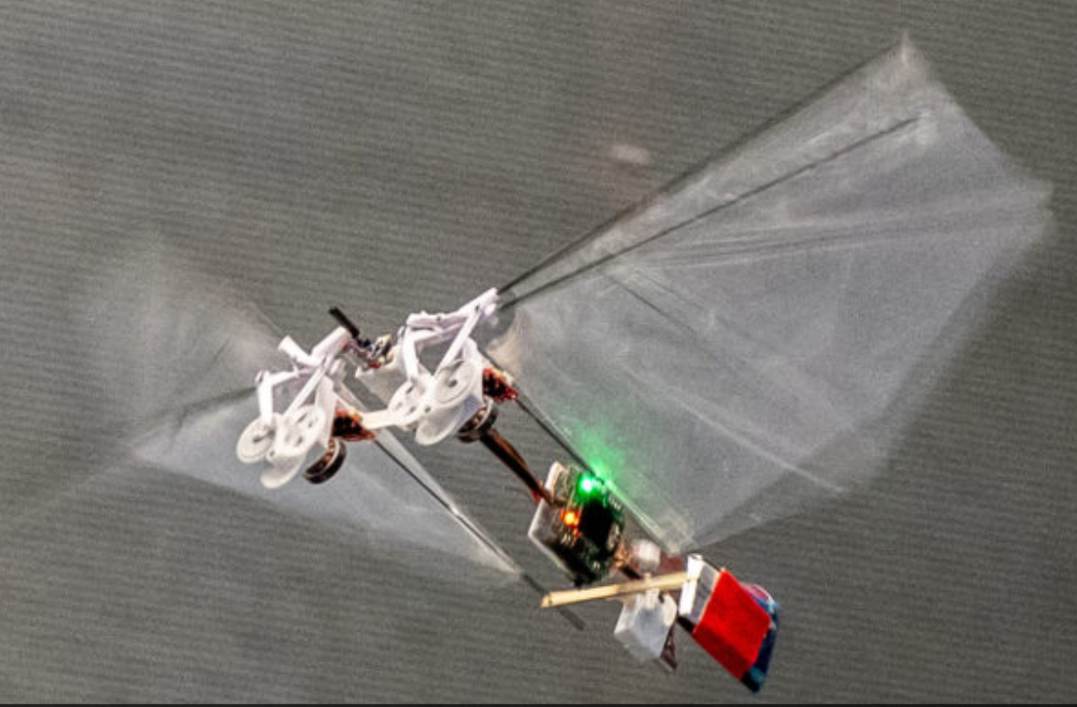
Biomimetics and Micro Aerial Vehicles (MAVs)
MAV - A small, portable type of unmanned aerial vehicle
Biomimetics/Bio-Inspired Design - The imitation of features and systems found in nature. I.e. certain synthetic materials and drugs, mechanical mechanisms inspired by anatomy, etc.
Festo eMotion Butterfly^{[1]}
GRIFFIN Ornithopter^{[2]}
TU Delft DelFly Nimble^{[3]}
[1]_https://www.festo.com/us/en/e/about-festo/research-and-development/bionic-learning-network/bionic-flying-objects/emotionbutterflies-id_33454/
[2] Zufferey, R., Tormo-Barbero, J., Feliu-Talegón, D. et al. How ornithopters can perch autonomously on a branch. Nat Commun 13, 7713 (2022). https://doi.org/10.1038/s41467-022-35356-5
[3] Matěj Karásek, Florian T. Muijres, Christophe De Wagter, Bart D.W. Remes, Guido C.H.E. de Croon: A tailless aerial robotic flapper reveals that flies use torque coupling in rapid banked turns. Science, Vol 361, Iss 6407, 2018. DOI: 10.1126/science.aat0350.

Slide 4
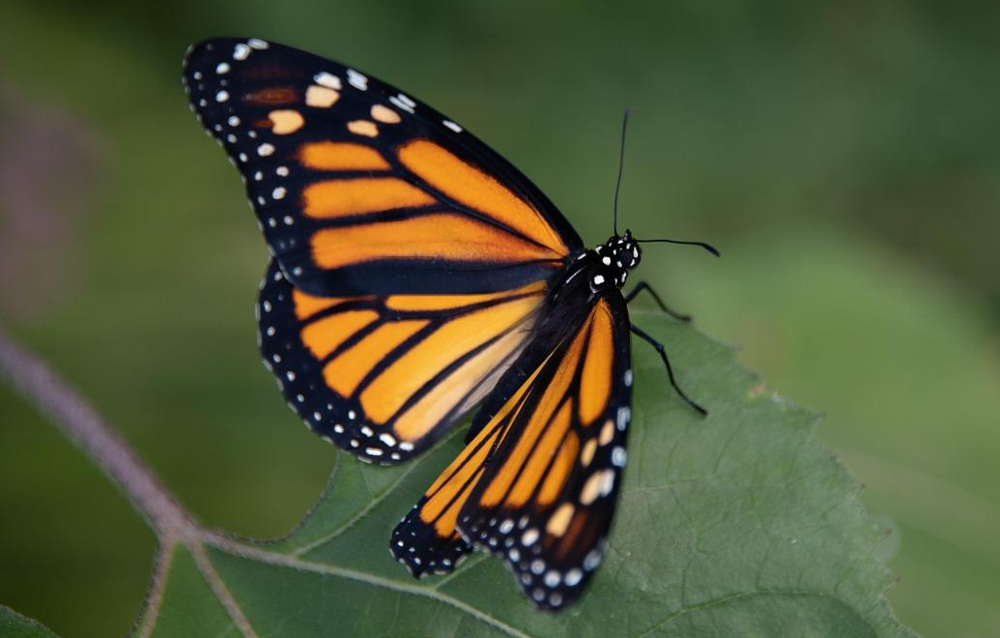
Butterfly Flight - Danaus Plexippus
The Monarch butterfly, or Danaus plexippus, is a relatively well studied species of butterfly.
It is arguably best known for its ~4000 km migration.
On average, they have a mass of ~0.5 g, a wingspan of ~9-10 cm, and a flapping frequency of 10 Hz.
Image Source: https://pixabay.com/photos/monarch-butterfly-insect-bug-4403142/

Slide 5
Objective - From Nature to Innovation

Slide 6
Butterfly Inspired Micro Aerial Vehicle (BIMAV)
Design

Slide 7
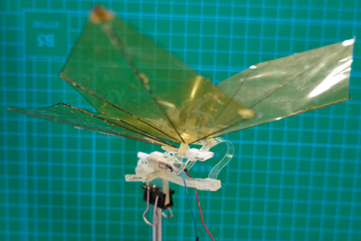
BIMAV Base Design (1/3)
Based on Shinshu University’s robobutterfly^{[1]}
Modified to house an on-board receiver and battery, as well as connect to flexible wing prototypes
[1] Aono, H. “Shinshu Butterfly”, private communication.

Slide 8
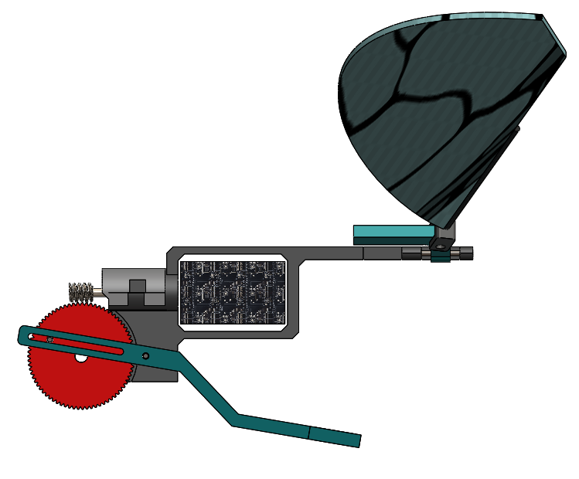
BIMAV Base Design (2/3)
Wing
Wing Leading Edge Carbon Fiber Rod
Worm and Spur Gear Configuration
Designs were modeled in SolidWorks and prototypes were constructed using both SLA and FDM 3D printing techniques.
Plantraco Micro9 BFly Board
Lever Arm

Slide 9
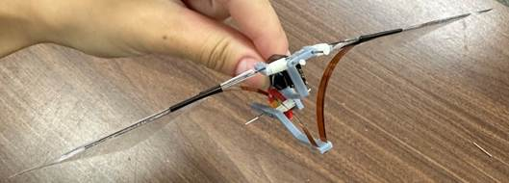
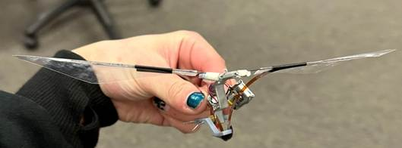
BIMAV Base Design (3/3)
The fully assembled resin version weighs 6.55 g and the PLA version weighs 6.74g.
Resin version was too flexible and brittle for proper power transfer.
PLA version is more rigid, although current wings are too big for the motor to power them.

Slide 10
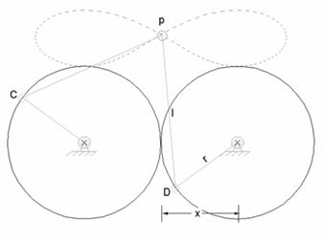
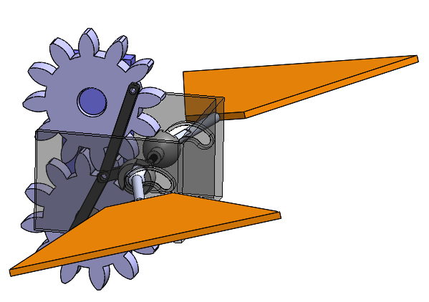
BIMAV - Figure 8 Motion (1/2)
Goal: Mimicking the complex flight pattern of a butterfly while still maintaining feasibility on a smaller scale.
Solution: Use passive mechanisms to achieve complex wing motion with only one motor.
Figure 8 Diagram Image Source: Sansoy, Figure Eight Motion Drive, https://www.instructables.com/Figure-Eight-Motion-Drive/

Slide 11
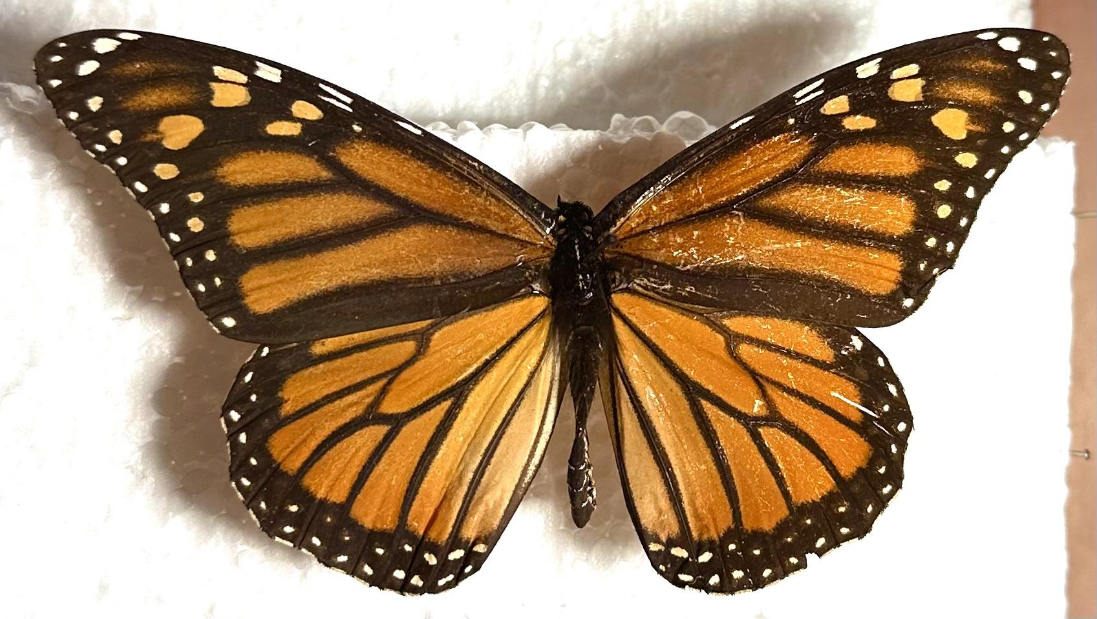
Flexible Wing Design
Actual butterfly forewings feature a strong leading edge vein called the costal vein
~3/4 chord length down the wing, this vein greatly diminishes in size
Leading Edge Vein
~4.2 cm
~5.6 cm

Slide 12
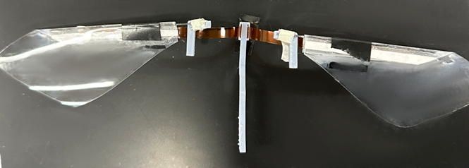
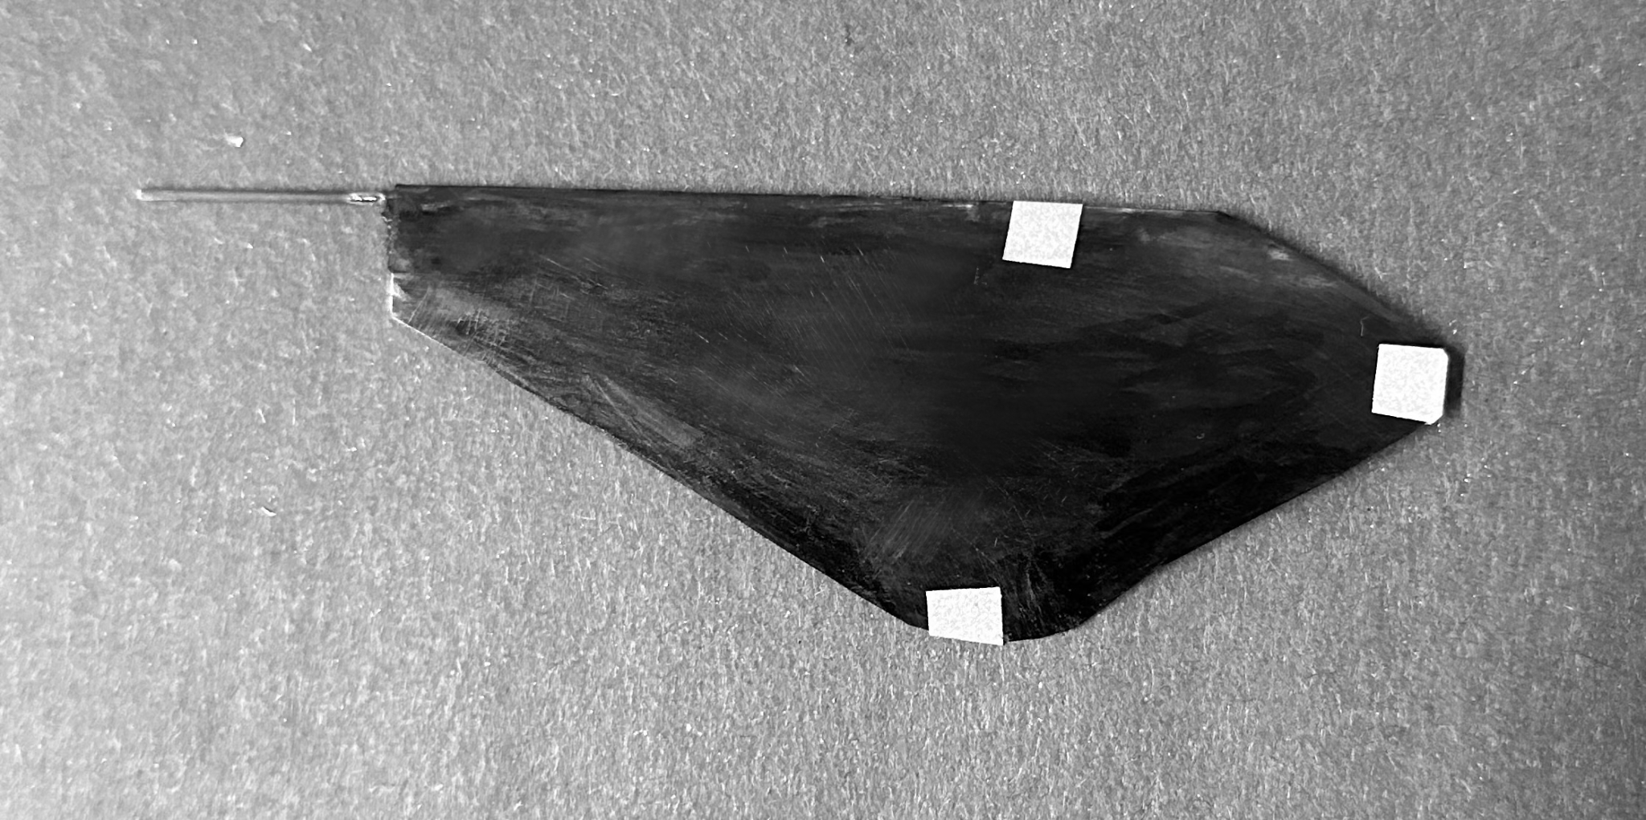
Flexible Wing Design (2/3)
A carbon fiber rod that extends ~3/4 cord length down the wing was used as the leading edge
The rest of the wings were made from a flexible plastic film material
A test wing was made with reflective markers for motion analysis.
Leading Edge Marker (LE)
Wing Tip Marker (Tip)
Trailing Edge Marker (TE)

Slide 13
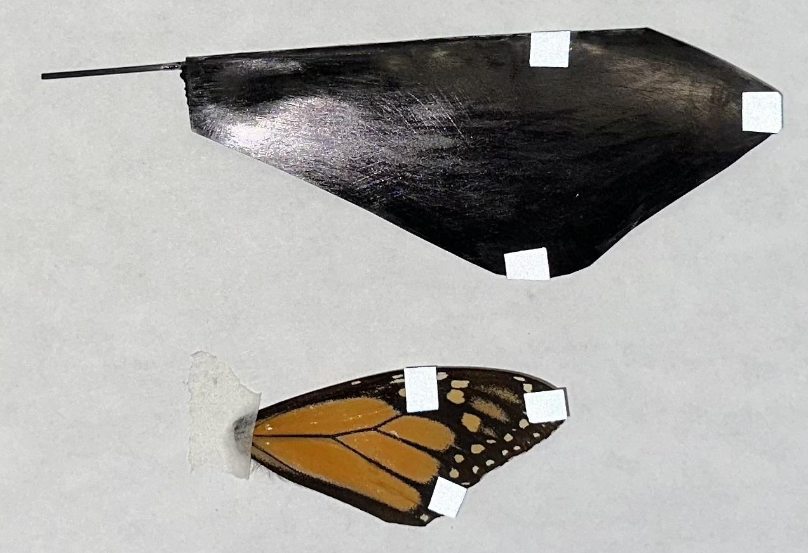
Flexible Wing Design (3/3)
9 cm
5.6 cm

Slide 14
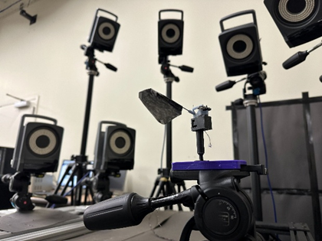
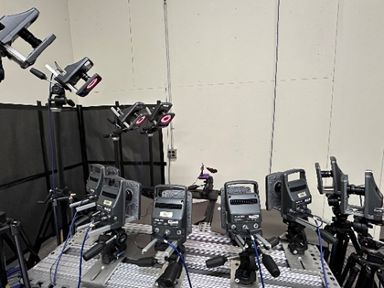
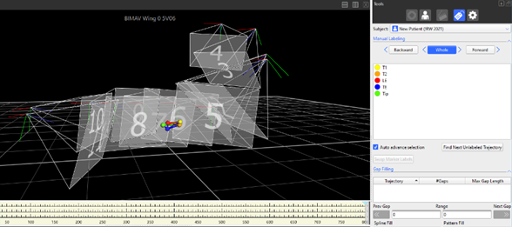
Wing Motion Analysis with Vicon
Vicon Motion Tracking Cameras
Wing Flapper Stand
Wing Markers in Vicon Environment
A Vicon motion tracking camera system was used to record wing motion on a flapping test stand.
A Nano 17 force sensor was used to measure generated forces

Slide 15
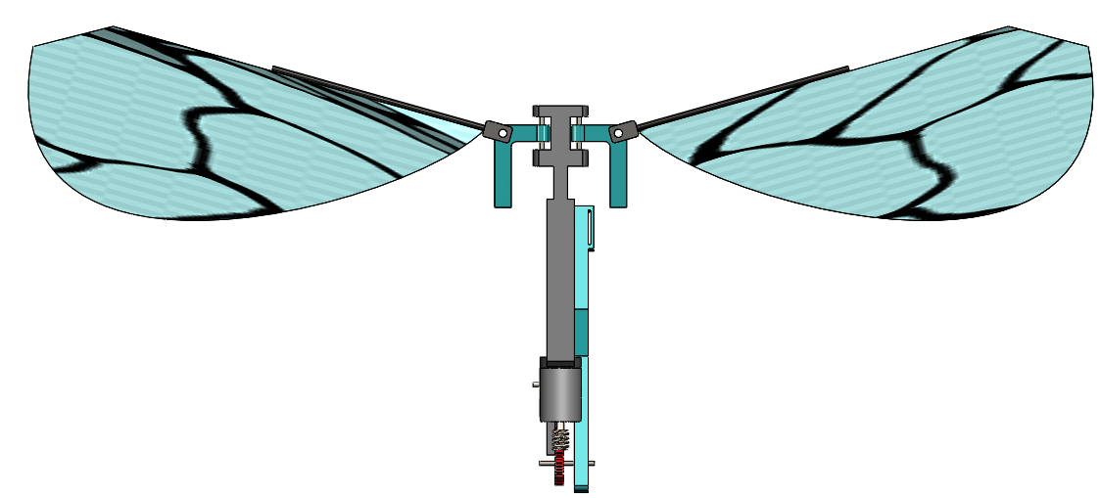
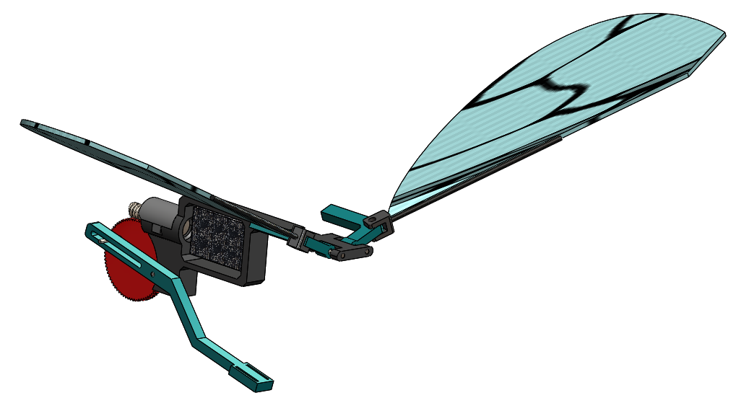
Wing Motion Angles
𝝮 = Feathering angle/angle of attack
𝛟 = Flap/Stroke angle
𝛉 = Deviation angle
𝛉
x
𝝮
𝛟
y
z

Slide 16
Results

Slide 17
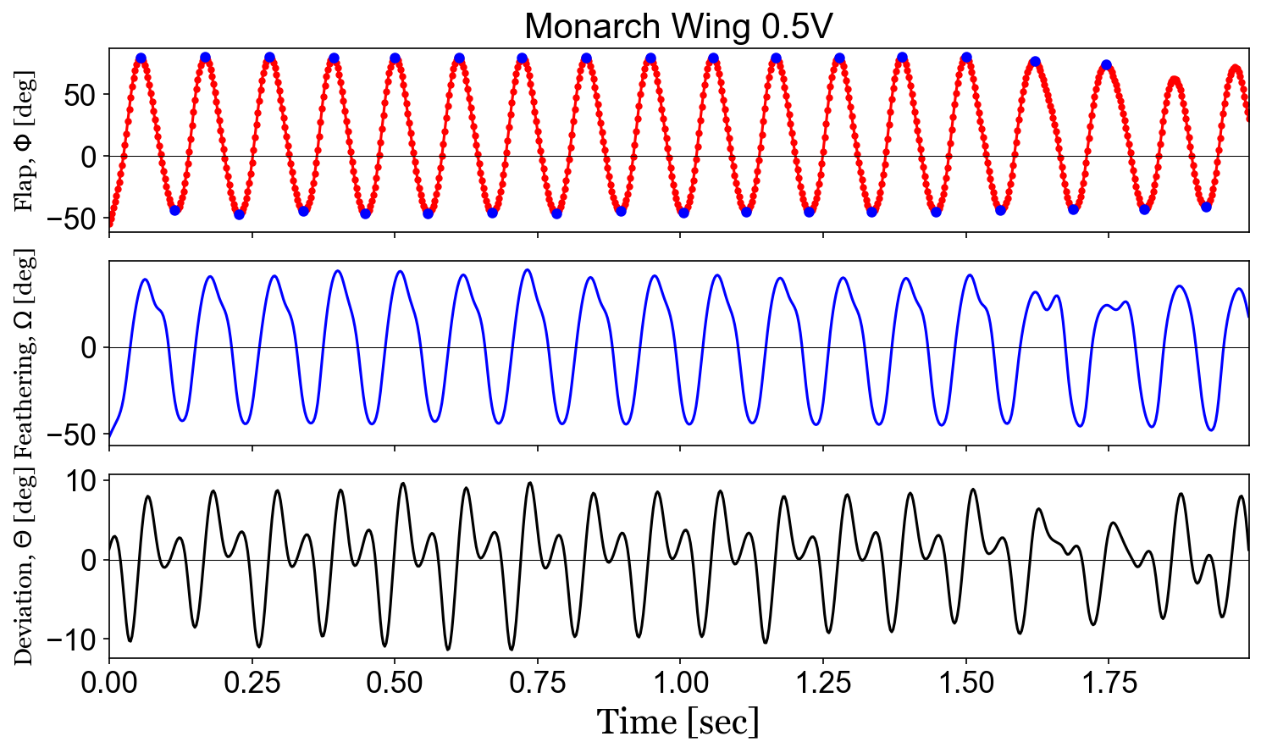
Wing Motion Analysis (1/2)
Wing angles calculated using Vicon motion tracking data.
Flapping Frequency = 9 Hz
Vicon sampling frequency = 400 Hz
x
𝝮
𝝮 = Feathering angle/angle of attack
𝛟 = Flap/Stroke angle
𝛉 = Deviation angle
𝛉
𝛟
y
z

Slide 18
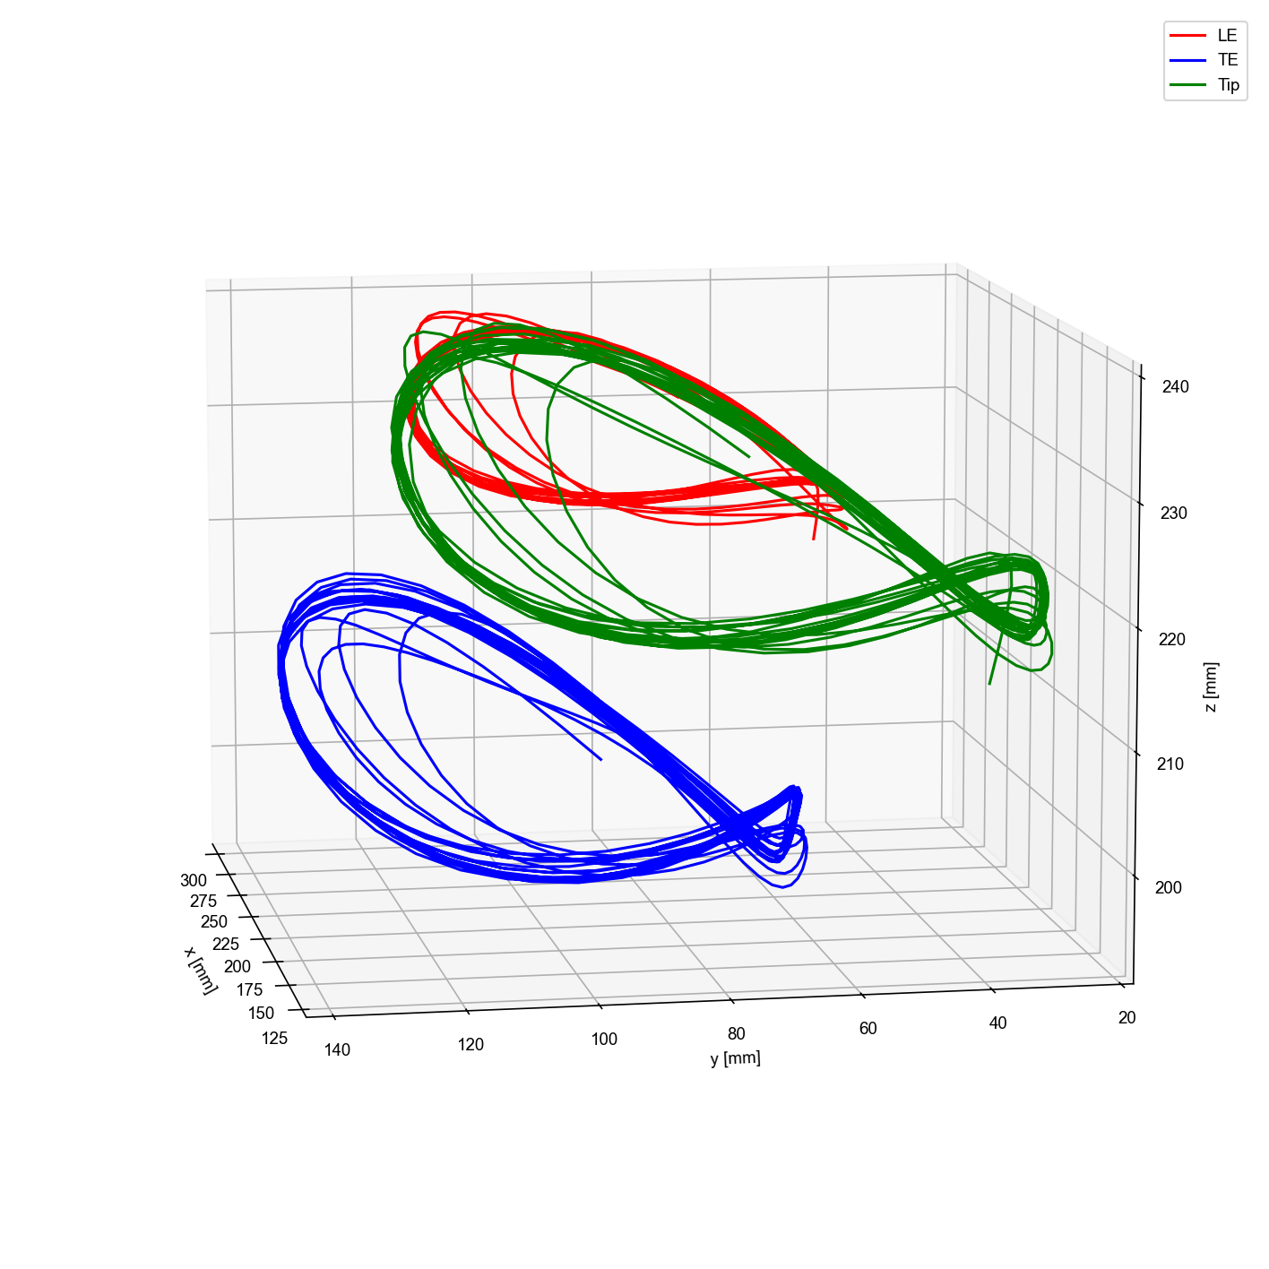
Wing Motion Analysis (2/2)

Slide 19
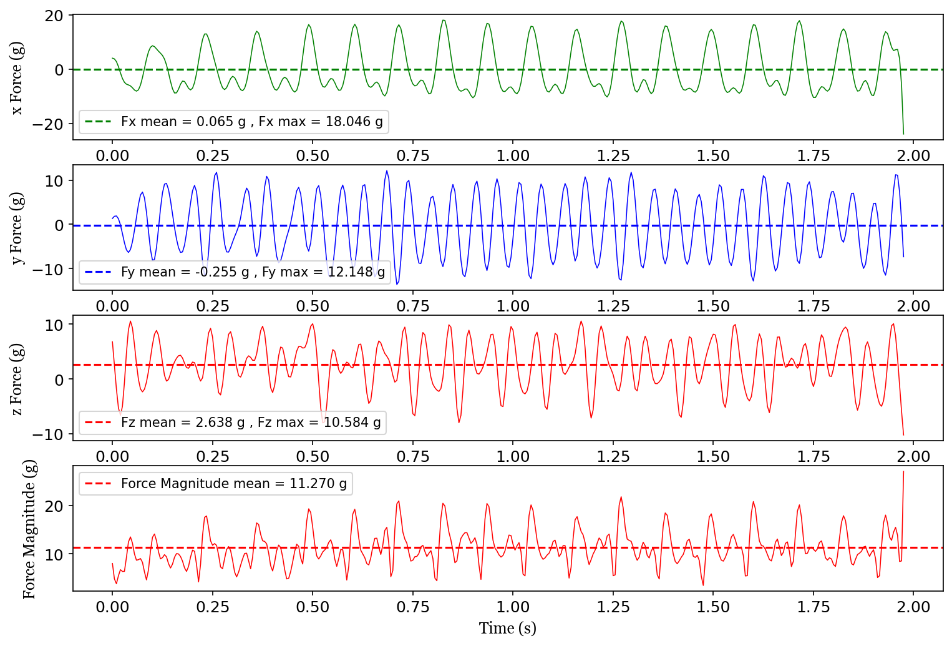
Force Production Analysis
Flapping frequency = 9 Hz
Force Sensor Sample Rate = 200 Hz
Average lift (Fx) from t = 0.5 s to t = 0.75 s is 0.698 g upwards (Mass of BIMAV = 6.74 g)
x
y
z

Slide 20
Concluding Remarks

Slide 21
Concluding Remarks
Current designs are in the early stages of development, but show promise.
Future work includes continued development and implementation of the figure 8 drive, as well as looking into mimicking the other veins on a butterfly’s wing using a flexible material like TPU to allow for more intentional wing compression.
Additional future work includes testing with oncoming air flow and changing the test flapper orientation.
With re-scaling and continued development of the designs, a first flight is also on the horizon.
The designs discussed show potential for being well suited for a Mars-environment flight design given the light mass, small size, and low power and frequency requirements.

Slide 22
Questions?

