Slide 1
Progress Towards Hotfire of a Student-Built Liquid Bipropellant Rocket Engine
Jeffery Reeves, Michael Johns, Vasilios Ekimogloy
The University of Alabama in Huntsville
AIAA Region II Student Conference, 4/3/2025 - 4/4/2025
Copyright © by Jeffery Reeves
Published by the American Institute of Aeronautics and Astronautics, Inc., with permission.

Slide 2
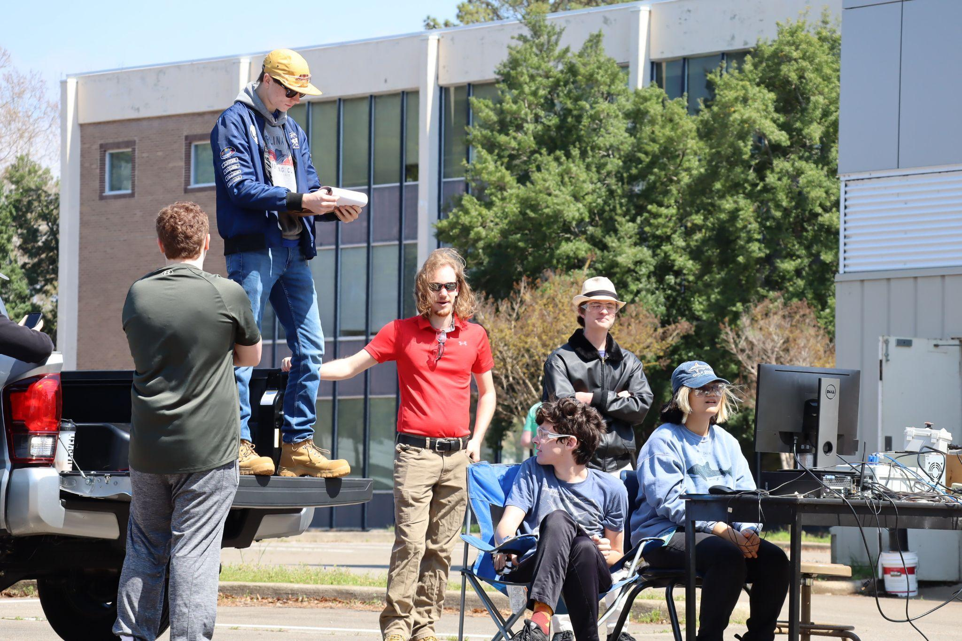
Tartarus Project Introduction (1/2)
Objective
To provide opportunities for hands-on liquid propulsion experience for UAH students covering all facets of the project design lifecycle
Safety briefing before cold flow

Slide 3
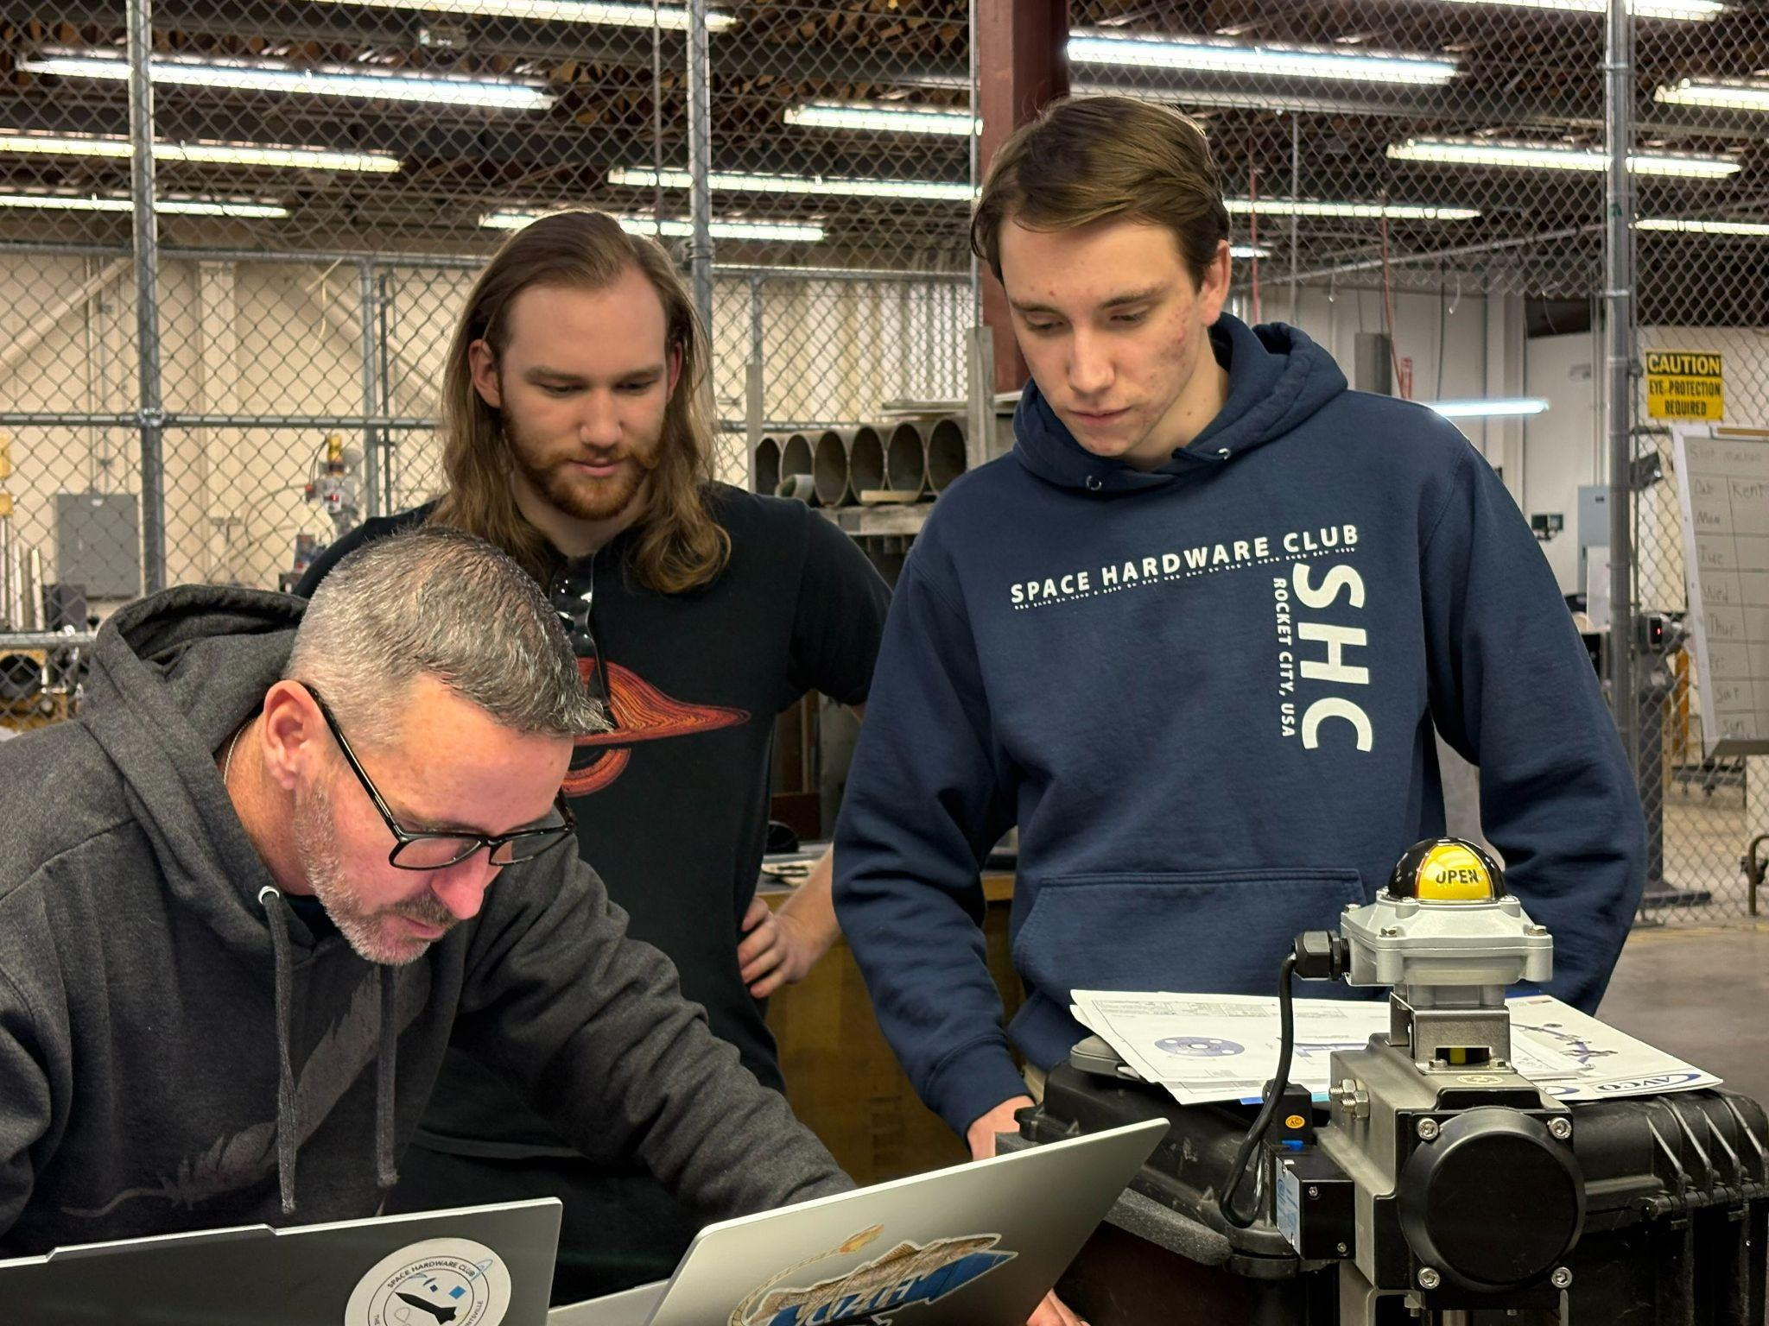
Tartarus Project Introduction (2/2)
Subteams
Controls: data acquisition and system control
Fluids: plumbing and ground systems
Propulsion: engine design, modeling, and analysis
SE&O: scheduling and systems management
A visit from our sponsor AVCO

Slide 4
Team Structure
Project Lead
Chief Engineer
Propulsion
Fluids
Controls
Systems Engineering and Operations
Responsibilities
- Engine Design
- Engine Development
Responsibilities
- Test Stand Design
- Test Stand Construction and Maintenance
Responsibilities
- Controls System Design
- Data Collection
Responsibilities
- Safety Analysis
- Schedule and Work Flow
- Media Relations

Slide 5
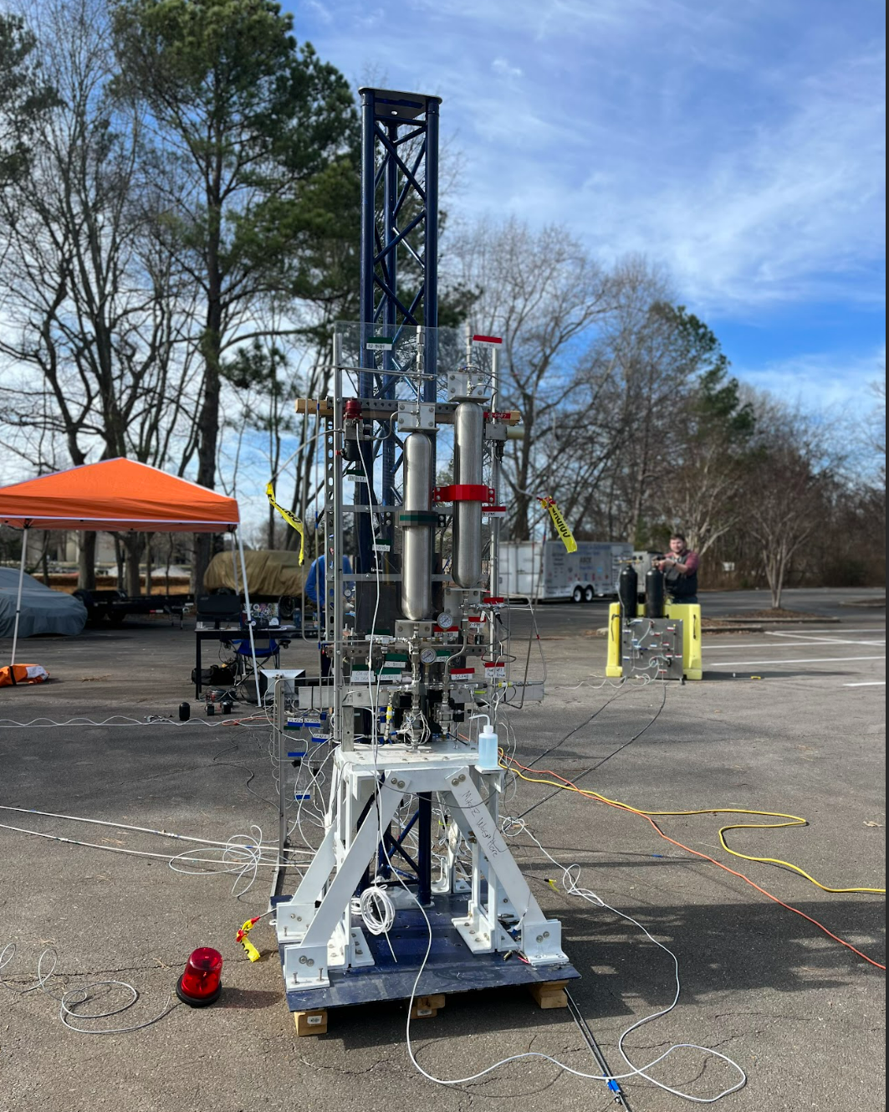
Original Project Scope
Original System
800 pound-thrust engine
  Nitrous oxide / ethane propellants
  Film-cooled
  Stainless steel engine material
Engine to be placed on a rocket
capable of flying 30,000 ft at
Spaceport America Cup
Original Test Stand

Slide 6
New Project Scope (1/3)
Rescope Phase 1
Design small-scale engine, ~280 lbf thrust
Design and manufacture a long term engine test stand fluid system
Create, apply, and perfect safety analyses and testing procedures
Use hotfire data to verify engine design models and simulations

Slide 7
New Project Scope (2/3)
Rescope Phase 2
Ongoing experimentation and research
Development of more powerful engines by researching varying factors, ie. injector, cooling, materials, etc.
Intended mainstay of project, alloted for further development of engine/pressurized systems research and experimentation

Slide 8
New Project Scope (3/3)
Rescope Phase 3
Parallel to Phase 2
Using information from data and experience from Phase 2, compete in the liquid division of Spaceport America Cup
Continued research in flight hardware to develop more efficient and powerful engines and rockets

Slide 9
Current Phase
Phase 1 - Prometheus
As of 04/02/2025, all systems for hotfire campaign have passed Preliminary and Critical Design Reviews
  August 2024 - Prometheus Engine CDR
  January 2025 - Mobile Test Stand CDR
  March 2025 - Control System CDR
Manufacturing and testing have already begun with hotfire set to occur in late September of 2025

Slide 10
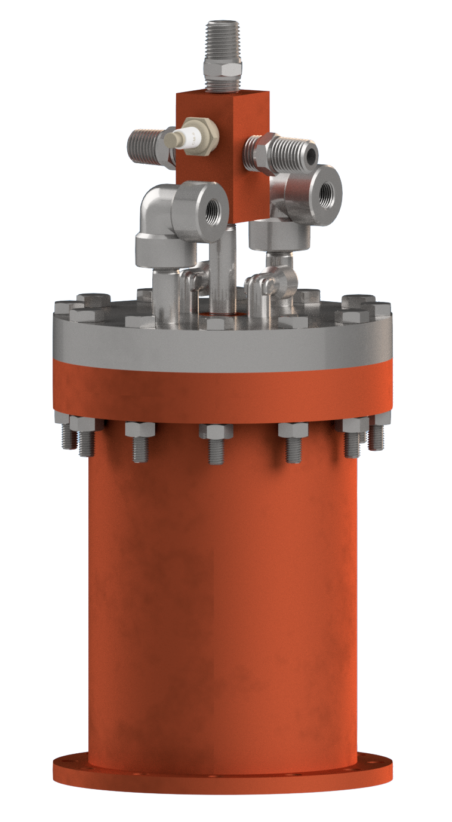
Prometheus Engine (1/3)
Engine Overview
Low-efficiency
Low-thrust
Verification piece
Designed for multiple test fires
Prometheus Engine Model

Slide 11
Prometheus Engine (2/3)
Propellant | Thrust | Chamber Pressure | Oxygen/ Fuel Ratio
Liquid Oxygen / Ethanol | ~280 lbs | 278 psi | 1.4

Slide 12
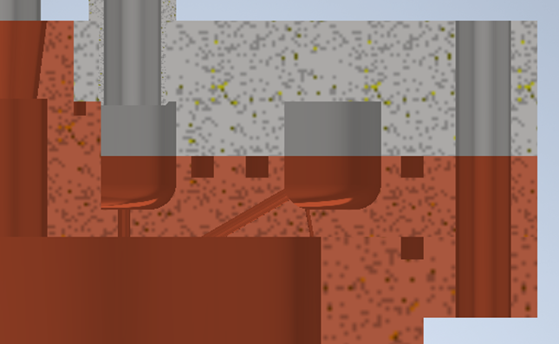
Prometheus Engine (3/3)
Engine Material
Injector
  Top half - Stainless Steel 303
  Bottom Half - Copper 110
Nozzle
  Copper 110
Prometheus Engine Injector Cross Section

Slide 13
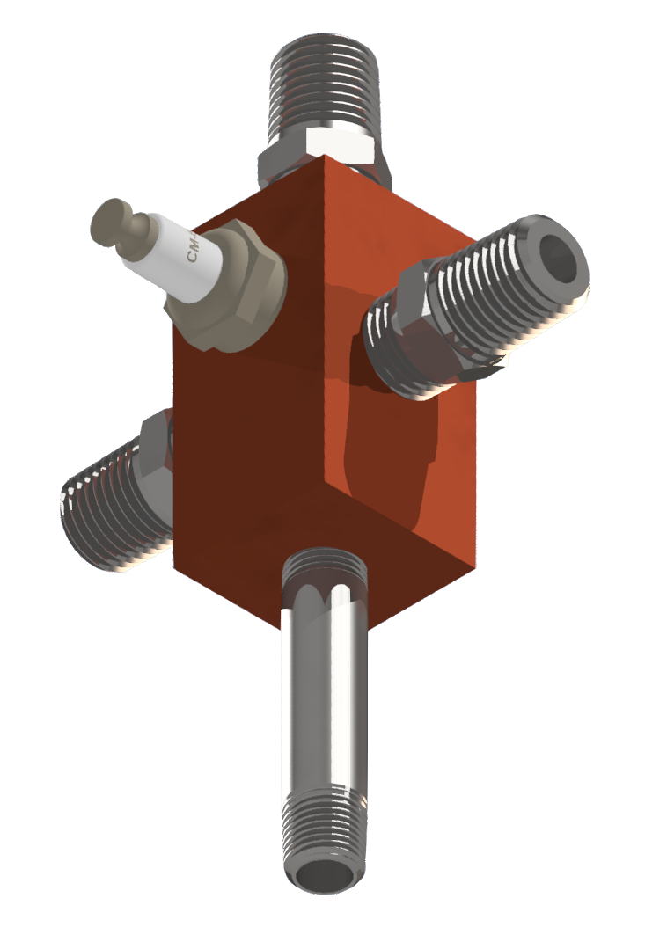
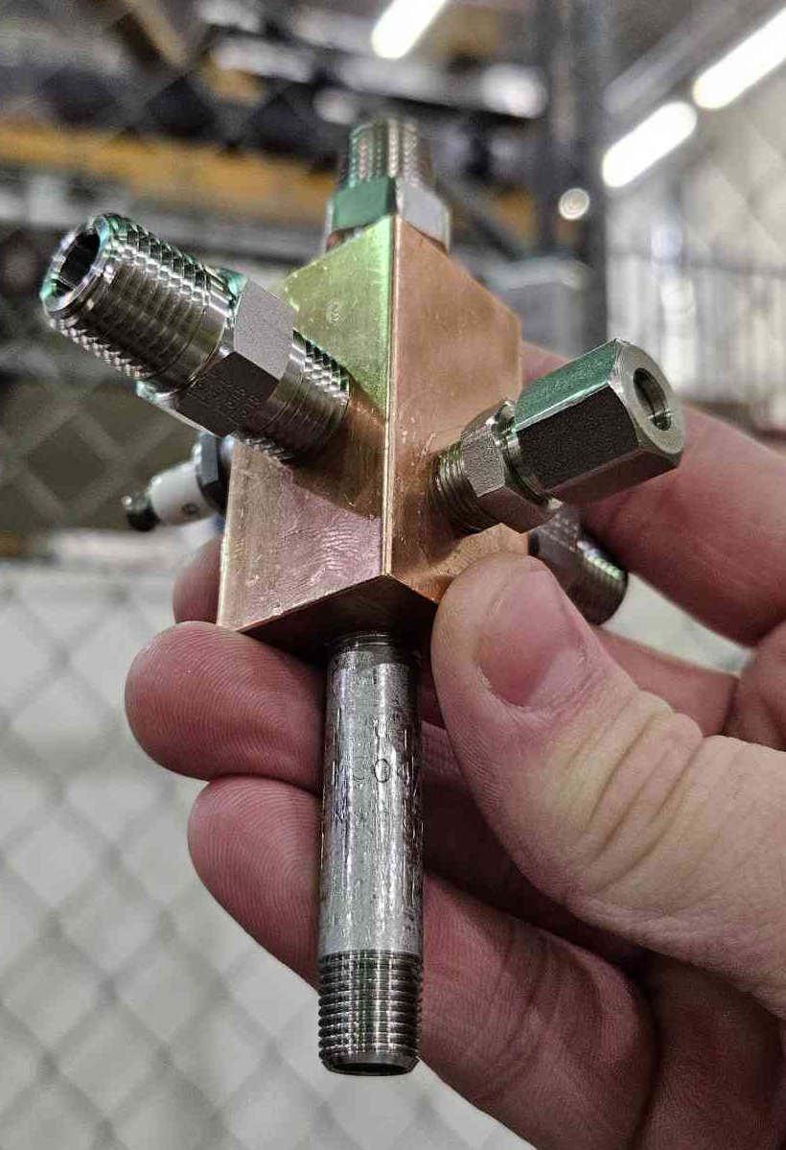
Torch Igniter
Igniter Overview
Custom GOx/Propane torch igniter to allow for repeated refires
Material: Copper 110
Capable of reaching temperatures up to 1500K
Prometheus Engine Igniter Model
Prometheus Engine Igniter Prototype

Slide 14
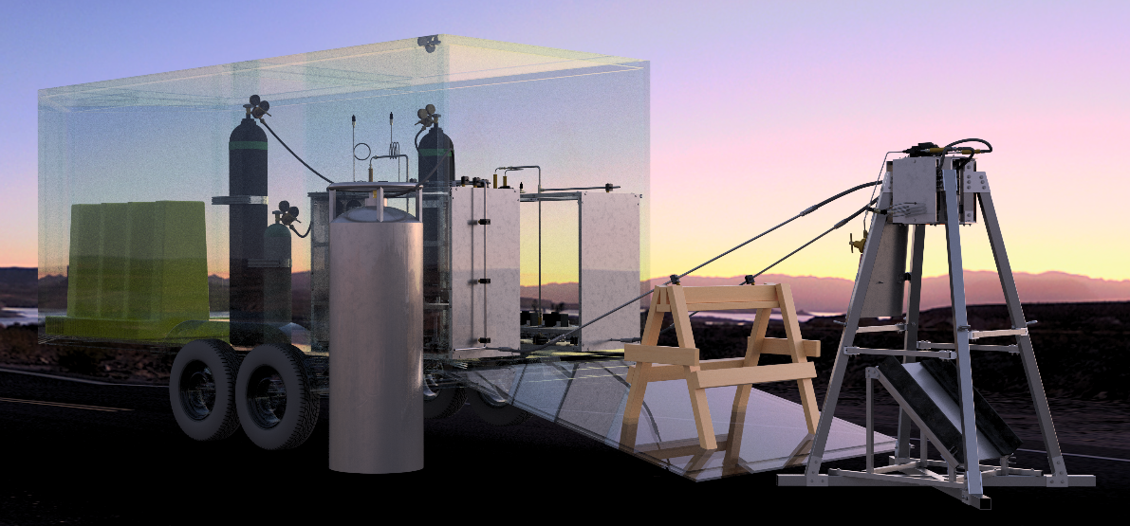
Mobile Test Stand
MTS Overview
Fluid system designed to be installed inside a trailer
Maximum operating pressure of 1000 psi
Modular components allow for simple and swift setup/breakdown times
Mobile Test Stand Model

Slide 15
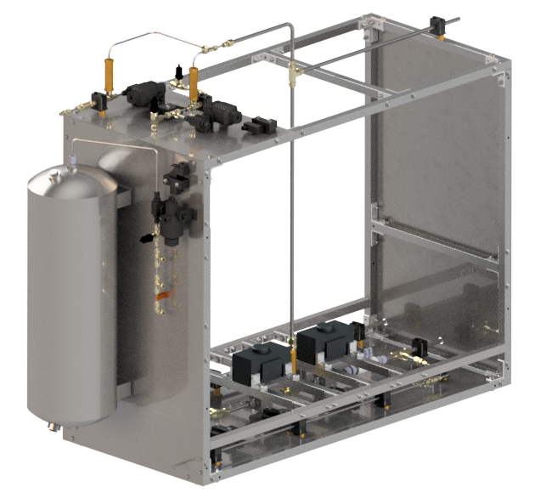
Ethanol Cabinet
Cabinet Capabilities
Pressurizes fuel to 415 psi for operation
Houses muscle pressure accumulation tank
Includes a 750 psi relief valve for equipment safety
Ethanol Cabinet Model

Slide 16
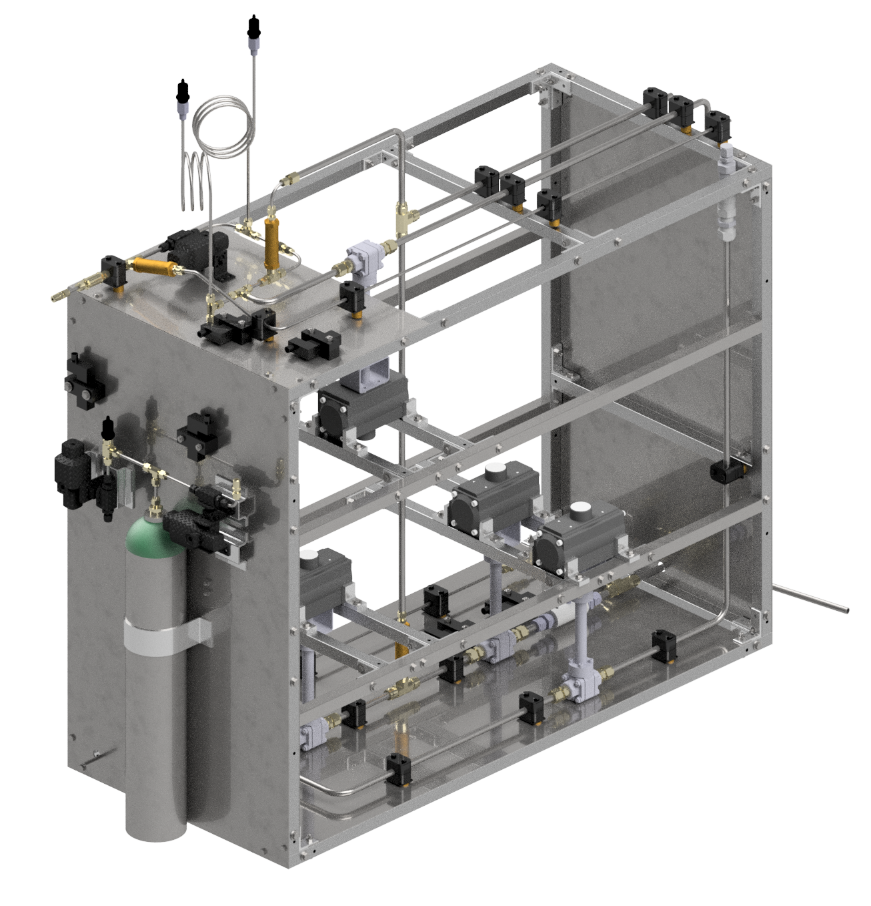
LOx Cabinet
Cabinet Capabilities
Pressurizes oxidizer to 415 psi for operation
Houses purge system to clear run lines
Includes a 750 psi relief valve for equipment safety
LOx Cabinet Model

Slide 17
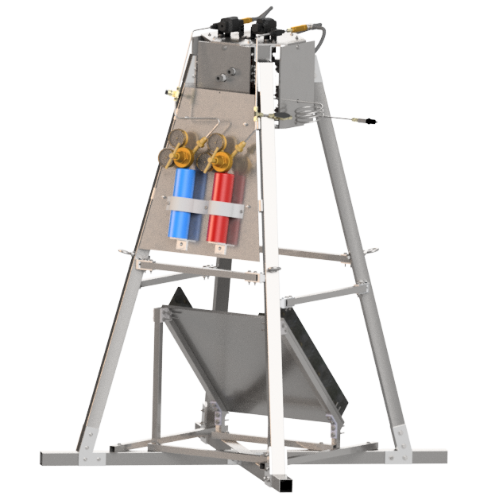
Engine Thrust Structure
ETS Capabilities
Rated for 1000 pounds of thrust
Mounts for igniter hardware are found here
Includes four steel ground tethers for stability
Load cells in engine cage
Engine Thrust Structure Model

Slide 18
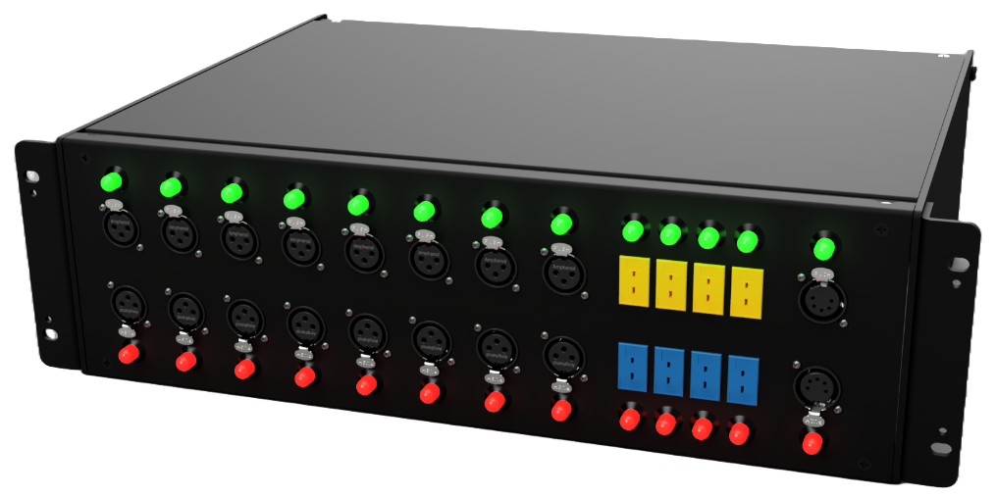
Custom Control System
Control System Overview
Required to collect pressure, temperature, and thrust data
Modular and easily expandable
Utilizes common programming languages
Control System Enclosures (Trailer)

Slide 19
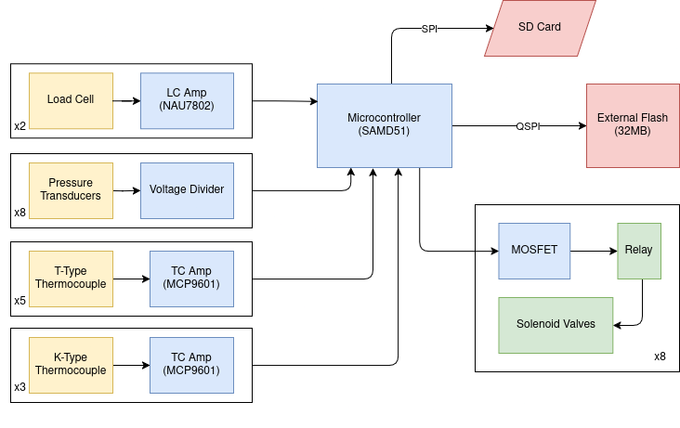
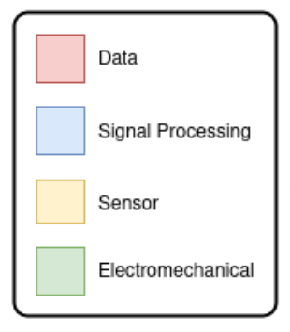
CCI Boards
CCI Board Capabilities
Able to log ~2,000,000 data points per second
Utilizes C++ for software
Uses industry-standard XLR connectors for ease of use and reliability

Slide 20
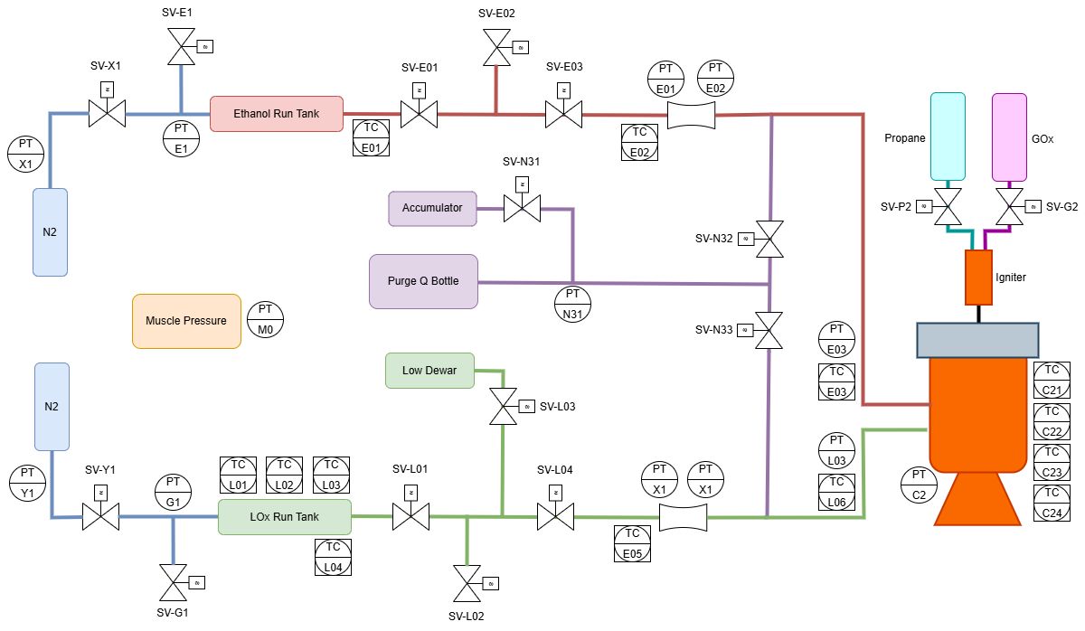
User Interface
User Interface Capabilities
Shown to the right is our interactive P&ID
Provides simple locating and actuation of solenoid valves
Includes live camera feed and live pressure/ temperature data
P&ID User Interface

Slide 21
Establishing Requirements
System Management
Visual Diagrams representing both components and tasks
Include both high fidelity description of high priority items and leave room for development of living documents for future tasks
Provide overarching timeline representation to utilize Rolling Wave Schedule effectively

Slide 22
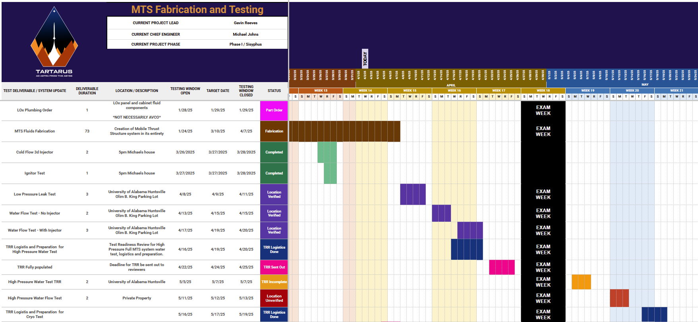
Gantt Charts
Purpose
Visual timeline of project
Linked to other system management
Automatic/Manual updates
Living document to check work progress against
Tartarus Master Testing and Fabrication Gantt Chart

Slide 23
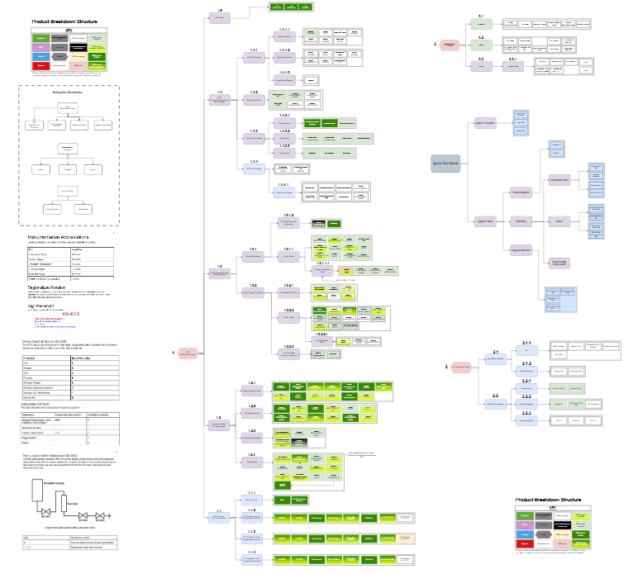
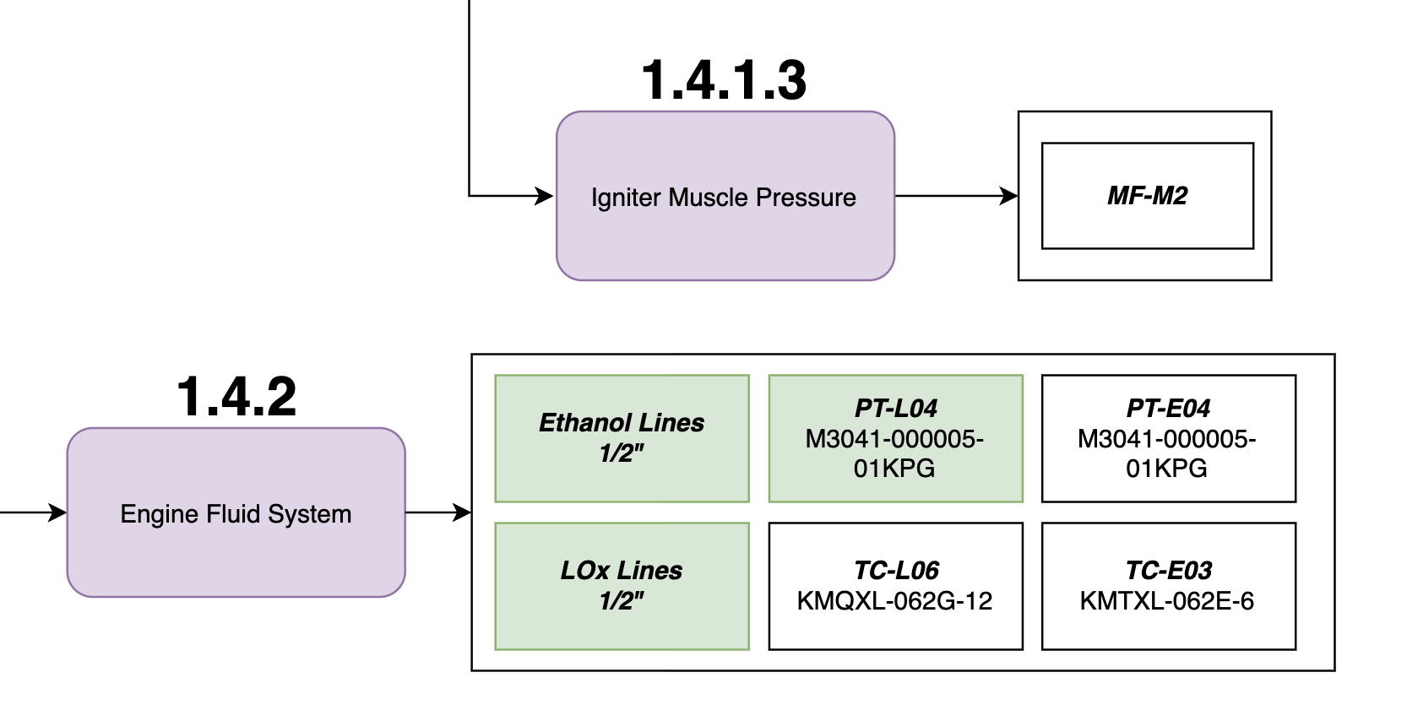
Product Breakdown Structure (PBS)
PBS Master Chart
Purpose
Used to track physical components & integration
Master chart used as a ‘web’ of components
Nested component tracking numbers
PBS of sections 1.4.2 and 1.4.1.3

Slide 24
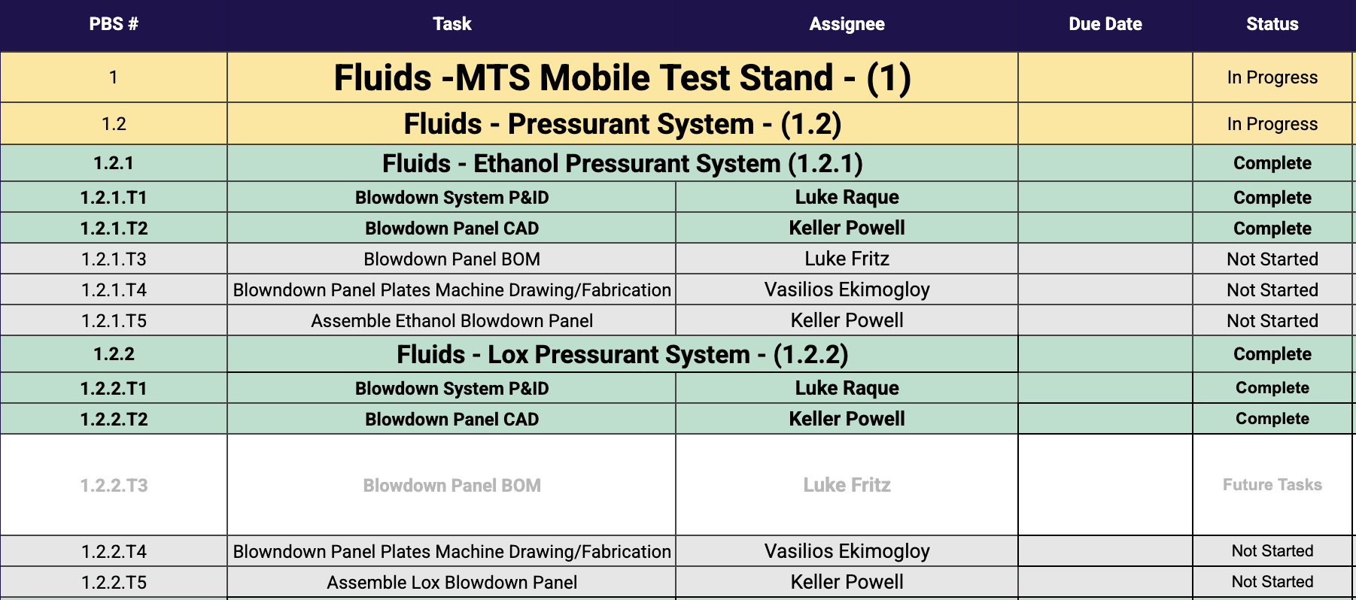
Work Breakdown Structure (WBS)
Purpose
Organizes tasks & responsibilities
Base for Gantt chart milestones
Tracks progress, task dependency, and member workload
WBS for MTS Fabrication and Design

Slide 25
Safety Analysis Scope
Purpose
Analytical safety is a series of industrial tools used to analyze and document safety
Forms a better understanding of safety practices in engineering
Helps establish confidence of system safety in advisors and reviewers

Slide 26
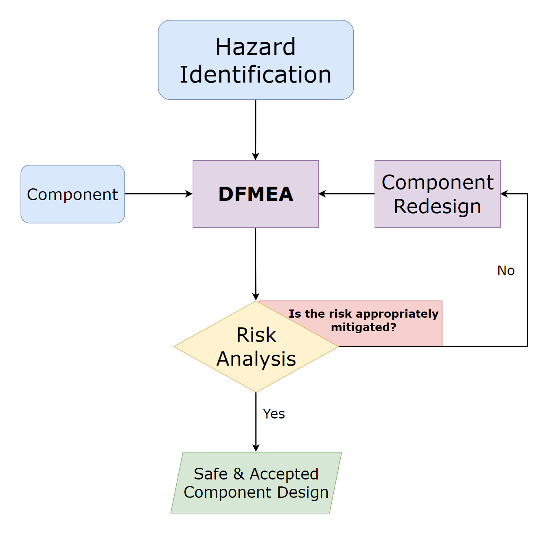
System Safety Analysis
System Analysis Process
Hazard Analysis
FMEA
Risk Analysis
Component redesign or Design Acceptance
Safety Analysis Workflow Diagram

Slide 27
Hazard Identification & Analysis
Hazard Definition
A hazard is a potential source of harm or damage to personnel, land, or equipment ​​
Purpose
Brainstorming possible failures of design
Pulling from OSHA and MIL standards
33 total end-effect hazards have been Identified for Tartarus
Identifying Hazards

Slide 28
Failure Modes and Effects Analysis
Function
Record and analyze all possible failures of a system
Failure analysis: determining how a part fails
Risk analysis: determining effects of a part failing
Main Components

Slide 29
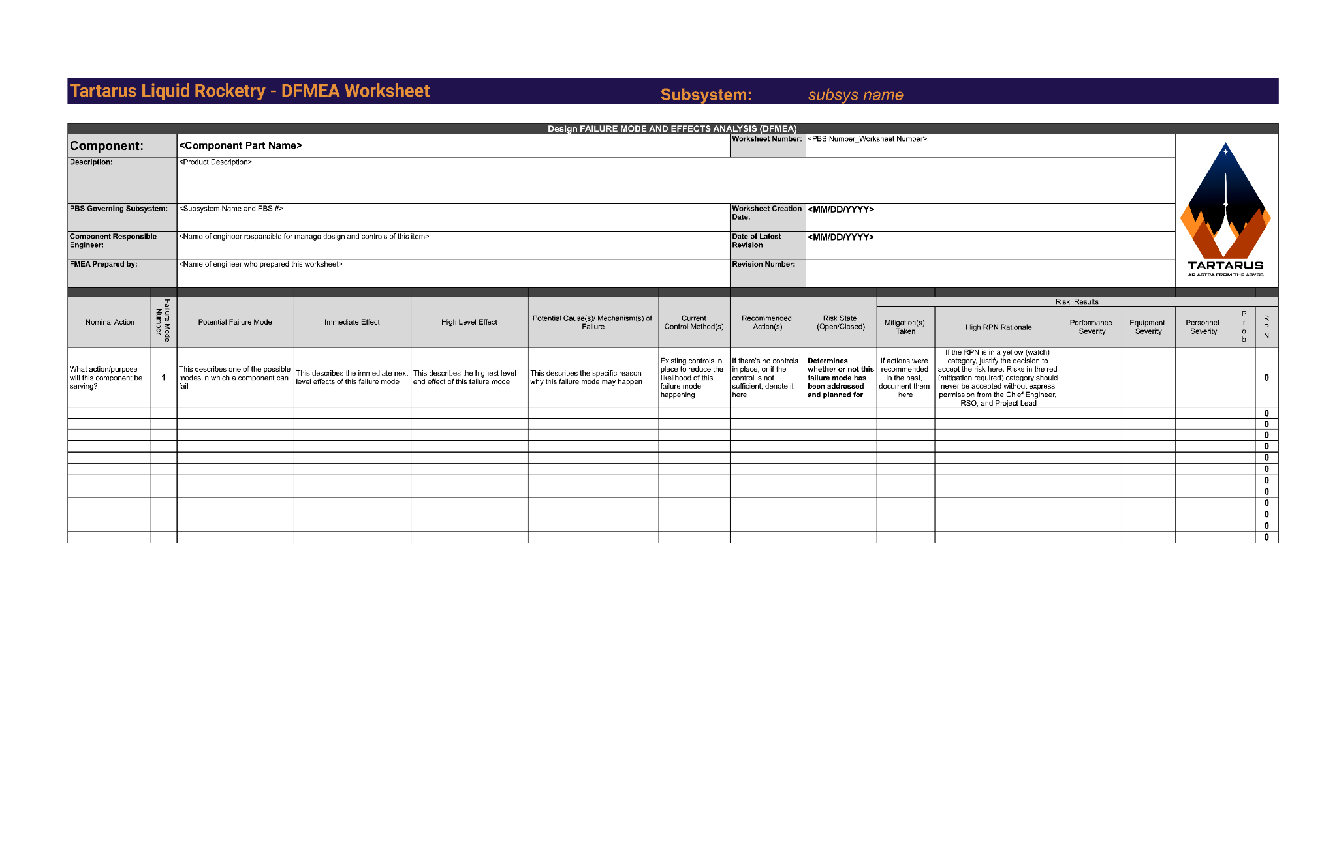
FMEA Worksheet
Failure Modes and Effects Analysis Full Worksheet

Slide 30
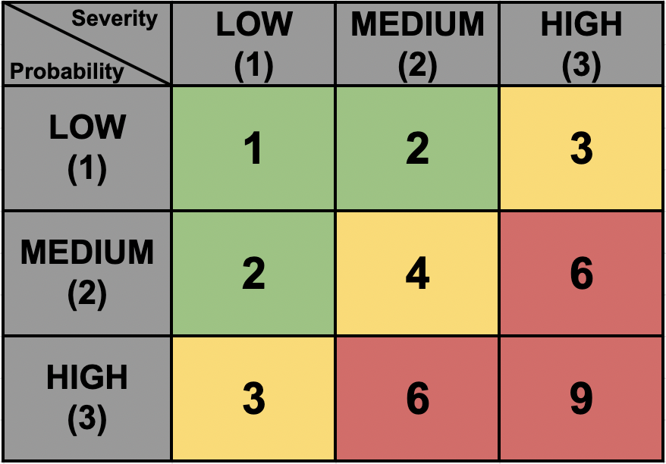
Risk Analysis
Function
Identify the effects of a failure
Quantify the safety of system components
Determine necessary safety actions
A risk is the probability x severity of a hazard occurring
Risk Definition
Mitigate
Watch
Accept
Condensed Risk Matrix

Slide 31
Risk Analysis Definitions
Severity
3 categories: personnel, hardware, mission
Ranges to low, medium, and high
Determined by research and analysis
Probability
Purely qualitative
Range based on whether component is COTS or custom
Determined by testing and research

Slide 32
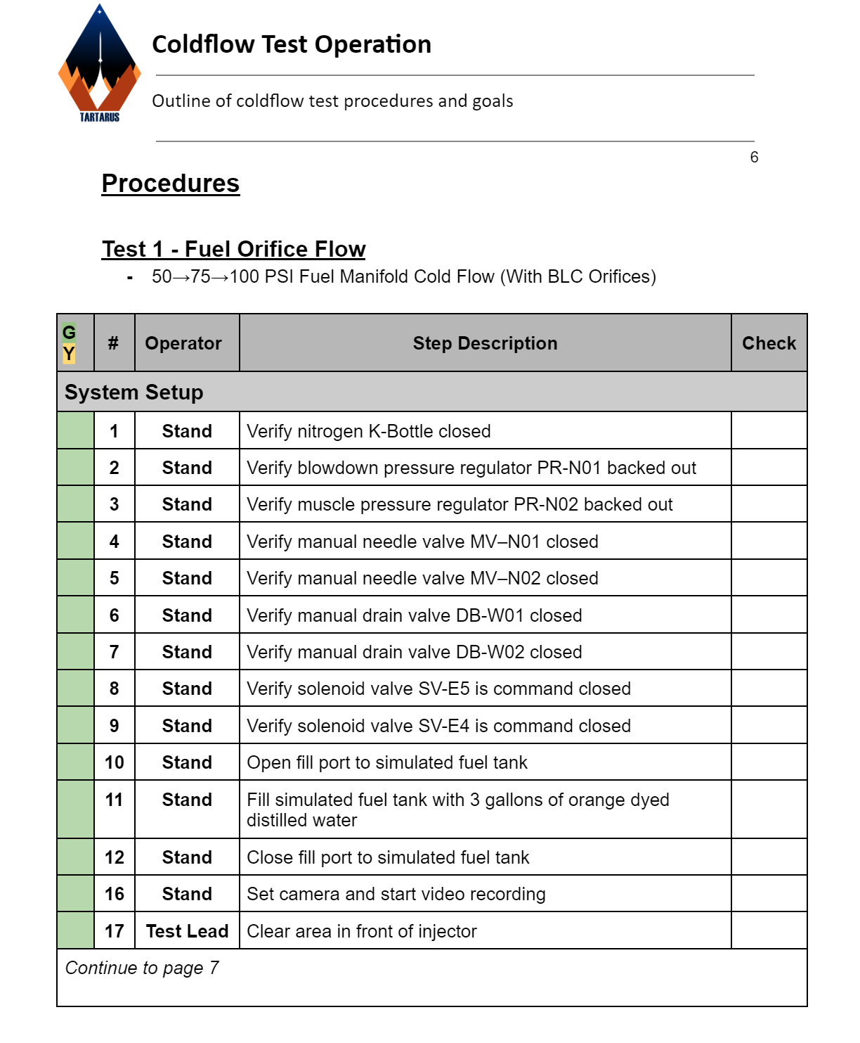
Test Organization
Test Preparation Packet
Bundle of all relevant system info
Standard operating procedure
System design documents
FMEA/RA
Contingency / emergency SOPs
Cold Flow Test SOP

Slide 33


Industry and Student Connections
Connections
AVCO
  Providing LOx-rated valves and solenoids for our use
YJSP
  Student connection in which we can discuss various topics like design changes and more

Slide 34
Current Progress (1/2)
Assembly
Testing
January to Current: Test stand assembly
  Ethanol cabinet structure complete
  LOx cabinet structure nearing completion
  ETS structure almost complete
Spring 2024: Prototype injector Cold Flow test
March 2025: 3D printed injector Cold Flow test
March 2025: Igniter test
April 2025: Targeted date for improved igniter test

Slide 35
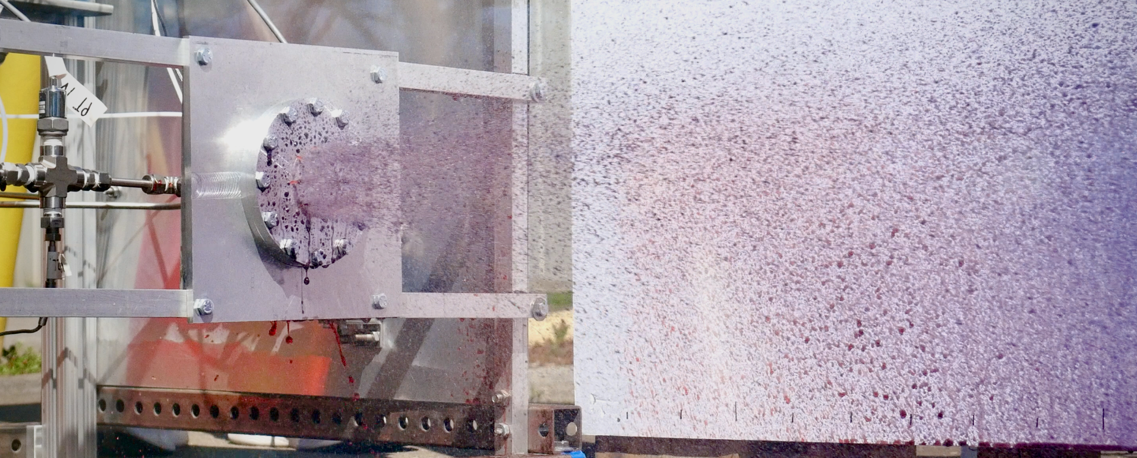
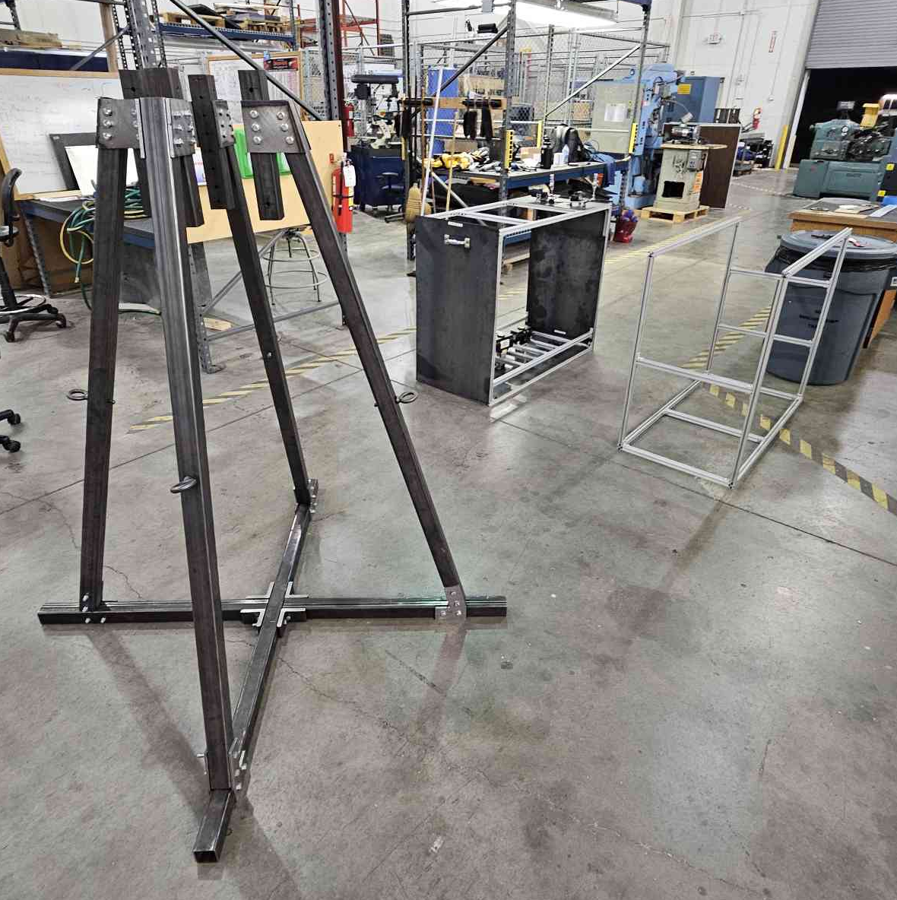
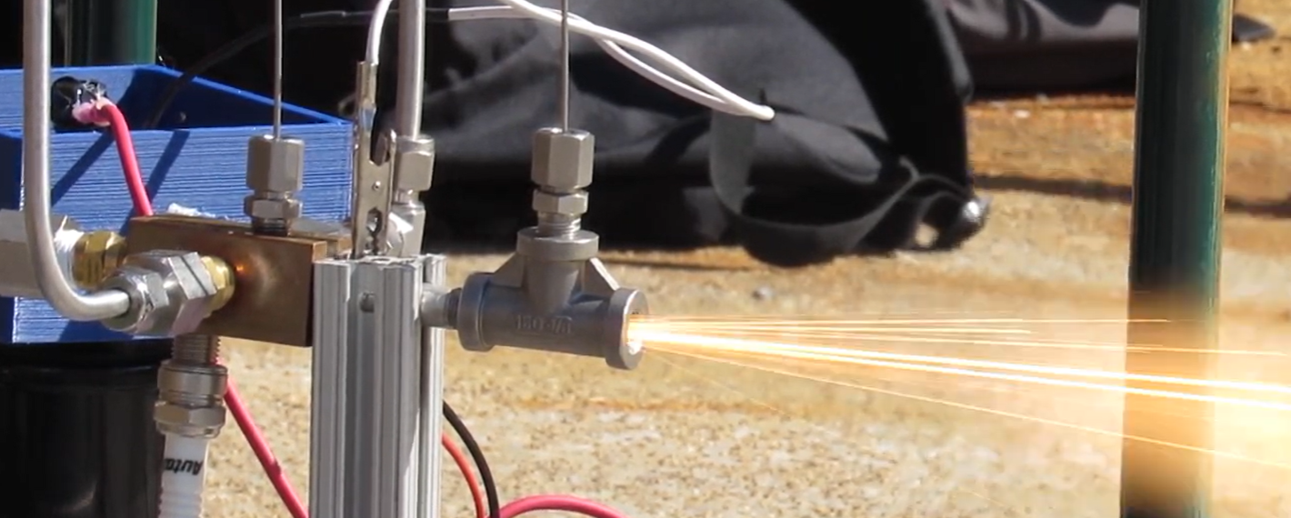
Current Progress (2/2)
Above: Cold Flow Test, Below: Igniter Test
Test Stand Structural Progress

Slide 36
Conclusions
Closing Remarks and Future Plans
Targeting hotfire for late September of 2025
Continue test stand and control system assembly throughout the end of April
High-level system tests in August
The team is confident in meeting the hotfire timeline

