Slide 1
Volunteer Spirit and Outreach
VOL. II
Christian Pack, University of Tennessee Chapter Treasurer
Mason Roddy, University of Tennessee Chapter Outreach Officer
Cole Perry, University of Tennessee Chapter Vice Chair

Slide 2
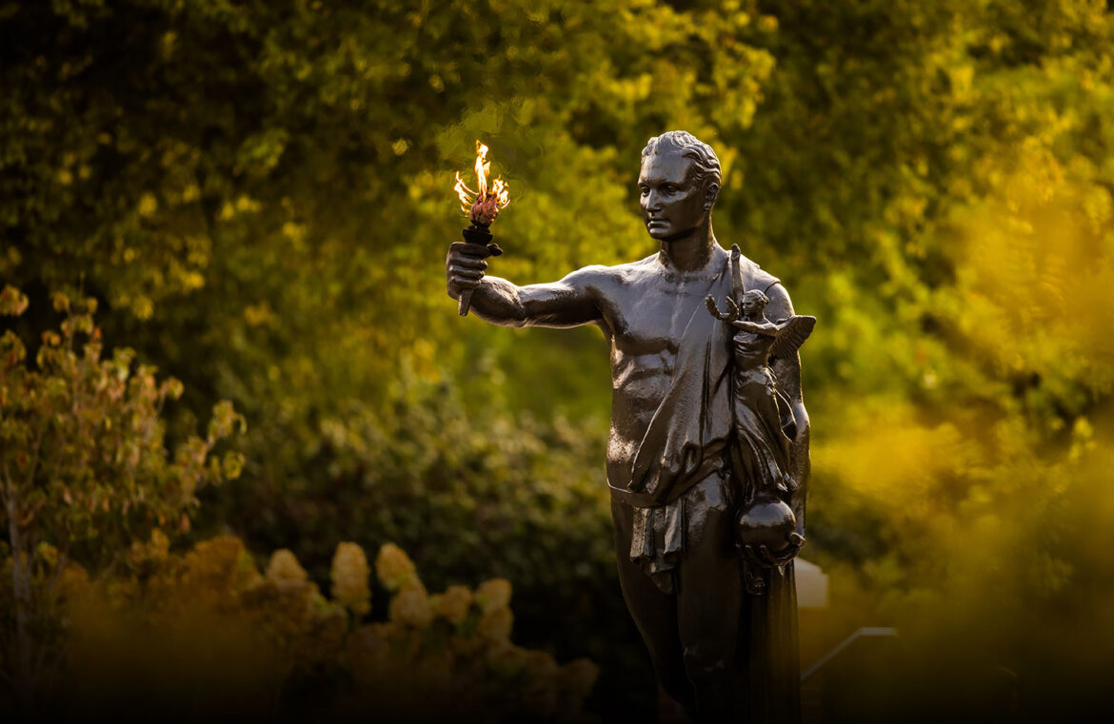
Objective – The Volunteer Spirit
Create a resource to provide easy inclusion of STEM into education and grow student interest
  Review of Previous Work
  Areas of Improvement
  Grow On-campus and Community Involvement

Slide 3
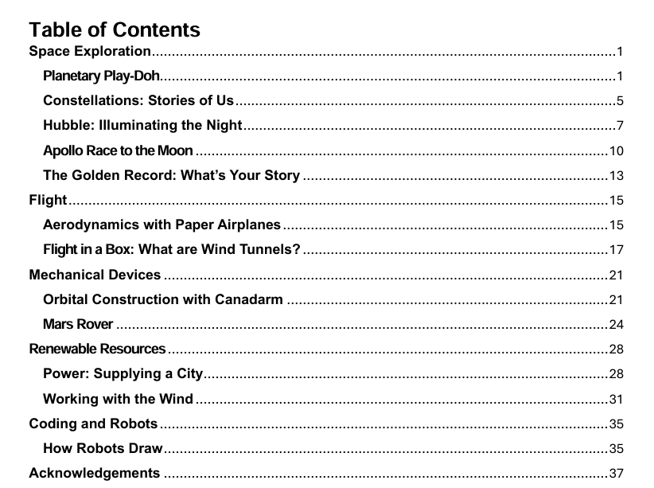
Review of Previous Work
Created a workbook of STEM activates
  Totaling 39 pages with 12 activities
Each lesson provided
  Introduction
  Materials and completion time
  Relevant background information
  Learning objectives
  Procedure
  References

Slide 4
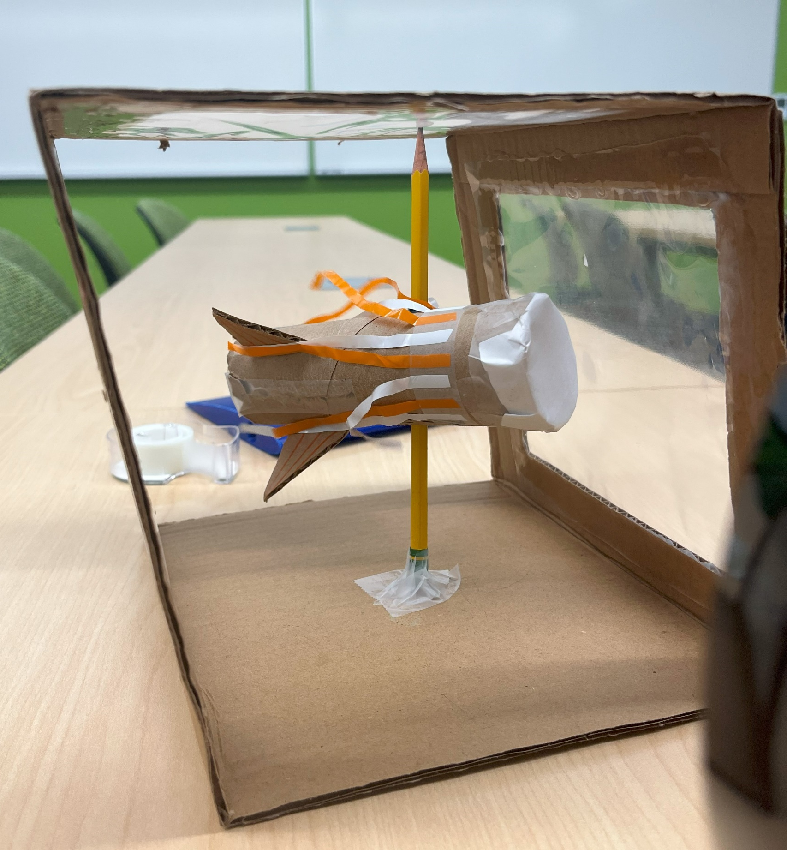
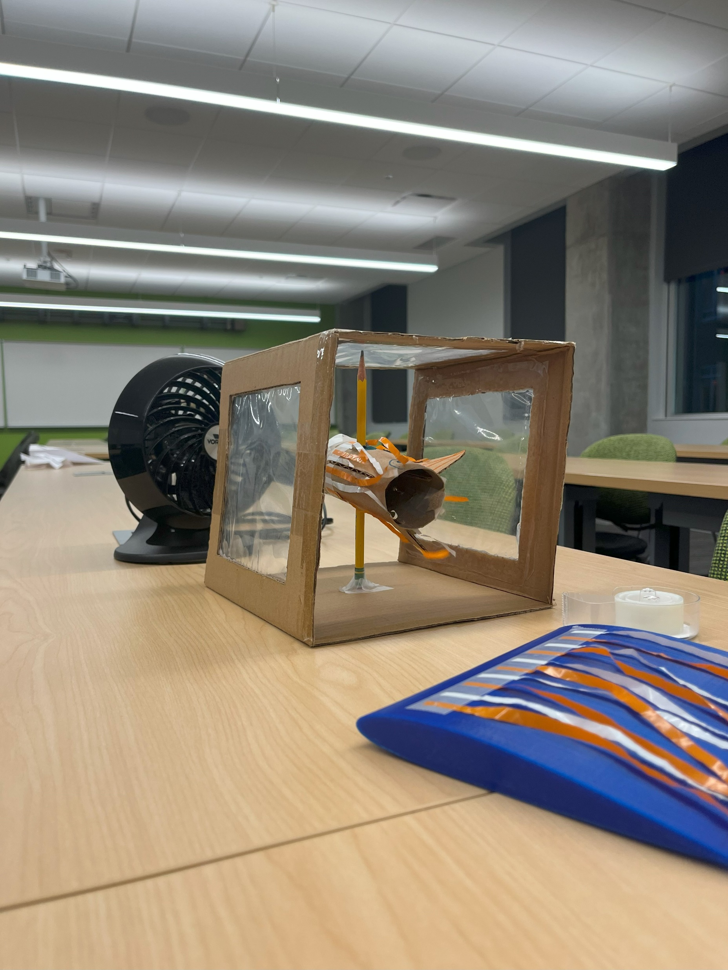
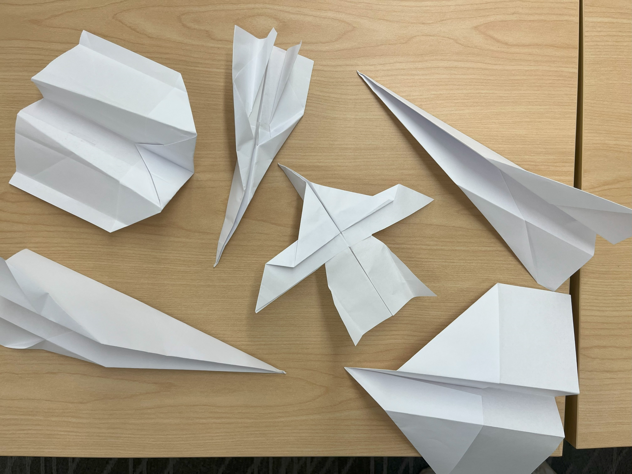
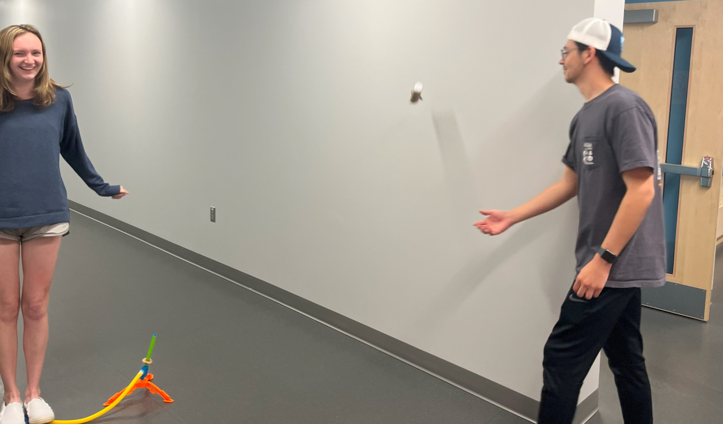
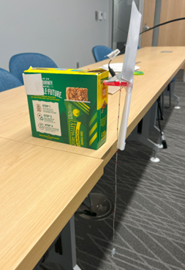
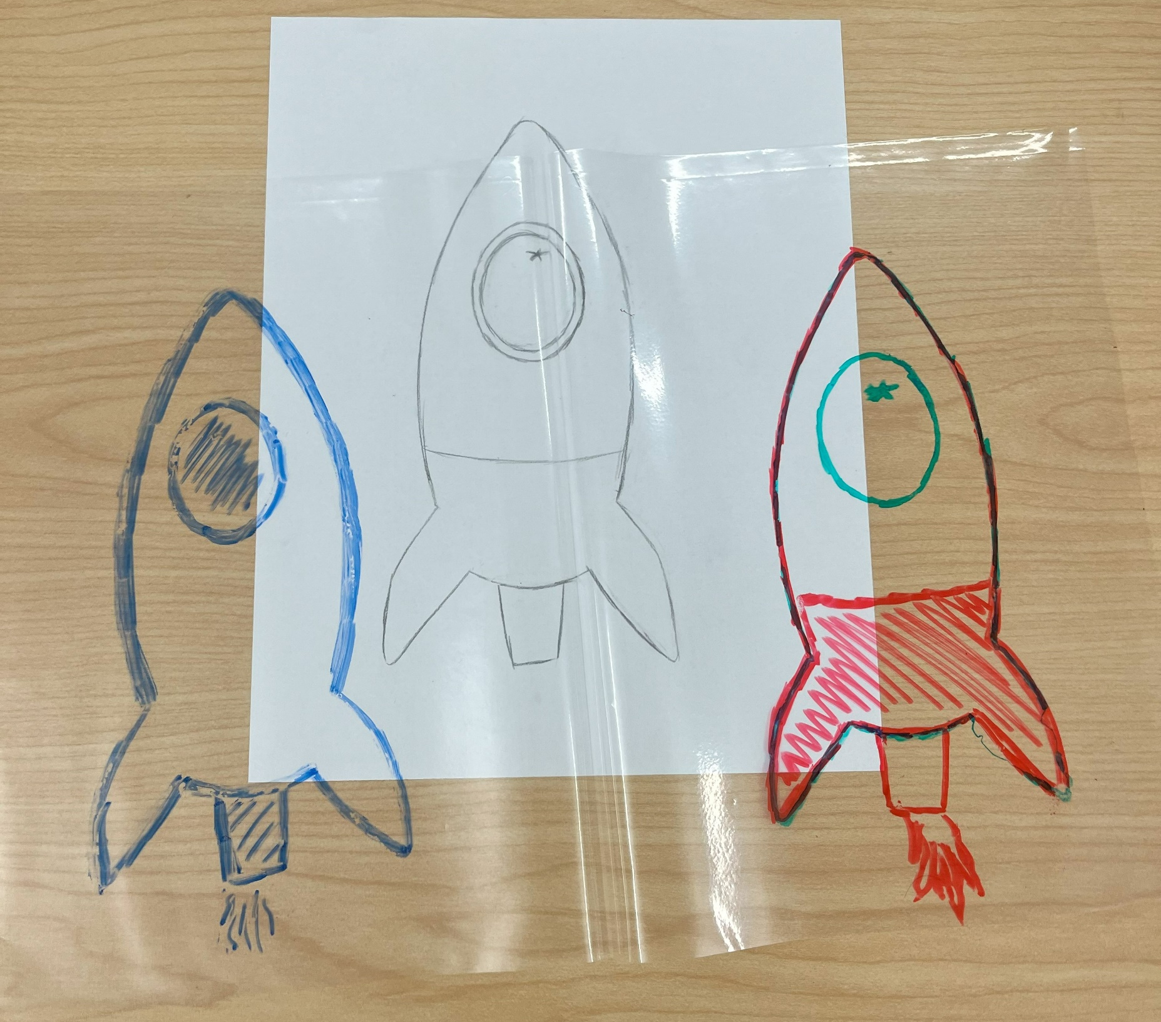
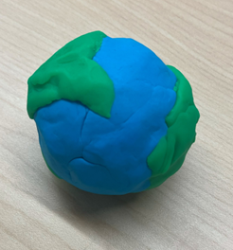
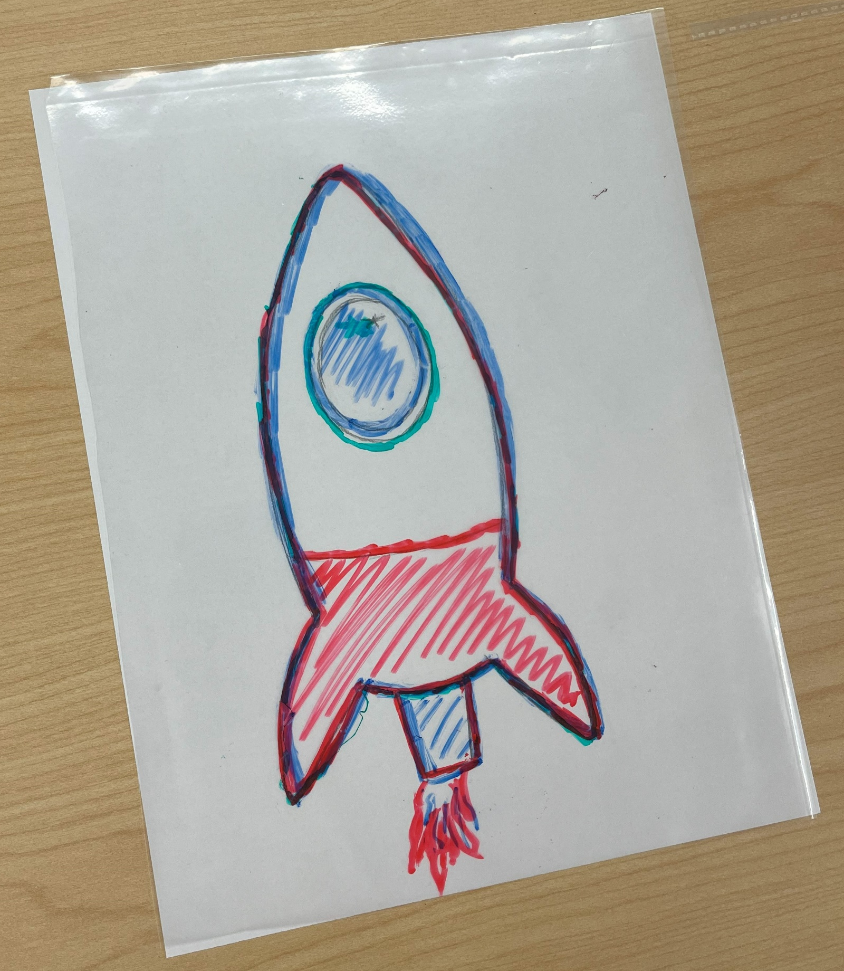
Activities
Paper Airplanes
Homemade Wind Tunnel
Homemade Wind Turbine
Stomp Rockets
Planetary Play-Doh
Space Telescope: Overlaying Filtered Colored Images

Slide 5
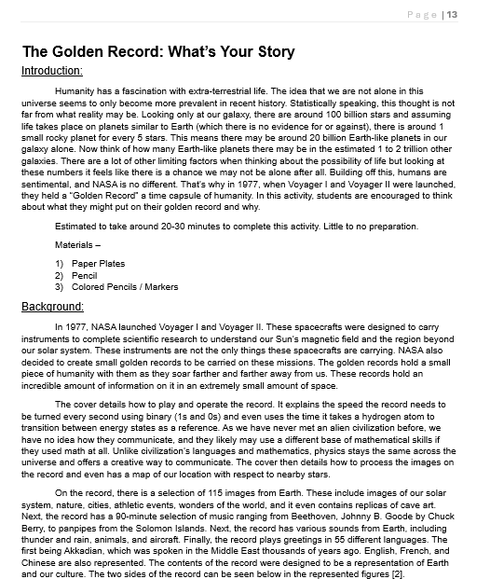
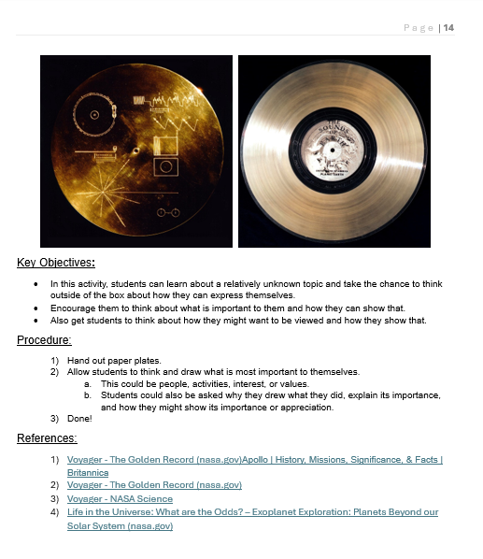
Example Activity

Slide 6
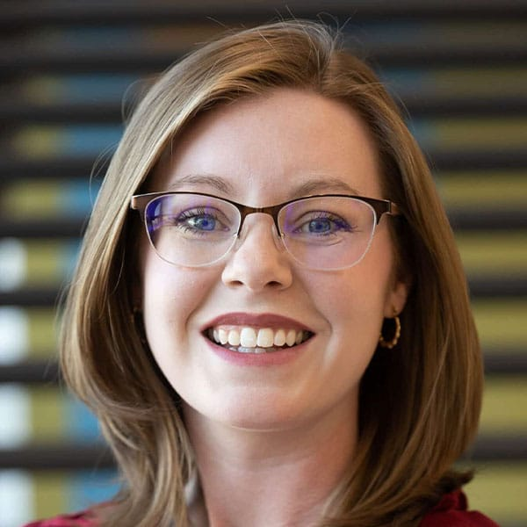
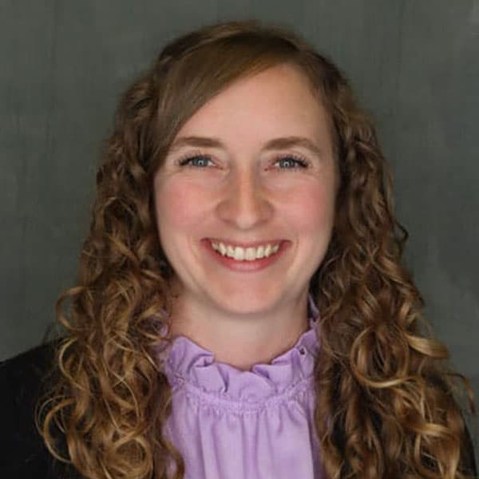
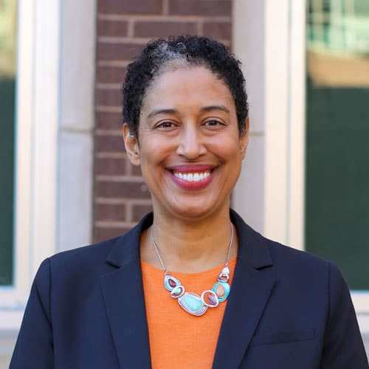


Current Improvement
Involved with campus resources
  Student Success Center
  Professors
  Student Organizations
Student Success Coordinator – Courtney Wahlen
Women in Engineering Coordinator - Kelly Clifton
Leadership in Engineering and Entrepreneurship Program Director – Dr. Angelique Adams
Student Space Technology Association (SSTA)

Slide 7
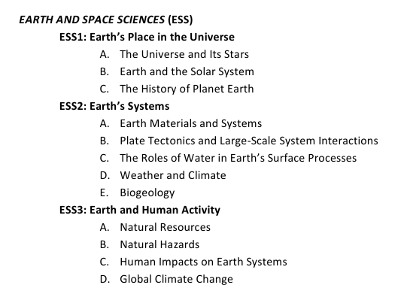
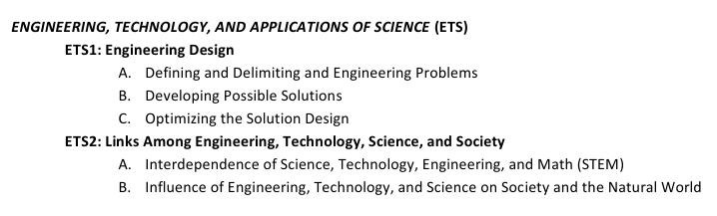
Current Improvement
Built upon workbook activities
  Made more applicable and accessible to educators
    The five Es: Engage, Explore, Explain, Extend, and Evaluate
    Implementing 'Tennessee Academic Standards'
    'Students will be able to …' and 'I can …'
  Improved format
  Six more activities and counting

Slide 8
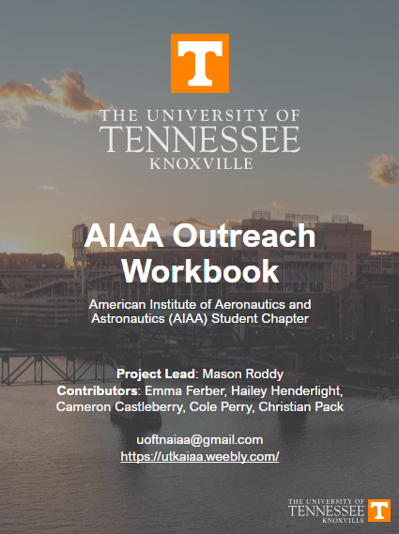
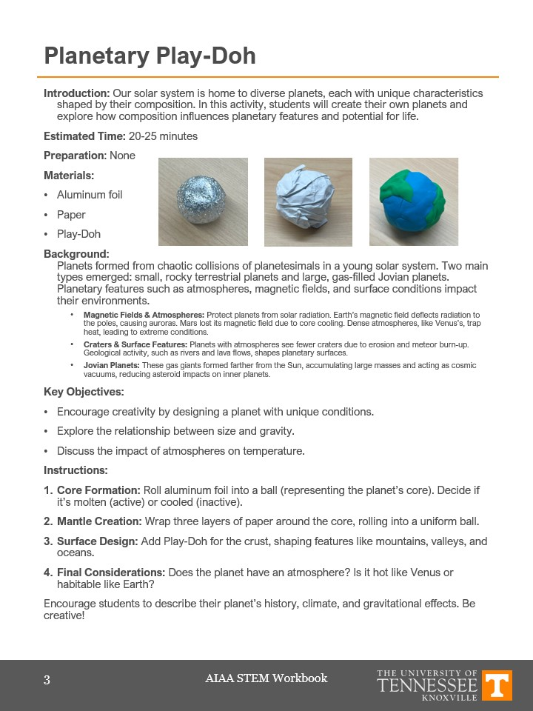
Current Improvement
Instructor and Student Resources
  Downloadable workbook and worksheets
  Available May 15th on our UTK-AIAA website:
    https://utkaiaa.weebly.com/stem-for-kids

Slide 9


Current Improvement
Community Involvement
  Continued volunteering at elementary school STEM Nights
  Worked with community organizations
    MUSE Knoxville
    Boys and Girls Club - Vestal

Slide 10
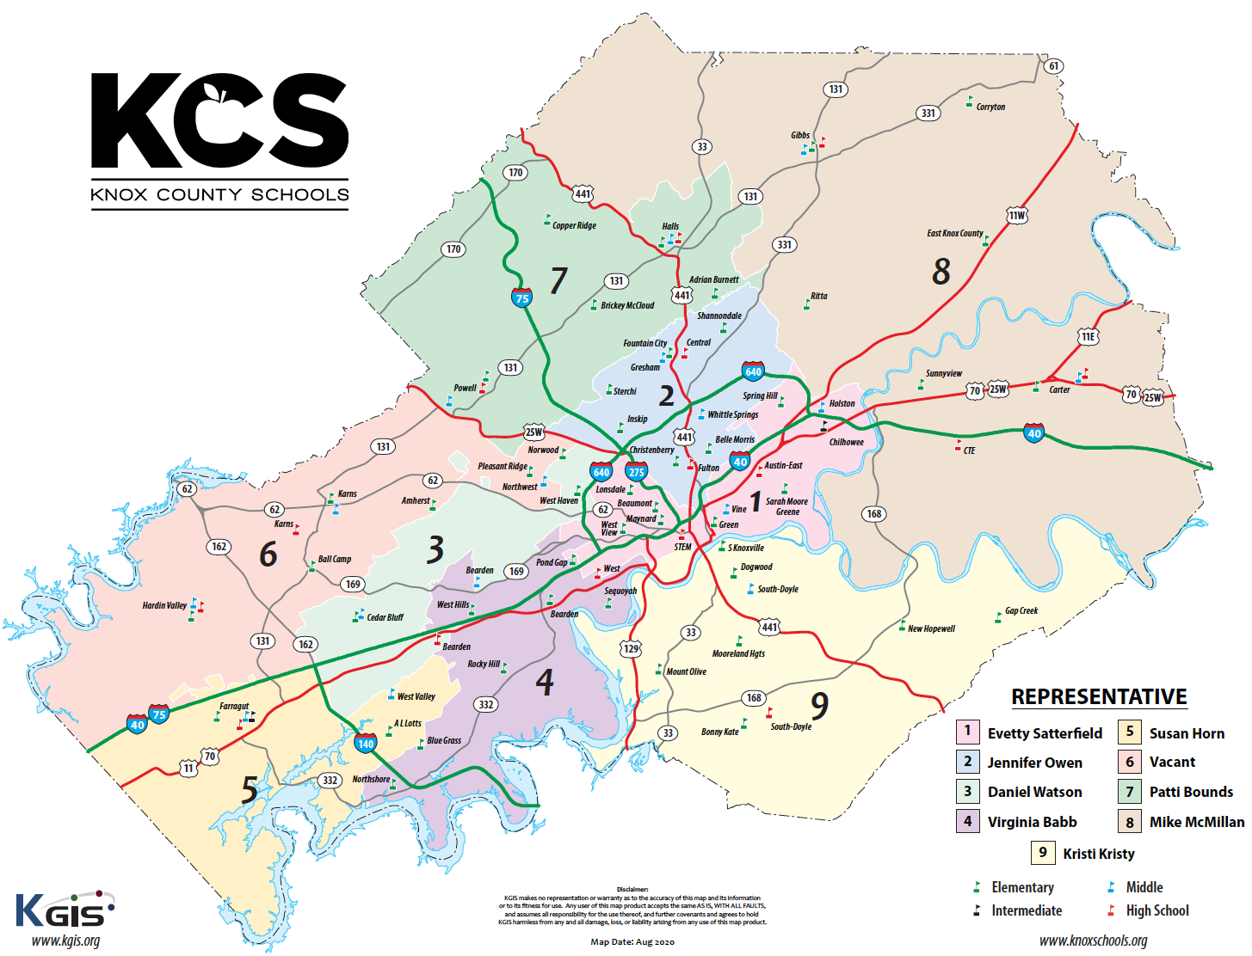
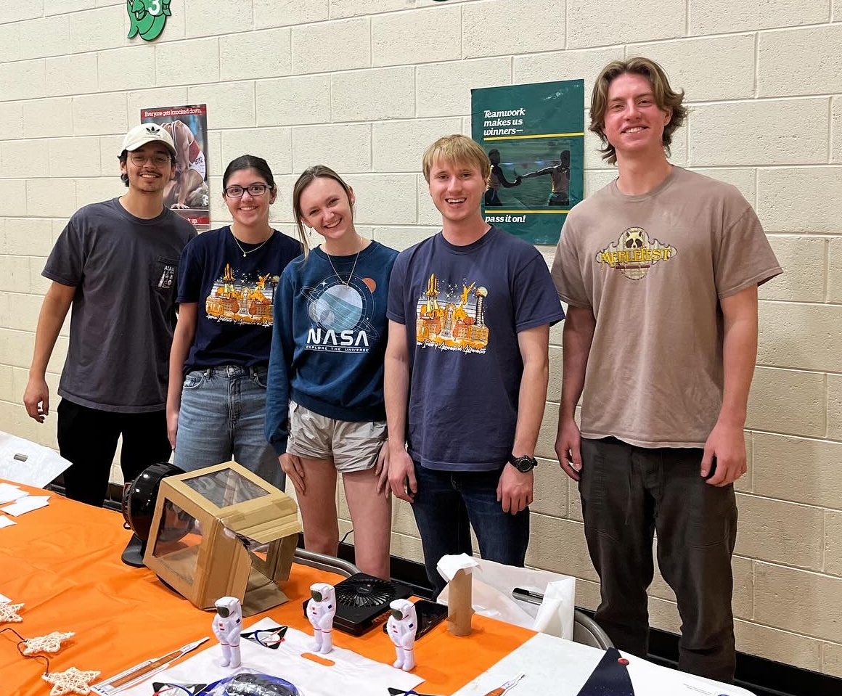
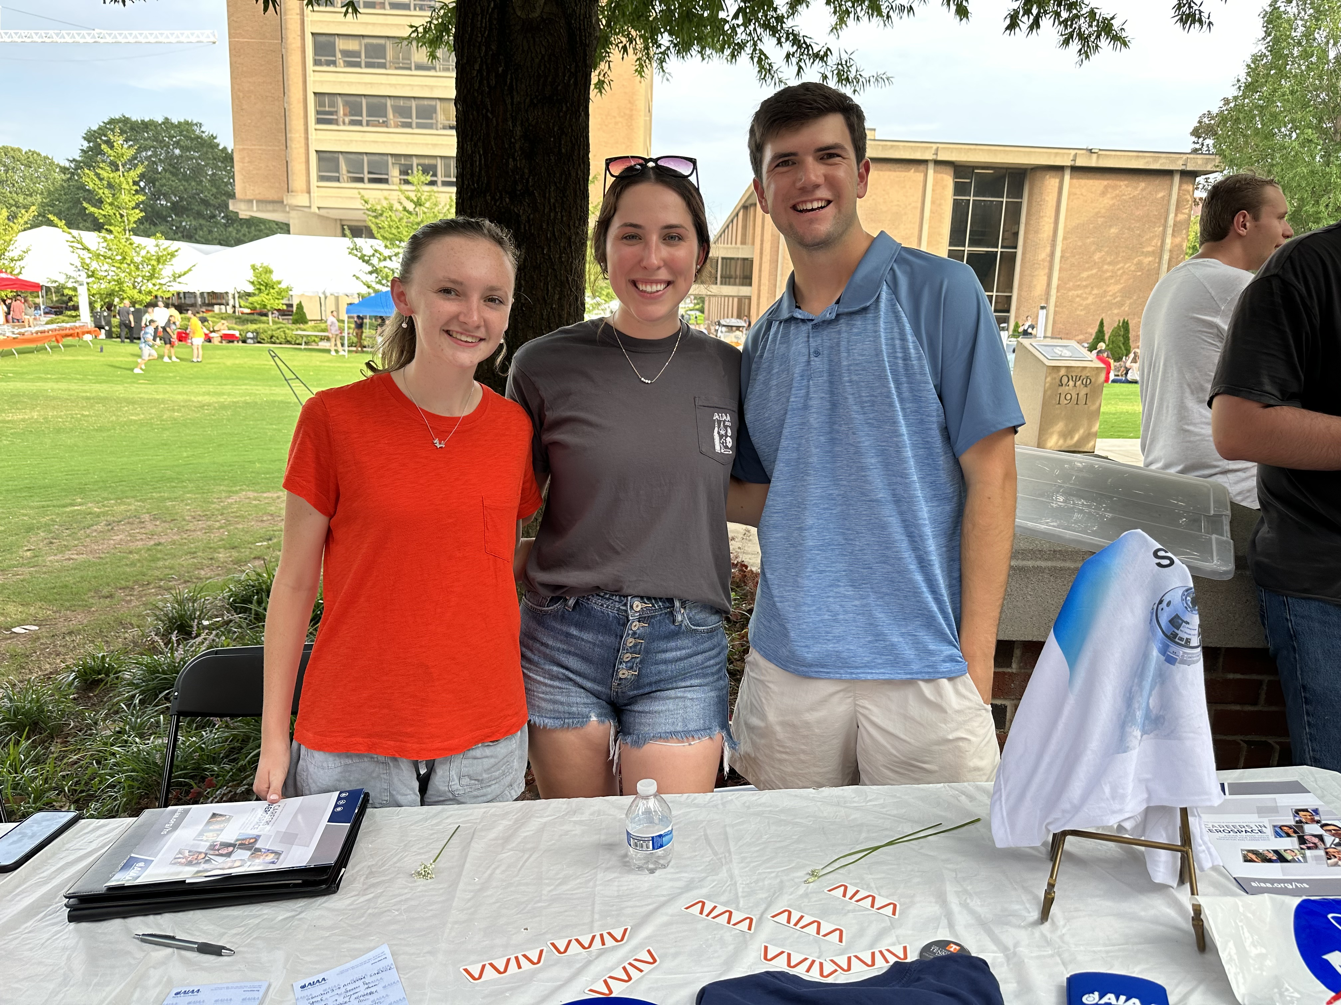
Future Plans
Finish the current project and mass promote the online resource to educators
Work with MUSE and Boys and Girls Club to create a multi-week lesson plan
Obtain teacher feedback and engagement
  Improve effectiveness of the lessons / activities in a classroom setting
Increase on-campus student involvement
Knox County School Zones / Map [5]

Slide 11

Conclusion
We are grateful for these experiences and are excited to continue our current outreach developments.
New perspective on education and how we can contribute to our local communities and future generation.

Slide 12
References
[1] Lighting the Way – Torchbearer (utk.edu)
[2] Vol is a Verb - Student Life (utk.edu)
[3] https://leadserve.utk.edu/
[4] ServeUTK | Clay and Debbie Jones Center for Leadership and Service
[5] Board of Education / Board Districts (knoxschools.org)
[6] Knox County School District (2024) - Knoxville, TN (publicschoolreview.com)

