Slide 1

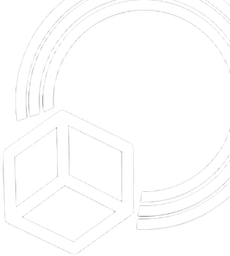

Investigating Photovoltaic Efficiency and Durability in Low​ Earth Orbit Through Nanosatellite Payload Design​
Rhodes College Department of Physics & Computer Science
Damian Nguyen, Kerry Tang, Ryan McCrory,
Jasper Scherz, Brayden Pallera, and José R. Pastrana ​

Slide 2

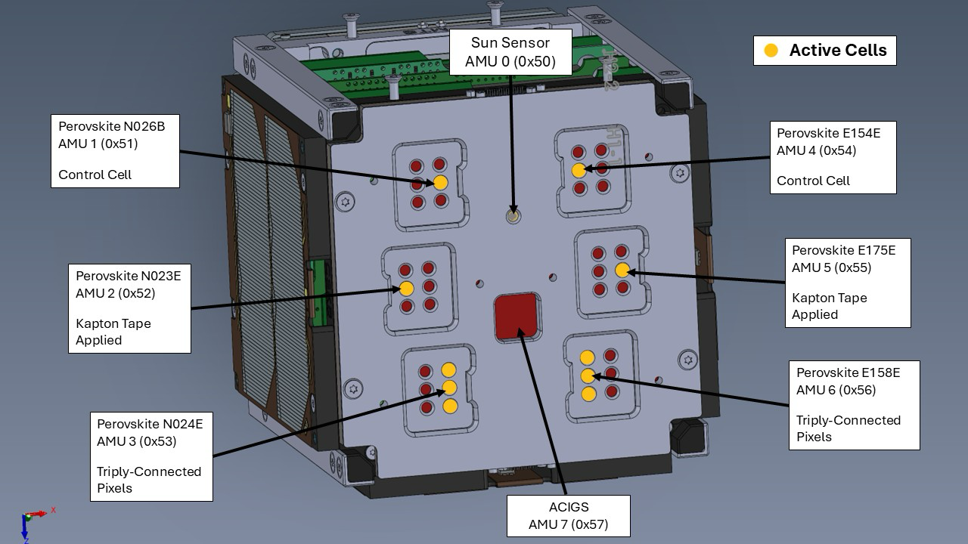
Table of Contents
Mission
Main Challenges
Photovoltaic Materials
Payload Overview
The “Sandwich”
  Pogo Board
  Top Plate
AMU Board
Circuits
Other Experiments
Conclusion

Slide 3
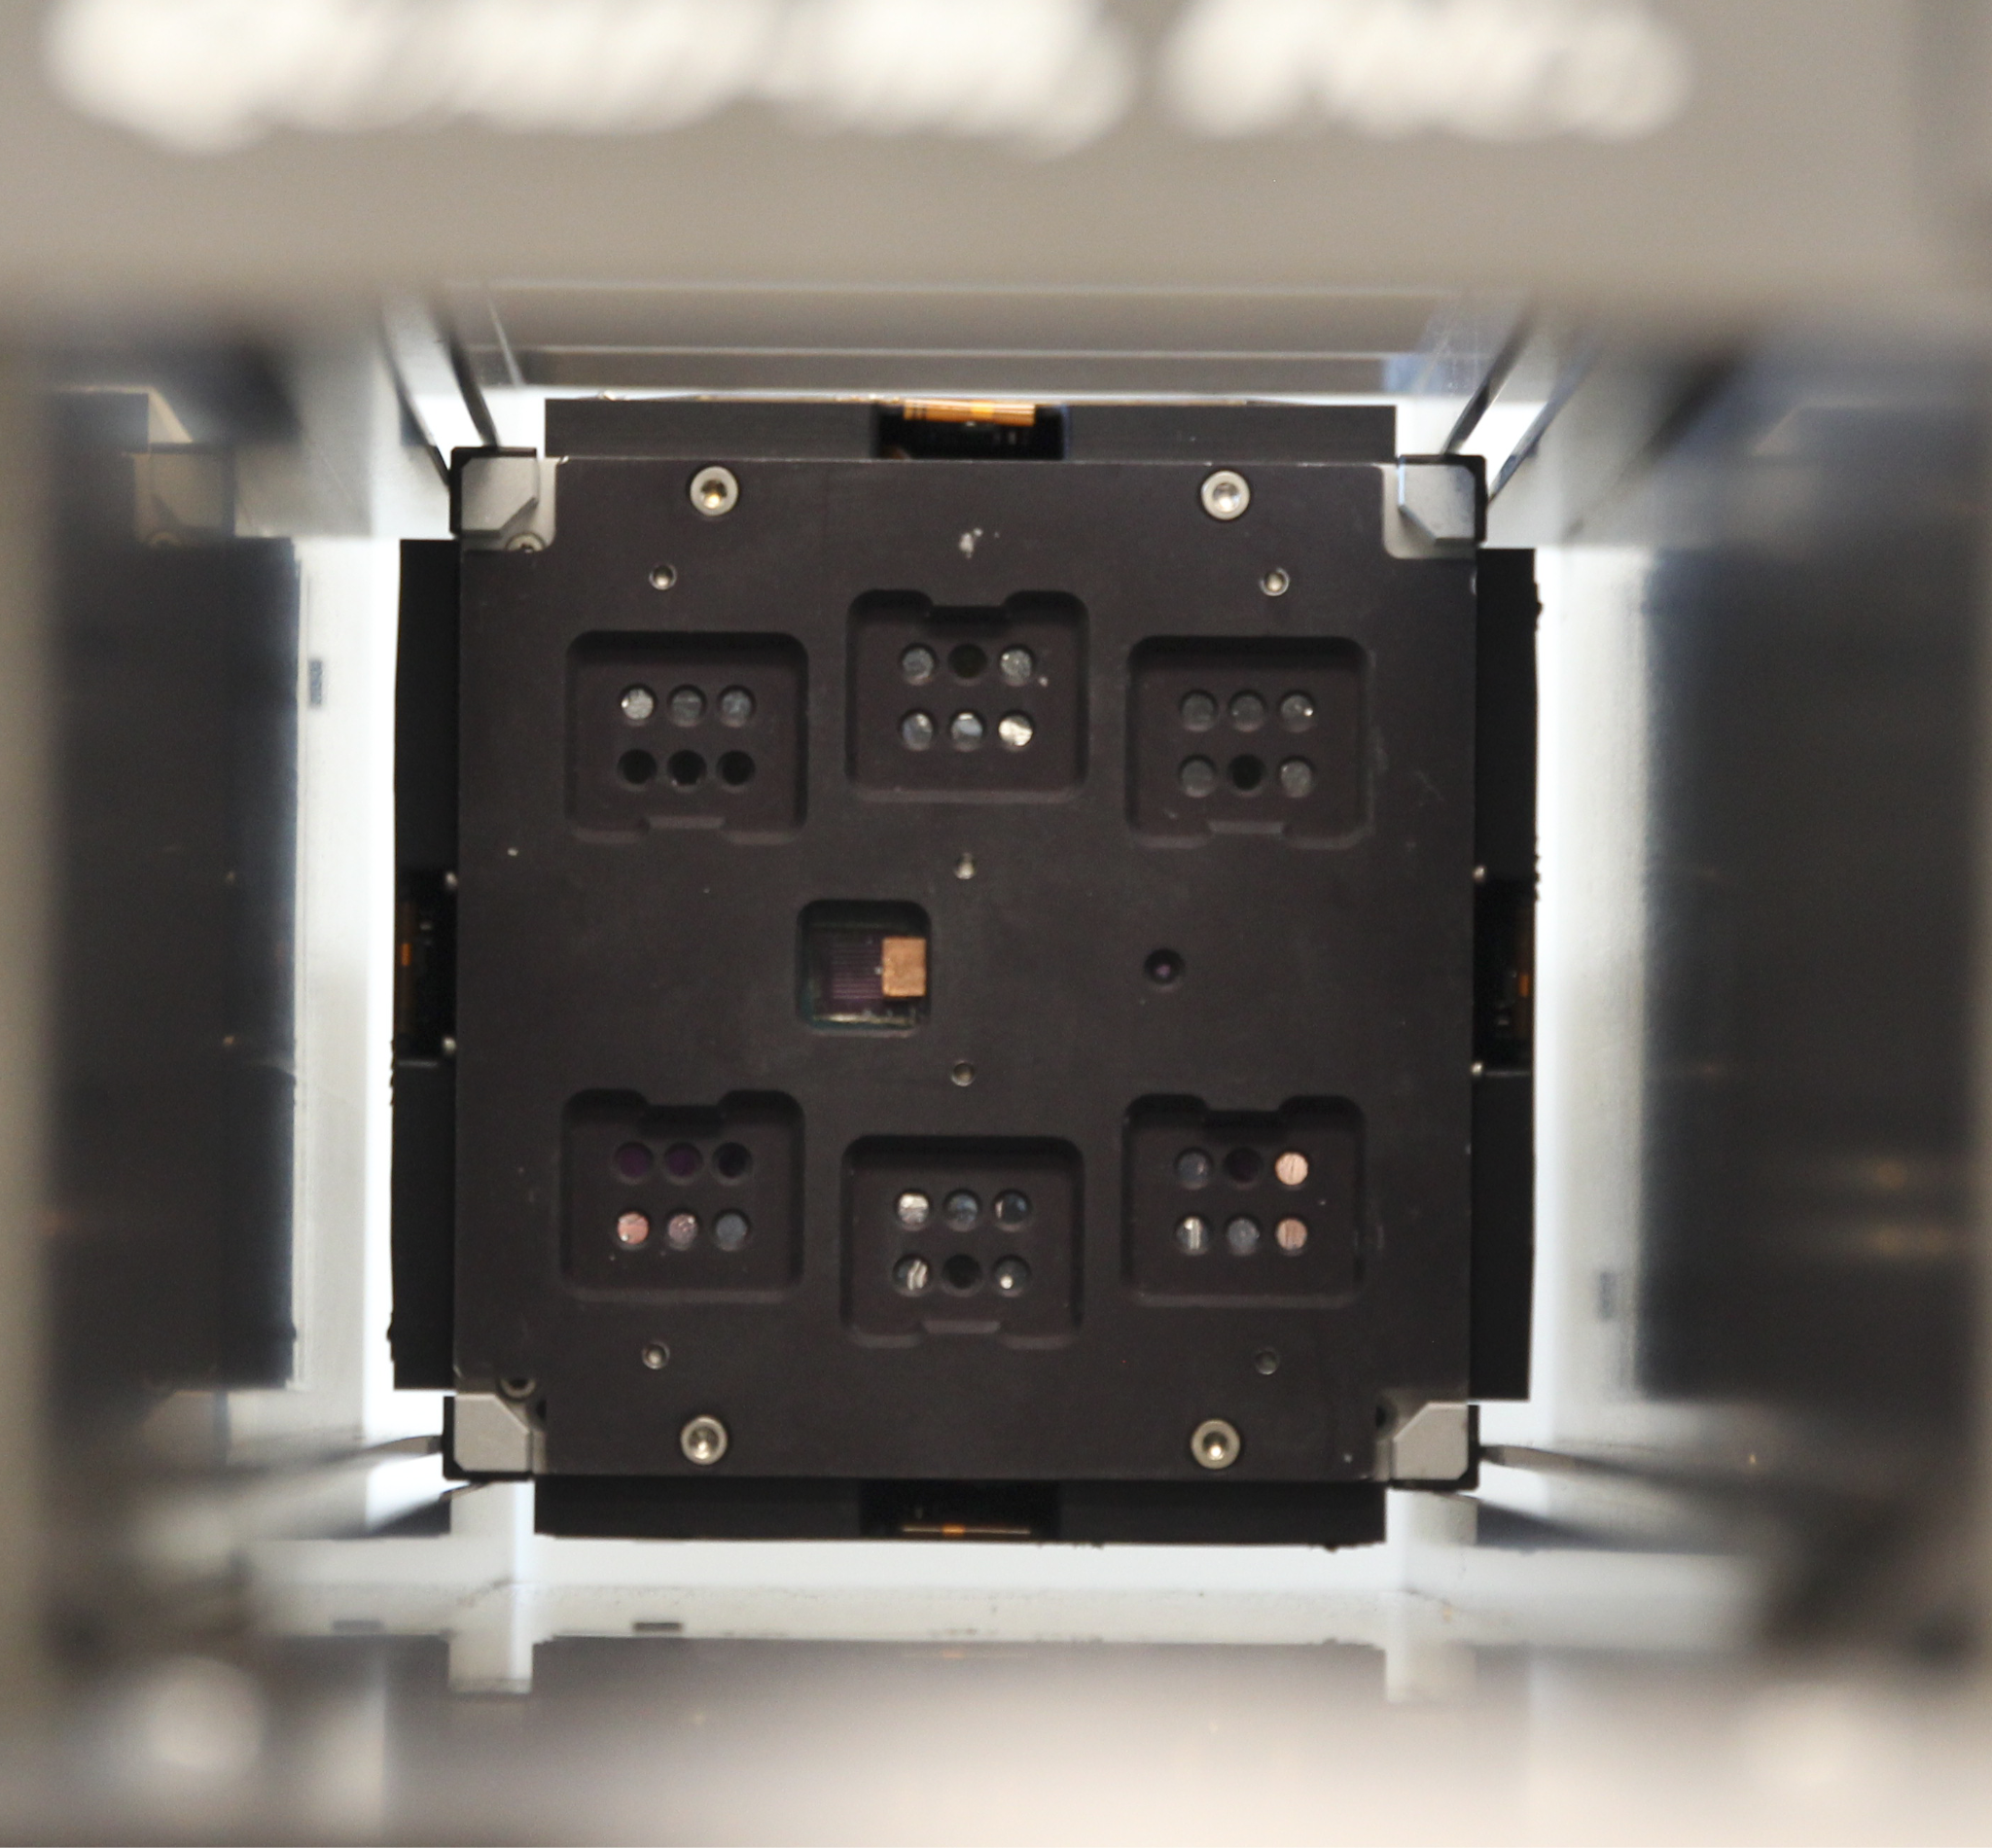
1. Mission of RHOK-SAT
1U CubeSat Nanosatellite
Collaborative project between Rhodes College, the University of Oklahoma, and the National Renewable Energy Lab (NREL)
Goal: To characterize and measure the degradation of six perovskite solar cells in low Earth orbit (LEO) in comparison to a reference ACIGS (silver-alloyed copper, indium, gallium, selenide) control cell

Slide 4
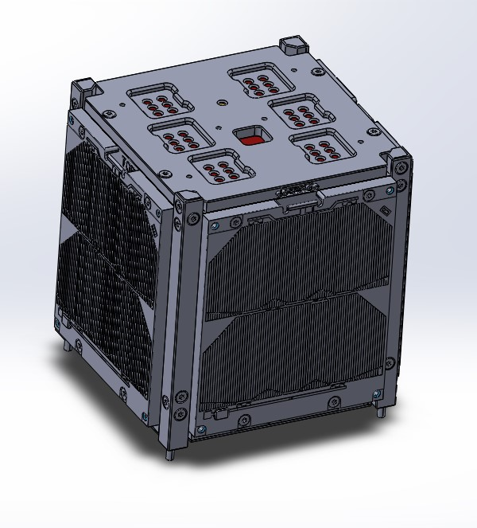
2. Main Challenges
Small form factor (10 cm x 10 cm x 11 cm)
Designing around the specific requirements of novel cells
No formal engineering program

Slide 5
3. Photovoltaic
Materials​

Slide 6
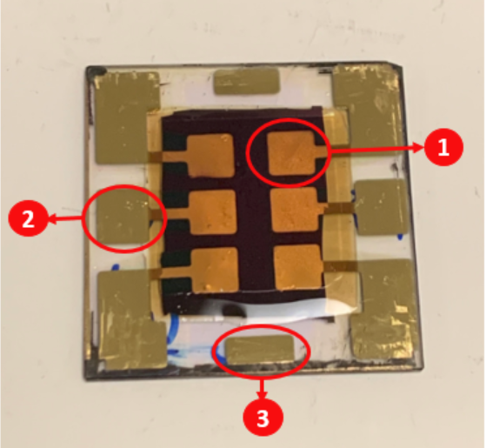
Perovskite Devices
Exciting Qualities:
Challenges:
Higher efficiency than conventional silicon cells
High radiation tolerance
Self-healing property
Inexpensive
Fast to produce (print on glass substrates)
Extremely delicate
Sensitive to humidity and prolonged exposure to heat
Requires dry connection
How does one interact with these pixels to measure them?
Sample Perovskite Device
1. Active Perovskite Area
2. Negative Electrode
3. Common Positive

Slide 7
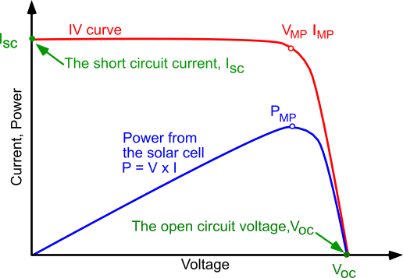
I-V Curve
VOC - Open circuit voltage
ISC - Short circuit current
With these parameters, we can measure power

Slide 8
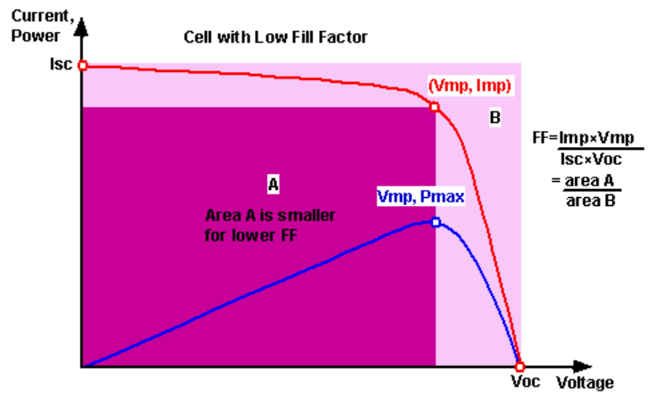
Determining Efficiency
Fill Factor (FF) - Ratio between VOC, ISC, and power
FF helps determine efficiency.

Slide 9
4. Payload

Slide 10
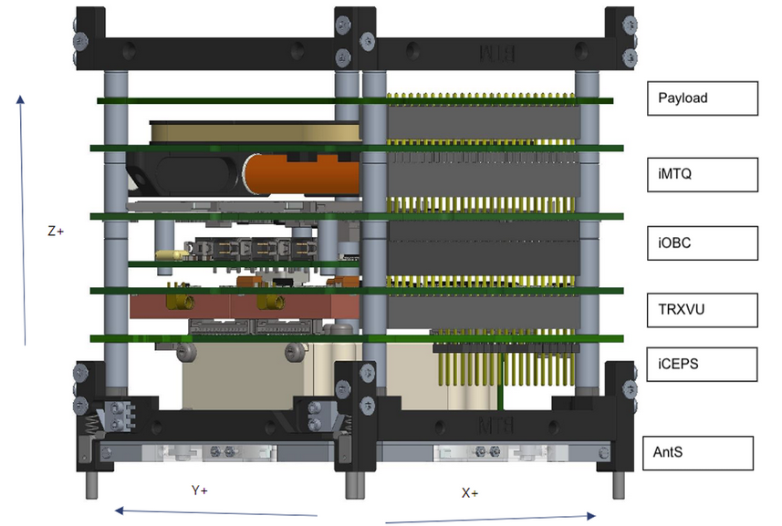
4. Payload Overview
Two main structures make up the payload, mounted on the +Z side:
  The “Sandwich” - the electromechanical assembly that houses the perovskites and other experimental components
  The AMU Board - Houses the Aerospace Measurement Unit (AMU)
RHOK-SAT Internal PCB Stack

Slide 11
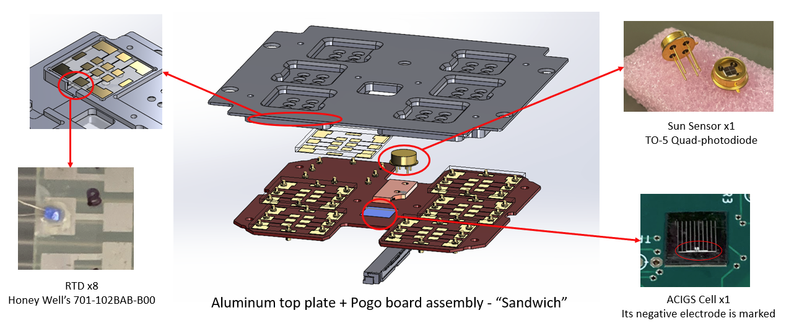
5. The “Sandwich”

Slide 12
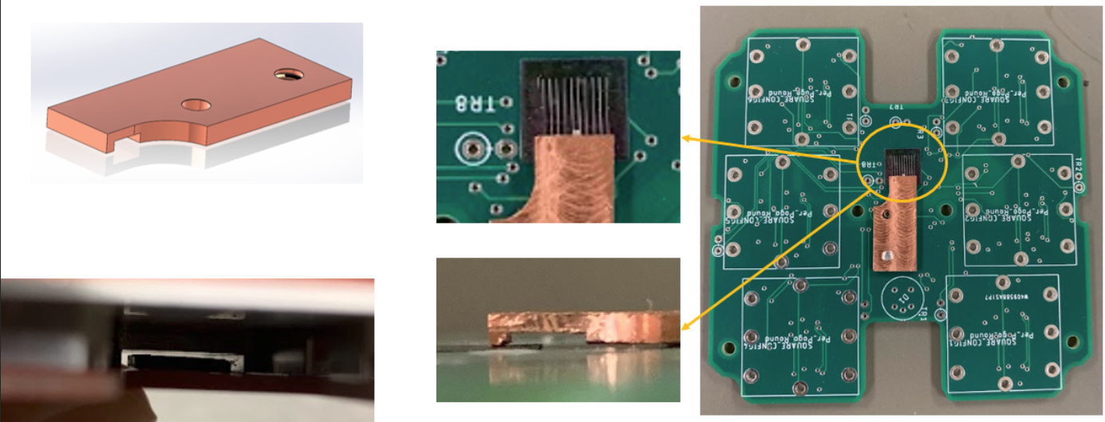
5. The “Sandwich” - Pogo Board (ACIGS)
ACIGS is printed on a small (10 x 10 mm) and thin stainless steel piece
Positive (Backside) - Conductive Epoxy
Negative (Horizontal slit) - “P-Connector” with teeth that precisely contact the cell, avoiding short circuit
Countersunk a hole to attach it by screw
P-Connector Design and Integration

Slide 13
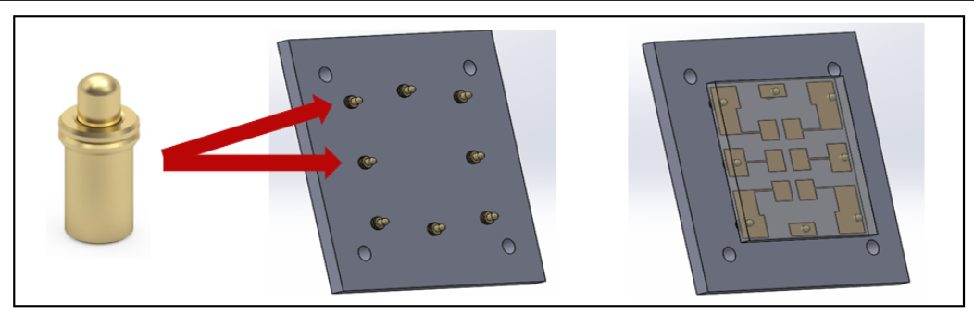
5. The “Sandwich” - Pogo Board (Perovskites)
Cannot use glue, tape, or solder due to the perovskite cells’ physical limitations
Pogo-pins, Gold - coated, spring-loaded pins were selected to be the dry connectors
Pogo Pins Connection Scheme to Perovskite Device

Slide 14
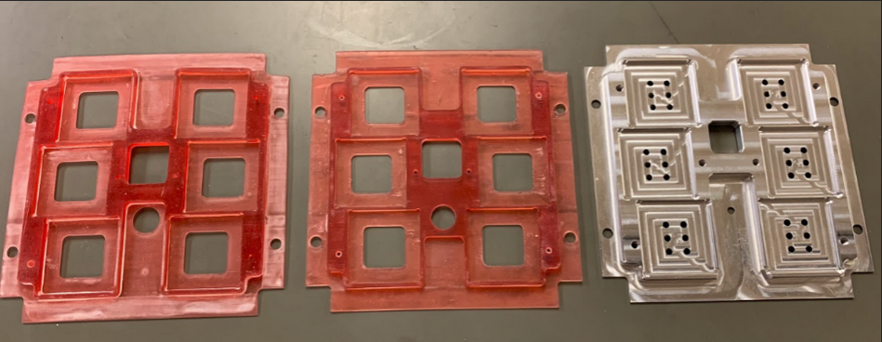
5. The “Sandwich” - Top Plate
Maintains a low profile
Six square pockets (For perovskite devices)
Six aperture holes for each perovskite devices and a sun sensor aperture for consistent area of illumination
From Resin Prototype to Aluminum Top Plate

Slide 15
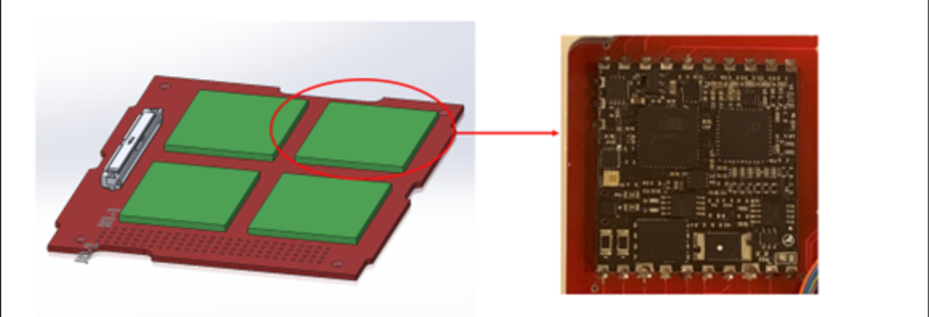
6. AMU (Aerospace Measurement Unit)
Capable of
  I-V sweeps
  Sunsensor measurements
  Temperature measurements
Non-volatile EPPROM (Electrically erasable programmable read-only memory)
Calibrated with help of representative from Aerospace Corporation
AMU - Programmable “All-in-one” microcontroller used to characterize the photovoltaic cells
(Manufactured by Aerospace Corporation)

Slide 16
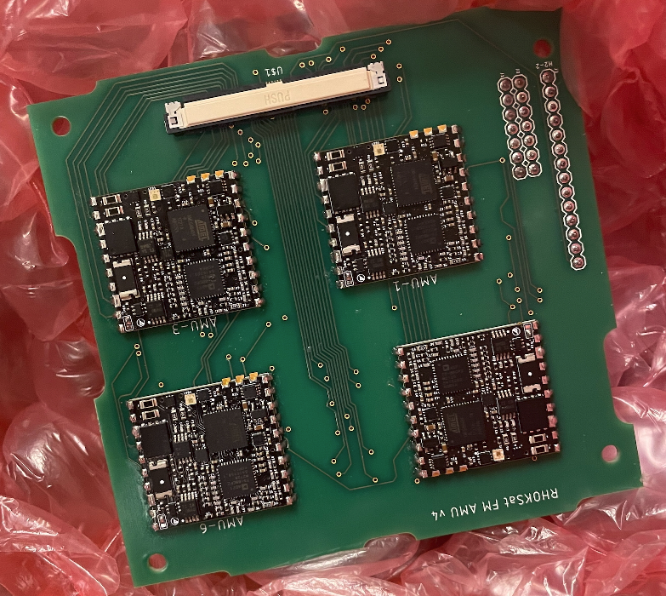
6. AMU Board
4 AMUs are mounted on each side of the board
60-pin Molex Connector
I2C, a two-wire serial communication protocol
Six out of eight AMUs measure the perovskite devices, the seventh measures the ACIGS cell, and the last, collects angle measurements from the sun sensor

Slide 17
7. Circuits

Slide 18
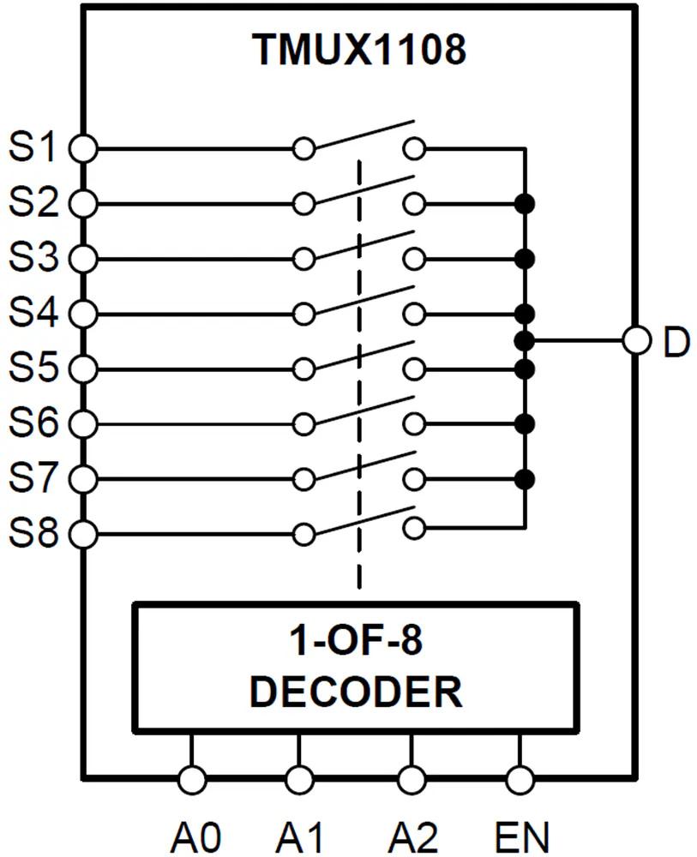
7.Circuitry - Original Measurement Circuit
8-Channel Multiplexer - Would have allowed 36 pixels with same number of AMUs
Manipulation of bit field correspond to binary inputs of the MUX
Cross talk threatened reliability of data
Alternative: Relays
  Typically too large
  Mechanical parts are not encouraged in space
Less is sometimes more

Slide 19
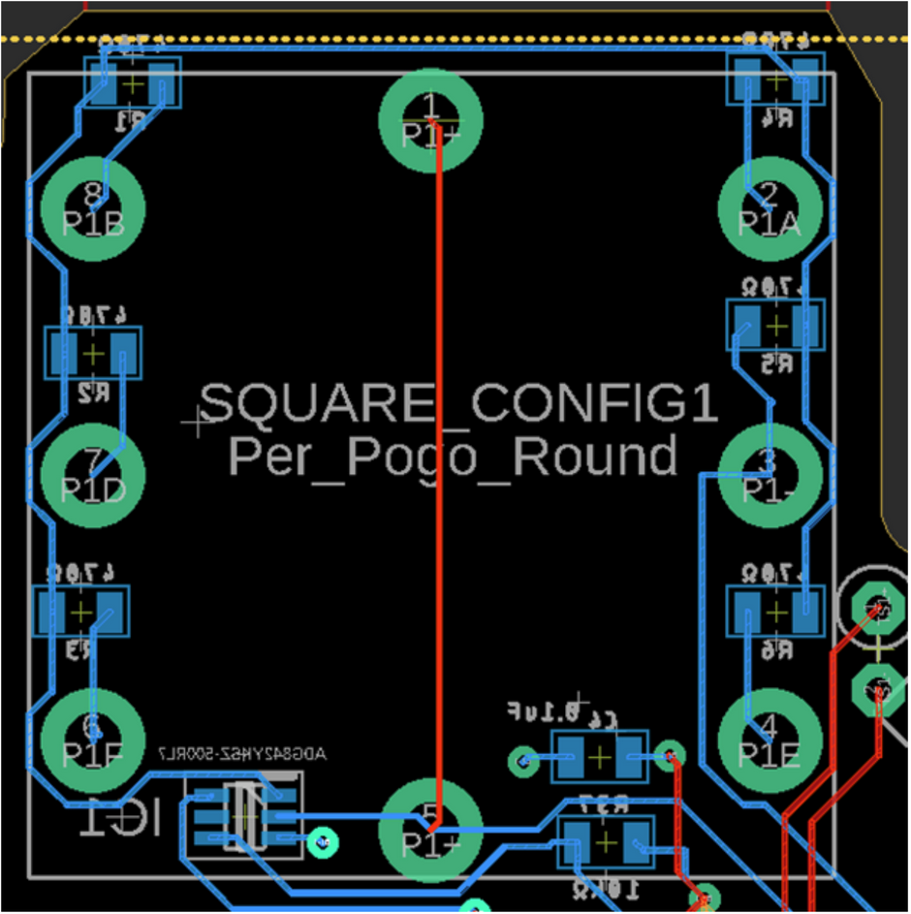
7. Circuitry - Single Pixel Measurement Circuit
4-Wire Measurement connection scheme across a single pixel
AMU uses an internal variable resistor to take measurements in steps
High resistance - Measures VOC
Minimal resistance - Measures ISC
Example of the circuit in a single slot (Designed in EAGLE CAD)

Slide 20
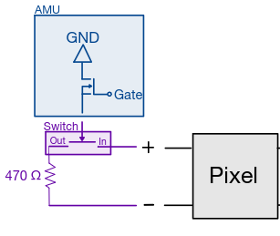
7. Circuitry - Resistor Circuit​
Perovskites left exposed to light will degrade without a load to discharge
  Cover unused pixels with silver Kapton
  Could use AMU’s internal resistor
Inverted switch (Default state ON)
Controlled via Metal-Oxide-Semiconductor Field Effect Transistor (MOSFET) HTR pin
Shunt resistance, so removed on measured single pixel
Kept on other pixels to keep substrate alive
Labeled Resistor Circuit
470 ohm resistive load - Chosen since average resistance where peak power occurs

Slide 21
8. Other experiments

Slide 22
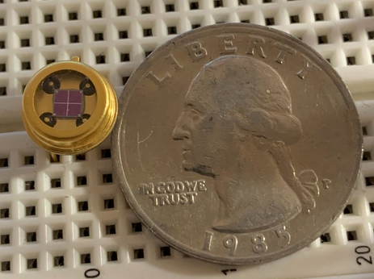
Sunsensor​
Why integrate a sun sensor?
  Unlike Keithley 2400 SMU, AMU is a passive circuit that relies on the cell’s voltages
Sun sensor acts as the trigger for the measurement procedure when light is within an angular threshold
(-25° to 25°)
TO-5 Quad Photodiode without aperture (Quarter for scale)

Slide 23
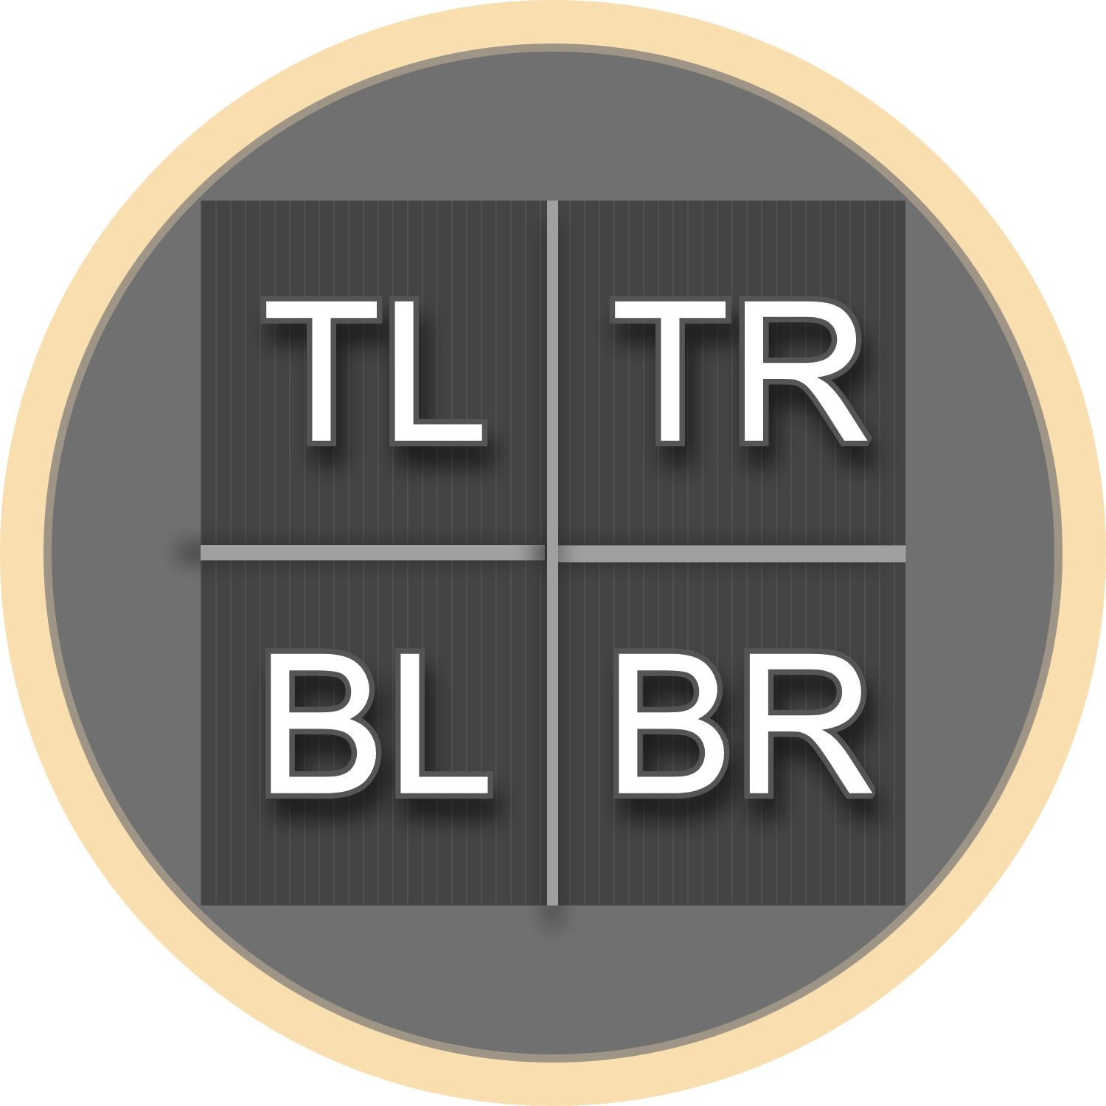



Mapping Voltage Ratios to Angles
Voltages on each of the four diode quadrants help determine top plate angle to the Sun
Labeled Quad Photodiode

Slide 24
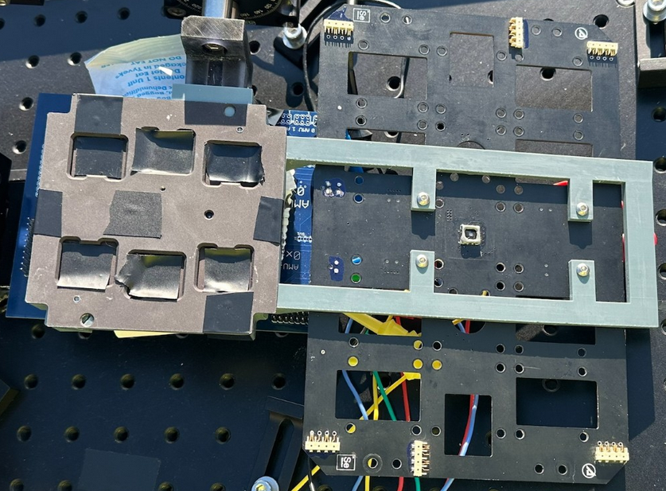

Sunsensor​ Calibration
Mount Flat-SAT parallel to EYAS
Arduino program captures raw voltage values from both sun sensors
Data analysis using Pandas data frames and filters to remove outliers
Curve fit to get corrected values
Sun Sensor Calibration Mount - Flat-Sat (left), EYAS (right)

Slide 25
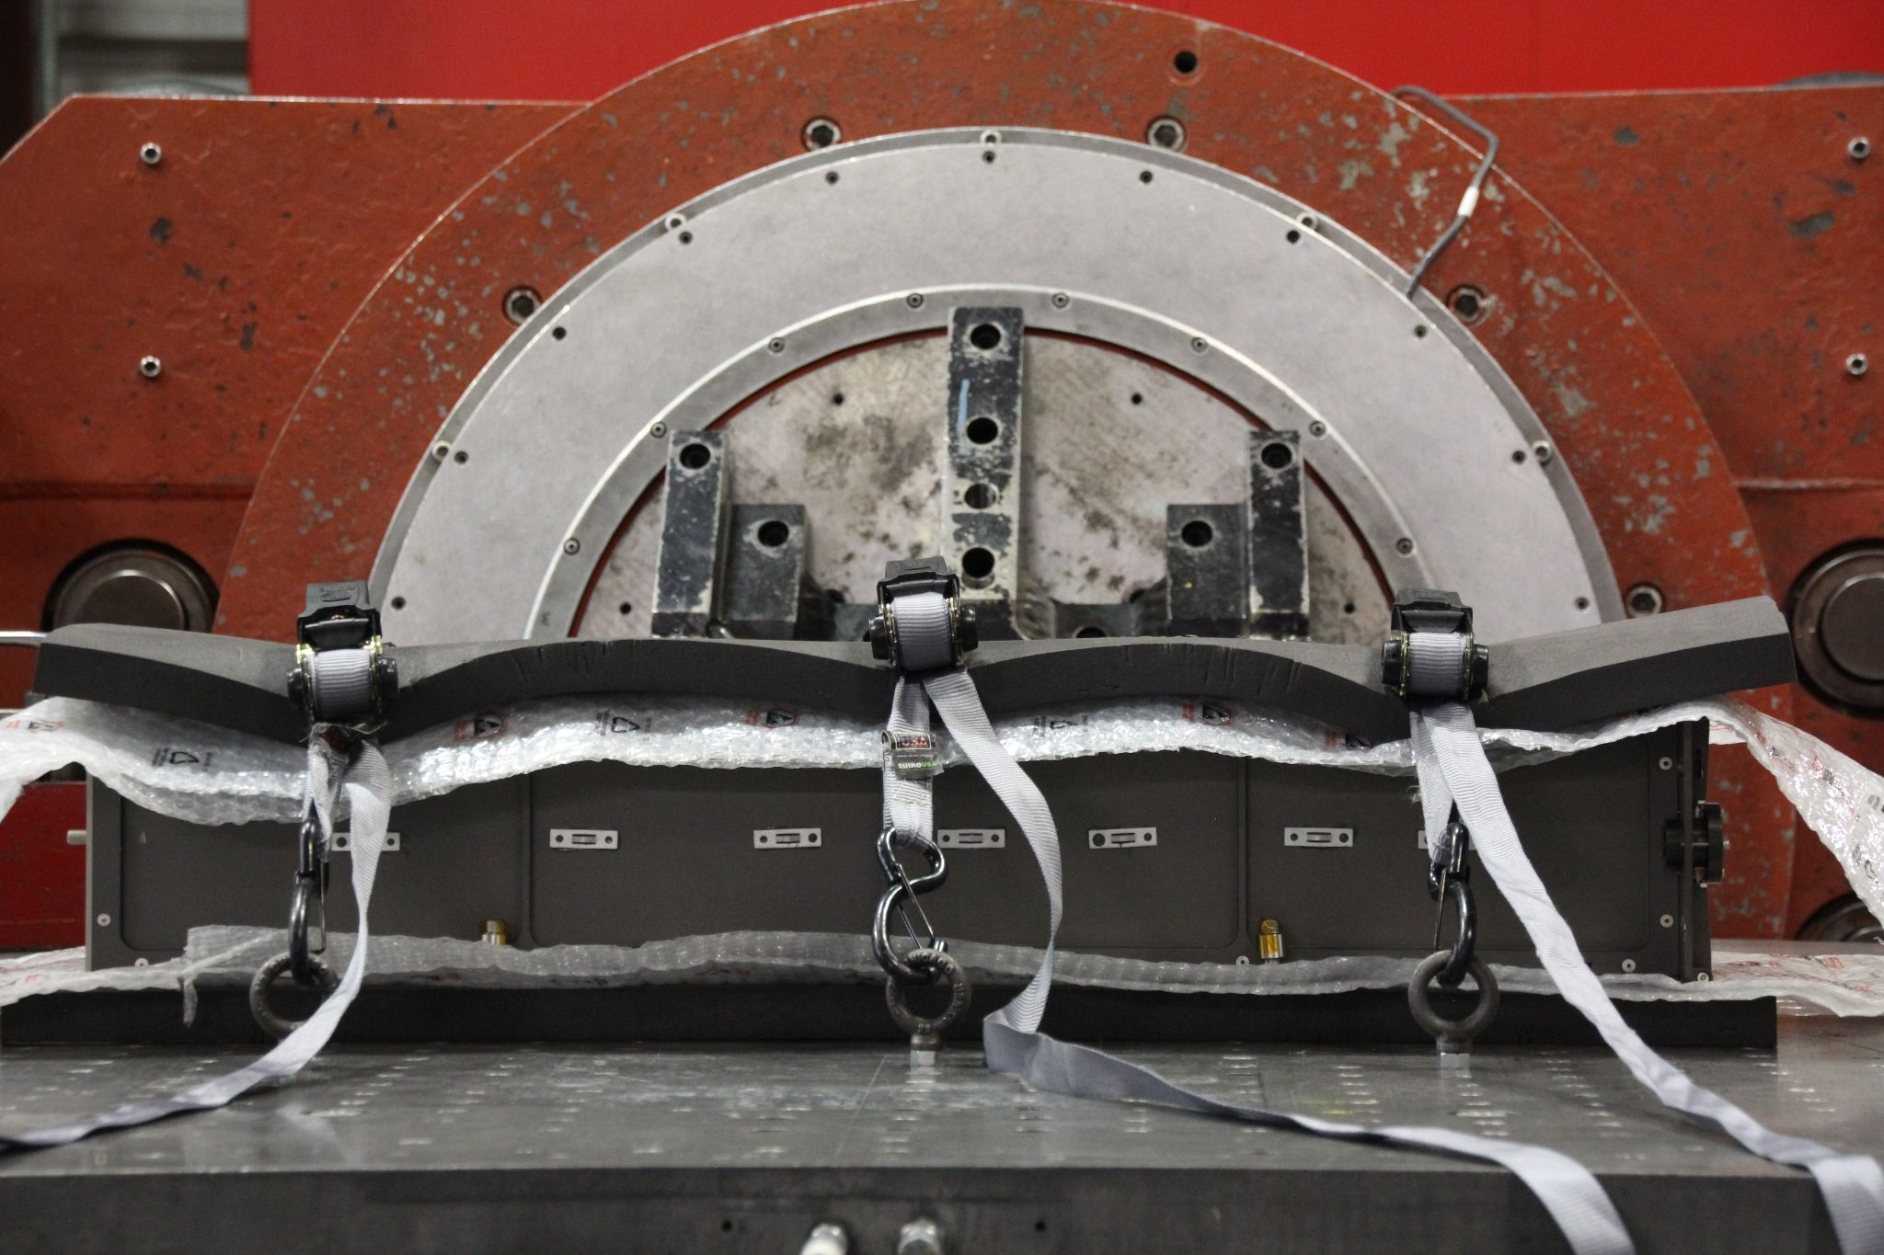
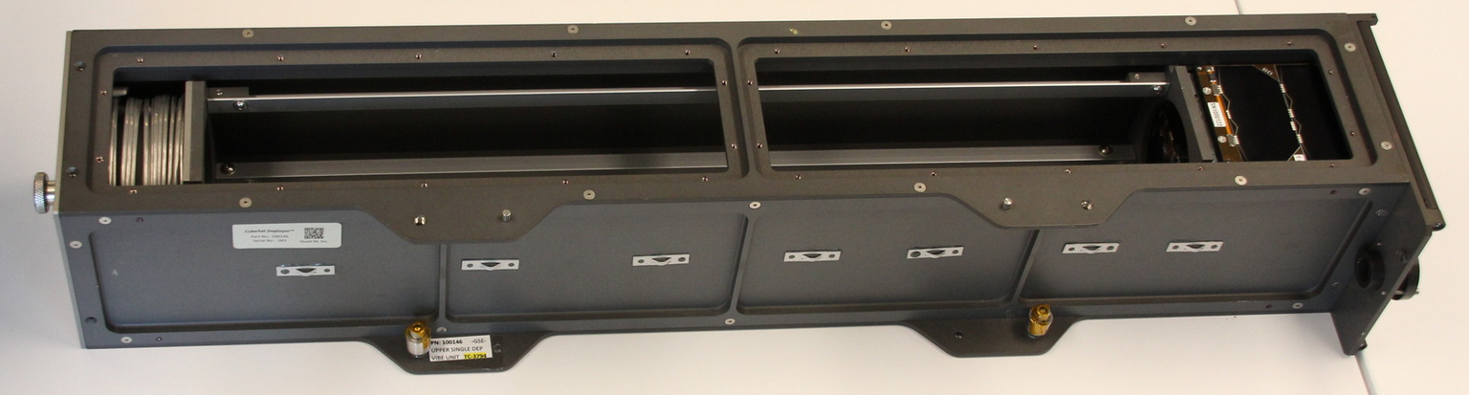
Vibration Test​
Vibration along three axes (X, Y, Z) inside a retired deployer unit
Simulates conditions that satellite will experience in Cygnus while en route to the ISS
RHOK-SAT in deployer while mounted on the vibration apparatus
Nanoracks deployer with panels removed

Slide 26
Conclusion

Slide 27
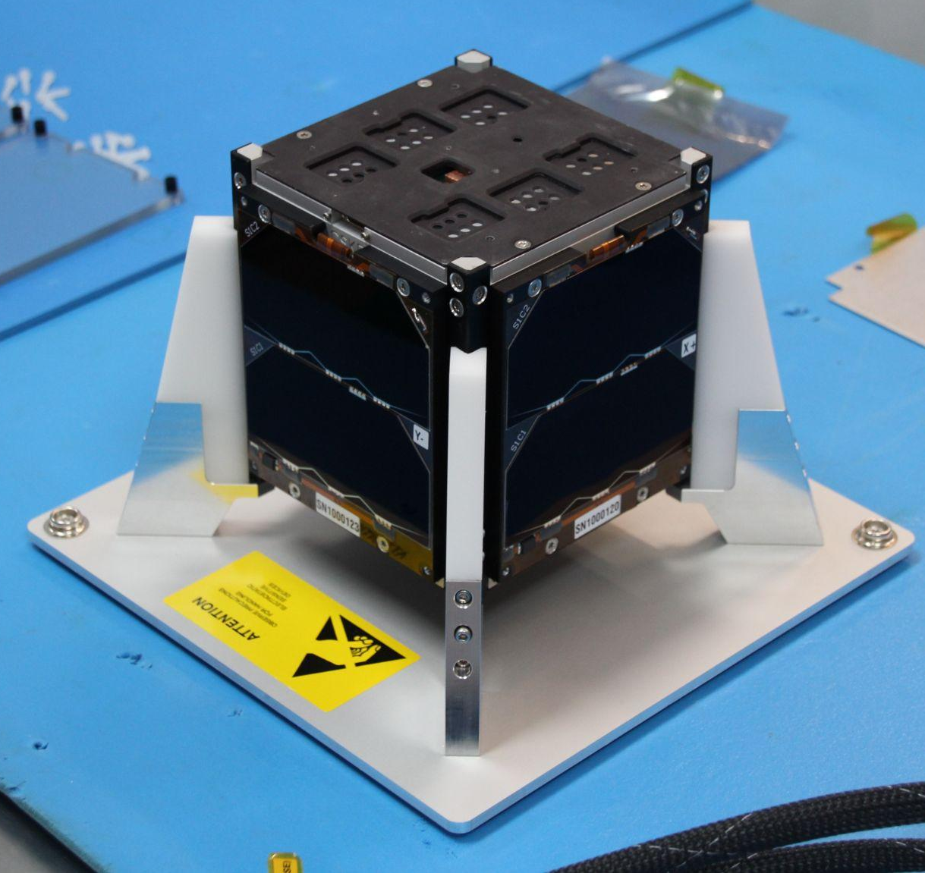
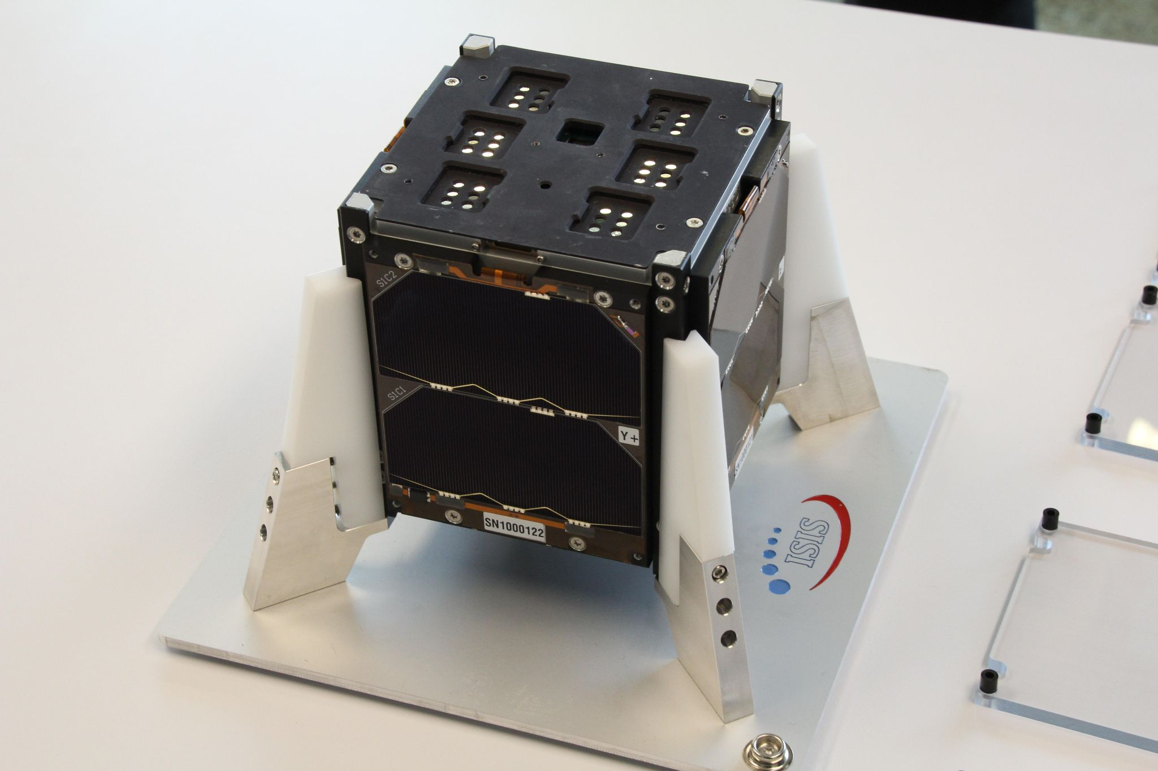
RHOKY IS GOING TO SPACE!

Slide 28
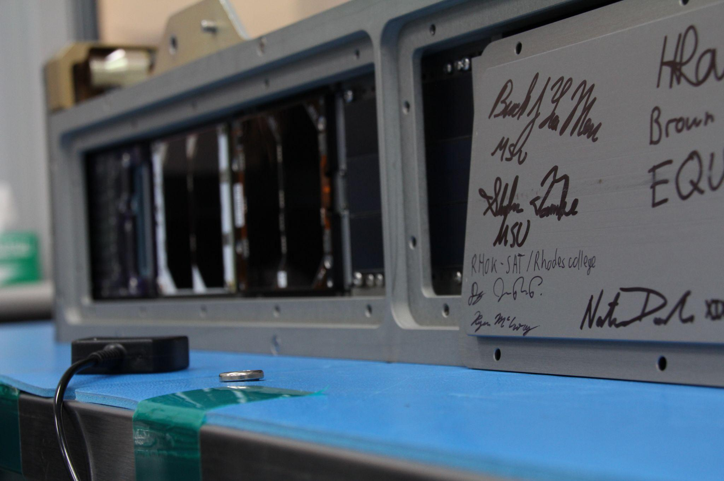
Special Thanks
RHOK-SAT is funded through a generous gift from Dr. Charles Robertson, NASA’s CSLI program, the Mac Armour Fellowship, the Gene Haas Foundation, and the Society of Physics Students Chapter Research Award.
• RHOK-SAT is advised by Dr. Bentley Burnham, Dr. Brent Hoffmeister, Dr. Ann Viano, Mr. Lanre Obadina, and Dr. Phillip Kirlin, all of Rhodes College; Rhodes College alumnus Mr. Brad Hensley; and former project director Mr. Joseph McPherson.
• Special thanks to Kelly Schutt and Joey Luther from the National Renewable Energy Laboratory (NREL) in Golden, Colorado, for major technical collaboration and providing the project with numerous perovskite solar cell devices for both testing and deployment.
• The AMUs were designed and provided by Colin Mann from The Aerospace Corporation in El Segundo, California.
• Vibe test procedures and mission management were handled by Brenden Swanik at Nanoracks/Voyager Technologies in Huntsville, Alabama.
• The ACIGS solar cell material was provided by Dr. Dmitry Poplavskyy from MiaSolé Hi-Tech Corp. and processed by Hadi Afshari.
• The team is grateful for the support of the Photovoltaic Materials and Devices Group at the University of Oklahoma and University at Buffalo; Dr. Ian R. Sellers, Dr. Brandon K. Durant, Hadi Afshari, Sergio A. Chacon, and Megh N. Khanal. Dr. Bibhudutta Rout conducts solar cell irradiation at the University of North Texas.
• The team is also grateful for the epoxy procedure advising by Mrs. Shira Weiner at MasterBond.
• The satellite structure and subsystems were provided by ISISpace in Delft, Netherlands.
• Other student contributors to the project include Mallory Miller, Ella Luking, Anas Matar, Hien Chau, and Kamil
Yousuf. Past contributors include Marouf Mohammad Paul, Zheng Yu Wong, William Butler, Albert Nguyen, Benjamin Wilson, Jess Hamer, Olivia Kaufmann, Mark Ellenberger, Giuliana Hofheins, Elijah Matlock, Johane Boff, and Raeba Roy.
Final Integration in Houston, Texas

